Slide 1
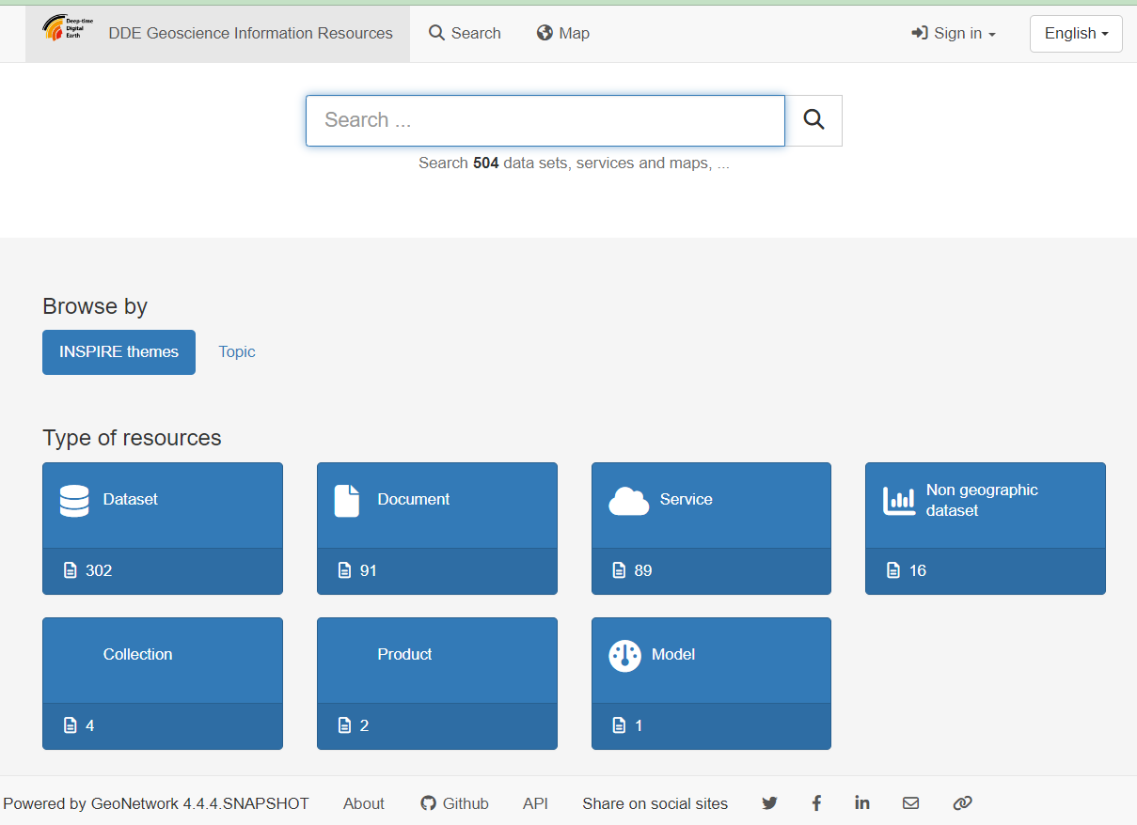
Basic landing page

Slide 2
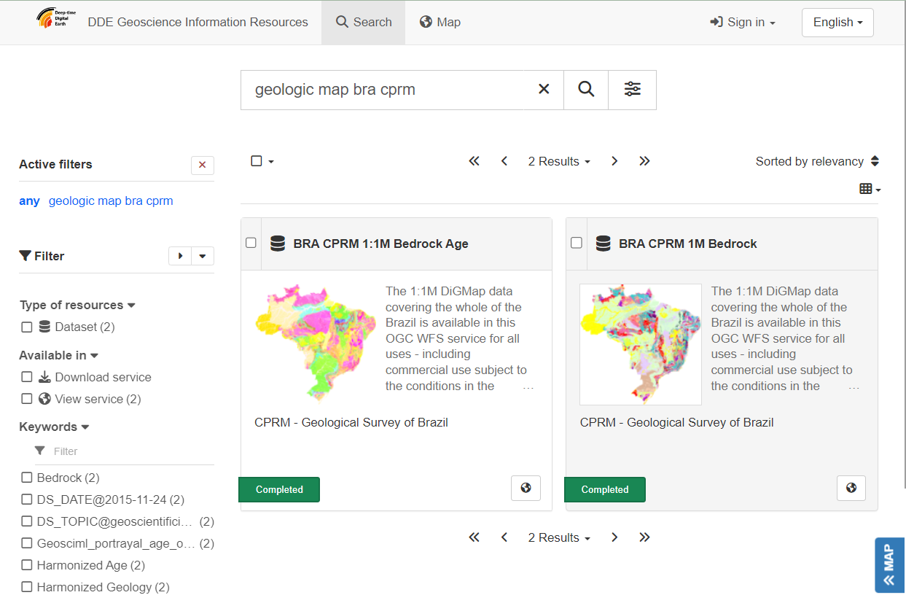
Search results;
Metadata harvested from
OneGeology

Slide 3
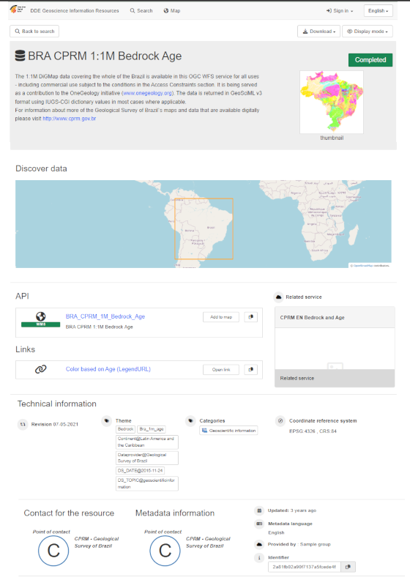
Search result detail page, image edited to get more content visible

Slide 4
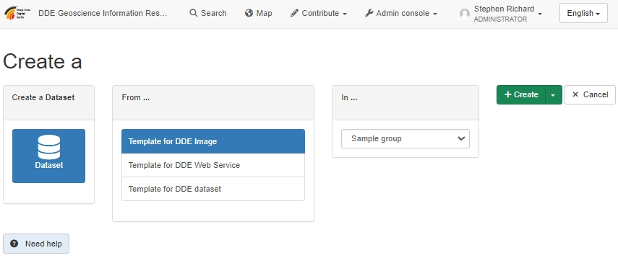
Create new record, requires login

Slide 5
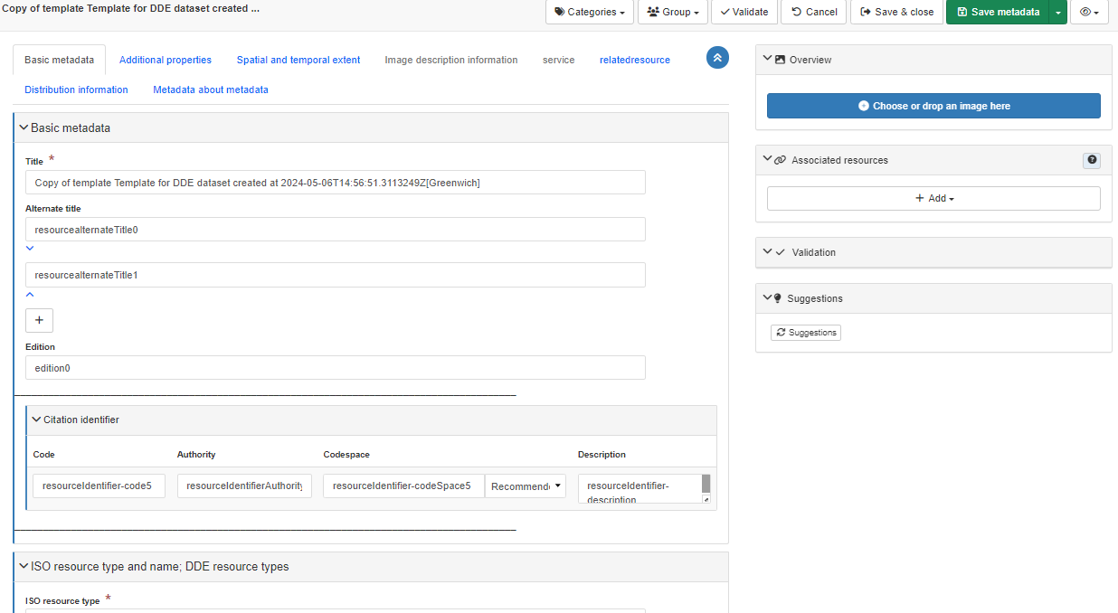
Metadata editor for DDE dataset

