Slide 1

US Geoscience Information Network, Web Services for Geoscience Information Discovery and Access
S. Richard, L. Allison, R. Clark, C. Coleman, and G. Chen
Az Geological Survey, Tucson, AZ, USA (steve.richard@azgs.az.gov)
Notes:
The US Geoscience information network has developed metadata profiles for interoperable catalog services based
on ISO19139 and the OGC CSW 2.0.2. Currently data services are being deployed for the US Dept. of Energy-funded
National Geothermal Data System. These services utilize OGC Web Map Services, Web Feature Services,
and THREDDS-served NetCDF for gridded datasets. Services and underlying datasets (along with a wide variety
of other information and non information resources are registered in the catalog system. Metadata for registration
is produced by various workflows, including harvest from OGC capabilities documents, Drupal-based web
applications, transformation from tabular compilations. Catalog search is implemented using the ESRI Geoportal
open-source server. We are pursuing various client applications to demonstrated discovery and utilization of the
data services. Currently operational applications allow catalog search and data acquisition from map services in an
ESRI ArcMap extension, a catalog browse and search application built on openlayers and Django. We are developing
use cases and requirements for other applications to utilize geothermal data services for resource exploration
and evaluation.

Slide 2
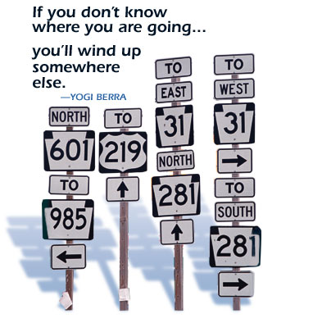
Roadmap for Presentation
USGIN Background
What defines the network
Discovery
Data services

Slide 3
What is USGIN
A Network defined by a collection of
service definitions
interchange formats
vocabularies
A community using an approach to geoscience information access
distributed
uses open source specification
common protocols
respects and acknowledges data ownership,
fosters communities of practice to grow
The resources that are accessible from the community

Slide 4
Who is USGIN
Data providers: State geological surveys (AASG) and the U.S. Geological Survey
Data consumers: geoscientists, environmental scientists
Developers? Open source community
If we’re successful, commercial developers

Slide 5
Major Components of GIN: Connecting the Geosciences
Catalog – find information
Services – provide information
Clients – find and use information

Slide 6
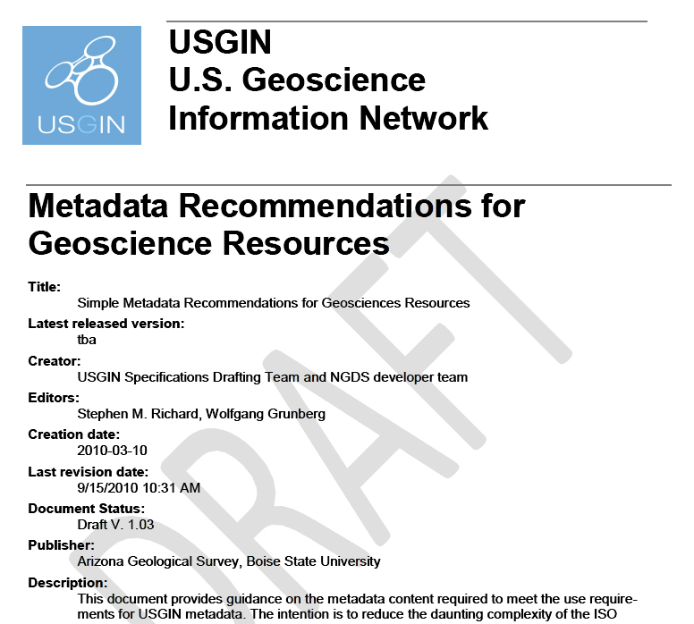
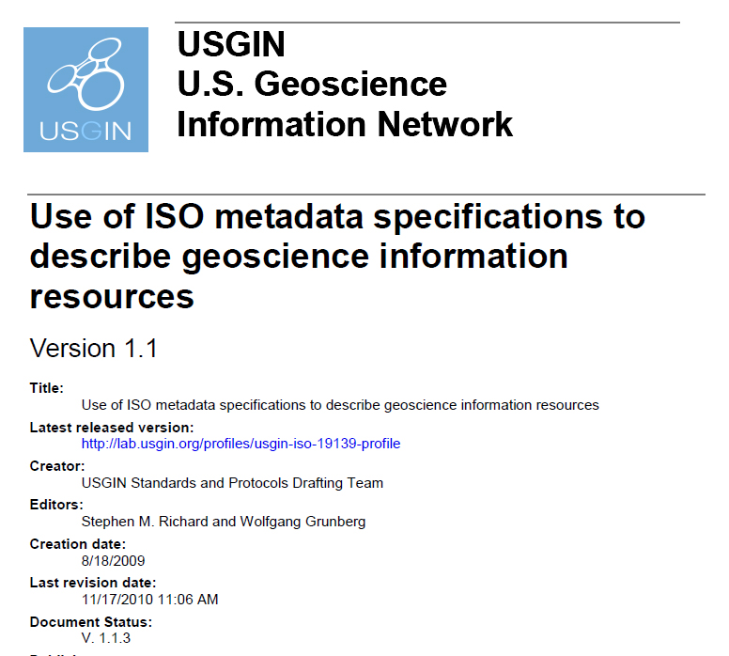
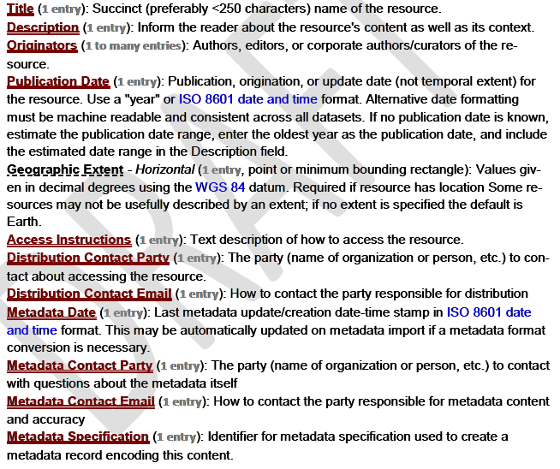
USGIN Metadata Implementation
Minimum Metadata Recommendations
USGIN Profile for ISO 19139 Metadata

Slide 7

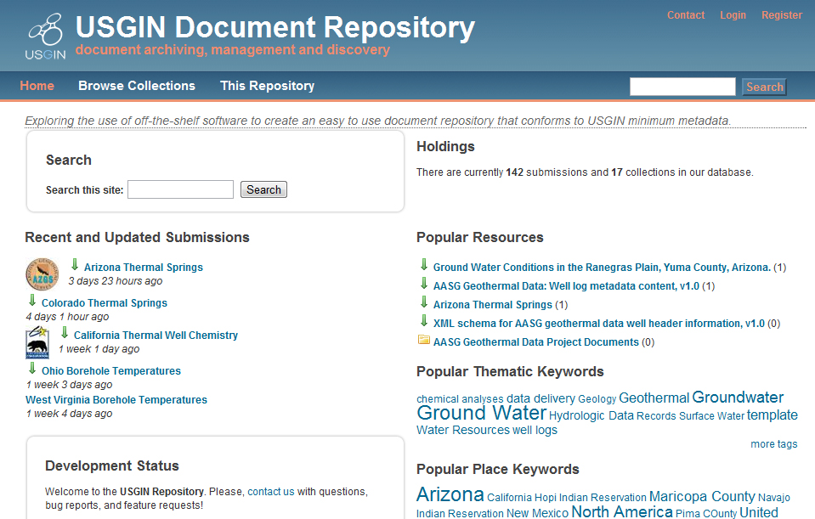
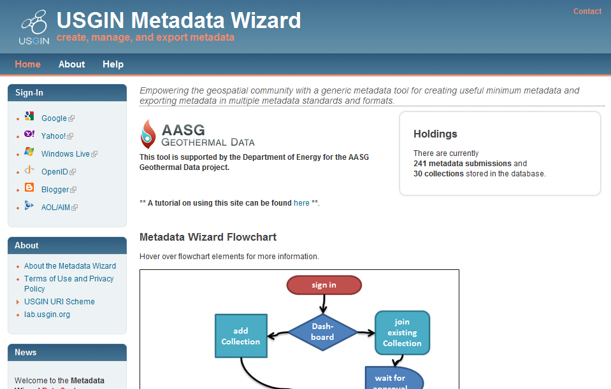
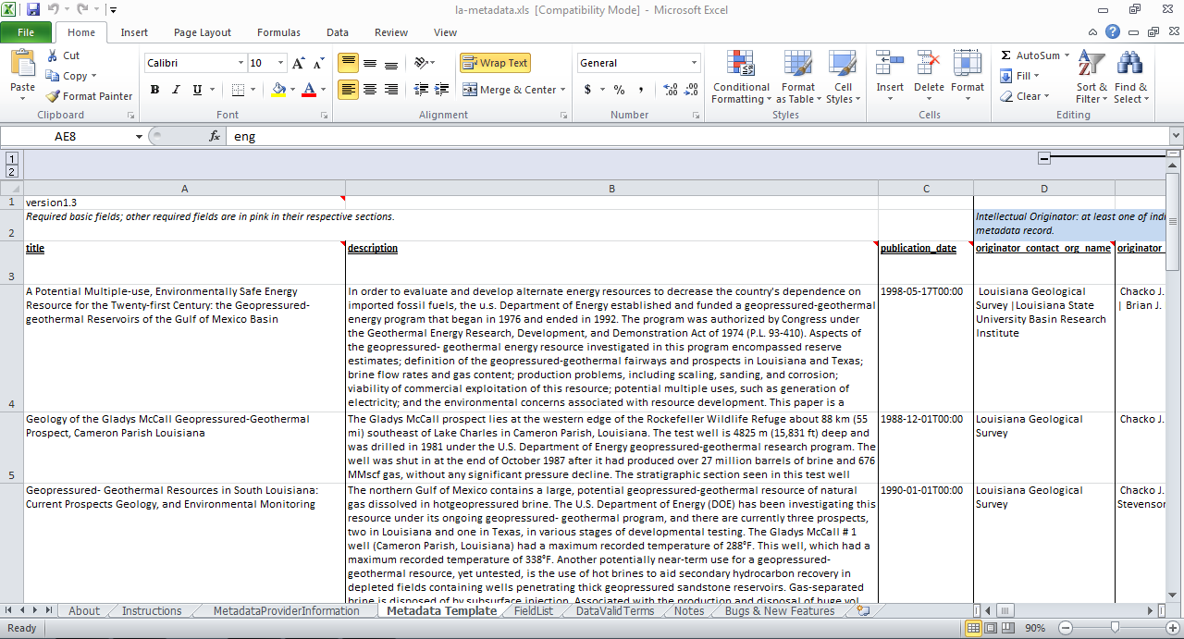

USGIN Metadata Implementation
Metadata Creation and Inclusion in a Catalog
Four Options:
Write XML, upload to Catalog
Excel Sheet + Python
For bulk updates, ETL
Metadata Wizard
For offline resources or resources already online
Document Repository
For resources that need to be made available online

Slide 8
Tiered Data Access
Community profile
vocabulary
provider
schema
Custom Structure
Data Integration
user
Unstructured
pre packaged files
Web app
Service
Data provider
Data user
Who determines content

Slide 9
Tiered Data Access
Where we want to get
Community profile
Existing web resources and common practice
Custom Structure
Data Integration
Unstructured
pre packaged files
Web app
Service
Data provider
Data user
Who determines content

Slide 10
Services for Maps and grids
OGC WMS
Map images
Harmonize with standard portrayal schemes
Clients: most GIS, web mapping frameworks
THREDDS/OpenDAP/NetCDF
Gridded data
Clients
Environmental data connector in ArcMap
Existing OpenDAP/NetCDF apps

Slide 11
Structured data Interchange
Observations: results of a single procedure to determine the value of some property
Features: compiled descriptions of an identifiable entity
INTERCHANGE FORMAT: a known content model and encoding
simple denormalized ‘flat’ schemes
complex objects with deeply nested schemes

Slide 12
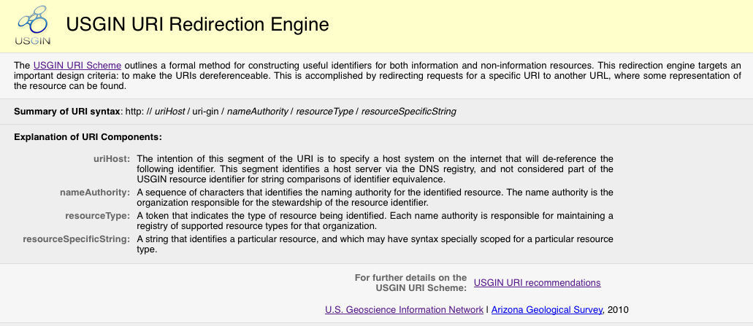
GIN: Linked Data
Uniform Resource Identifier (URI) Redirection Tool
Allows data providers to configure dereferencing of GIN URIs to web locations
Use of rewrite rules based on regular expressions
Backbone for GIN linked data system http://resources.usgin.org/uri-gin

Slide 13
USGIN: GML simple features
Content models:
GML simple features for interchange: denormalized, property values are strings or numbers, simple point, line, or polygon geometry
OGC WFS implementation, works with existing clients
State Geological Surveys publish to National Geothermal Data System (NGDS)
Listing of currently deployed services: http://metadata.stategeothermaldata.org/search/wfs

Slide 14
Exchange features
Active Fault
Borehole lithology log
Borehole log observation
Borehole temperature data
Geothermal facility feature
Direct use feature
Drill stem test
Earthquake hypocenter
Aqueous chemistry
Geologic Unit characterization
Gravity data
Heat flow measurement
Hot spring description
Isopach map
Metadata
Permeability
Production statistics record
Rock chemistry (EARTHCHEM)
Thermal conductivity measurement
Well header
Volcanic vent description
Notes:
14

Slide 15
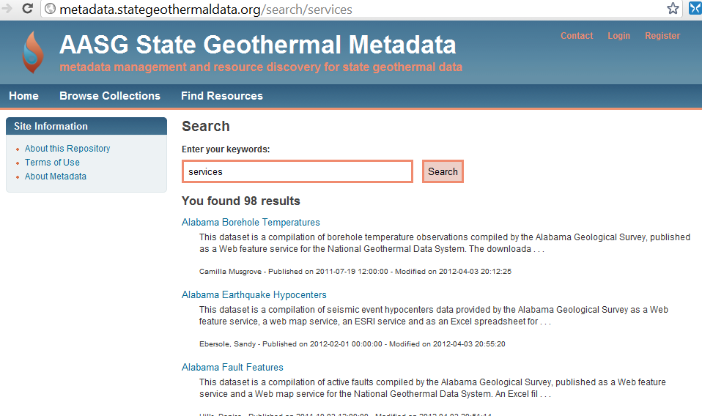
Active services

Slide 16
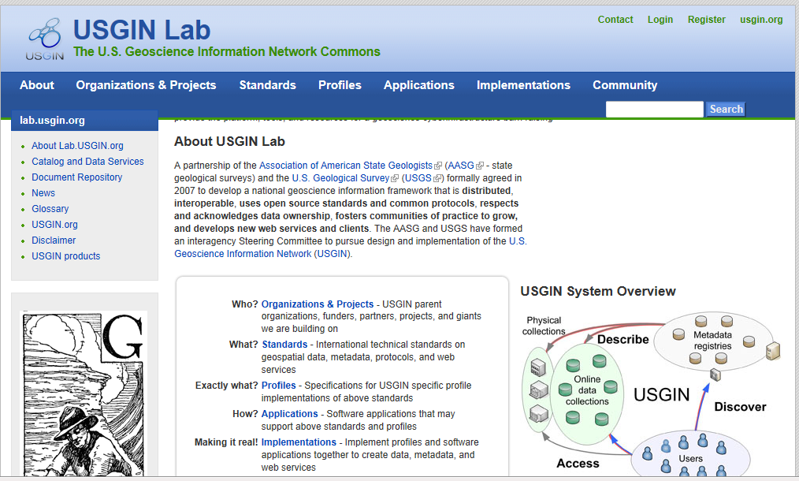
GIN: community web site
Community web site (http://lab.usgin.org )
Blogs
Information about standards, profiles, applications
Accounts open to anyone

Slide 17

GIN Vision
a distributed national network of digital data accessible using common standards and protocols
…respects ownership of data
…builds on existing data systems.

Slide 18
Thank you!!
http://usgin.org
http://lab.usgin.org/usgin-products
http://stategeothermaldata.org

