Slide 1
The Geoscience Information Network
Objective: Make geoscience information easier to find, distribute, and analyze
Approach applicable to any geospatial resource:
  FIND: Standard metadata content, standard metadata catalog service protocol
  DISTRIBUTE: Assist community to implement data services utilizing common OGC protocols
  ANALYZE: Develop data-specific schema standards to promote real data interoperability

Slide 2
Three Levels of Interoperability
FIND: Provide standardized metadata for resources that may or may not be available online
DISTRIBUTE: Provide resources themselves online using standard OGC protocols
ANALYZE: Provide data services in dataset-specific standardized schema

Slide 3

The Hub: CSW Catalog Services
CSW protocol insures standardized method for searching through metadata records.
USGIN profile for ISO 19119 metadata allows for automated resource retrieval by standardizing metadata content
Catalogs capable of harvesting from one another allow every aspect of the system to be distributed and maintained by the responsible organizations

Slide 4
Getting Metadata Into the Catalog
Metadata Already Exists
Metadata Needs to be Created
Is the resource already available online?
Online
Not Online
Online
Not Online
Excel Spreadsheet or
AZGS-Assisted ETL
Upload metadata to a
web-accessible folder
USGIN
Metadata
Wizard
USGIN
Document
Repository
Catalog Harvests
Metadata Records

Slide 5
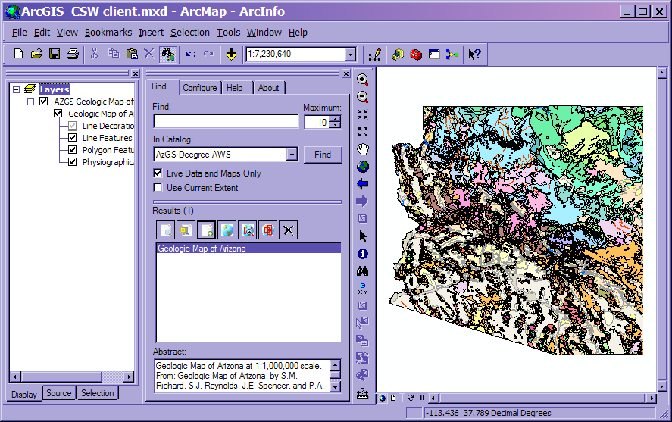
Search the Catalog in Existing Applications

Slide 6
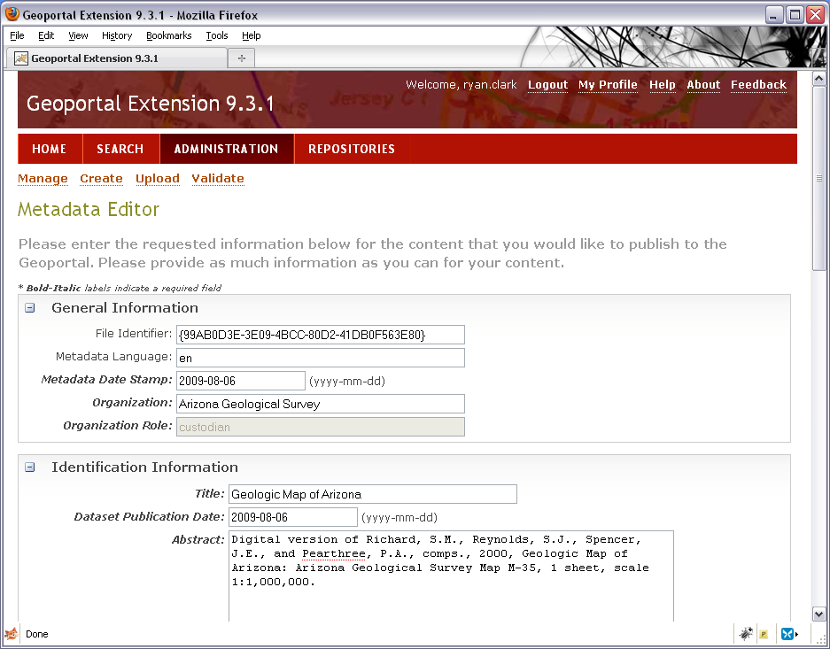
Search the Catalog On The Web

Slide 7
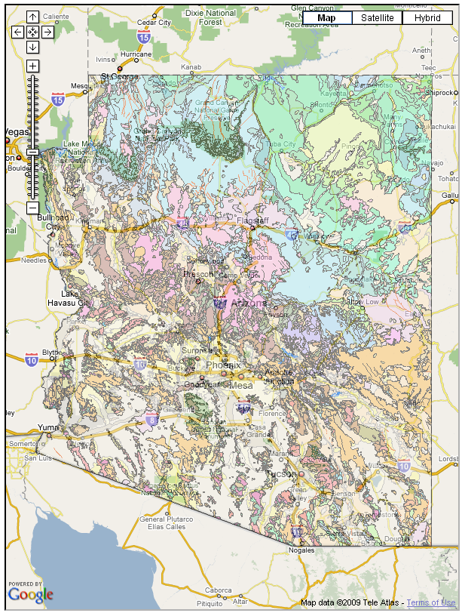
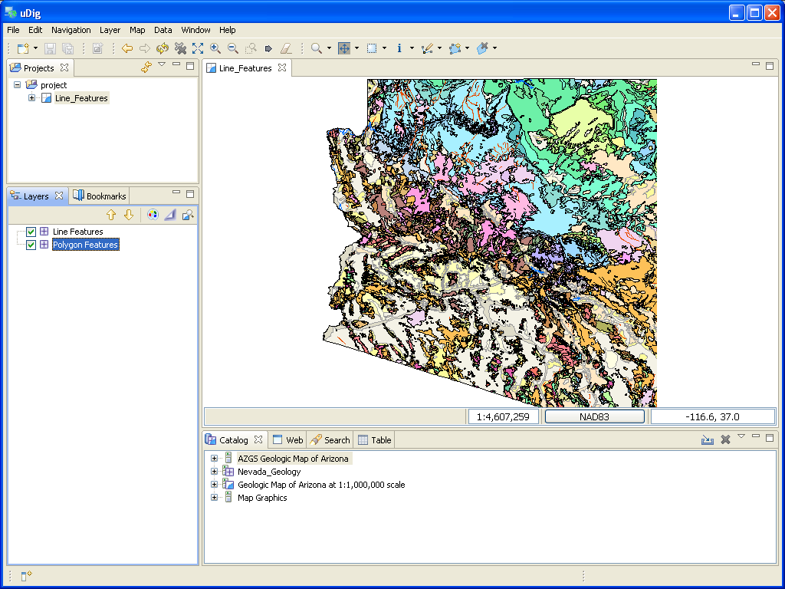
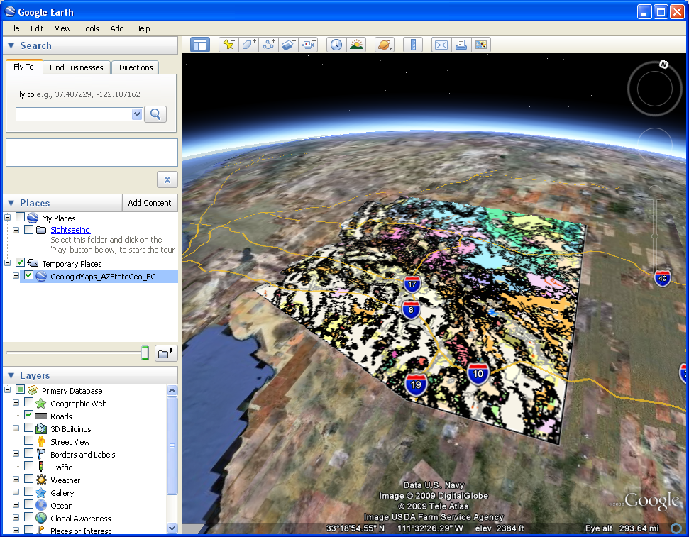
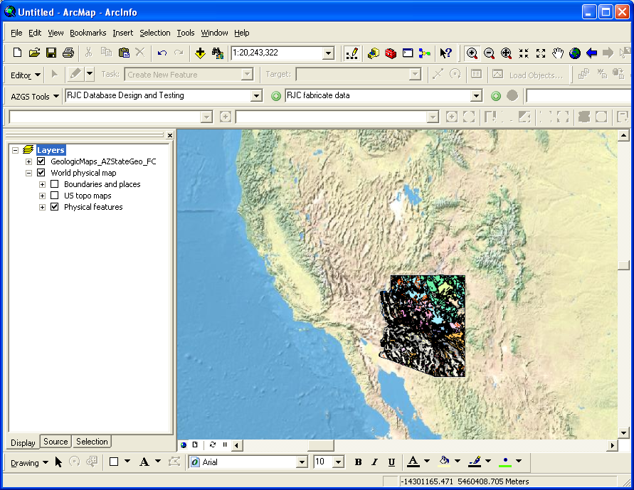
Existing Applications Can Consume OGC Services
Notes:
This is a very small subset of all the software that can consume WMS
Check out the OGC website for a more comprehensive list (there are tons…)

Slide 8
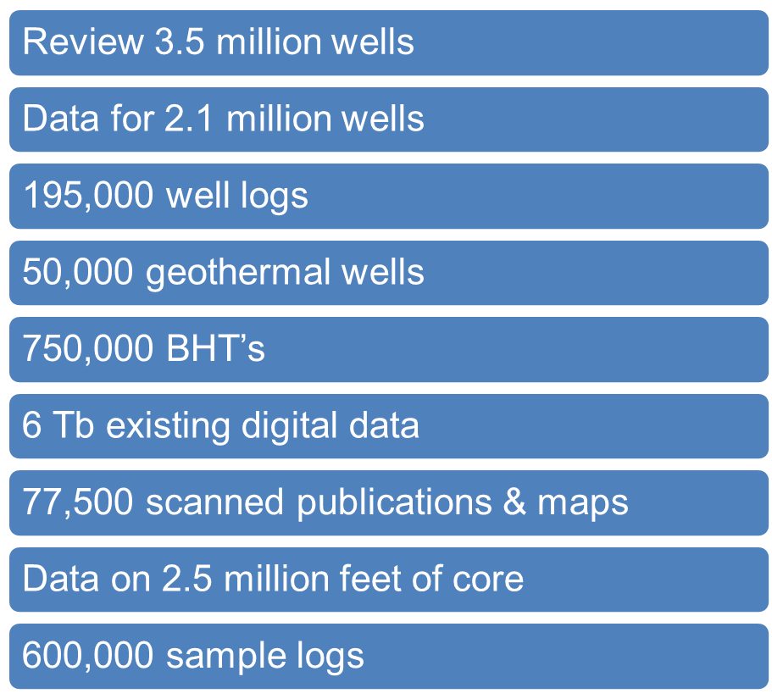

State Contributions to the National Geothermal Data System

Slide 9
USGIN Partners and Collaborators
Official Partners on DOE-funded Geothermal Project:
  Association of American State Geologists
  US Geological Survey
  Microsoft Research
  Energistics, Inc.
Involved in OneGeology: Building a distributed 1:1M-scale geologic map of the world
Approved by Gov. Jan Brewer (AZ) as a data integration framework for Arizona State Agencies
iPlant Collaborative: Cyberinfrastructure for the plant sciences
Developing relationships with ESIP federation, CUAHSI and DataOne

Slide 10
Building the System: Social Engineering
Starting a bootstrapping process
Use of existing protocols means lots of software is already available
Striving to provide simple transformation tools to ease the barrier to entry
The more the merrier!
More
Data
More
Users
More
Software

