Slide 1
Bulk Data Task Force Update
Government Publishing Office
Lisa LaPlant, Program Manager
November 2018

Slide 2
Updates
FDsys Retirement in December
Govinfo Developer Hub
Trustworthy Digital Repository Audit
Govinfo September 2018 Release
Statute Compilations Collection
USLM Projects
Innovation Hub
GitHub Bill Status

Slide 3
FDsys Retirement in December
In December 2018, the FDsys website including the FDsys Bulk Data Repository, FDsys Sitemaps, and the FDsys Link Service will be retired and replaced with govinfo.
Please migrate tools and processes to govinfo.
Immediately before FDsys is retired, redirects from FDsys to govinfo will be enabled.
https://www.govinfo.gov/about#fdsys-transition
Notes:
Mid December

Slide 4
Govinfo Developer Hub
Visit www.govinfo.gov/developers
Bulk Data Repository with JSON and XML Endpoints
RSS Feeds for Content and Metadata
Sitemap with Updated Structure
API and Link Service
GitHub Repositories and Issue Tracking

Slide 5
Trustworthy Digital Repository Audit
Trustworthy Digital Repository Audit is underway by the Primary Trustworthy Digital Repository Authorization Body (PTAB)
  Stage 1 – Complete
  Stage 2 – Onsite Visit in Early December
Working to become first Federal agency to be named as a Trustworthy Digital Repository for Government information through certification under ISO 16363
Validates GPO’s commitment to standards-based digital preservation practices across 109 criteria in the areas of
  Organizational Governance
  Digital Object Management
  Infrastructure and Security Management
Notes:
Stage 1 complete.
Stage 2 onsite visit early December.

Slide 6
Govinfo September 2018 Release
Performed updates for key components
Implemented Links from CFR Details Pages to Related FR Docs
Provided New and Updated Finding Aids including a Resource List, the Congressional Record Index Corrections List, the Numerical List of Serial Set Documents and Reports, and the Schedule of Serial Set Volumes.
Over 29 bug fixes and enhancements including GitHub API Issues #7 and #8, metadata reports, more automated tests, the Statute Compilations collection, and USLM integration for Enrolled Bills, Public and Private Laws, and Statutes at Large.
www.govinfo.gov/features/september-2018-release

Slide 7
Statute Compilations Collection
Goal is to provide a uniform set of laws in USLM to enable downstream processes and increase efficiencies
Phase 1 – Launched!
https://www.govinfo.gov/app/collection/comps
In coordination with HOLC/SOLC/Clerk, make select Statute Compilations (COMPS) in PDF available on govinfo as a Beta
Ingest legacy COMP DTD XML & locator files into govinfo CMS
Phase 2 – FY19
Convert legacy COMP DTD XML or locator files into USLM XML
Provide access to COMPS in USLM XML as Bulk Data

Slide 8
Documents in USLM Project
Soft Launch of Beta USLM XML on govinfo!
Convert a subset of enrolled bills, public laws, and the Statutes at Large from GPO locator-coded text format into USLM XML
Enrolled Bills and Public Laws (113th Congress, 2013 forward), Statutes at Large (108th Congress, 2003 forward)
GPO, House, Senate, OFR/NARA, Congressional Support Organizations
Vendor is Xcential Corporation
Notes:
The Documents in USLM project and the FR/CFR Pilot Project are being run in parallel and focus on transforming key legislative and regulatory publication in to XML that uses the United States Legislative Markup or USLM schema.
Objectives:
Promote domestic interoperability among documents as they flow through the legislative cycle.
Promote international interoperability with documents produced by parliaments world-wide.
Transition the Legislative branch from current 1st Generation DTDs to 2nd Generation XML schema.
Validate and, if necessary, extend the existing USLM schema for use in the entire legislative process.
Non-disruptively enhance existing processes at the House, Senate, GPO, and OFR.
Provide a USLM dataset to GPO for use in the Composition System Replacement project.
Provide a USLM dataset for potential projects to refresh the Bill-DTD XMetal editing environment.
Provide a USLM dataset of laws to OLRC for use in the House Modernization Initiative.
Provide a USLM dataset to the transparency community, vendor community, and the public.

Slide 9
FR/CFR Pilot Project
Parallel initiative to the Documents in USLM Project
Validate the USLM XML schema and tools in the Federal regulatory cycle and in GPO’s publishing processes
CFR Titles 5 – Administrative Personnel, 12 – Banks and Banking, 27 – Alcohol Tobacco Products and Firearms, and 40 – Protection of Environment (2016 forward); FR (2015 forward)
GPO, OFR/NARA
Vendor is Xcential Corporation
Sample Files and Deliverables Coming Soon!
Notes:
Objectives:
Promote interoperability among documents as they flow through the regulatory cycle.
Validate and, if necessary, extend the existing USLM schema for use in the regulatory cycle.
Increase the efficiency and accuracy of updating the CFR from regulations published in the FR.
Provide a USLM data set to support advanced delivery and presentation methods.
Provide an initial set of tools for editors to navigate and work with the FR and CFR in USLM.
Provide a USLM dataset to GPO for use in the Composition System Replacement project.

Slide 10
USLM Deliverables
Available on govinfo
Soft launch for enrolled bills, public and private laws, Statutes at Large
Beta USLM XML files were created by converting locator-coded text files into XML files that validate against the Draft USLM 2.0.3 schema
https://www.govinfo.gov/bulkdata
Available on GitHub
Draft 2.0.3 USLM schema for comment
Schema Review Guide outlining differences from 1.0.18
CSS and schema required for file validation
https://github.com/usgpo/uslm/tree/proposed
**please submit comments via GitHub issue**
Next steps
FR / CFR sample files and deliverables

Slide 11
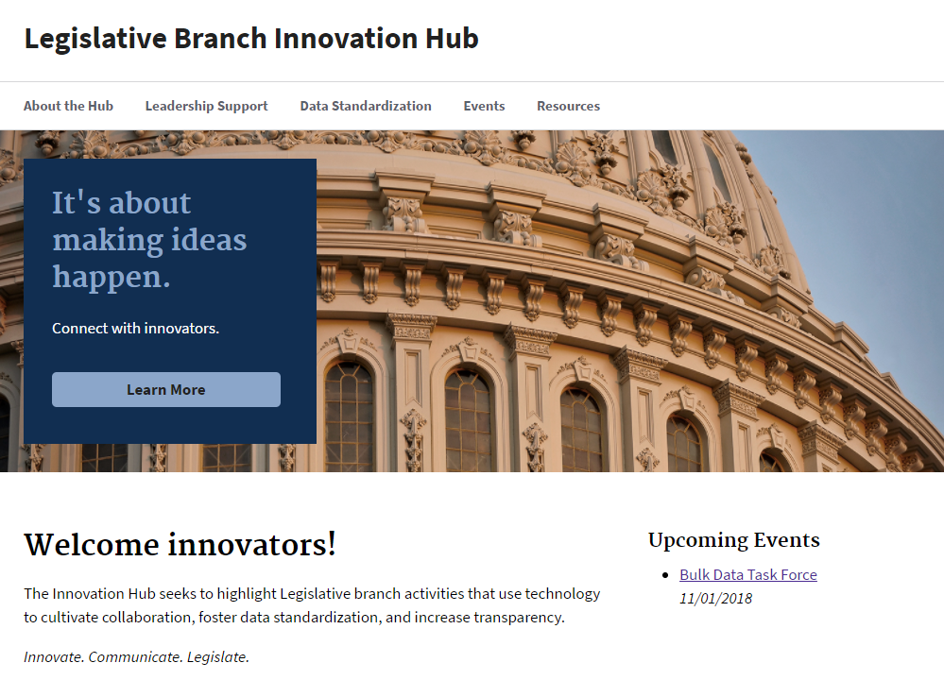
Innovation Hub
usgpo.github.io/innovation
Notes:
Innovation Hub
Uses U.S. Web Design System Jekyll Remote Theme. https://designsystem.digital.gov/ and https://github.com/18F/uswds-Jekyll.

Slide 12
GitHub Bill Status
https://github.com/usgpo/bill-status
Issues and Requests
  100 Closed
  10 Open
Highlights
  Batch complete feed https://www.govinfo.gov/rss/billstatus-batch.xml
  Monitored and closed operational issues
  Exploring use cases for an API for Bulk Data Repository
  Propose <textVersions> in Bill Status XML - Issue #45

Slide 13
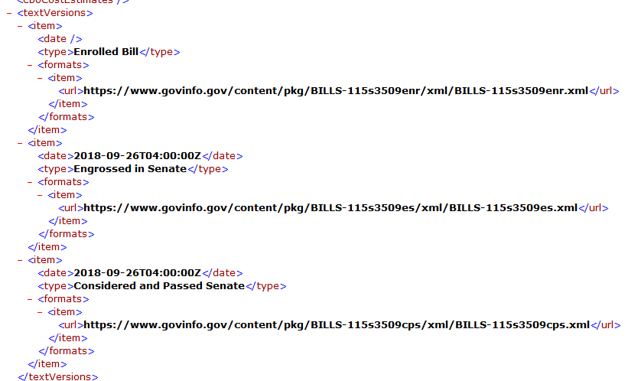
Text Versions in Bill Status XML

Slide 14
Contacts and Sites
llaplant@gpo.gov
@lisalaplant
github.com/usgpo
usgpo.github.io/innovation
github.com/usgpo/uslm
govinfo.gov
api.govinfo.gov

