Slide 1
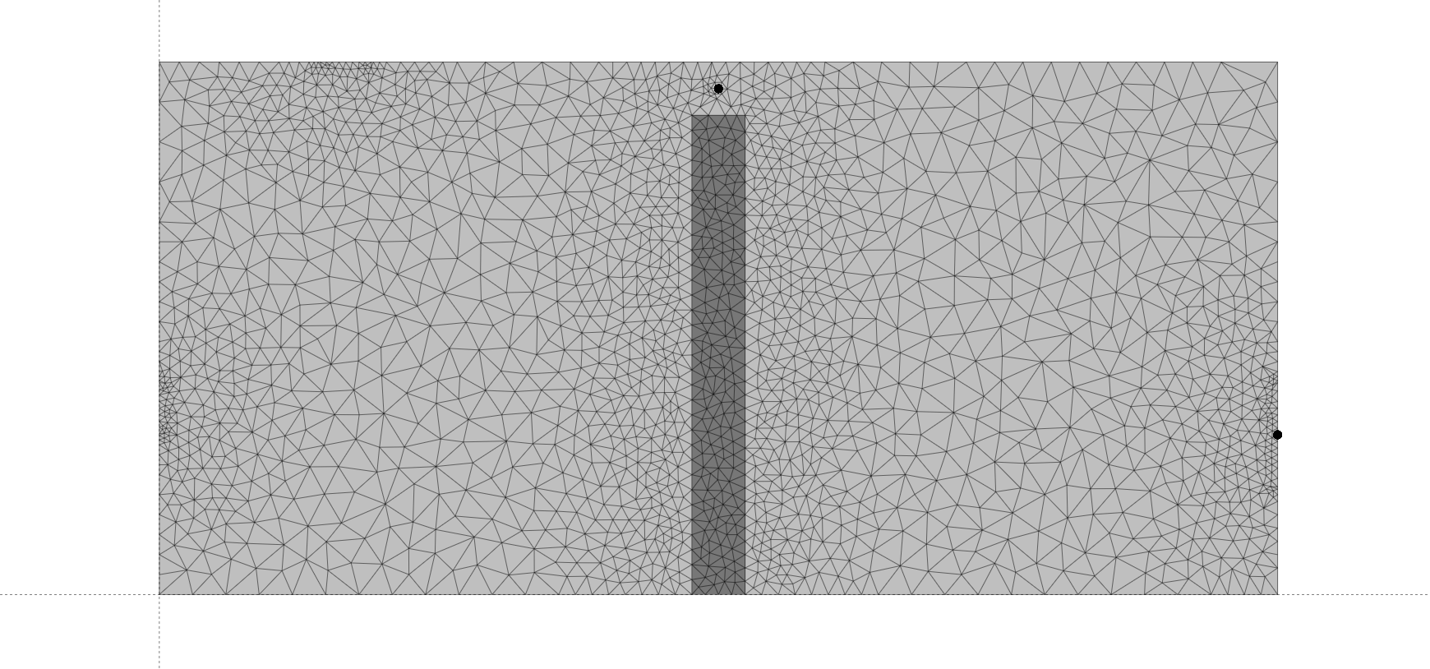
OP 1
Inflow 1
Inflow 2
OP 2
Outflow

Slide 2
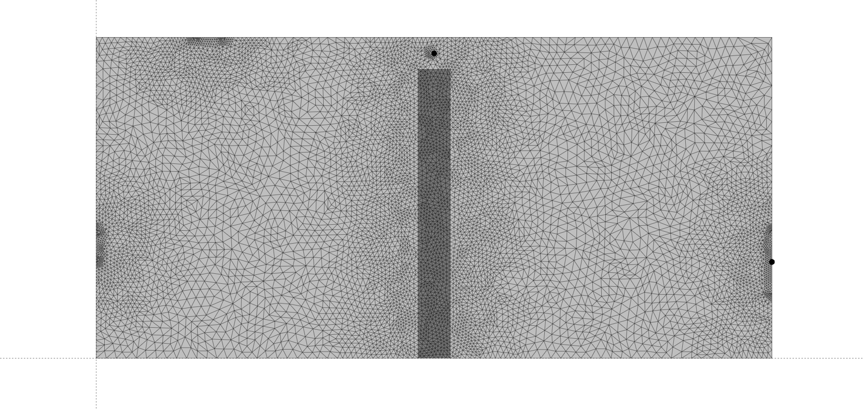
OP 1
Inflow 1
Inflow 2
OP 2
Outflow

