Slide 1
Fitting Percentage of Body Fat to Simple Body Measurements:
College Women
Presented by:
Alyakaev Kamil
Kolodyazhny Maxim
Ushakov Stanislav

Slide 2
Background and Premise
1

Slide 3


Background and Premise
1

Slide 4
Background and Premise
Main Objective:
— To develop a model for estimating body fat percentage using simple body measurements in college women aged 18-25.
— To demonstrate the utility of multiple regression and provide practice in model building for students.
Reasoning:
— Obesity is one of the leading causes of poor health.
1

Slide 5
Background and Premise
Output:
— The model itself;
— Sample assignment;
— Associated R code;
— Grading rubric
1

Slide 6
Background and Premise
1

Slide 7
Q2. Hypotheses
Formally, the article tests the hypothesis that body fat percentage can be accurately predicted using simple body measurements. Not stated explicitly.
The article tests the hypothesis that the relationship between body fat percentage and these body measurements is linear.
2
The article tests the hypothesis that the regression model assumptions, such as normality of residuals and constant variance, are reasonably satisfied.

Slide 8
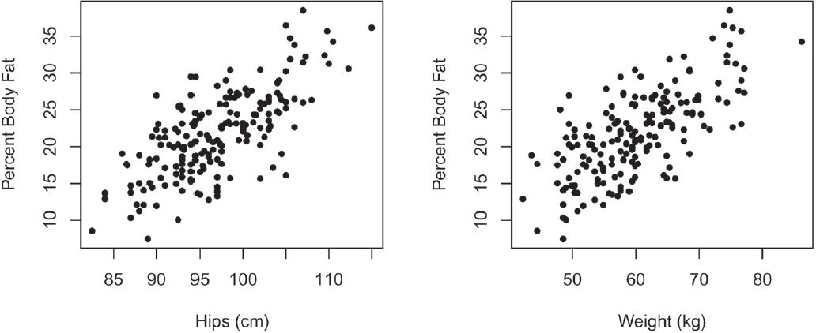
Q2. Hypotheses
Formally, the article tests the hypothesis that body fat percentage can be accurately predicted using simple body measurements. Not stated explicitly.
The article tests the hypothesis that the relationship between body fat percentage and these body measurements is linear.
2
The article tests the hypothesis that the regression model assumptions, such as normality of residuals and constant variance, are reasonably satisfied.

Slide 9
Q2. Hypotheses
Formally, the article tests the hypothesis that body fat percentage can be accurately predicted using simple body measurements. Not stated explicitly.
The article tests the hypothesis that the relationship between body fat percentage and these body measurements is linear.
The article assumes that the regression model assumptions, such as normality of residuals and constant variance, are reasonably satisfied.
2

Slide 10
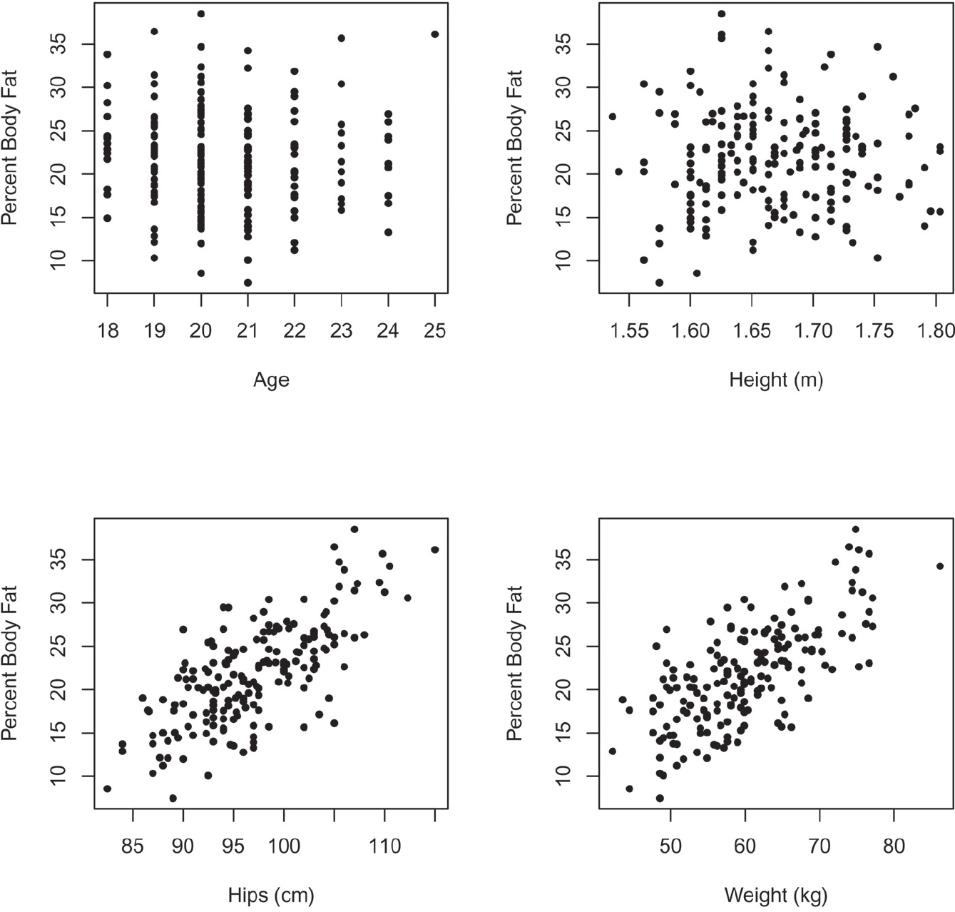
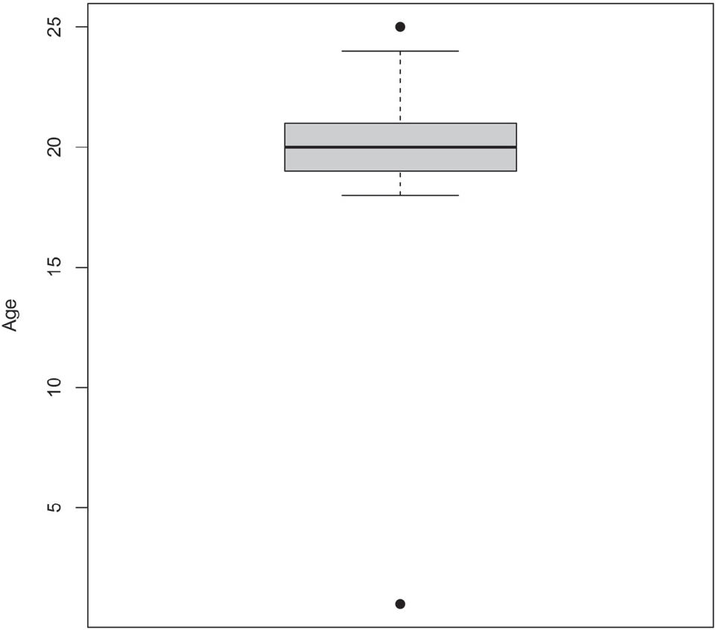
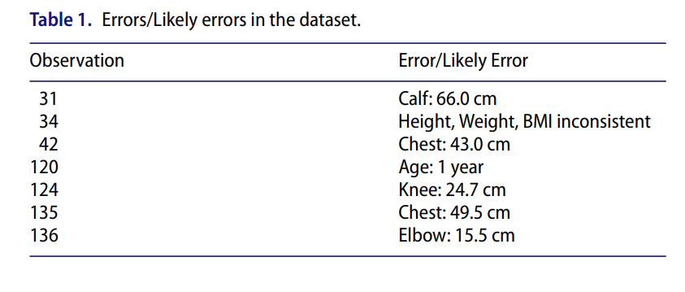
Q3. Dataset
Subjects were 184 women aged 18-25;
Was collected by measuring the percentage of body fat, age, weight, height, and 14 circumference measurements (Waist, Hips, Ankle and e.t.c.) for each woman;
Was based on an older dataset with men as subjects instead of women;
Preprocessing included numerical and visual analysis in order to determine the strength of the linear associations and correlations between variables.
3
Both backwards and forwards selections were used to determine best subsets, for variable selection.

Slide 11
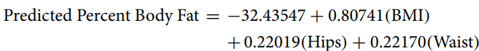
Q4. The Model
This model is a multiple regression model with standard error of 3.543%. (3.62% corrected)
4

Slide 12
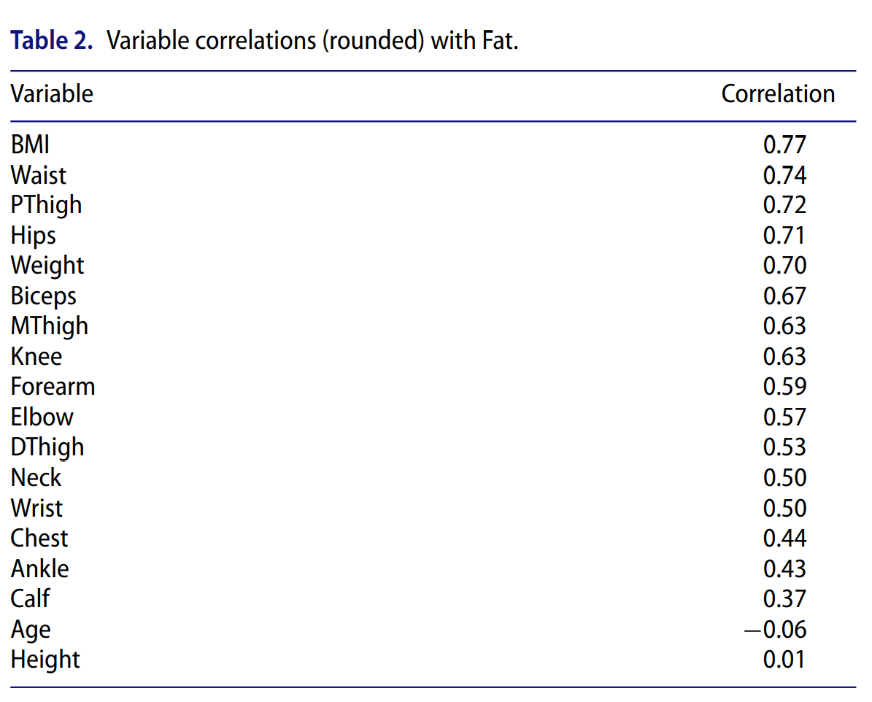
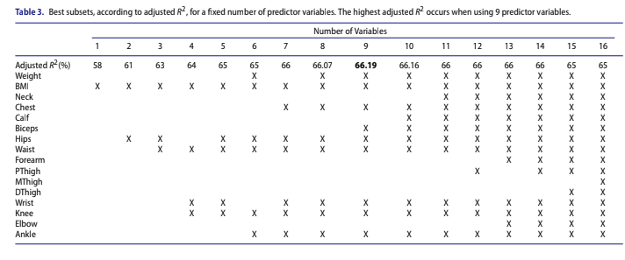
Q5. Coefficients
5

Slide 13
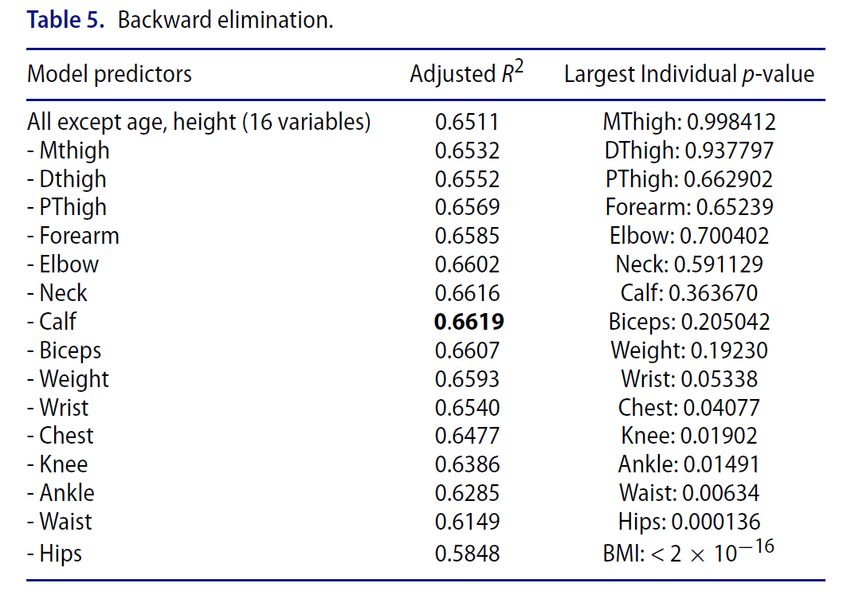
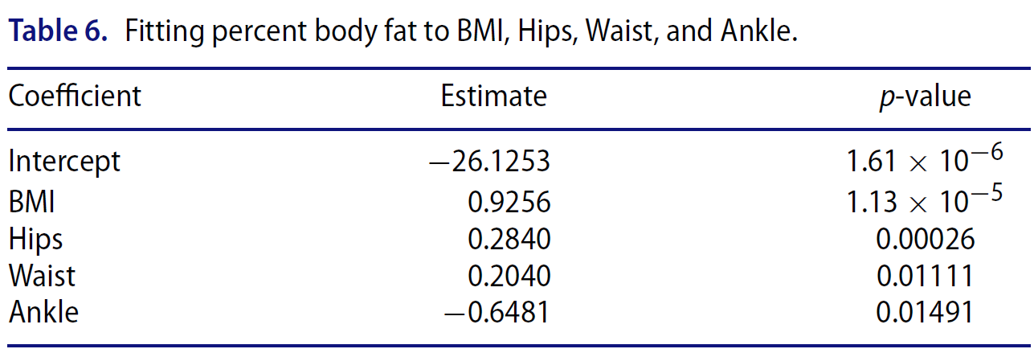
Q6. Values and P-Values
6

Slide 14
Q7. Multicollinearity
The problem is present, because of the nature of the data: body measurements are mainly the correlated ones, since human bodies tend to be proportional (duh).
Adequate incorporation of predictor variables
Homogeneity of error variance
Normality of the errors
7
Independence of the errors

Slide 15
Q8. Heteroskedasticity
8

Slide 16
Q9. Other Problems
The author mentions the problem with optimistic estimate of error and proposes a solution of cross-validation.
9

Slide 17
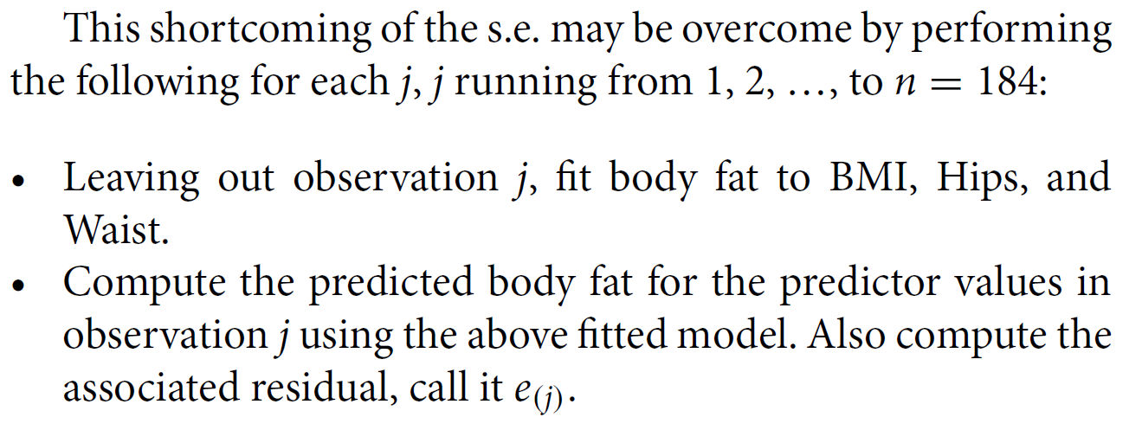
Q9. Other Problems
The author mentions the problem with optimistic estimate of error and proposes a solution of cross-validation.
9

Slide 18
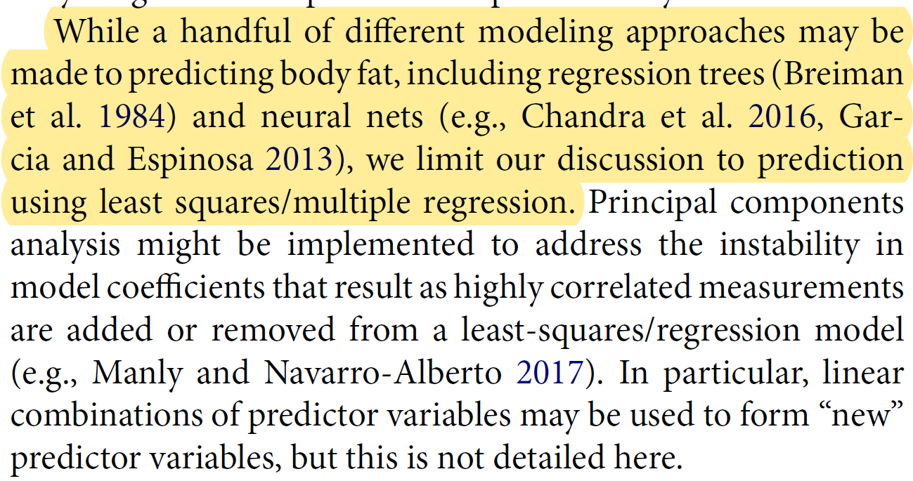
Q10. Other Models
10

Slide 19
Q11. Other Improvements
The author could test for heteroscedasticity using the Breusch-Pagan test or the White test.
The author could use other estimation methods, such as maximum likelihood instead.
The author could have used considered to compare their model to other, non-linear models.
11

Slide 20
Q12. Likeliness of the Article
The research has a real-life application, as well as providing educational value to the reader, who is presumed to be a student.
The model built in the research is robust enough for the cause.
The author also provides self-critique.
The full R code is provided.
12
The article includes an appendix, which is a grading rubric that states specifically everything that is good to have in such a research.

Slide 21


QUE?

