Slide 1
COMPLAINT
MANAGEMENT SYSTEM
Resolving Complaints, Delivering Better Service
MySQL Capstone Project
Presented by: D Eekshitha Sai , M Guna Charan Tej , V Usha Madhuri, K Manoj Kumar

Slide 2
Project Overview
The Complaint Management System is a MySQL-based project designed to manage users, employees, departments, complaint categories and complaints. The system stores data in related tables and uses SQL queries to assign, track, update and analyze complaints efficiently.
Key Features:
User management
Department & employee management
Complaint registration & assignment
Priority and status tracking
Reports & analysis

Slide 3
Problem Statement
Organizations receive complaints that must be assigned to the appropriate department and employee for resolution. Handling them manually leads to lost requests, unclear ownership and delays. The objective of this project is to build a relational database that stores user, employee, department, category and complaint information, and supports operational and reporting queries such as complaint tracking, priority and status monitoring, and employee workload analysis.
Effects

Slide 4
Objectives
To store and manage user, employee and department information.
To classify complaints under different categories.
To assign complaints to employees and track priority and status.
To generate reports on complaint workload and resolution.

Slide 5
DATABASE DESIGN
Table structure normalized to 3NF | Strong relationships
Users
Departments
Employees
Field Name | Data Type | Key
user_id | INT | PK
full_name | VARCHAR(100) | -
phone | VARCHAR(15) | UQ
email | VARCHAR(100) | UQ
address | VARCHAR(150) | -
Field Name | Data Type | Key
department_id | INT | PK
department_name | VARCHAR(50) | -
Field Name | Data Type | Key
employee_id | INT | PK
department_id | INT | FK
employee_name | VARCHAR(100) | -
phone | VARCHAR(15) | -
email | VARCHAR(100) | -
Complaint_Categories
Complaints
Field Name | Data Type | Key
category_id | INT | PK
category_name | VARCHAR(50) | -
Field Name | Data Type | Key
complaint_id | INT | PK
user_id | INT | FK
employee_id | INT | FK
category_id | INT | FK
Field Name | Data Type | Key
complaint_date | DATE | -
priority | VARCHAR(10) | -
status | VARCHAR(20) | -
description | VARCHAR(255) | -

Slide 6
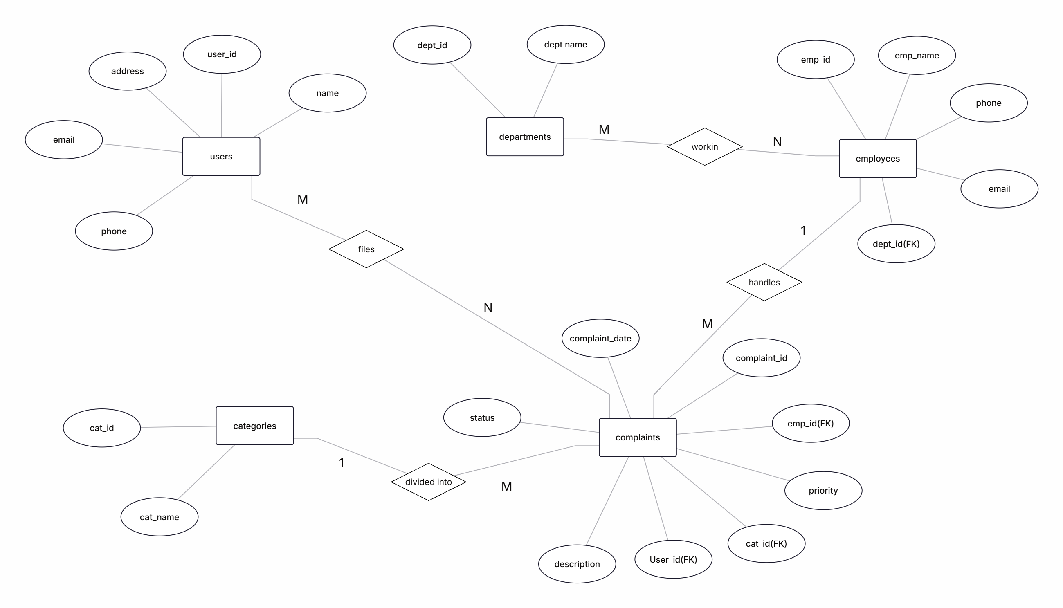
ER Diagram

Slide 7
RELATIONSHIPS
Departments → Employees
Users → Complaints
Employees → Complaints
Categories → Complaints
One-to-Many
One-to-Many
One-to-Many
One-to-Many
A department has multiple employees.
A user can file multiple complaints.
An employee can handle multiple complaints.
A category groups multiple complaints.
DESIGN BENEFITS
Data Consistency
Reduced Duplication
Referential Integrity
Efficient Retrieval
Accurate and reliable data.
Avoids redundant information.
Ensures valid relationships.
Optimized for faster queries.

Slide 8
SQL Sublanguages – DDL and DML
DDL (Data Definition Language)
DML (Data Manipulation Language)
DDL is used to create, modify, and delete database structures.
DML is used to insert, update, and delete records in a table.
SQL Query
SQL Query
CREATE TABLE Complaint_Categories (
category_id INT PRIMARY KEY,
category_name VARCHAR(50)
);
INSERT INTO Departments
VALUES (6, 'Legal');
SELECT * FROM Departments
WHERE department_id = 6;
Sample Output
Sample Output
STATEMENT | OUTPUT
CREATE TABLE | Query OK, 0 rows affected
STATEMENT | OUTPUT
INSERT | Query OK, 1 row affected
DEPARTMENT_ID | DEPARTMENT_NAME
6 | Legal

Slide 9
SQL Sublanguages – DQL and TCL
DQL (Data Query Language)
TCL (Transaction Control Language)
DQL is used to retrieve data from database tables.
TCL commands manage transactions and control changes made to the database.
SQL Query
SQL Query
SELECT complaint_id, priority, status
FROM Complaints
WHERE priority = 'High'
AND status = 'Open';
START TRANSACTION;
UPDATE Complaints
SET employee_id = 102,
status = 'In Progress'
WHERE complaint_id = 1001;
COMMIT;
Sample Output
COMPLAINT_ID | PRIORITY | STATUS
1001 | High | Open
1010 | High | Open
1016 | High | Open
Sample Output
STATEMENT | OUTPUT
START TRANSACTION | Query OK, 0 rows affected
UPDATE | Query OK, 1 row affected
COMMIT | Query OK, 0 rows affected

Slide 10
Aggregate Functions
Summarize complaint, user and employee data
Sample Output
SQL Query
SELECT
COUNT(*) AS total_complaints,
COUNT(DISTINCT user_id) AS users,
COUNT(DISTINCT employee_id)
AS employees_assigned,
MIN(complaint_date) AS first_date,
MAX(complaint_date) AS latest_date
FROM Complaints;
Metric | Value
Total Complaints | 20
Users Complaining | 10
Employees Assigned | 8
First Complaint | 2026-07-01
Latest Complaint | 2026-07-11
Functions used: COUNT(), COUNT(DISTINCT), MIN(), MAX()
Business value: Gives a quick overview of complaint volume and workload.

Slide 11
Grouping & Counting
Complaints raised department-wise
Sample Output
SQL Query
SELECT d.department_name,
COUNT(*) AS total_complaints
FROM Complaints c
JOIN Employees e
ON c.employee_id = e.employee_id
JOIN Departments d
ON e.department_id = d.department_id
GROUP BY d.department_name
ORDER BY total_complaints DESC;
DEPARTMENT_NAME | TOTAL_COMPLAINTS
IT | 7
HR | 6
Finance | 3
Network | 2
Adminstration | 2
Clauses used: GROUP BY, ORDER BY, COUNT()
Business value: Identifies the busiest department (IT) for resource planning.

Slide 12
String Functions
Format and display employee and complaint information
Sample Output
SQL Query
SELECT
UPPER(employee_name) AS upper_name,
LOWER(employee_name) AS lower_name,
CONCAT(employee_name, ' - ',
department_name) AS emp_dept
FROM Employees e
JOIN Departments d
ON e.department_id = d.department_id
LIMIT 3;
UPPER_NAME | LOWER_NAME | EMP_DEPT
RAVI | ravi | Ravi - IT
PRIYA | priya | Priya - IT
KIRAN | kiran | Kiran - HR
Functions used: UPPER(), LOWER(), CONCAT()
Business value: Improves text formatting and report readability.

Slide 13
String Functions – Text Handling
Extract and replace text in complaint descriptions
Sample Output
SQL Query
SELECT complaint_id,
LEFT(description, 4) AS first_4,
RIGHT(description, 5) AS last_5,
REPLACE(description, 'login',
'authentication') AS new_desc
FROM Complaints
WHERE description LIKE '%login%';
ID | FIRST_4 | LAST_5 | NEW_DESC
1001 | Unab | ortal | Unable to authentication to employee portal
1005 | Unau | ected | Unauthorized authentication attempt detected
1017 | Unab | hange | Unable to authentication after password change
Functions used: LEFT(), RIGHT(), REPLACE()
Business value: Cleans and standardizes complaint text for reports.

Slide 14
Date & Time Functions
Track complaints and summarize complaint activity
Sample Output
SQL Query
SELECT
complaint_id,
DATE_FORMAT(complaint_date,
'%d-%b-%Y') AS formatted_date,
DAYNAME(complaint_date) AS day_name,
MONTHNAME(complaint_date) AS month
FROM Complaints
LIMIT 3;
ID | FORMATTED_DATE | DAY_NAME | MONTH
1001 | 01-Jul-2026 | Wednesday | July
1002 | 02-Jul-2026 | Thursday | July
1003 | 03-Jul-2026 | Friday | July
Functions used: DATE_FORMAT(), DAYNAME(), MONTHNAME()
Business value: Helps generate monthly reports and analyze complaint trends.

Slide 15
Joins
Joins combine records from two or more related tables.
Types of joins: INNER JOIN • LEFT JOIN • RIGHT JOIN • CROSS JOIN
INNER JOIN
LEFT JOIN
SELECT c.complaint_id, u.full_name,
e.employee_name
FROM Complaints c
INNER JOIN Users u
ON c.user_id = u.user_id
INNER JOIN Employees e
ON c.employee_id = e.employee_id;
SELECT e.employee_name,
COUNT(c.complaint_id) AS total
FROM Employees e
LEFT JOIN Complaints c
ON e.employee_id = c.employee_id
GROUP BY e.employee_name;
Sample Output
Sample Output
COMPLAINT_ID | FULL_NAME | EMPLOYEE_NAME
1001 | Aarav | Ravi
1002 | Aarav | Priya
1003 | Bhavya | Kiran
EMPLOYEE_NAME | TOTAL
Ravi | 3
Priya | 2
Kiran | 3
INNER JOIN returns matching records. LEFT JOIN returns all records from the left table, with 0 where no complaint matches.

Slide 16
Subqueries
Find employees handling more complaints than average
Sample Output
SQL Query
SELECT employee_name
FROM Employees
WHERE employee_id IN (
SELECT employee_id
FROM Complaints
GROUP BY employee_id
HAVING COUNT(*) > (
SELECT AVG(cnt) FROM (
SELECT COUNT(*) AS cnt
FROM Complaints
GROUP BY employee_id) t
)
);
EMPLOYEE_NAME
Ravi
Kiran
Sneha
Arjun
How it works
Innermost query: average complaints per employee (2.5).
Outer queries: employees whose count is above 2.5.
Subquery used: AVG of complaints per employee
Business value: Highlights employee workload imbalances.

Slide 17
Views
A view is a virtual table created from a SELECT query. It simplifies frequently used queries and presents selected information.
Create the view
To retrieve the view
CREATE VIEW Open_Complaints AS
SELECT c.complaint_id, u.full_name,
c.priority, c.complaint_date,
c.description
FROM Complaints c
JOIN Users u ON c.user_id = u.user_id
WHERE c.status = 'Open';
SELECT *
FROM Open_Complaints;
Sample Output
COMPLAINT_ID | FULL_NAME | PRIORITY | COMPLAINT_DATE
1001 | Aarav | High | 2026-07-01
1006 | Charan | Medium | 2026-07-04
1010 | Esha | High | 2026-07-06

Slide 18
Stored Procedures
A stored procedure is a reusable set of SQL statements stored in the database.
Complaints of a particular employee
To execute
DELIMITER //
CREATE PROCEDURE
GetComplaintsByEmployee(
IN emp_id INT)
BEGIN
SELECT complaint_id, priority,
status, description
FROM Complaints
WHERE employee_id = emp_id;
END //
DELIMITER ;
CALL GetComplaintsByEmployee(101);
Sample Output
ID | PRIORITY | STATUS | DESCRIPTION
1001 | High | Open | Unable to login to employee portal
1005 | High | Resolved | Unauthorized login attempt detected
1014 | Medium | In Progress | MS Excel keeps crashing

Slide 19
Stored Procedures – Priority & Category
Complaints by priority
Complaint count by category
CREATE PROCEDURE
GetComplaintsByPriority(
IN p_priority VARCHAR(10))
BEGIN
SELECT complaint_id, status,
description
FROM Complaints
WHERE priority = p_priority;
END //
CREATE PROCEDURE
CountComplaintsByCategory(
IN p_category_id INT)
BEGIN
SELECT COUNT(*) AS total_complaints
FROM Complaints
WHERE category_id = p_category_id;
END //
To execute
To execute
CALL GetComplaintsByPriority('High');
CALL CountComplaintsByCategory(3);
Sample Output (first 2 of 8 rows)
Sample Output
ID | STATUS
1001 | Open
1003 | In Progress
TOTAL_COMPLAINTS
3

Slide 20
Triggers – Complaint Log
A trigger is a database object that automatically executes when a specified event occurs on a table.
Create the trigger
Test the trigger
CREATE TABLE Complaint_Log (
log_id INT AUTO_INCREMENT PRIMARY KEY,
complaint_id INT, user_id INT,
category_id INT, complaint_date DATE
);
DELIMITER //
CREATE TRIGGER log_new_complaint
AFTER INSERT ON Complaints
FOR EACH ROW
BEGIN
INSERT INTO Complaint_Log
(complaint_id, user_id,
category_id, complaint_date)
VALUES (NEW.complaint_id, NEW.user_id,
NEW.category_id, NEW.complaint_date);
END //
DELIMITER ;
INSERT INTO Complaints VALUES
(1021, 1, 101, 1, '2026-07-12',
'Low', 'Open', 'Test complaint');
SELECT * FROM Complaint_Log;
Sample Output
LOG_ID | COMP_ID | USER | CATEGORY | DATE
1 | 1021 | 1 | 1 | 2026-07-12
Every new complaint is logged automatically.

Slide 21
Triggers – Status History
A trigger is a database object that automatically executes when a specified event occurs on a table.
Create the trigger
Test the trigger
CREATE TABLE Complaint_Status_History (
history_id INT AUTO_INCREMENT PRIMARY KEY,
complaint_id INT, old_status VARCHAR(20),
new_status VARCHAR(20), update_date DATETIME
);
DELIMITER //
CREATE TRIGGER log_status_change
AFTER UPDATE ON Complaints
FOR EACH ROW
BEGIN
IF OLD.status <> NEW.status THEN
INSERT INTO Complaint_Status_History
(complaint_id, old_status,
new_status, update_date)
VALUES (OLD.complaint_id, OLD.status,
NEW.status, NOW());
END IF;
END //
DELIMITER ;
UPDATE Complaints
SET status = 'Resolved'
WHERE complaint_id = 1001;
SELECT * FROM
Complaint_Status_History;
Sample Output
ID | COMP_ID | OLD | NEW | UPDATED
1 | 1001 | Open | Resolved | 2026-07-12 10:30:00
Every status change is recorded with old and new values.

Slide 22
CONCLUSION
❄
THE COMPLAINT MANAGEMENT SYSTEM DEMONSTRATES HOW MYSQL CAN MANAGE USER, EMPLOYEE, DEPARTMENT AND COMPLAINT INFORMATION EFFICIENTLY.
THE PROJECT USES RELATIONAL DATABASE DESIGN, SQL COMMANDS, FUNCTIONS, JOINS, SUBQUERIES, VIEWS, STORED PROCEDURES AND TRIGGERS.
THESE FEATURES HELP TRACK COMPLAINTS, GENERATE REPORTS, MAINTAIN DATA CONSISTENCY, AND AUTOMATE ROUTINE DATABASE OPERATIONS.
❄
❄
❄

Slide 23
THANK YOU

