Slide 1
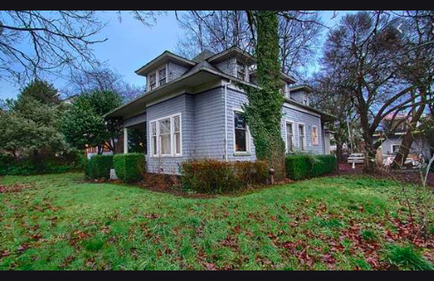
House Sales Price Prediction

Slide 2
New Construction Starts in US
10,740,000 starts in 2019
1,567,000 starts in Jan 2020

Slide 3

Business Issue
Analysis – New Construction perspective
Important features
Bedrooms
Bathrooms
Lot size
Living space
Grade

Slide 4
Data set
King County in Washington State – includes Seattle
Sales from May 2014 to 2015
21,600 lines of Data
Python, pandas, statsmodels, sklearn

Slide 5
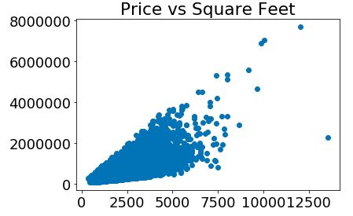

Slide 6
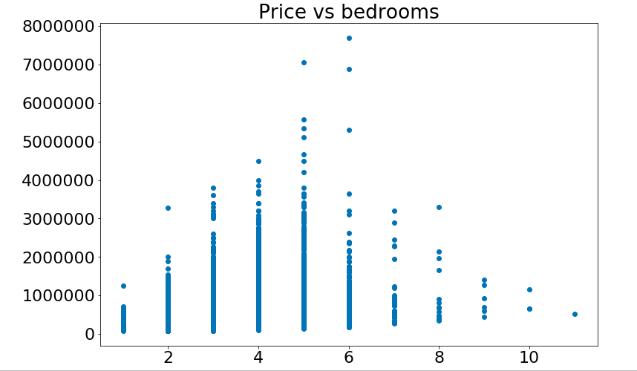

Slide 7
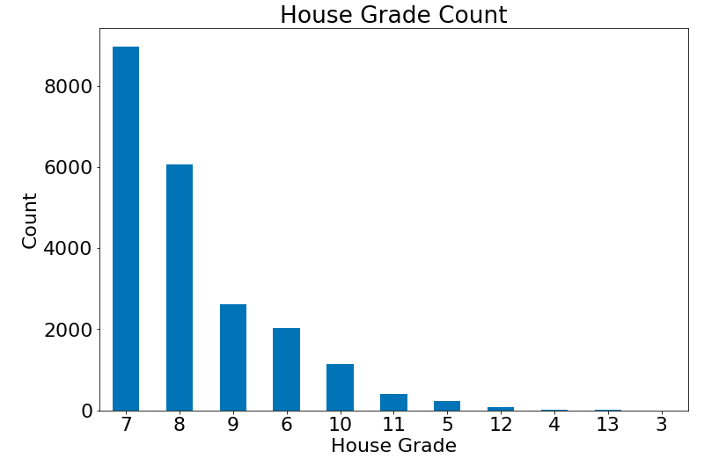

Slide 8
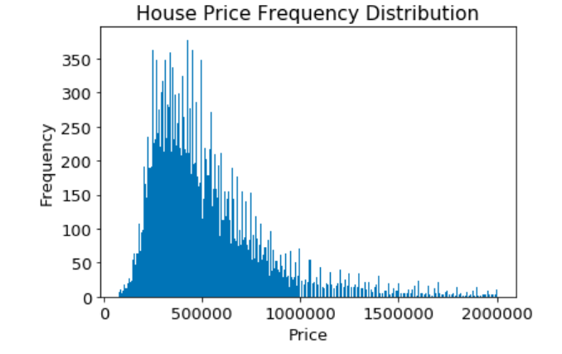

Slide 9
EDA Analysis
2+ Bathrooms – 52%
3-4 Bedrooms - 75%
9,600 houses were in the price range of $350,000 -$650,000
1,400 houses are more than a million

Slide 10
Model Predictions
R2 = .64
Bathrooms – 3.333
Square feet living – 1.28
Floors - 3269
Latitude – 7.739

Slide 11
Recommendations
3-4 bedrooms
2+ bathrooms
$350,000 - $650,000

Slide 12
Next Steps

Slide 13
Usha Menta
Thank You!

