Slide 1


Movie Arena: Microsoft Entrance
'
Usha Menta

Slide 2
Sources
Box Office Mojo
Rotten Tomatoes
tn movie budgets

Slide 3
Movie Industry
Worldwide Collections
31 billion in 2017
29 billion in 2018
Foreign
Collections
64% in 2017
61% in 2018

Slide 4
Top 10 Theme
Top ten movies
Top ten studios
Top ten genres

Slide 5
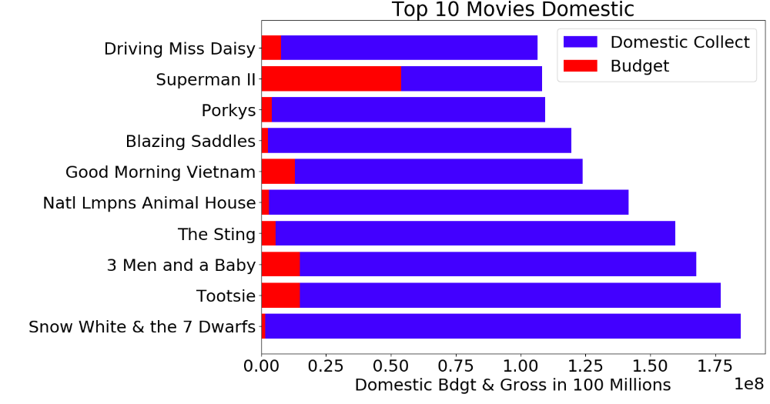
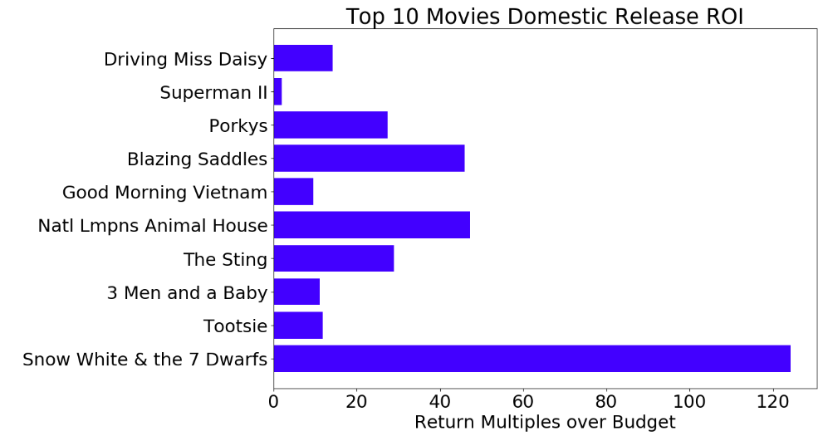
Top 10 Movies – Domestic Releases

Slide 6
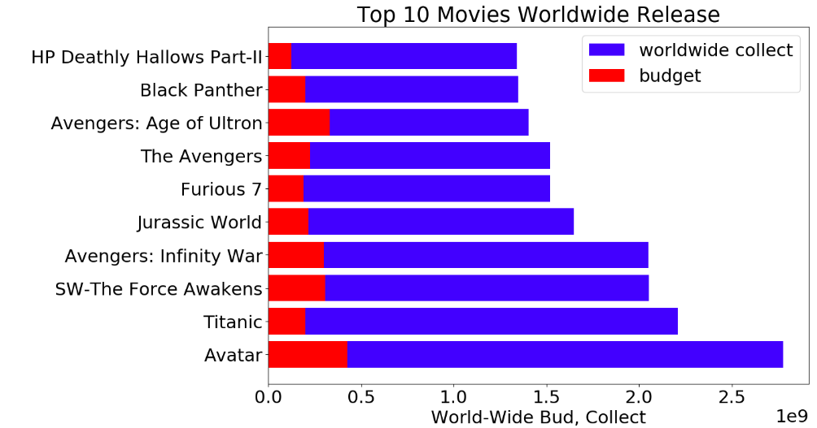
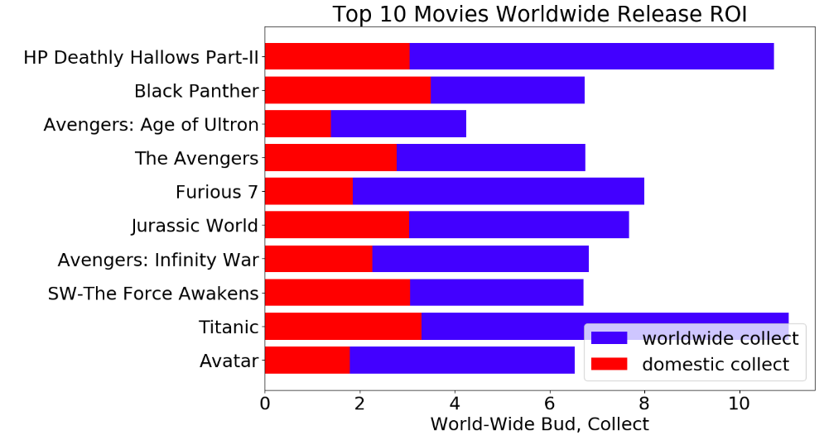
Top 10 Movies: Worldwide Releases

Slide 7
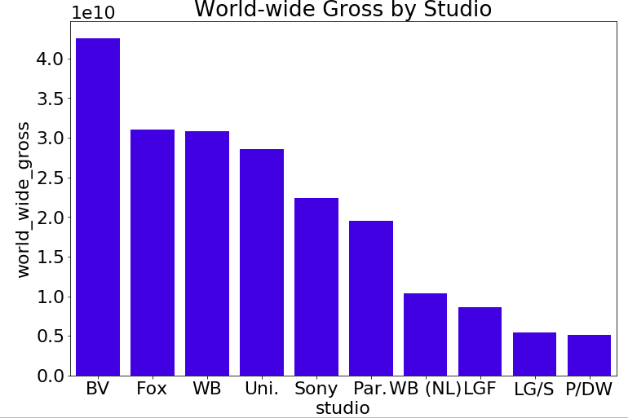
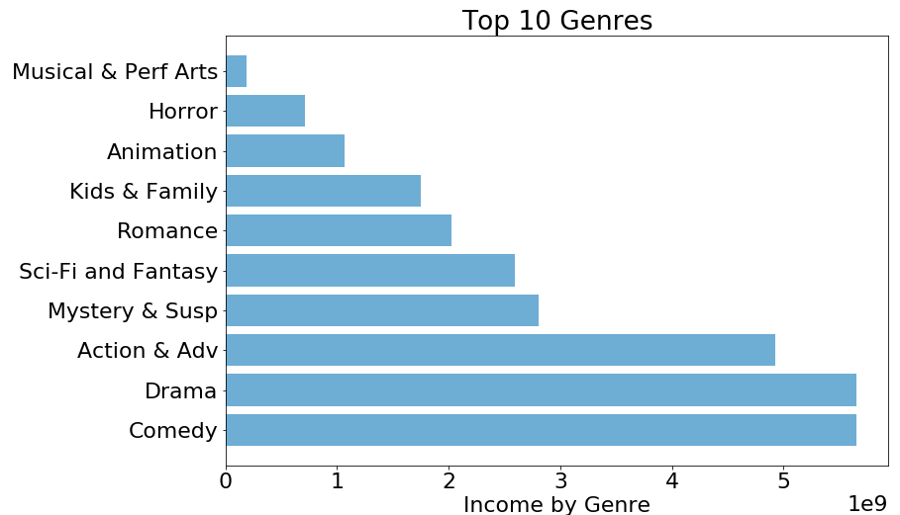
Notes:
Box office Mojo

Slide 8
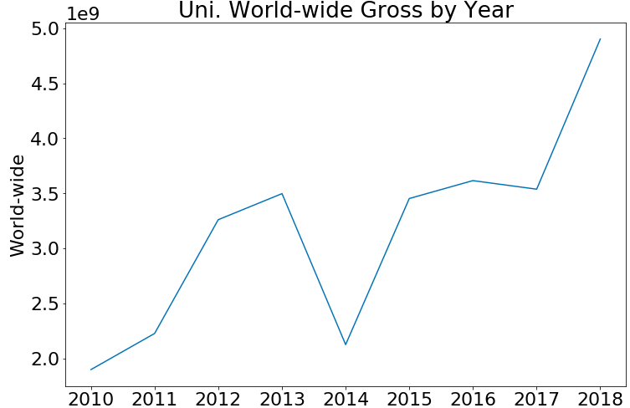
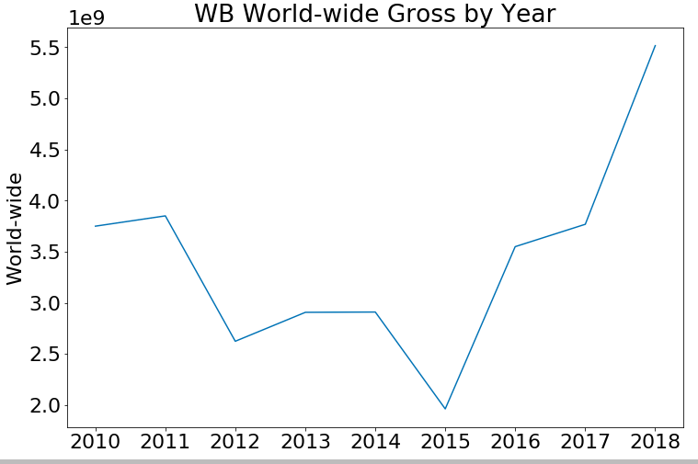
Two Studios with Positive Trends
Notes:
Box Office Mojo

Slide 9
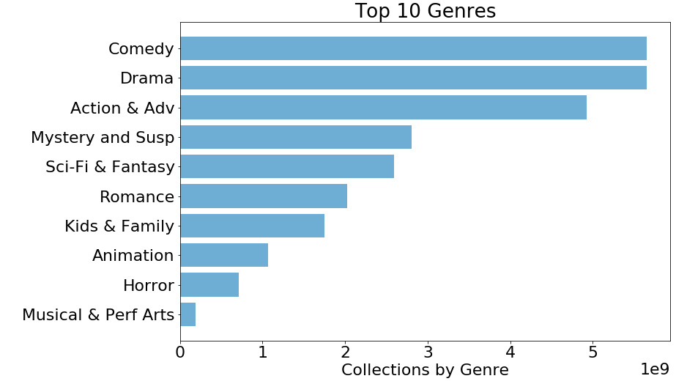

Slide 10
RECOMMENDATIONS
Enter the movie market through acquisition.
Universal or Warner Brothers
Produce a movie in the popular genre
Comedy, Drama, Action/Adventure
Release the movie domestic or worldwide
Depending on Budget

Slide 11
Thank You!
Usha Menta
usha.atma@gmail.com

