Slide 1
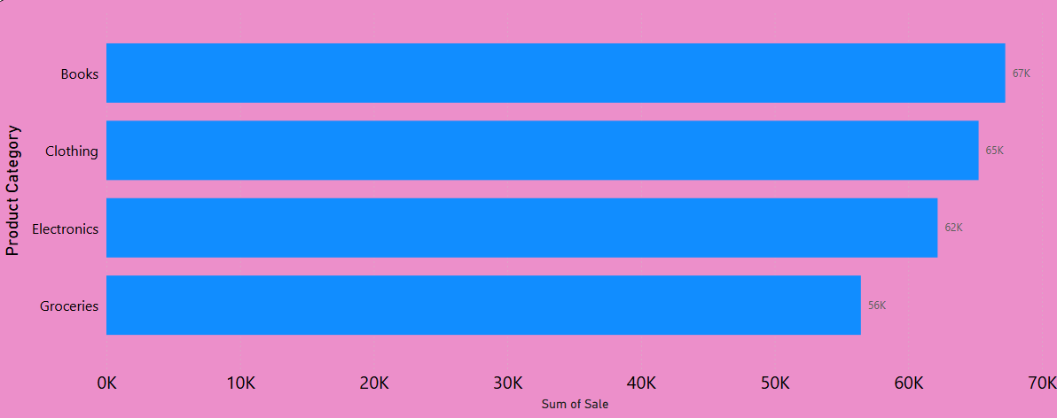
Customer Sales Report
Sales by Product Category

Slide 2
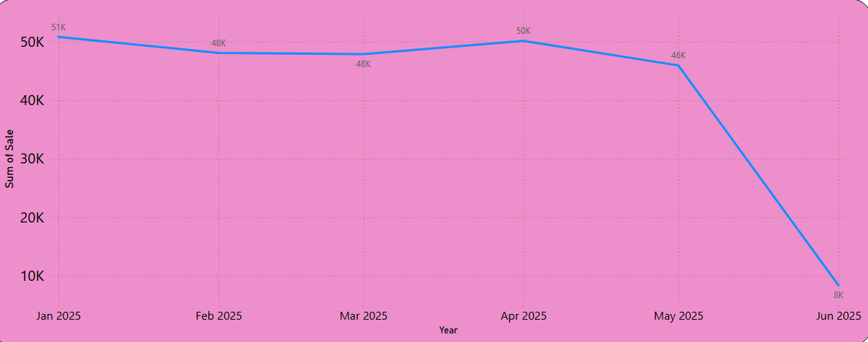
Customer Sales Report
Sales by Year, Quarter, Month, Day

Slide 3
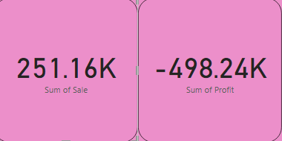
Customer Sales Report
Cards
Cards for Total Sales, Profit

Slide 4
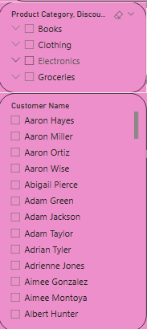
Customer Sales Report
Slicers for Category, Month, Discount

Slide 5
Customer Sales Report
The data has been enhanced and cleaned for Power BI, including:
Profit column (calculated)
Year-Month column for time-series analysis
Data Visuals:
Cards for Total Sales, Profit has been recorded
Line Chart: Sales over Year-Month
Bar Chart: Sales by Product Category
Slicers for Category, Month, Discount has been added.

