Slide 1
SQLPilot
SQL Server Migration Agent
LLM-driven · DBA-as-pilot, agent-as-copilot
Demo preview · May 2026 · v0.9

Slide 2



THE PROBLEM
Migrating SQL Server to Azure is slow and risky.
Assessment is manual
Target choice is opinion
Migration is a checklist
DBAs hand-run discovery scripts, eyeball Excel reports, and map findings to Microsoft docs by memory.
Azure VM vs Managed Instance vs SQL Database — picked from gut feel and pricing pages, not evidence.
Provision, restore, validate, hand off. Many steps, easy to skip one. No audit trail when something breaks.
SQLPilot v0.9 · Demo Preview
2 / 12

Slide 3
WHAT IS SQLPILOT
An agent that runs the migration end-to-end.
Five stages from on-prem assessment to app-team handoff. The agent invokes tools, consults a knowledge base of Microsoft Learn citations, and logs every decision. The DBA approves at gates and owns the outcome.
1
2
3
4
5
STAGE
STAGE
STAGE
STAGE
STAGE
Assessment
Decision
Migration
Handoff
Day to Day
SQLPilot v0.9 · Demo Preview
3 / 12

Slide 4




LLM-DRIVEN
The model does the work. The DBA owns the outcome.
LLM Agent
DBA
Reads Phase 1 findings · normalizes them into the agent's working state
Approves the assessment before moving to target decision
Looks up each finding in the KB · picks Microsoft Learn citations
Reviews the recommended Azure target — overrides if needed
Decides the recommended Azure target by reasoning across the verdicts
Authorizes the live migration (provision · restore · validate)
Calls tools: Terraform · BACKUP/RESTORE · DBCC CHECKDB · handoff document
Signs off on the handoff to the application team
Every model decision is captured in the decision log for audit
Owns the outcome: the DBA is the pilot, the agent is the copilot
SQLPilot v0.9 · Demo Preview
4 / 12

Slide 5
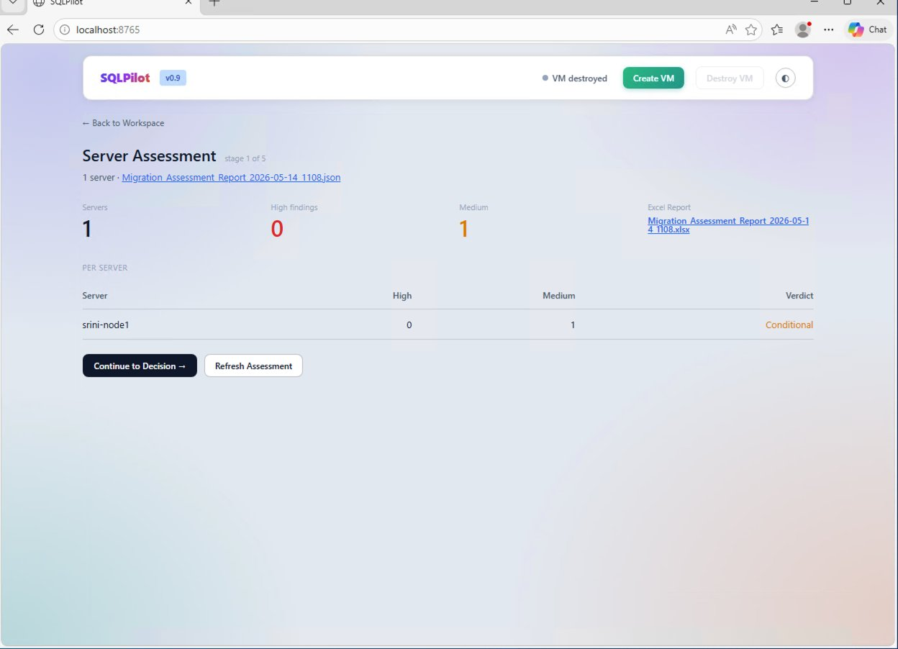
STAGE 1 · ASSESSMENT
Walk the estate. Find the migration blockers.
AGENT
Invokes Phase 1 assessment wrapper · multi-server via CMS group or single
Parses findings into structured JSON · summarizes counts by severity
Hands a per-server verdict to the Decision stage
DBA
Approves the assessment before the agent proceeds to target selection.
SQLPilot v0.9 · Demo Preview
5 / 12

Slide 6
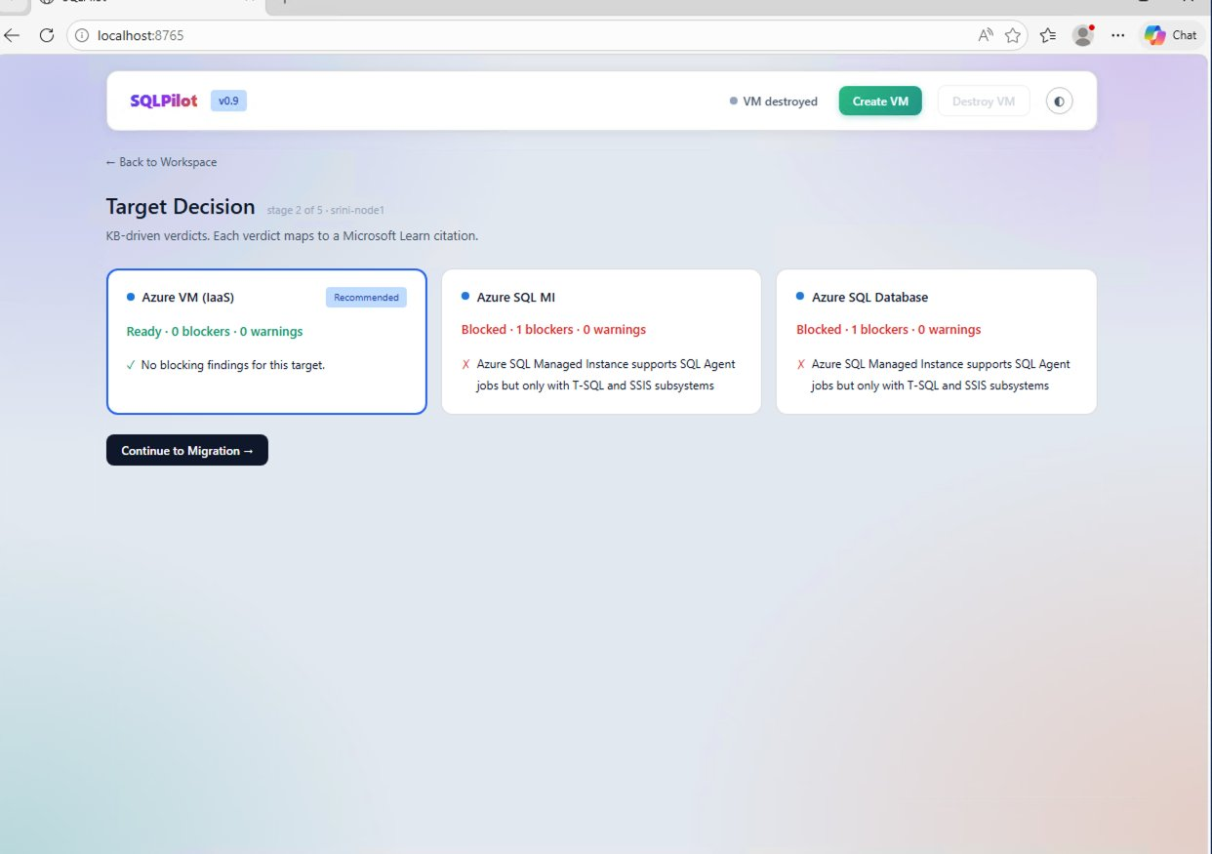

STAGE 2 · DECISION
Pick a target. Cite Microsoft Learn for every verdict.
AGENT
Maps each finding to a knowledge-base topic (kb.json)
Aggregates verdicts across Azure VM · Managed Instance · SQL Database
Recommends a target and shows the Microsoft Learn citation behind each rule
DBA
Reviews the recommended target. Overrides if needed before authorizing migration.
SQLPilot v0.9 · Demo Preview
6 / 12

Slide 7

STAGE 3 · MIGRATION
Stand up an equivalent server in Azure.
AGENT
Terraform apply · 12 resources · ~7 min · IP returned to the UI
BACKUP TO URL → RESTORE FROM URL · streams progress to the activity feed
12
6:54
0
DBCC CHECKDB on every user database · page-level integrity verified
AZURE RESOURCES
APPLY TIME · M:SS
DBCC ERRORS
DBA
Authorizes the live deploy at the gate. Watches the activity feed for anomalies.
SQLPilot v0.9 · Demo Preview
7 / 12

Slide 8
STAGE 3 · MIGRATION
Eight sub-steps. Three real today. Five Phase 3.
We're honest about what's wired up. Real sub-steps run live against Azure today; Phase 3 sub-steps are specified and visible in the UI with a deferred badge.
3.1
Provision target VM (terraform apply, 12 resources)
Real
3.2
Restore user databases (BACKUP TO URL → RESTORE FROM URL)
Real
3.3
Migrate SQL logins (SID-preserving via dbatools)
Phase 3
3.4
Migrate SQL Agent jobs (schedules + alerts + operators)
Phase 3
3.5
Migrate SSIS packages + SSISDB catalog
Phase 3
3.6
Migrate linked servers · sp_configure · credentials
Phase 3
3.7
Configure Azure Backup vault (daily + 15-min log)
Phase 3
3.8
Validate (DBCC CHECKDB on all user databases)
Real
SQLPilot v0.9 · Demo Preview
8 / 12

Slide 9
STAGE 4 · HANDOFF
Package the handoff for the application team.
AGENT
Generates the new connection string · format examples · validation queries
Calls out required app-side changes (encryption, port, TLS)
1
0
✓
Includes integrity check results and a sign-off block for audit
DOCUMENT
MANUAL EDITS
DBA SIGNED
DBA
Reviews the document, signs off, copies as email to send to the app team.
SQLPilot v0.9 · Demo Preview
9 / 12

Slide 10

STAGE 5 · DAY TO DAY
Day-to-Day Operations — Phase 3 roadmap.
AGENT
dbatools daily health checks · backup status · wait stats
Ola Hallengren maintenance · index · integrity · backup
v1.0
9+
First Responder Kit (sp_Blitz family) · scheduled runs
Drift detection · anomaly detection on key metrics
TARGET RELEASE
PLANNED TOOLS
DBA
Receives the daily DBA report; intervenes on flagged anomalies only.
SQLPilot v0.9 · Demo Preview
10 / 12

Slide 11
WHAT'S NEXT
From v0.9 demo to v1.0 production.
Phase 3 — finish Migration
Phase 3 — Day-to-Day Ops
v1.0 platform
SQL logins (SID-preserving)
dbatools daily health checks
Multi-server assessment UX
SQL Agent jobs
Ola Hallengren maintenance
Config-driven pipelines
SSIS packages + SSISDB
First Responder Kit (sp_Blitz family)
Cost estimation per target
Linked servers + sp_configure
Daily DBA report email
Email/Slack/Teams handoff
Azure Backup vault auto-config
Drift / anomaly detection
AWS / GCP target options
SQLPilot v0.9 · Demo Preview
11 / 12

Slide 12
Questions?
SQLPilot v0.9
LLM-driven SQL Server migration · DBA-as-pilot

