Slide 1
SQLPilot
SQL Server Migration Agent
LLM-driven · DBA-as-pilot, agent-as-copilot
Demo preview · May 2026 · v0.9

Slide 2



THE PROBLEM
Migrating SQL Server to Azure is slow and risky.
Assessment is manual
Target choice is opinion
Migration is a checklist
DBAs hand-run discovery scripts, eyeball Excel reports, and map findings to Microsoft docs by memory.
Azure VM vs Managed Instance vs SQL Database — picked from gut feel and pricing pages, not evidence.
Provision, restore, validate, hand off. Many steps, easy to skip one. No audit trail when something breaks.
SQLPilot v0.9 · Demo Preview
2 / 16

Slide 3
WHAT IS SQLPILOT
An agent that runs the migration end-to-end.
Five stages from on-prem assessment to app-team handoff. The agent invokes tools, consults a knowledge base of Microsoft Learn citations, and logs every decision. The DBA approves at gates and owns the outcome.
1
2
3
4
5
STAGE
STAGE
STAGE
STAGE
STAGE
Assessment
Decision
Migration
Handoff
Day to Day
SQLPilot v0.9 · Demo Preview
3 / 16

Slide 4




LLM-DRIVEN
The model does the work. The DBA owns the outcome.
LLM Agent
DBA
Reads Phase 1 findings · normalizes them into the agent's working state
Approves the assessment before moving to target decision
Looks up each finding in the KB · picks Microsoft Learn citations
Reviews the recommended Azure target — overrides if needed
Decides the recommended Azure target by reasoning across the verdicts
Authorizes the live migration (provision · restore · validate)
Calls tools: Terraform · BACKUP/RESTORE · DBCC CHECKDB · handoff document
Signs off on the handoff to the application team
Every model decision is captured in the decision log for audit
Owns the outcome: the DBA is the pilot, the agent is the copilot
SQLPilot v0.9 · Demo Preview
4 / 16

Slide 5



HOW THE AGENT WORKS
Prompt. Model picks a tool. Run it. Loop.
The agent runs an LLM in a tool-use loop. Each turn, the model sees the goal + the history so far + the available tools, and decides which tool to call next. Results feed back into the next turn. Every choice is recorded.
1
2
3
4
Prompt
Model picks
Tool runs
Log + loop
Goal + state + tool list sent to the model (Anthropic Messages API).
Model chooses a tool and the arguments — or says "I'm done".
Real PowerShell runs: Phase1 / decide / terraform / restore / day2 / handoff.
Result captured to the decision log. Fed back to the model. Next turn.
⟲ loops until the model decides the stage is complete
SQLPilot v0.9 · Demo Preview
5 / 16

Slide 6
ARCHITECTURE
PowerShell-native. No build pipeline. One process.
SQLPilot runs entirely in PowerShell on a Windows host. An HttpListener serves the UI and dispatches to tool scripts. No Node, no React build, no external services beyond Azure.
UI
index.html — single-file SPA, vanilla JS, served by HttpListener on :8765
Agent
agent.ps1 runs the LLM tool-use loop (Anthropic Messages API) · server.ps1 dispatches /api/* to tool scripts
Tools
kb · Phase1 · decide · terraform · restore · day2 · handoff (all real PowerShell, no mocks)
SQLPilot v0.9 · Demo Preview
6 / 16

Slide 7
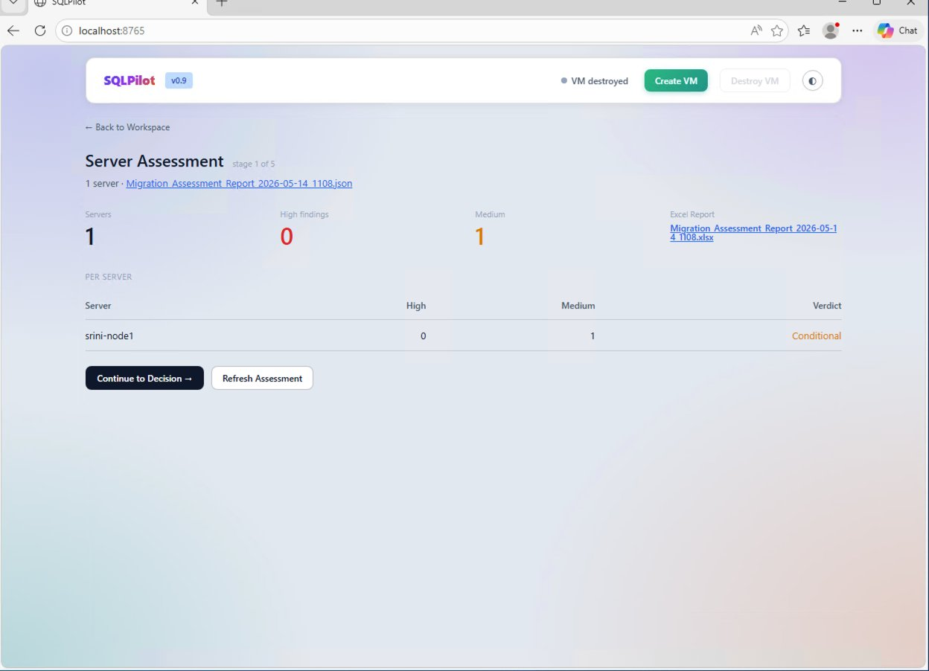
STAGE 1 · ASSESSMENT
Walk the estate. Find the migration blockers.
AGENT
Invokes Phase 1 assessment wrapper · multi-server via CMS group or single
Parses findings into structured JSON · summarizes counts by severity
Hands a per-server verdict to the Decision stage
DBA
Approves the assessment before the agent proceeds to target selection.
SQLPilot v0.9 · Demo Preview
7 / 16

Slide 8
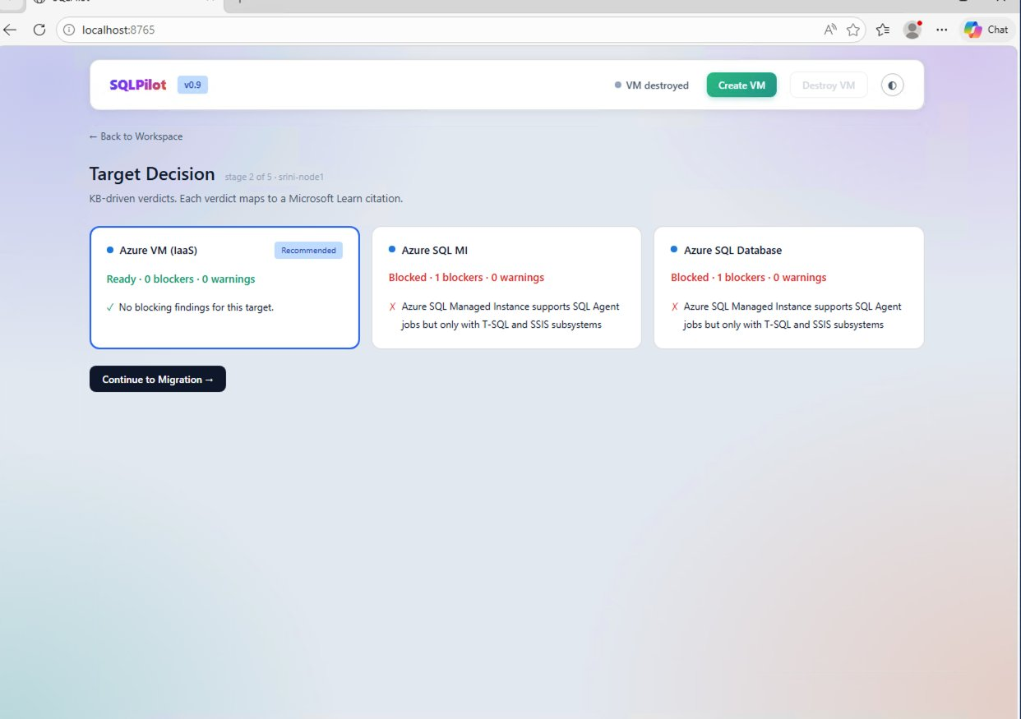

STAGE 2 · DECISION
Pick a target. Cite Microsoft Learn for every verdict.
AGENT
Maps each finding to a knowledge-base topic (kb.json)
Aggregates verdicts across Azure VM · Managed Instance · SQL Database
Recommends a target and shows the Microsoft Learn citation behind each rule
DBA
Reviews the recommended target. Overrides if needed before authorizing migration.
SQLPilot v0.9 · Demo Preview
8 / 16

Slide 9

STAGE 3 · MIGRATION
Stand up an equivalent server in Azure.
AGENT
Terraform apply · 12 resources · ~7 min · IP returned to the UI
BACKUP TO URL → RESTORE FROM URL · streams progress to the activity feed
12
6:54
0
DBCC CHECKDB on every user database · page-level integrity verified
AZURE RESOURCES
APPLY TIME · M:SS
DBCC ERRORS
DBA
Authorizes the live deploy at the gate. Watches the activity feed for anomalies.
SQLPilot v0.9 · Demo Preview
9 / 16

Slide 10
STAGE 3 · MIGRATION
Eight sub-steps. Three real today. Five Phase 3.
We're honest about what's wired up. Real sub-steps run live against Azure today; Phase 3 sub-steps are specified and visible in the UI with a deferred badge.
3.1
Provision target VM (terraform apply, 12 resources)
Real
3.2
Restore user databases (BACKUP TO URL → RESTORE FROM URL)
Real
3.3
Migrate SQL logins (SID-preserving via dbatools)
Phase 3
3.4
Migrate SQL Agent jobs (schedules + alerts + operators)
Phase 3
3.5
Migrate SSIS packages + SSISDB catalog
Phase 3
3.6
Migrate linked servers · sp_configure · credentials
Phase 3
3.7
Configure Azure Backup vault (daily + 15-min log)
Phase 3
3.8
Validate (DBCC CHECKDB on all user databases)
Real
SQLPilot v0.9 · Demo Preview
10 / 16

Slide 11
STAGE 4 · HANDOFF
Package the handoff for the application team.
AGENT
Generates the new connection string · format examples · validation queries
Calls out required app-side changes (encryption, port, TLS)
1
0
✓
Includes integrity check results and a sign-off block for audit
DOCUMENT
MANUAL EDITS
DBA SIGNED
DBA
Reviews the document, signs off, copies as email to send to the app team.
SQLPilot v0.9 · Demo Preview
11 / 16

Slide 12

STAGE 5 · DAY TO DAY
Day-to-Day Operations — Phase 3 roadmap.
AGENT
dbatools daily health checks · backup status · wait stats
Ola Hallengren maintenance · index · integrity · backup
v1.0
9+
First Responder Kit (sp_Blitz family) · scheduled runs
Drift detection · anomaly detection on key metrics
TARGET RELEASE
PLANNED TOOLS
DBA
Receives the daily DBA report; intervenes on flagged anomalies only.
SQLPilot v0.9 · Demo Preview
12 / 16

Slide 13
AUDIT TRAIL
Every model decision is logged. Replayable.
The model chose every tool call you see below. After the demo the DBA can replay the entire run — what the model decided, what it called, what came back. The decision log is the answer to "why did the AI do that?".
11:08:14 run_phase1_assessment server=Node5 1 server · 1 high · 17 medium
11:08:42 consult_kb topic=xp_cmdshell blocker · MS Learn Q&A · ref MI/SQLDB
11:08:51 consult_kb topic=clr_strict warning · MS Learn · ref MI
11:08:58 decide_target candidates=VM,MI,SQLDB → Azure VM (IaaS) · Conditional
11:11:12 apply_terraform action=apply 12 resources · 6m54s · 4.246.61.164
11:19:22 restore_database db=SQLPilotDemo 2016 rows · 10s · ok
11:19:35 validate_database scope=all 1 DB · 0 errors · passed
11:20:09 generate_handoff target=app team document generated · ready to send
SQLPilot v0.9 · Demo Preview
13 / 16

Slide 14
COST
Per-run Azure spend is tiny.
Standard_D2as_v7 in westus2. SQL 2022 Developer image. Resources destroyed at end of run — cost meter only ticks while live.
$0.10
~7 min
~4 min
PER HOUR · WHILE RUNNING
FULL DEPLOY
FULL TEARDOWN
Typical demo run costs less than a dollar — even if you leave it running for an hour.
SQLPilot v0.9 · Demo Preview
14 / 16

Slide 15
WHAT'S NEXT
From v0.9 demo to v1.0 production.
Phase 3 — finish Migration
Phase 3 — Day-to-Day Ops
v1.0 platform
SQL logins (SID-preserving)
dbatools daily health checks
Multi-server assessment UX
SQL Agent jobs
Ola Hallengren maintenance
Config-driven pipelines
SSIS packages + SSISDB
First Responder Kit (sp_Blitz family)
Cost estimation per target
Linked servers + sp_configure
Daily DBA report email
Email/Slack/Teams handoff
Azure Backup vault auto-config
Drift / anomaly detection
AWS / GCP target options
SQLPilot v0.9 · Demo Preview
15 / 16

Slide 16
Questions?
SQLPilot v0.9
LLM-driven SQL Server migration · DBA-as-pilot

