Slide 1

SMART INDIA HACKATHON 2026
Problem Statement ID – SIH26133
Problem Statement Title- Explainable AI for Diabetic Retinopathy Screening in Rural India
Theme- MedTech / BioTech / HealthTech
PS Category- Software
Team ID- 174884
Team Name- Vital X

Slide 2
NetraXAI
Vital X
Proposed Solution
The problem
Frontline screening needs usable retinal images, clear severity assessment, and a practical route to specialist review.
Our solution
NetraXAI is designed to analyse retinal fundus images, predict DR severity, and present visual explanations for a doctor’s review.
Core features
  Severity prediction: Classify images into five DR grades.
  Image quality check: Flag unsuitable images for recapture.
  Explainability: Highlight regions influencing the prediction.
  Screening report: Combine the result and visual evidence for review.
PROTOTYPE LINK: https://ushakiran45.github.io/SIH26038-DR-Screening/
WORKING: Working video

Slide 3
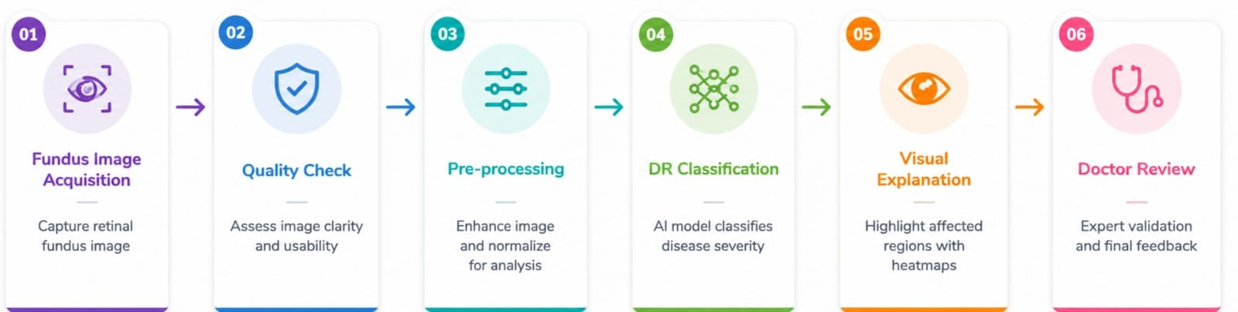
TECHNICAL APPROACH
Vital X
Current implementation
PyTorch model checkpoint available.
Five severity categories: No DR, Mild, Moderate, Severe, Proliferative.
Reported evaluation results available for 550 images.
Next integration steps
Add image quality assessment and Grad-CAM visualisation.
Build a screening interface and downloadable report.
Evaluate MATLAB and Simulink workflow simulation

Slide 4
FEASIBILITY AND VIABILITY
Vital X
Technical feasibility
Existing five-class DR model with reported 84.36% accuracy and 0.8949 quadratic weighted kappa on 550 images.
Model checkpoint available for integration into a screening interface.
Next steps: image quality checks, visual explanations, and report generation.
Practical viability
Designed to support screening at primary health centres with access to a fundus camera.
Proposed workflow keeps doctors involved in reviewing results and referral decisions.
Deployment requires testing on local images and intended hardware.
KEY CHALLENGES
Severe-class recall
Current recall is 31%, requiring further error analysis and model improvement.
Image quality
Blur, illumination and capture quality may affect screening reliability.
Camera & location variation
Performance needs validation across different cameras and local datasets.

Slide 5
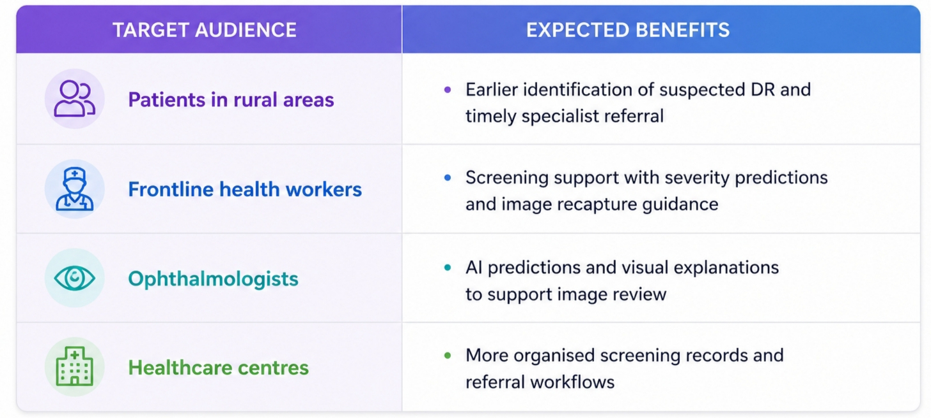
IMPACT AND BENEFITS
Vital X
Expected impact: Improve access to DR screening and support timely care in underserved areas.

Slide 6
RESEARCH AND REFERENCES
Vital X
Wilkinson et al. (2003) — International Clinical DR Severity Scale
Clinical basis for the five severity categories.
Research paper
Selvaraju et al. (2017) — Grad-CAM
Foundation for the proposed visual explanations of model predictions.
Research paper
Porwal et al. (2018) — IDRiD Dataset
Retinal images with annotations for DR grading and lesion segmentation; a resource for planned validation.
Dataset paper
APTOS (2019) — Blindness Detection Dataset
Public retinal-image dataset for DR classification research.
Dataset

