Slide 1

type:- Data Analysis & Visualization with AI
Your Name :- Sonkusare DEEP
Date :-25-04-2026
Company name :- AI CORE SYSTEM

Slide 2
1: Introduction:- What is AI in Data Analysis? AI = Systems that learn patterns from data Used to: Analyze large datasets Predict trends Automate insights Traditional vs AI: Manual analysis Automated intelligent analysis ✅

Slide 3
2: What is Data Analysis? Process of extracting useful information from data Types: Descriptive → What happened? Diagnostic → Why happened? Predictive → What will happen? Prescriptive → What should we do?

Slide 4
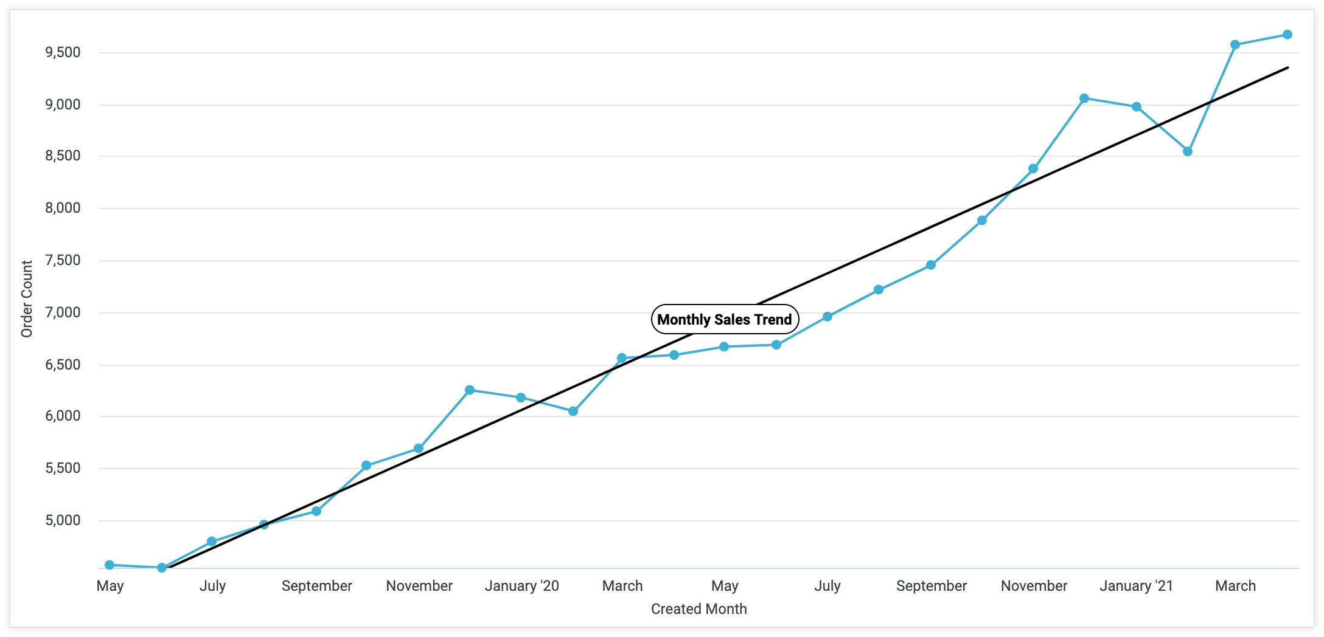
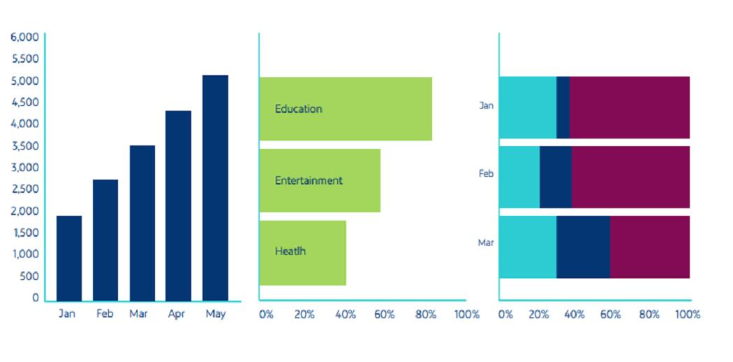
3: Data Visualization Presenting data in visual format: Charts Graphs Dashboards Why important? Easy understanding Better decision-making Pattern recognition

Slide 5
Slide 4: Where AI is Used in Data Analysis? Auto data cleaning Pattern detection Forecasting Anomaly detection Natural Language Queries 👉 Example: “Show sales growth of last 5 years” → AI generates graph instantly

Slide 6
Slide 5: Popular AI Tools for Data Analysis Python (Pandas, NumPy) Power BI + AI features Tableau + AI insights Excel AI tools Google AutoML ChatGPT (for analysis & code)

Slide 7
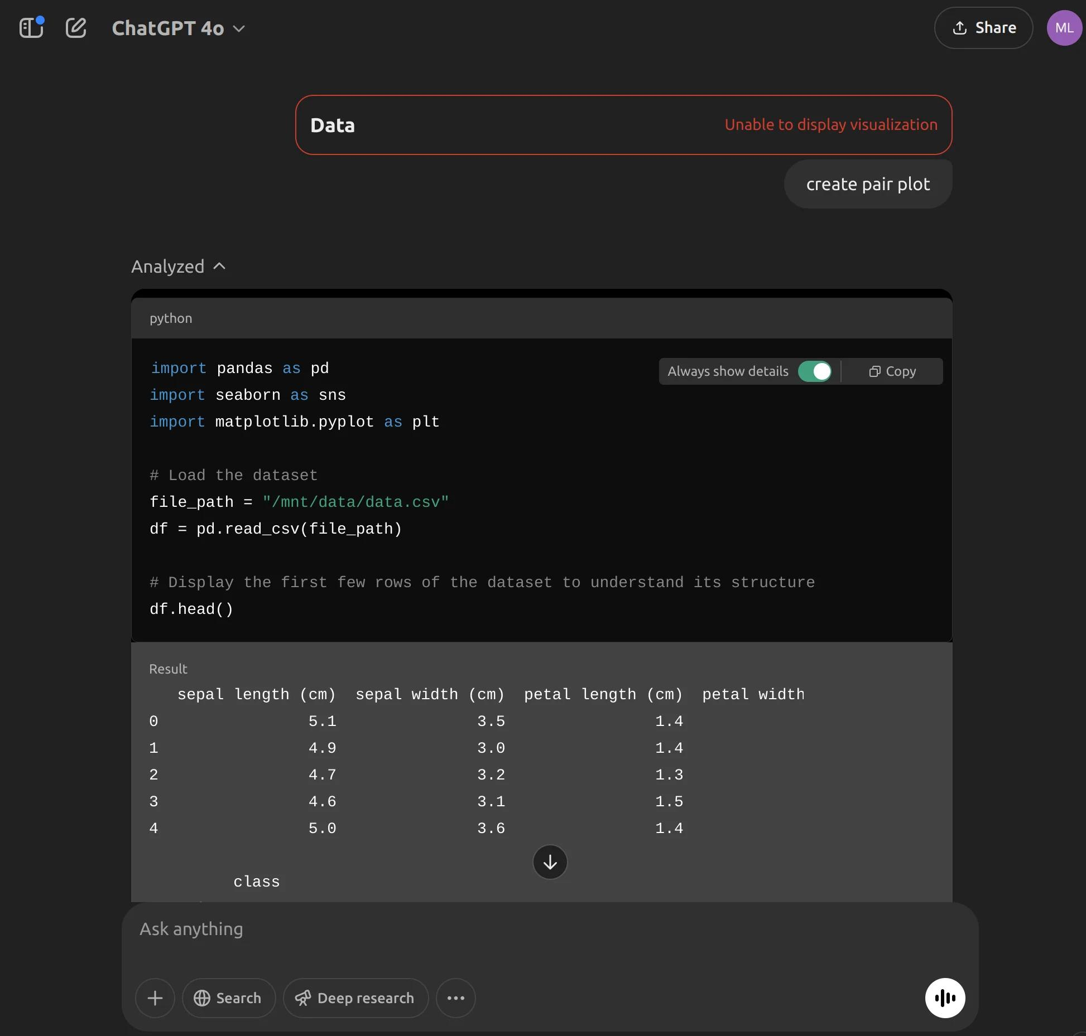
Slide 6: Tool Demonstration (Important for you) Example: Using AI (ChatGPT) Prompt: “Analyze this dataset and create a sales trend graph” Output: Python code generated Graph visualization Insights automatically 👉 You can DEMO: Upload CSV Ask AI → get chart + explanation

Slide 8
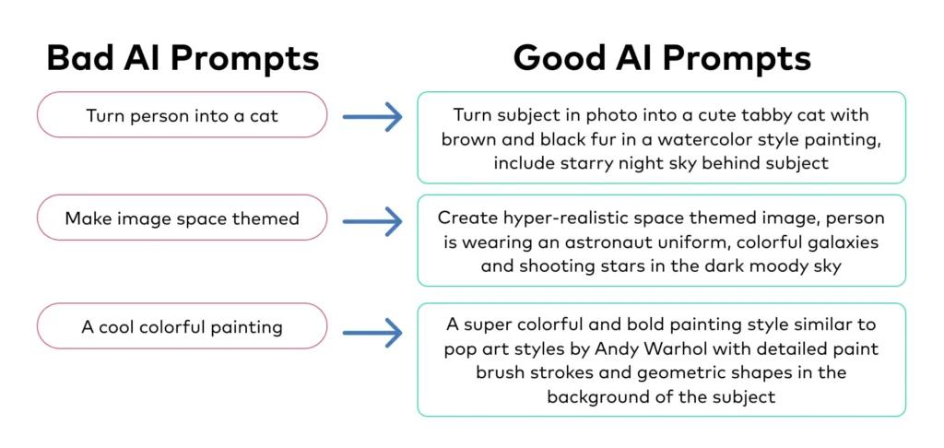
Slide 7: What is Prompt Engineering? 🧠 Definition Designing input (prompt) to get accurate & meaningful AI output AI works better with clear and structured instructions Quality of output depends on quality of prompt

Slide 9
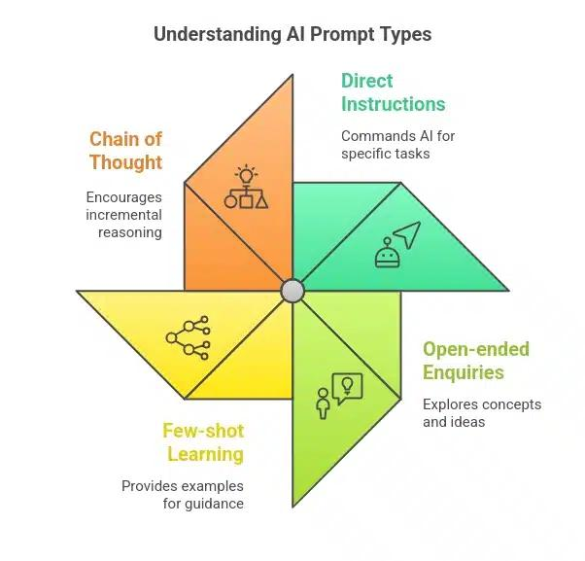
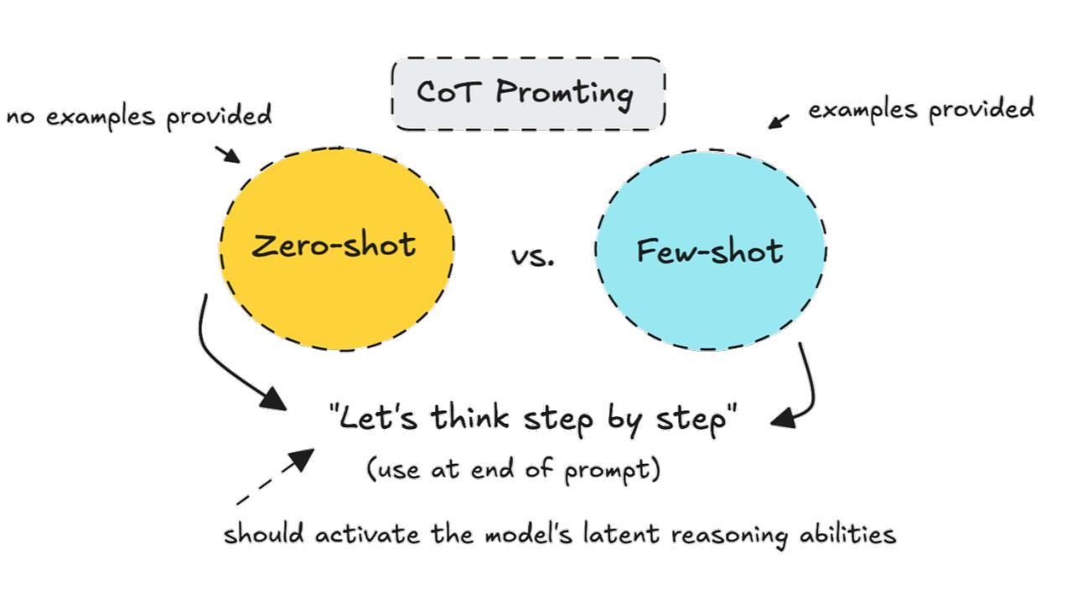
Slide 8: Types of Prompts Zero-shot → No example Few-shot → With examples Chain-of-thought → Step-by-step reasoning Chain-of-Thought Prompting Step-by-step reasoning Best for complex problems Improves accuracy & logic Prompting controls AI behavior More context = better results Used in real AI systems & chatbots Important skill for data scientists

Slide 10
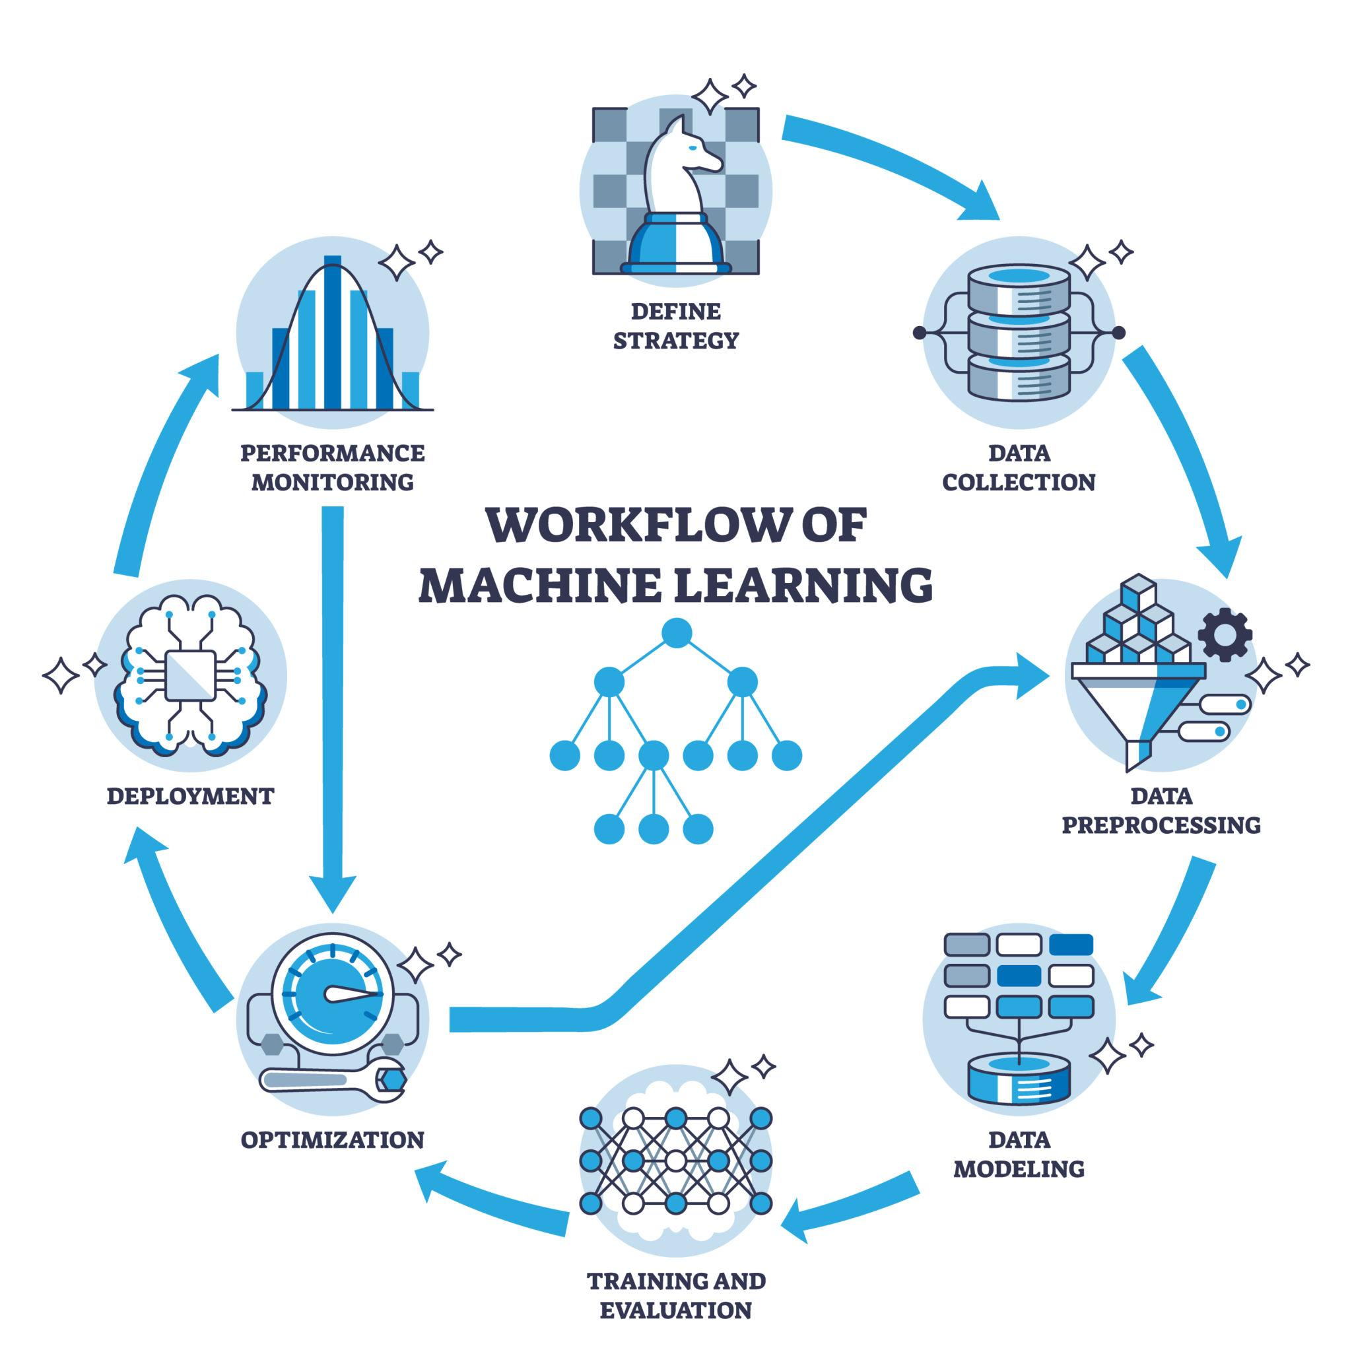
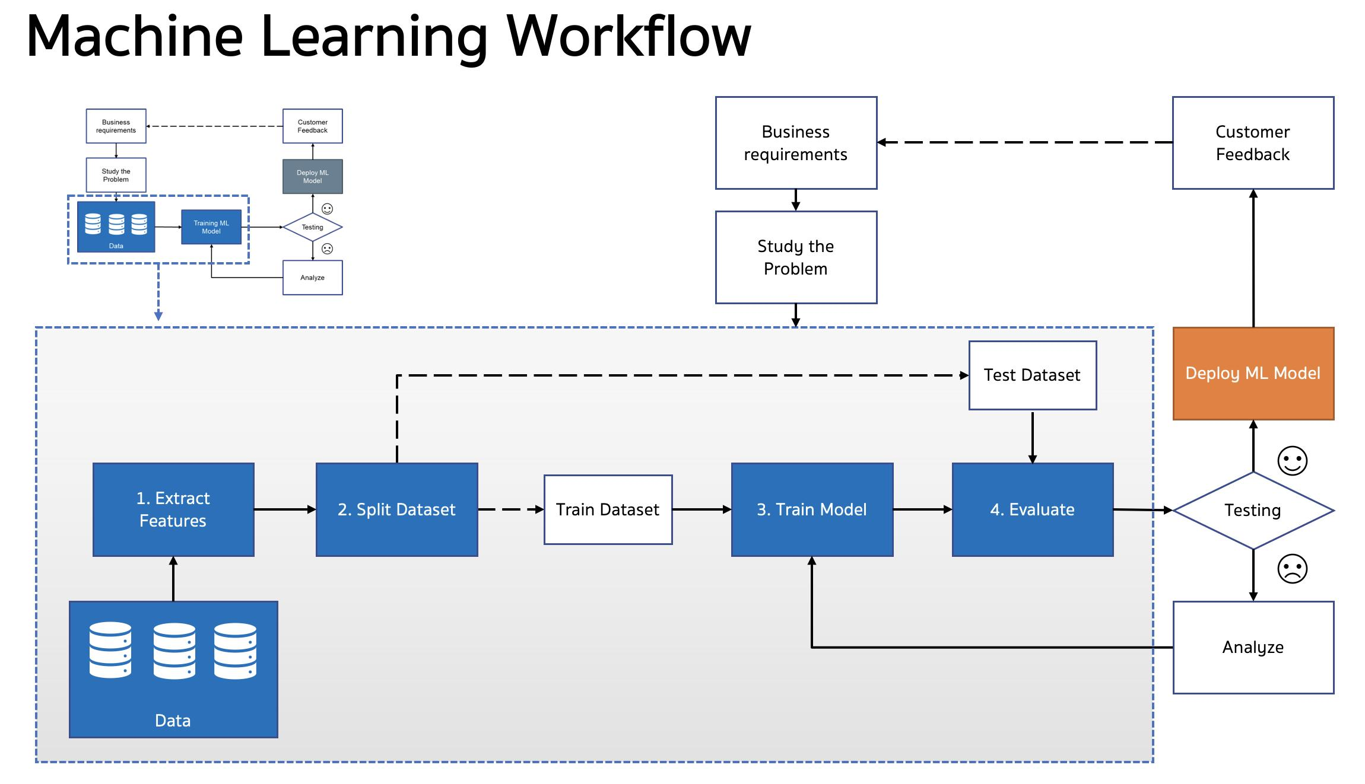
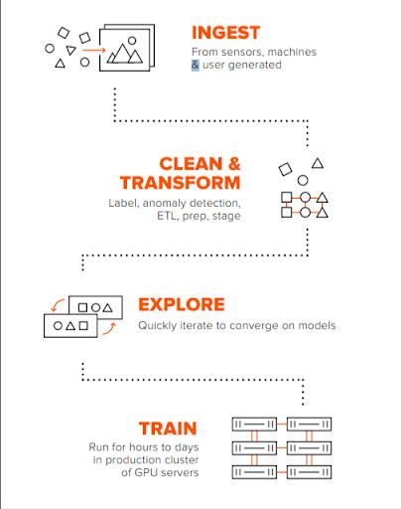
Slide 10: How AI Actually Works? AI Workflow: Data Input Processing Model Training Prediction Output

Slide 11
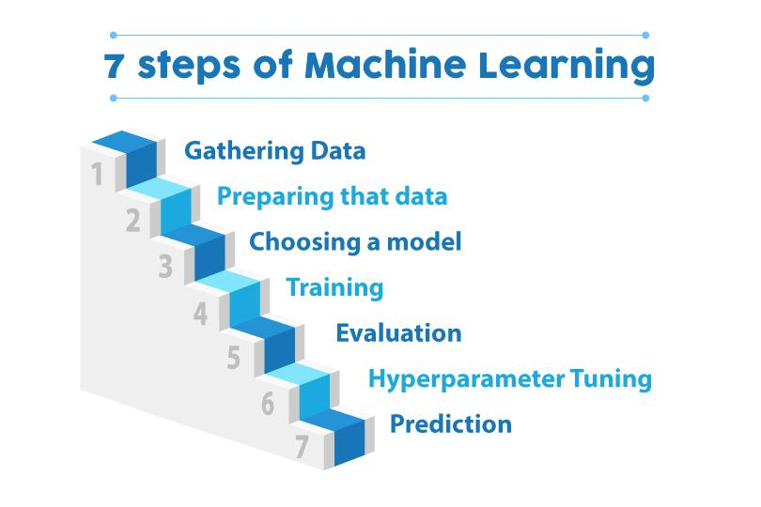
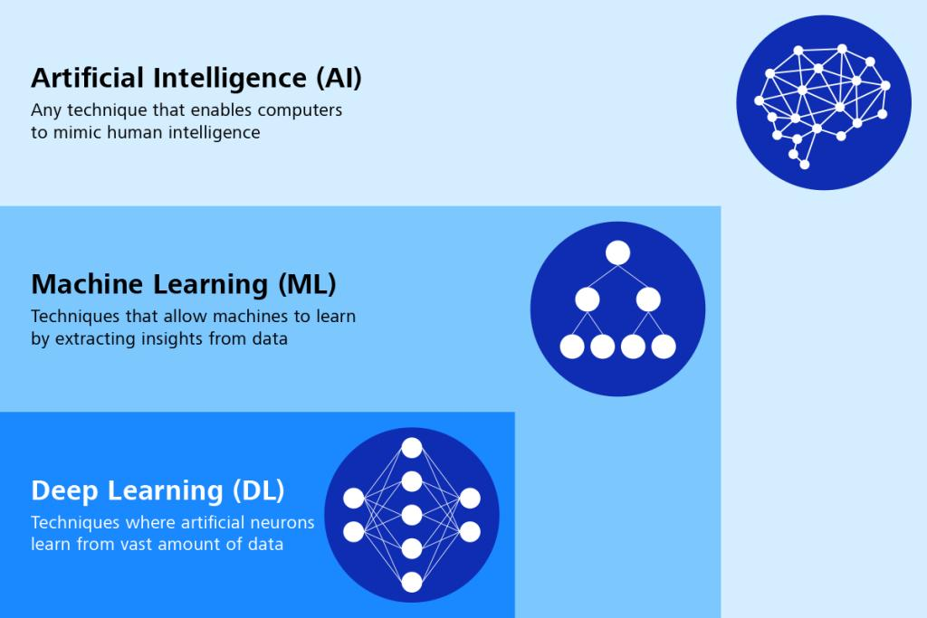
Slide 11: Machine Learning Basics AI ⟶ ML ⟶ Deep Learning Types: Supervised Learning Unsupervised Learning Reinforcement Learning Deep Learning mimics human brain using neural networks”
Machines learn from data without explicit
programming
Uses algorithms to identify patterns
Improves performance over time
Machine Learning turns data into
intelligent decisions

Slide 12
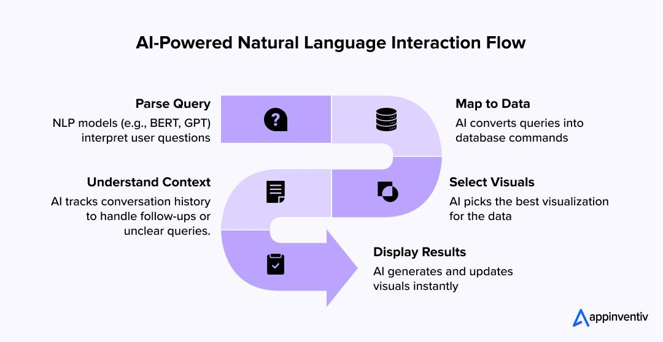
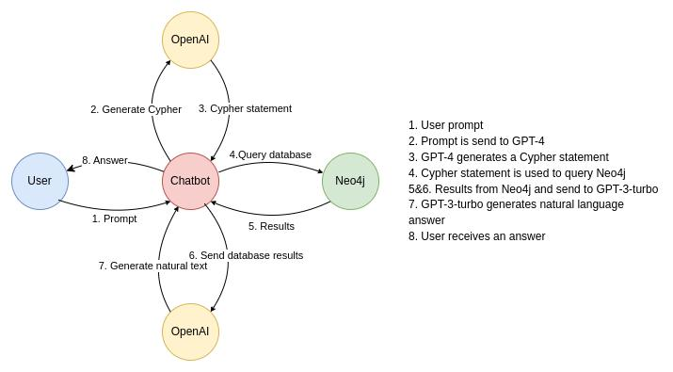
Slide 12: AI in Visualization Auto chart generation Smart dashboards Natural language → charts Example: 👉 “Show revenue by region” → AI builds graph
AI selects best chart type automatically
Supports interactive dashboards
Can handle large datasets
Used in business intelligence tools
Reduces human effort & errors
AI makes data visualization faster
smarter, and interactive

Slide 13
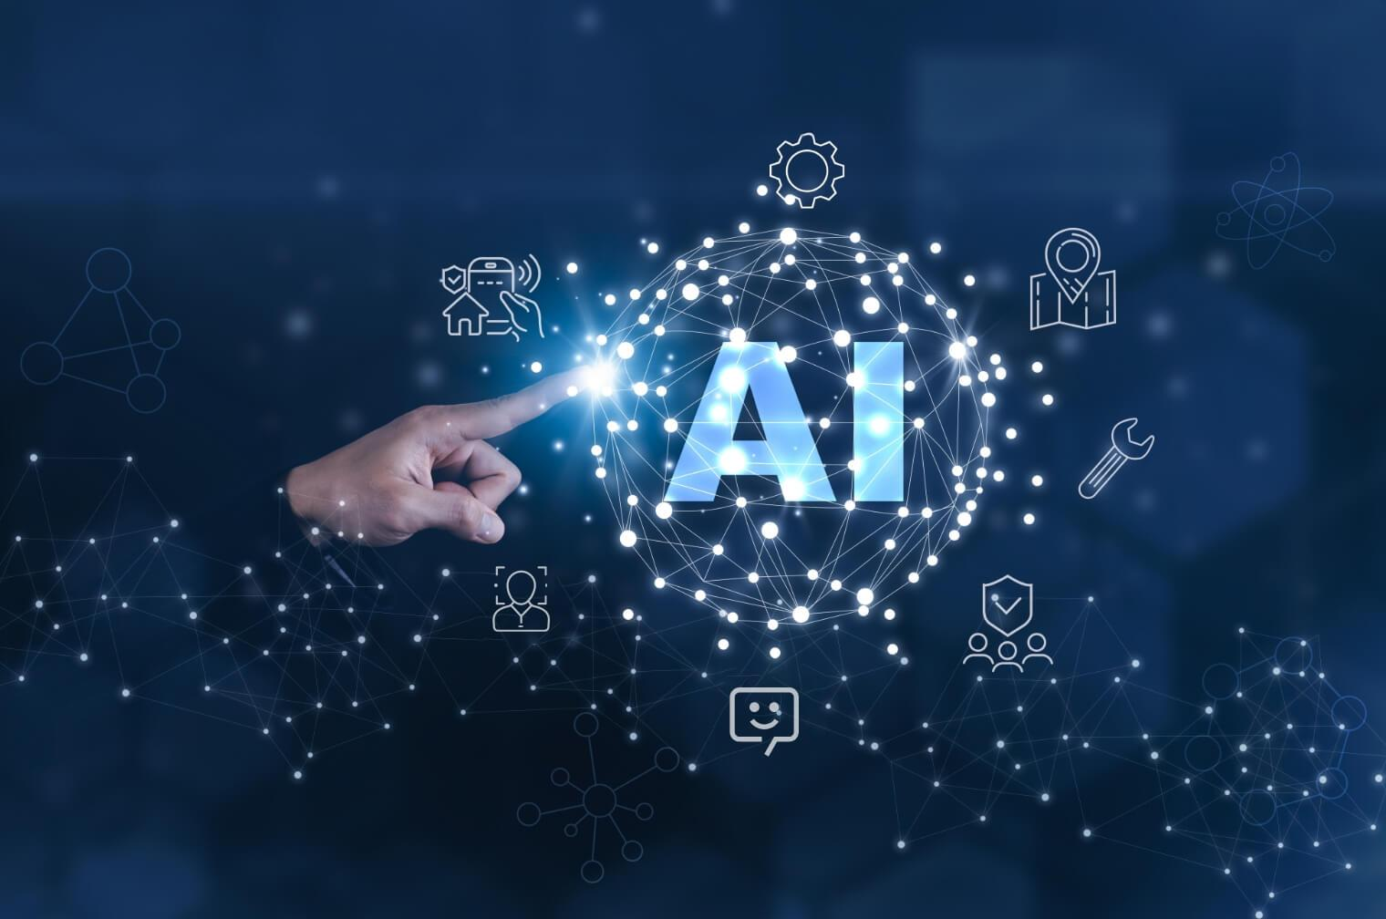
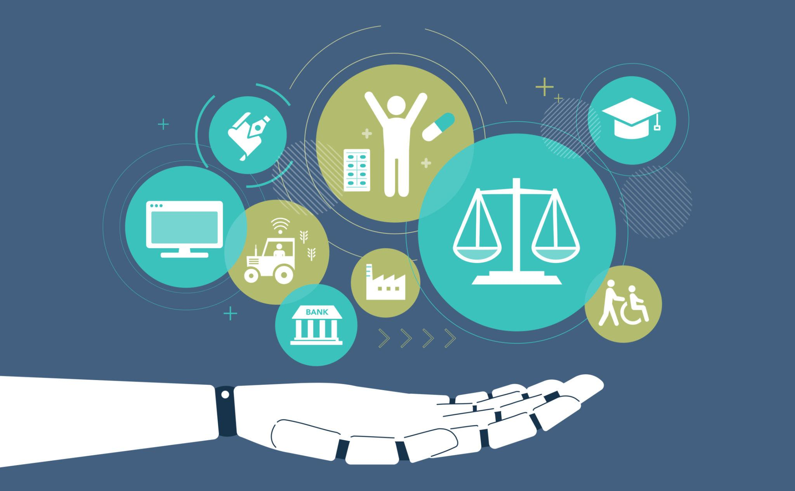
🚀 Slide 13: Real-World Use Cases Business Analytics Healthcare predictions Stock market analysis Customer behavior tracking Fraud detection 🏥 Healthcare Predictions Disease detection (early diagnosis) Patient data analysis AI-based medical imaging
🚗 Self-driving cars (AI decision making)
🎤 Voice assistants (Siri, Alexa)
🧠 Chatbots & virtual assistants
📦 Supply chain optimization
🎯 Predictive maintenance (machines fail hone se pehle detect)
🛒 E-commerce dynamic pricing

Slide 14
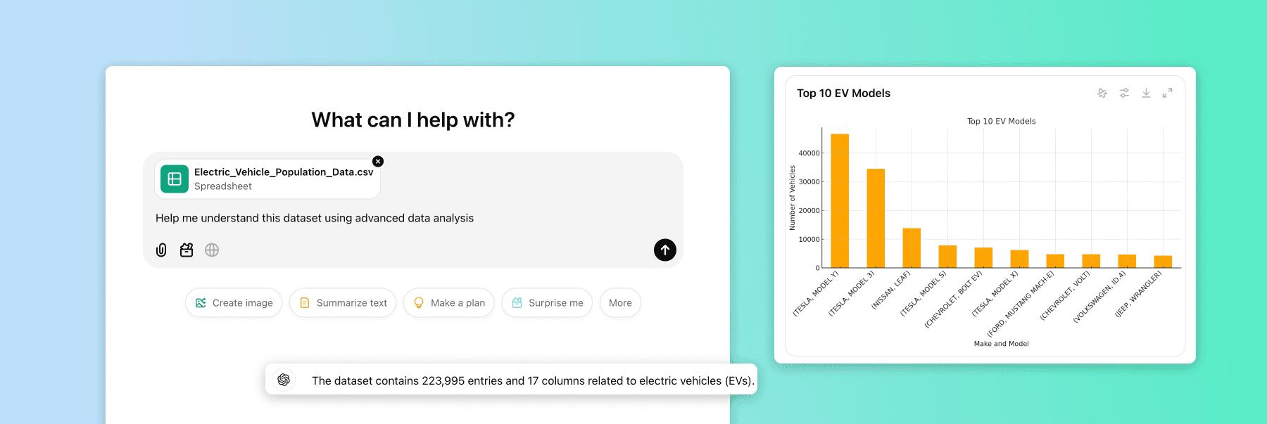
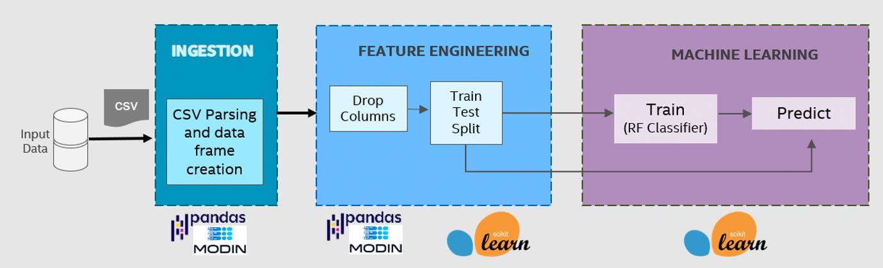
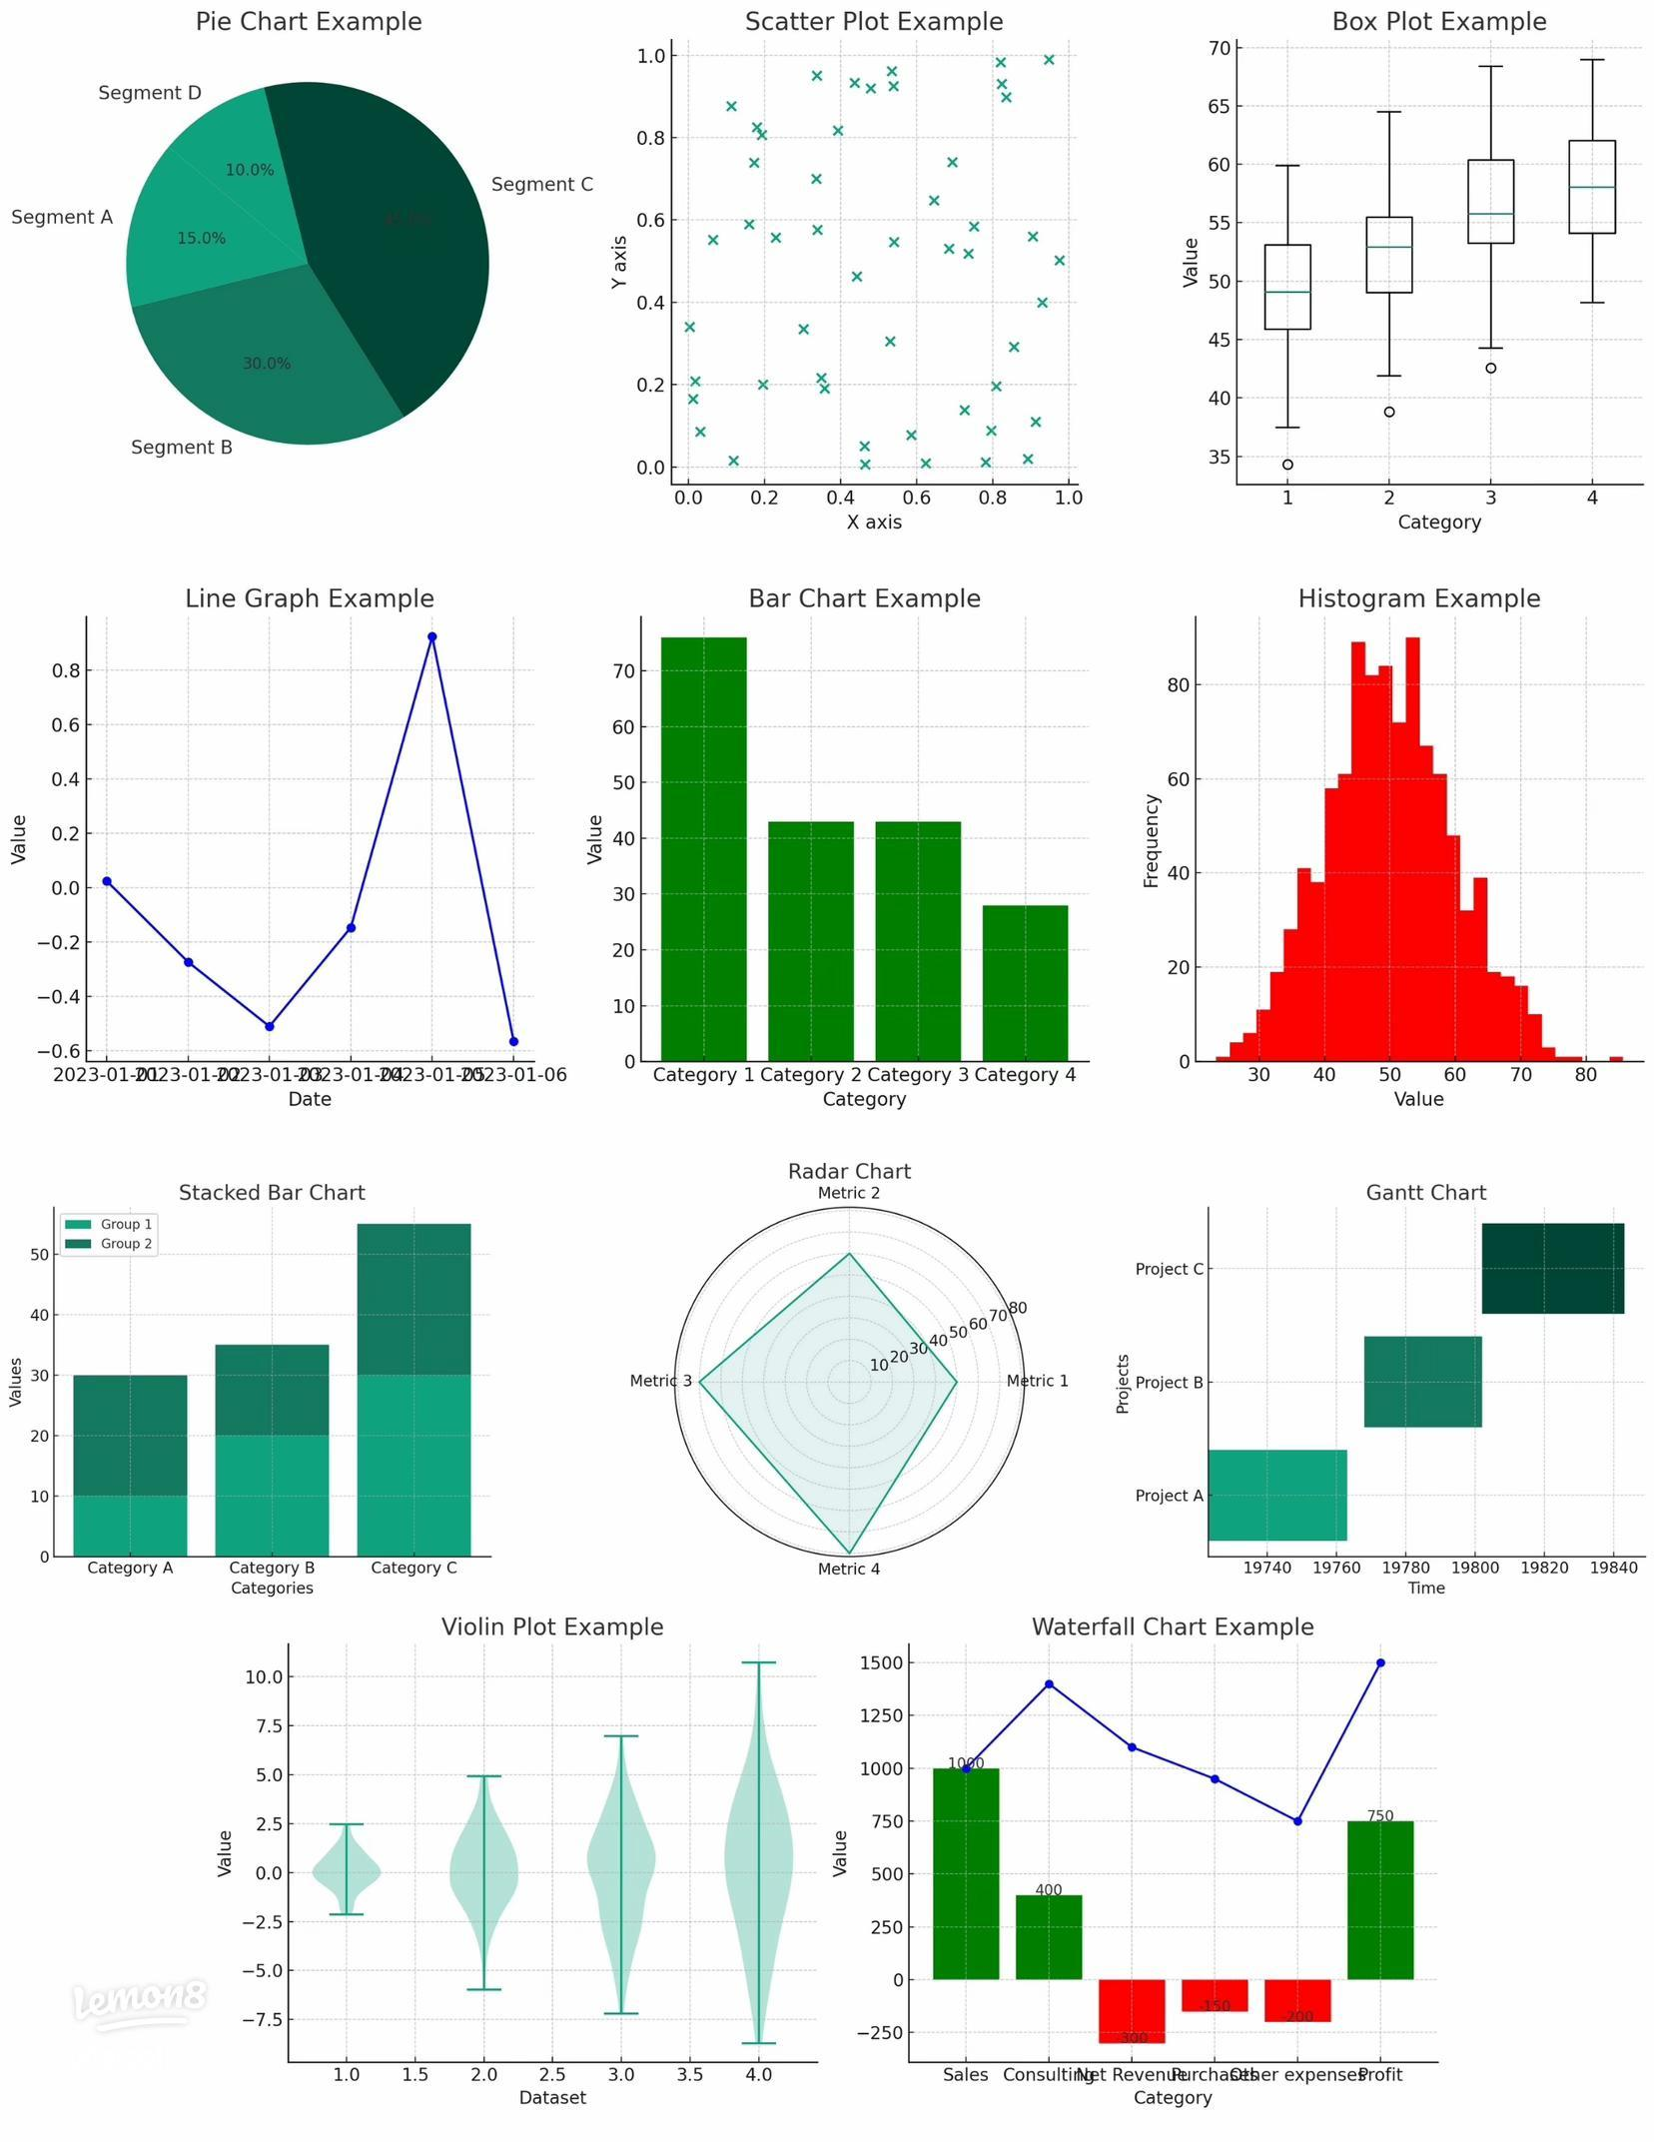
🚀 Slide 14: Live Demo 🎬 Objective of Demo Show how AI works in real-time Convert data → insights → visualization Demonstrate power of prompt engineering 🧪 Demo 1: Data → Visualization 👉 Steps: Upload CSV dataset Ask AI: “Create visualization and provide insights” 👉 Output: Graph generated Trends highlighted Summary insights

Slide 15
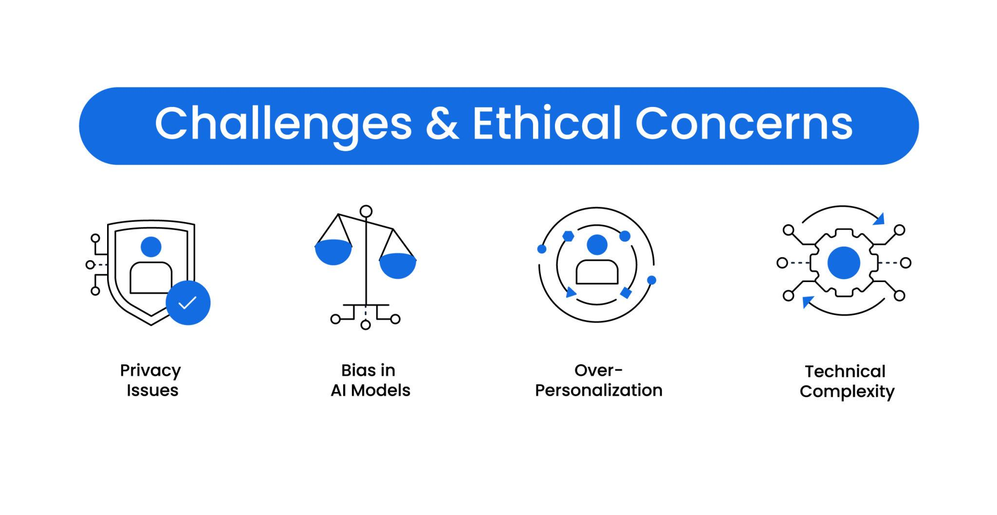
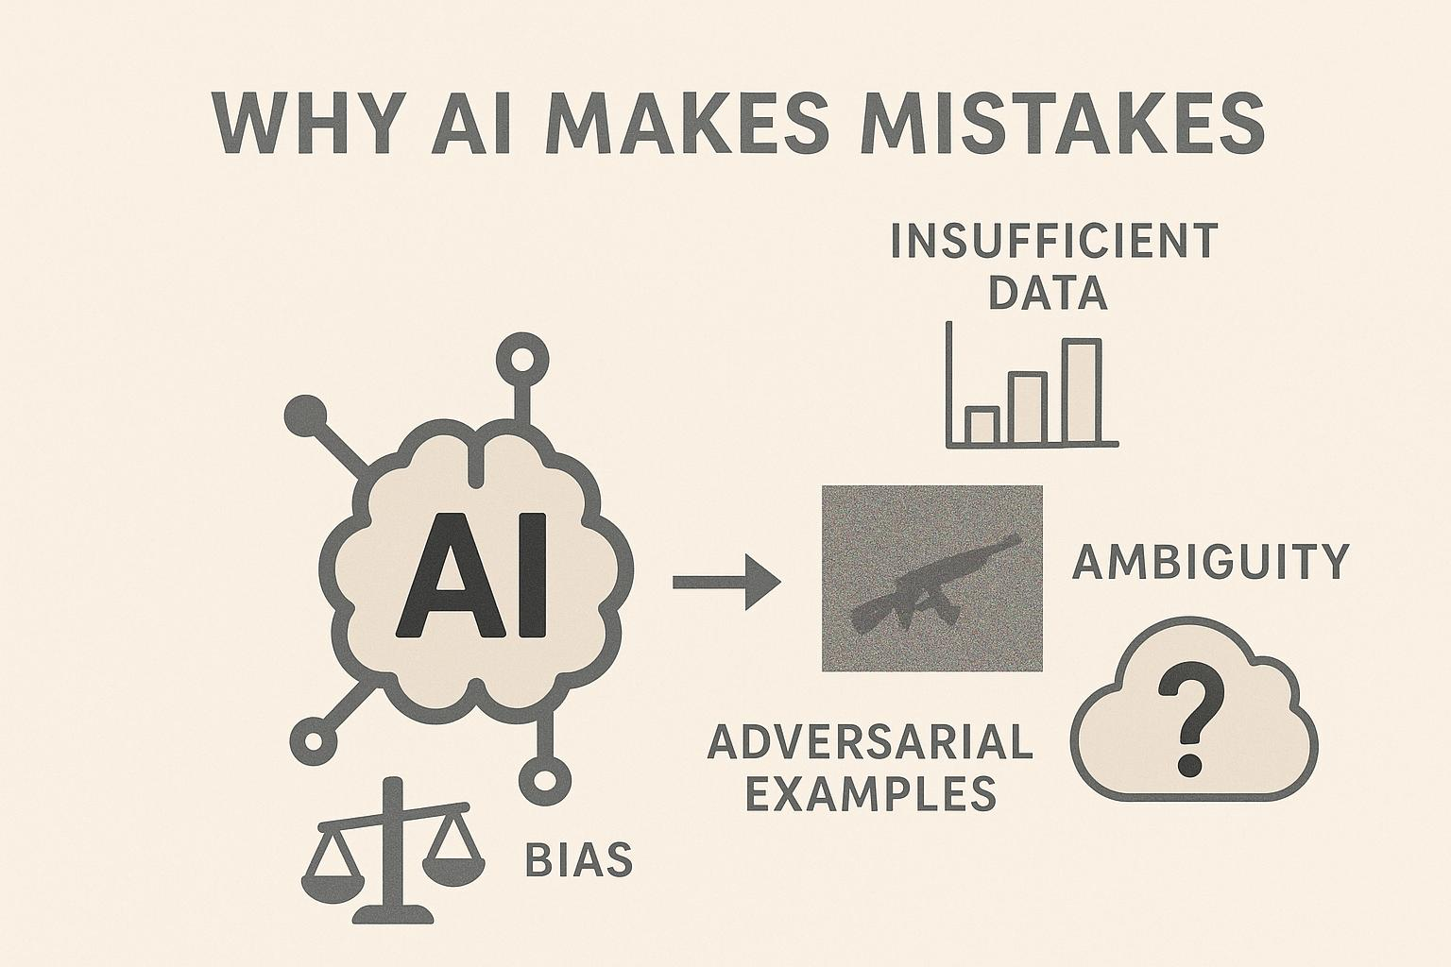
⚠️ Slide 15: Limitations of AI 🧠 Why AI is Not Perfect AI powerful hai, but not 100% reliable Human supervision is still required 🚫 Key Limitations 📊 Data Bias AI depends on training data Biased data → biased result
🔒 Privacy & data security issues
💸 High computational cost
🧩 Lack of transparency (black-box models)
📉 Overfitting / underfitting problems
🌍 Ethical concerns (misuse of AI)
🔄 Requires continuous training & updates

Slide 16
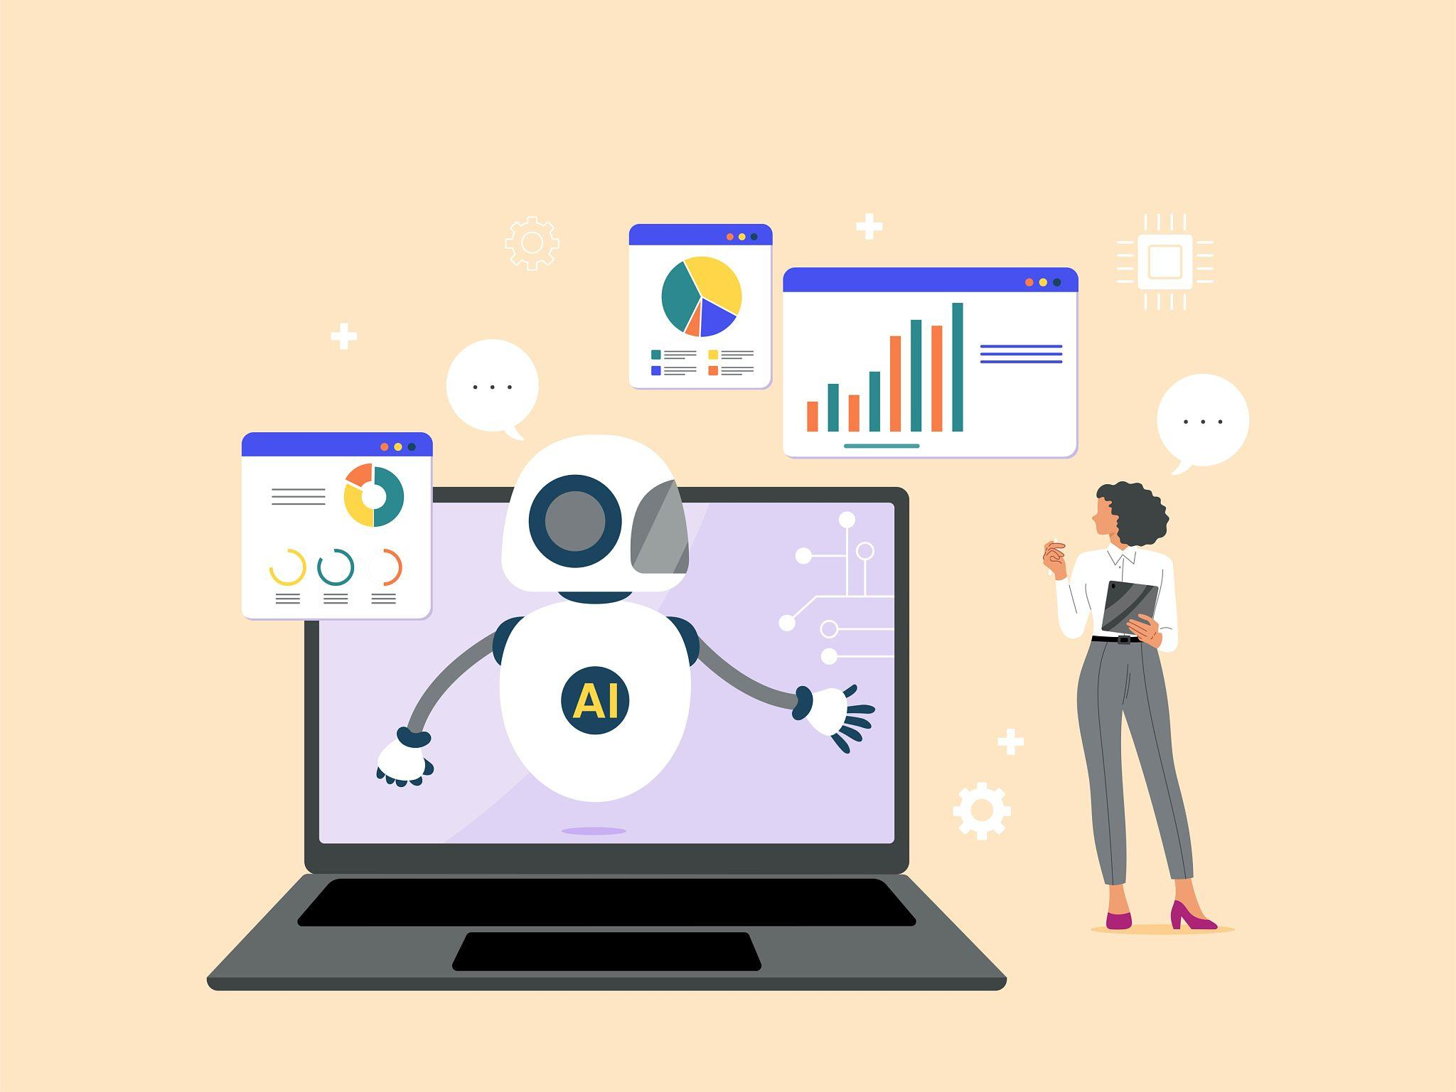
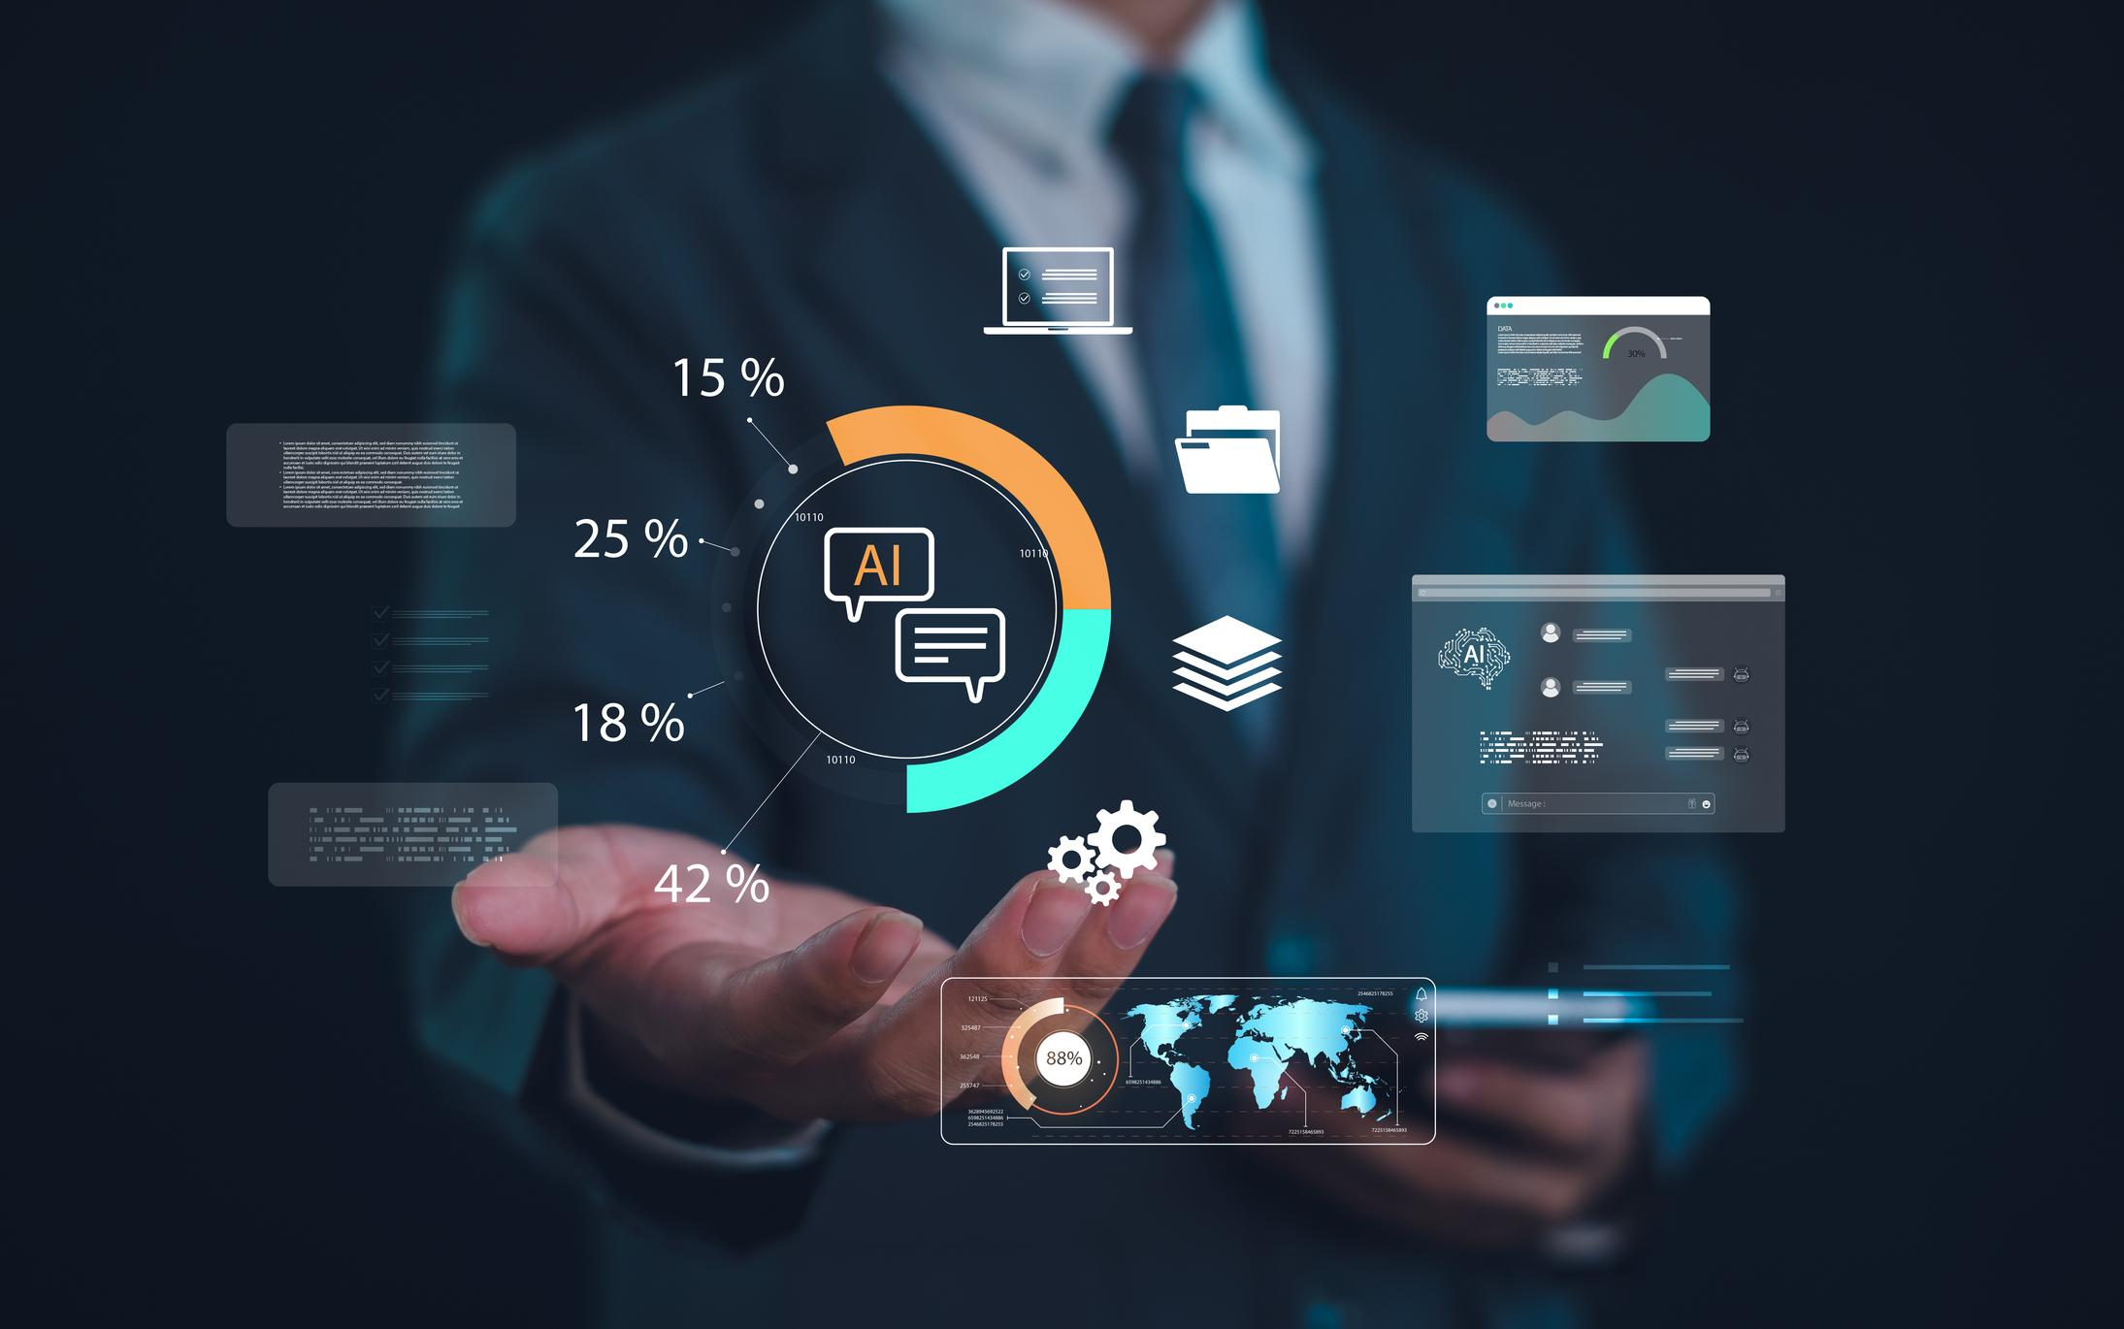
🔐 Slide 16: Future of AI in Data Analysis 🧠 Future Vision AI will make data analysis fully automated Human effort will reduce, speed will increase Decisions will be faster & smarter 🚀 Key Trends 🤖 Fully automated analytics 📊 AI-powered dashboards 🎤 Voice-based analytics (ask → get insights) ⚡ Real-time decision systems 🔄 Continuous learning systems (self-improving AI) .Future of data analysis is AI-driven and autonomous

Slide 17
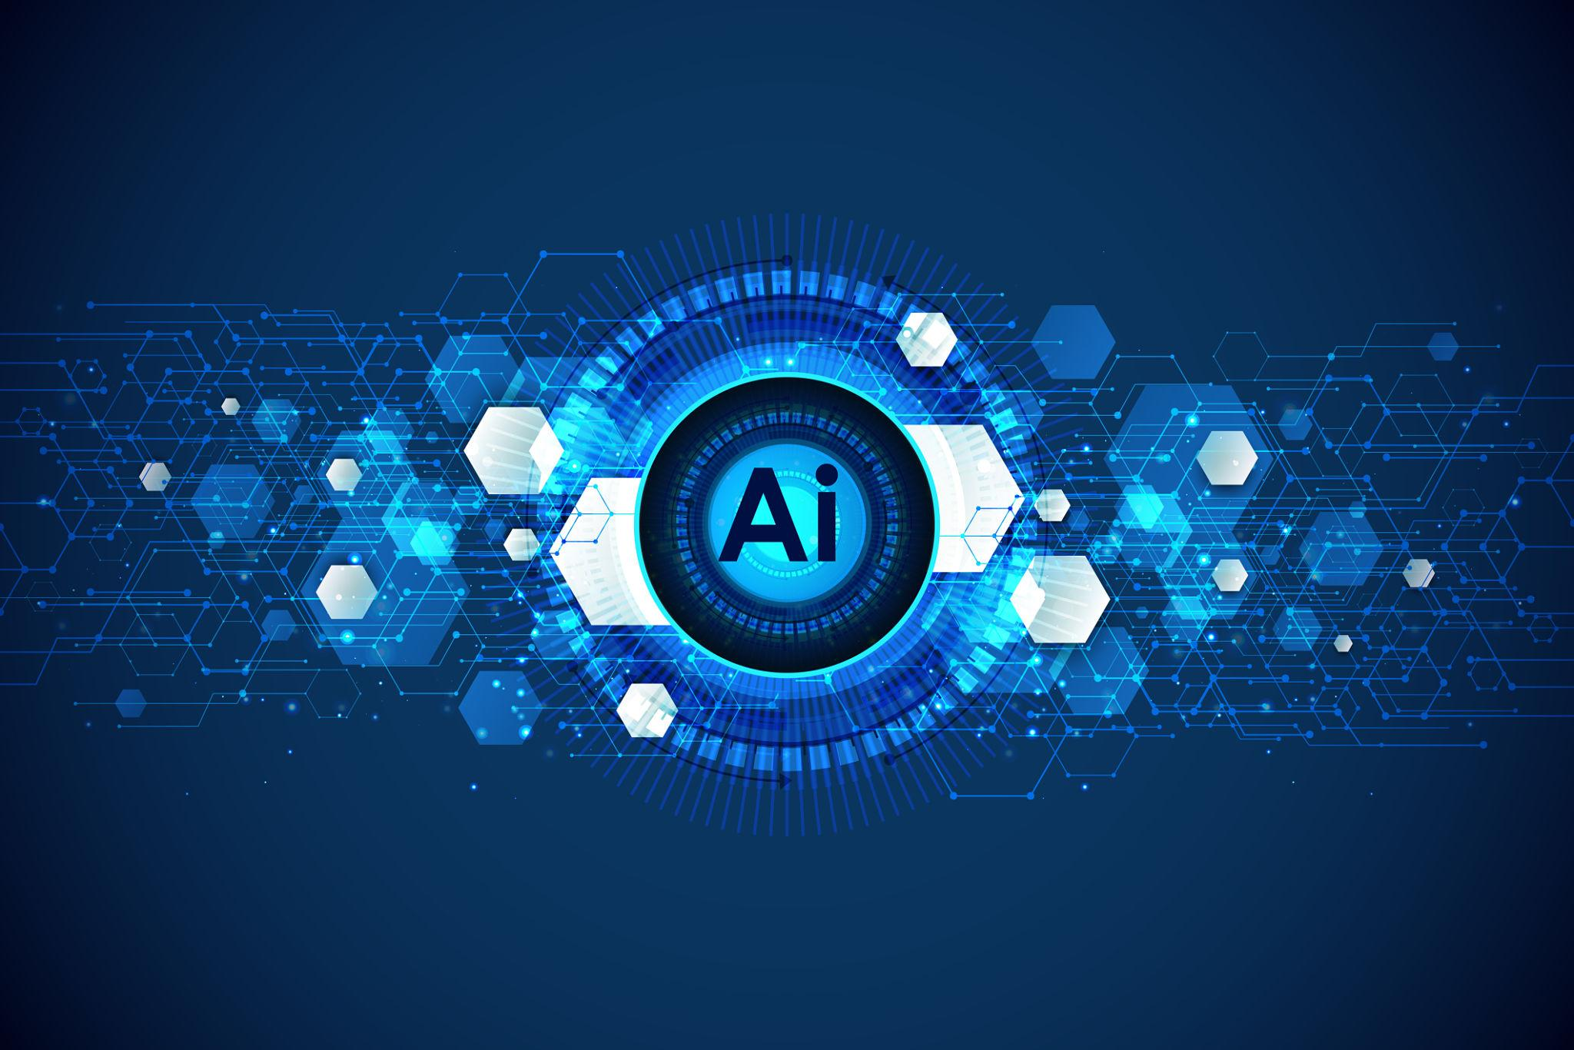
🏁 Slide 17: Conclusion 🎯 Key Takeaways 🤖 AI makes data analysis faster, smarter, and scalable 🧠 Prompt engineering is a critical skill for controlling AI output 📊 Data visualization transforms data into clear insights ⚡ AI enables real-time, data-driven decision making 👉 “Data is the new oil, and AI is the engine that drives it” 👉 “The future belongs to those who can understand and use AI effectively” 👉 “AI is not just a tool — it is the future of intelligent decision making”

