Slide 1

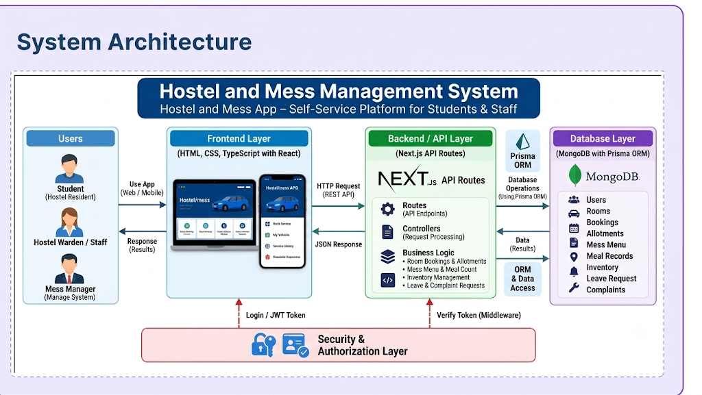
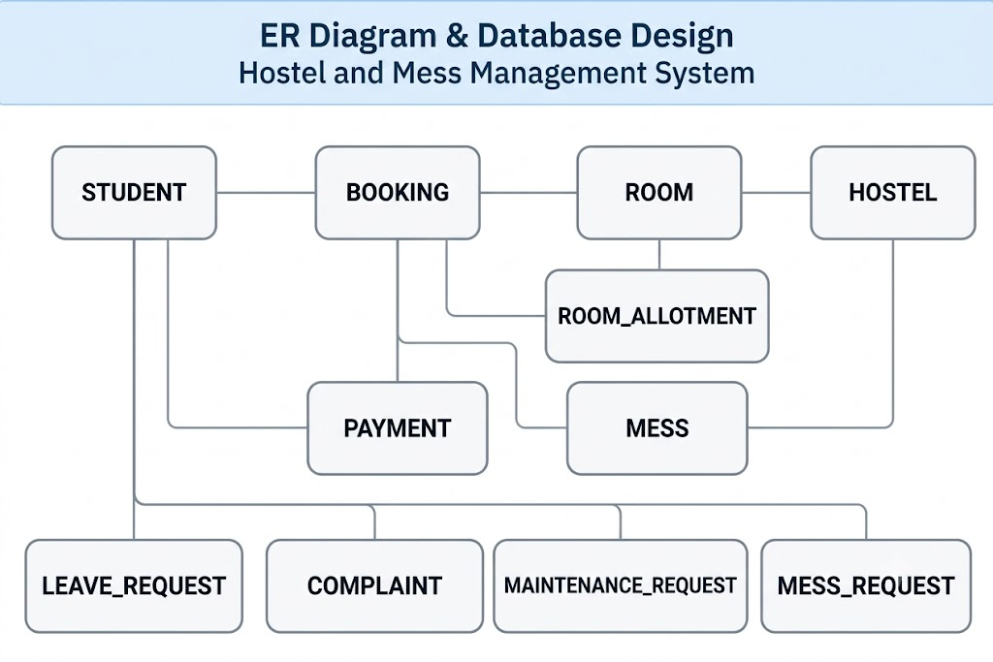
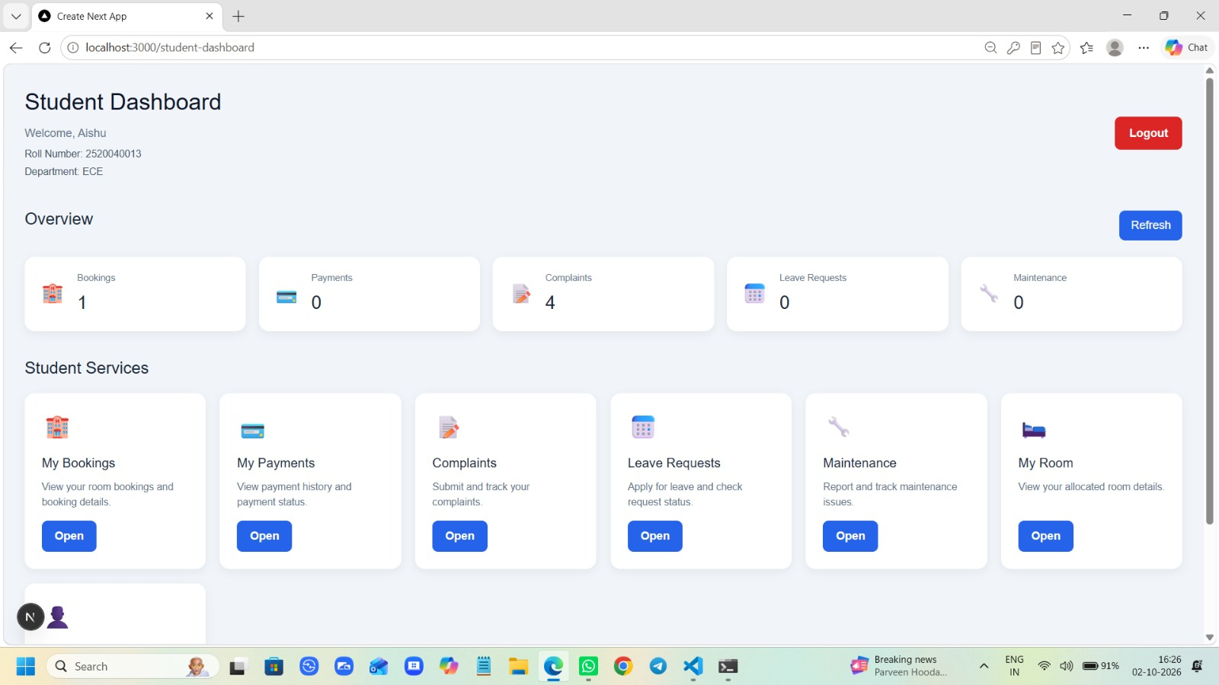
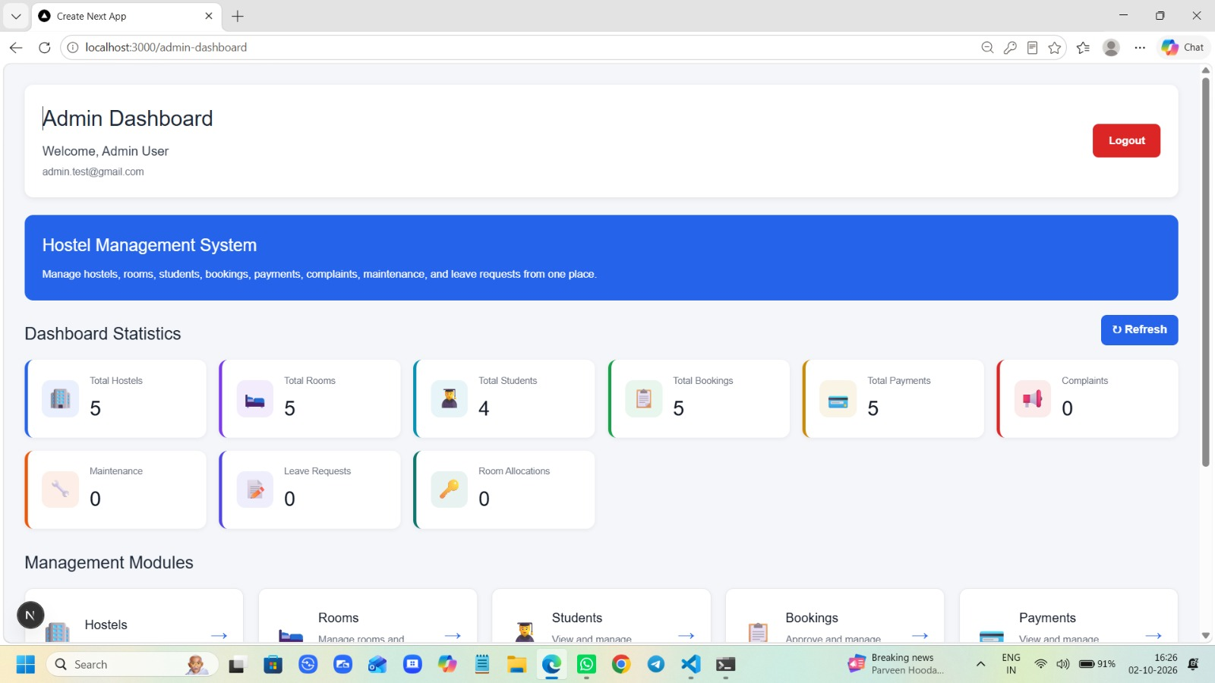

HOSTEL AND MESS MANAGEMENT
Team ID: 02 | Section: s-11 | K . Usharani Roll – 2520090049 | K . Mrudula – 2520090073 | B . Navya - 2520090189 |
Guide: Dr. M . Gayatri
Database Systems Engineering and Distributed Backend Development (25CS1302E) | KLH Bachupally Campus, CS & IT | PBL 2026-27
Abstract
Tools & Technologies
The Hostel Management System is a web app for students and administrators to manage hostel services.
Built with Next.js, React, TypeScript, MongoDB & Prisma.
Outcome: Reduces paperwork and simplifies hostel management.
Front-End: React, Next.js, TypeScript, HTML, CSS
Back-End: Next.js API Routes + REST APIs
Database: MongoDB
Tools: Git & GitHub, VS Code, Prisma ORM, MongoDB, Postman, Draw.io
Problem Statement & Objectives
Problem: Manual hostel processes make room, booking, payment, leave and complaint tracking difficult.
Objective 1: Centralize hostel services.
Objective 2: Provide Student & Admin dashboards.
Objective 3: Digitize hostel requests and records.
Scope: Students, admins, rooms, bookings, payments, leave, complaints & maintenance.
System Architecture
Existing vs Proposed System
Feature | Existing System | Proposed System
Records | Manual | Digital
Room Allocation | Offline | Online
Requests | Separate | Centralized
Tracking | Difficult | Real-time
Gap | Paperwork | Automated system
ER Diagram & Database Design
Feasibility Study
Technical: Next.js, MongoDB, Prisma & REST APIs
Economic: Open-source tools and low cost
Operational: Easy role-based access
Schedule: Semester-based development
Implementation Screenshots
Results & Testing
Conclusion
Future Scope
CRUD operations tested successfully
Role-based access verified
Database validation completed
Student/Admin workflows tested
Centralized hostel management achieved
Reduces paperwork and manual effort
Improves service tracking and accessibility
Mobile application
Online payment integration
Notifications & alerts
Advanced reports
References: [1] Flanagan, D., JavaScript: The Definitive Guide, O’Reilly Media, 2020.
[2] Next.js Documentation, Next.js Documentation, Vercel.
[3] React Documentation, React – A JavaScript Library for Building User Interfaces, Meta.

