Slide 1
The-battle-of-Neighbourhoods
IBM DATA SCIENCE CAPSTONE

Slide 2
Introduction
Toronto is an international center of business, finance, arts, and culture, and is recognized as one of the most multicultural and cosmopolitan cities in the world.
York was renamed and incorporated in 1834, as the city of Toronto.
It was designated as the capital of the province of Ontario in 1867 during Canadian Confederation.

Slide 3
Problem Description
you receive a job offer from a great company on the other side of the city with great career prospects
given the far distance from your current place you unfortunately must move if you decide to accept the offer.
able to determine neighborhoods on the other side of the city that are the same as your current neighborhood, and if not perhaps similar neighborhoods that are at least closer to your new job

Slide 4
Objective
The aim of this report is to study and analyze the neighborhoods of Toronto city and group them into similar clusters and, to analyze those clusters to gather meaningful information.
That information can be used to find out neighborhoods that are same as your current neighborhood or at least similar.

Slide 5
Data Description
Toronto Neighborhood Data-information obtained i.e. the table of postal codes was transformed into a pandas data frame for further analysis.
b) Coordinate data for each Neighborhood in Toronto:

Slide 6
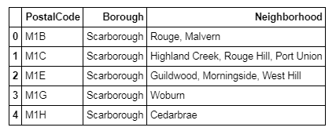
Methodology
Gathering data into a Pandas dataframe

Slide 7
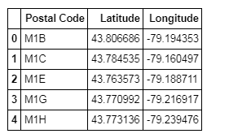
Fetched the coordinate data for all the neighborhoods in Toronto using the csv file and put it into a dataframe.

Slide 8
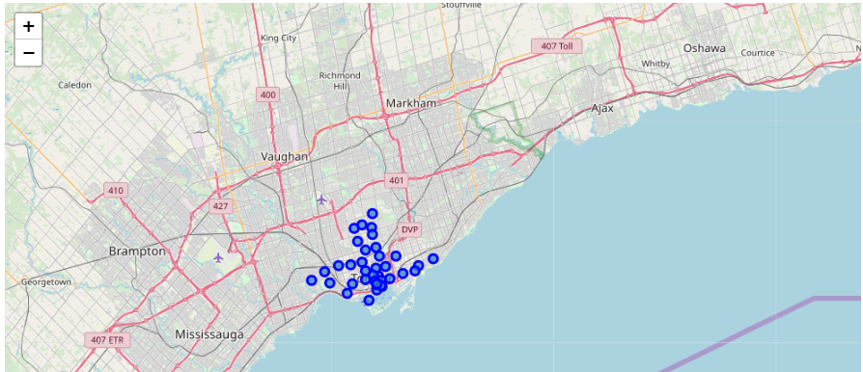
Generating a map of Toronto and plotting the Neighborhood data on it

Slide 9
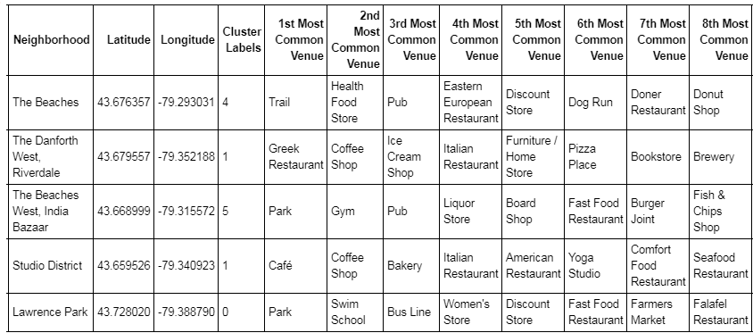
Results
Adding the Cluster Labels to the Venue Data

Slide 10
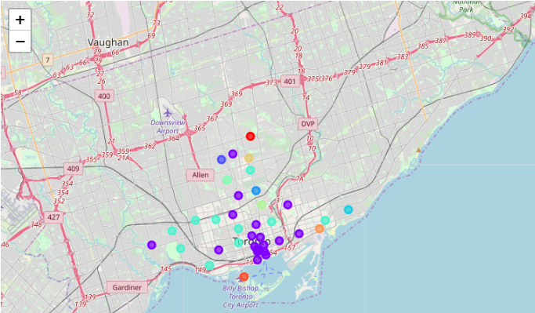
Visualizing the resulting Clusters

Slide 11
Conclusion
In a fast moving world, there are many real life problems or scenarios where data can be used to find solutions to those problems.
Like seen in the example above, data was used to cluster neighborhoods in Toronto based on the most common venues in those neighborhoods.
Similarly, data can also be used to solve other problems, which most people face in metropolitan cities.

