Slide 1
Introduction to Probabilistic Graphical Models
Usha Rengaraju

Slide 2
Queries:
usharengaraju@gmail.com
#PGMS

Slide 3
Applications of PGMs

Slide 4
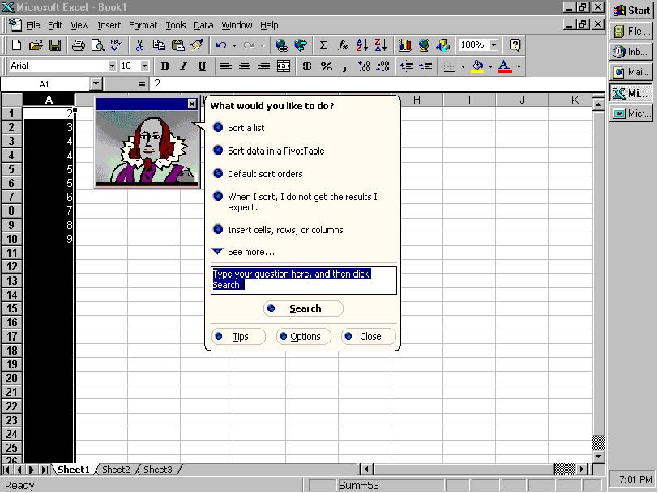
Microsoft Lumiere Project

Slide 5
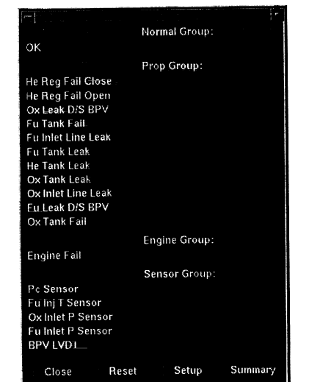
NASA Mission Control Center

Slide 6


Slide 7
Why Graphical Models ?
They can handle incomplete data sets
They help us learn about Causal relationships
Prior Knowledge and data can be combined with well studied techniques from Bayesian statistics
Principled approach for avoiding the overfitting of data

Slide 8
Handling uncertainty with Graphical Models
Representation:
How to capture model uncertainties in possible world
How to encode domain knowledge/ assumptions and constraints
Inference:
How to do I answers queries based on model and/or Data
Learning:
What model is right for my data

Slide 9
Types
Bayesian Network - Directed Graphical Model
Markov Network - Undirected Graphical Model

Slide 10
Bayesian Networks
Bayesian Network is a compact distribution of probability distribution that is too large to be handled by traditional specification of probability and statistics such as tables and equations

Slide 11
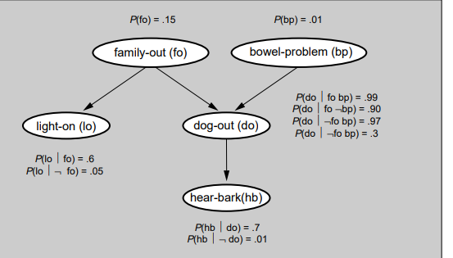
Bayesian Networks

Slide 12
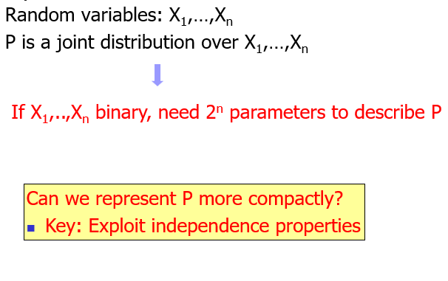
Joint Distribution
The joint probability distribution is the probability of every possible event as defined by the combination of the values of all the variables.

Slide 13
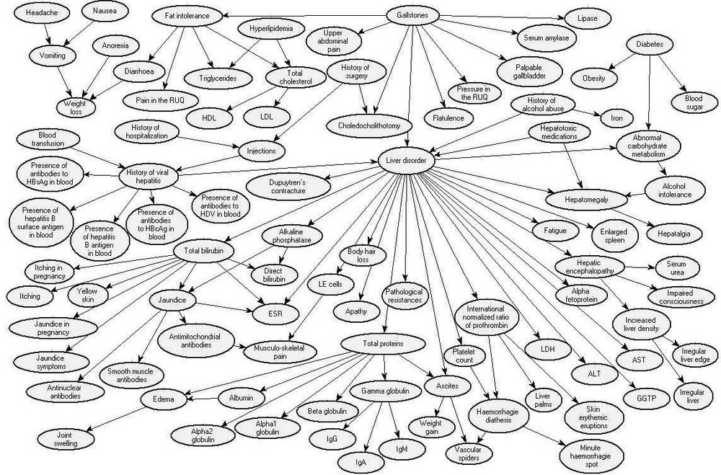

Slide 14
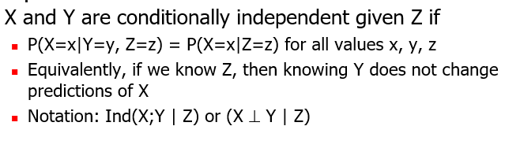
Conditional Independence

Slide 15


Slide 16
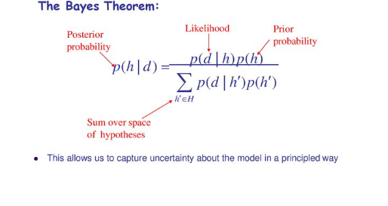

Slide 17
D-separation:
Formal procedure for determining independence
Explaining away :
When you have competing possible causes for some event, and the chances of one of those causes increases, the chances of the other causes must decline since they are being "explained away" by the first explanation.

Slide 18
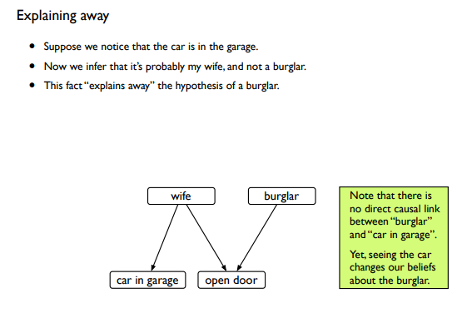

Slide 19
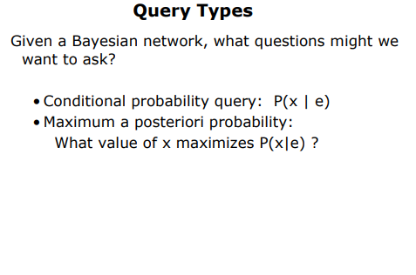
Inference

Slide 20
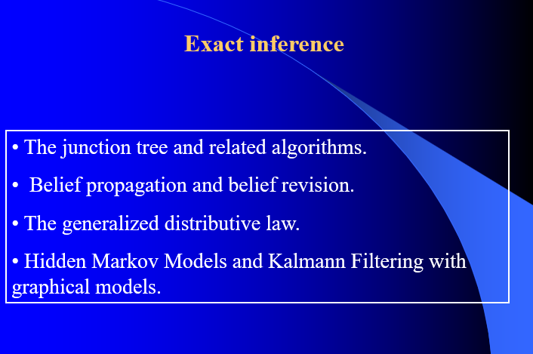

Slide 21
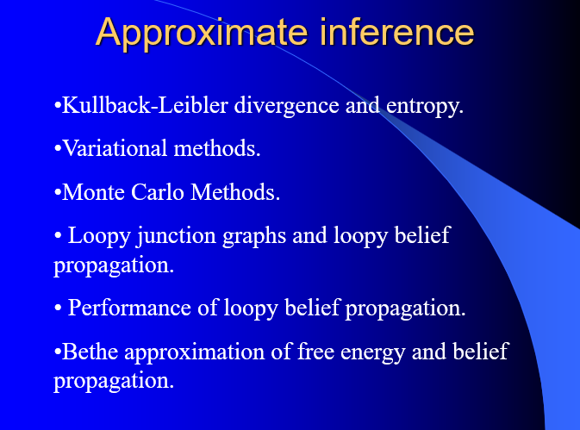

Slide 22
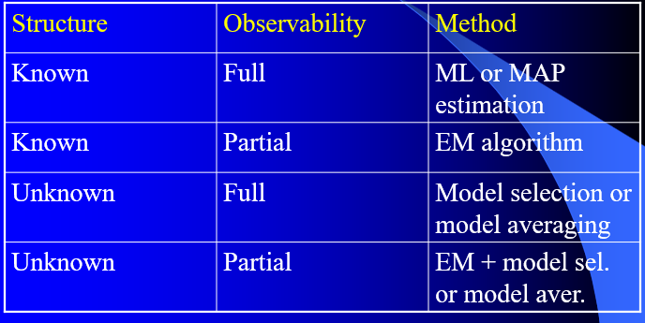
Learning

Slide 23
Credit Card Approval

Slide 24
