Slide 1
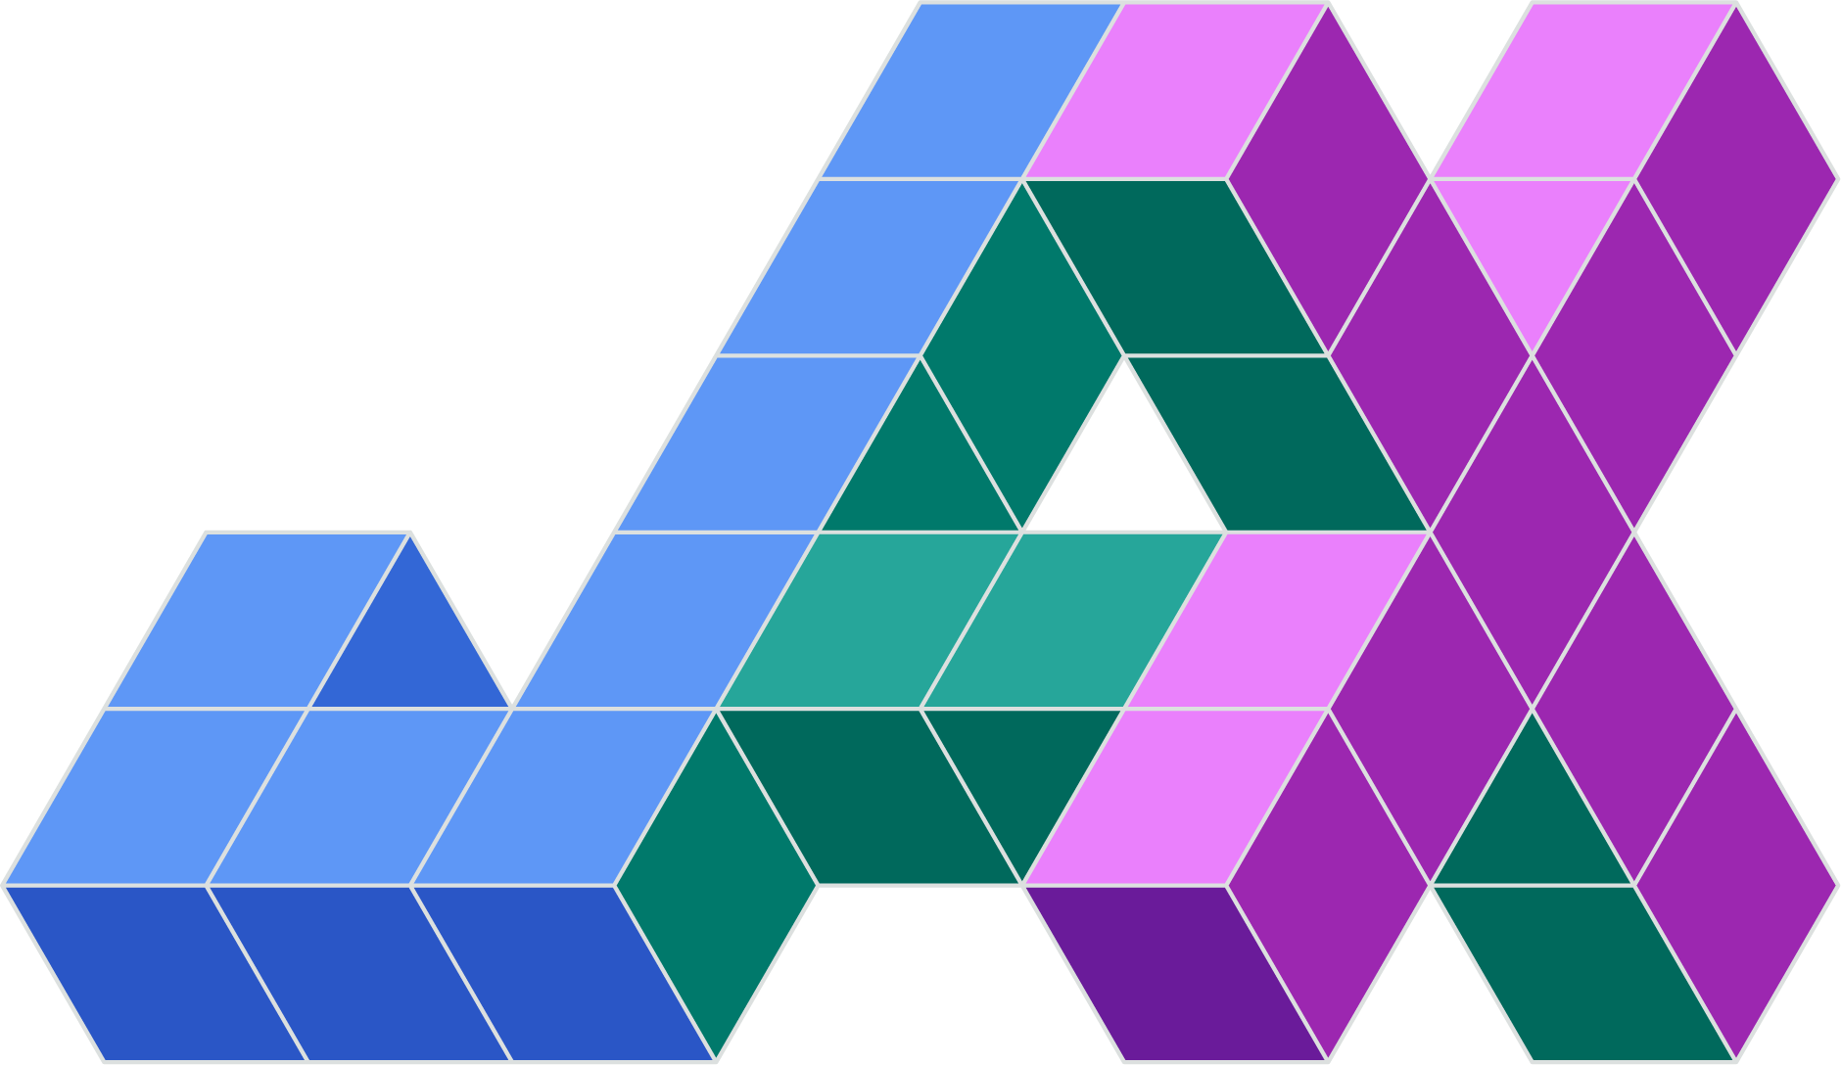
Accelerating Machine Learning Research using JAX

Slide 2
Agenda
What is JAX?
Features of JAX
Device Array
Speed : Device Array Vs Numpy Array
Immutability of JAX Array
Automatic Differentiation using grad
JIT Compilation and XLA
Automatic Vectorization using vmap
Parallel Evaluation using pmap
Pseudo Random Number Generation using PRNG

Slide 3
JAX is a Python library designed for high-performance machine learning research.
Its API for numerical functions is based on NumPy
JAX is simple, flexible, and easy to adopt

Slide 4
Features of JAX
Just-in-Time (JIT) compilation.
Enables NumPy code on not only CPU but GPU and TPU as well.
Automatic differentiation of NumPy and native Python code.
Automatic vectorization.
Express and compose transformations of numerical programs.
Advanced (pseudo) random number generation.

Slide 5
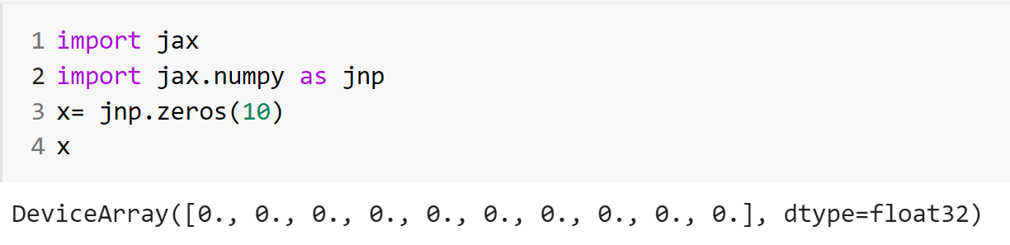
Device Array -Array Object in JAX

Slide 6
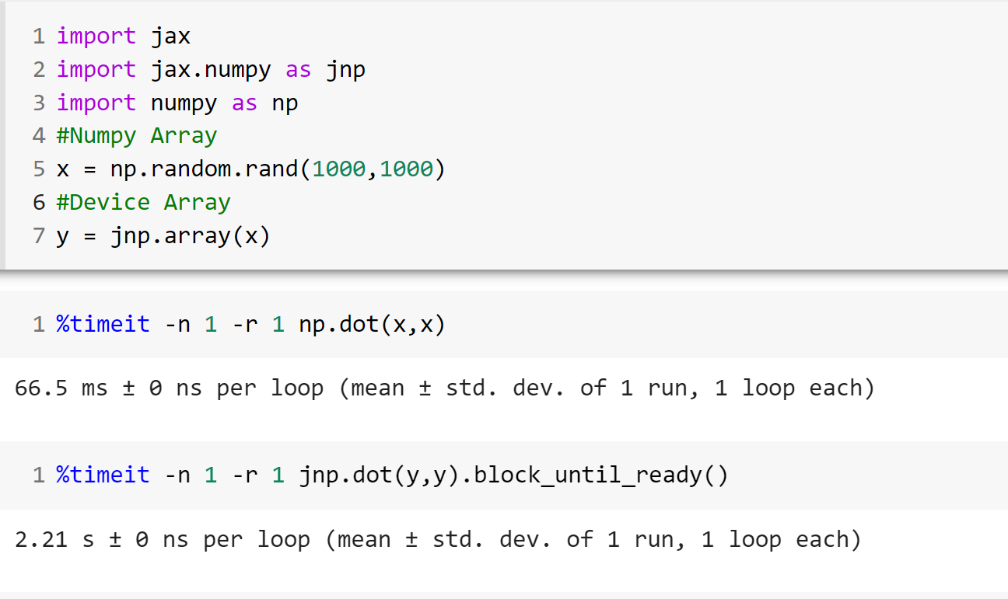
Numpy array vs Device Array

Slide 7
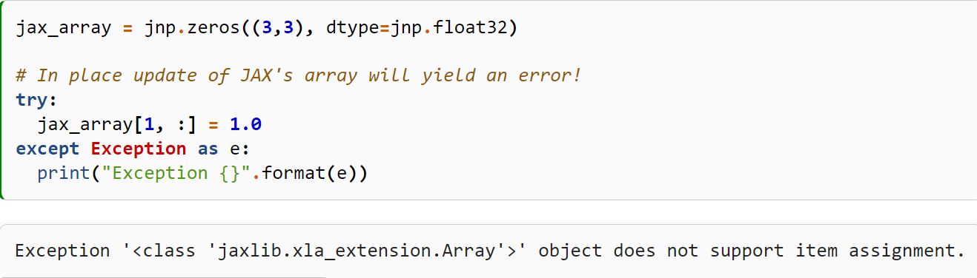
Immutability

Slide 8
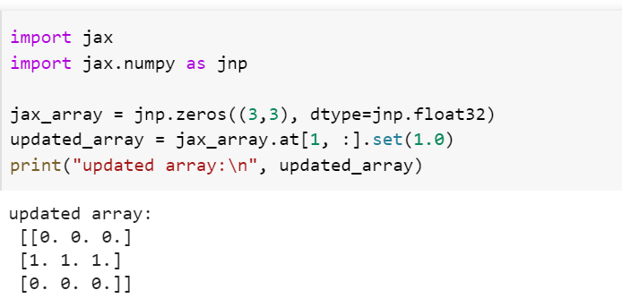
Array Updation in JAX

Slide 9
Pure Functions
A Pure Function doesn’t have side effects and always returns the same value for a given input .
Eg : Math.cos(x)
Advantages
Reproducibility
Parallelization

Slide 10
JAX and Pure Functions
JAX function transformations work only with Pure Functions
Doesn’t allow in place array updation
Immutability of inputs and global state

Slide 11
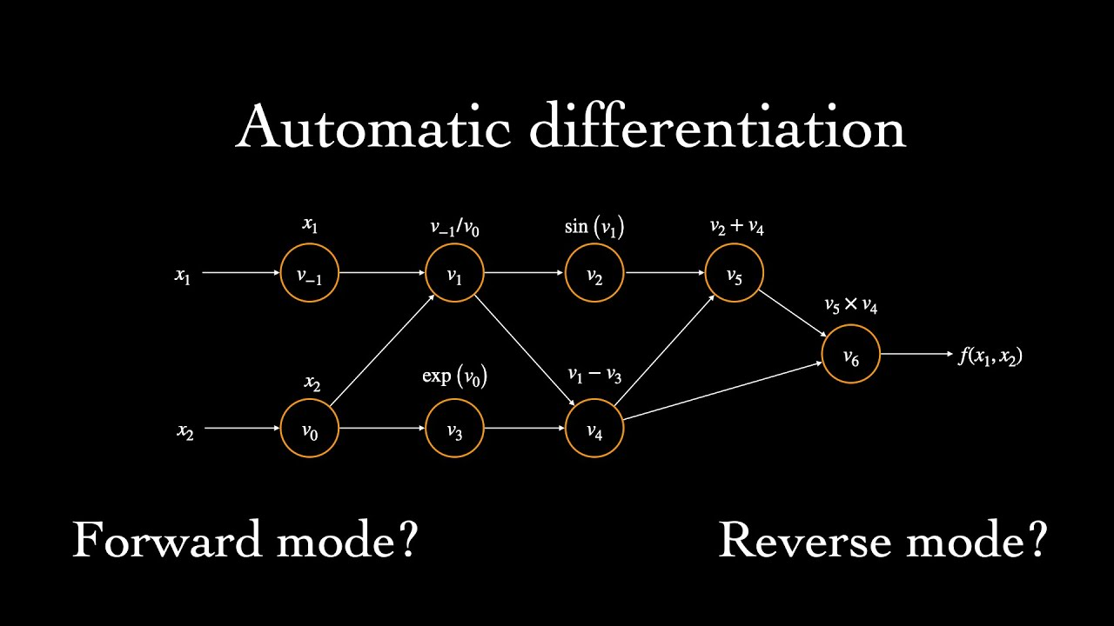
Automatic Differentiation
Automatic differentiation is a set of techniques to evaluate the derivative of a function .
AD applies chain rule repeatedly to arithmetic operations like addition , subtraction , multiplication and division and derivatives can be computed automatically and accurately to working precision .
Pic Credit : Ari Seff

Slide 12
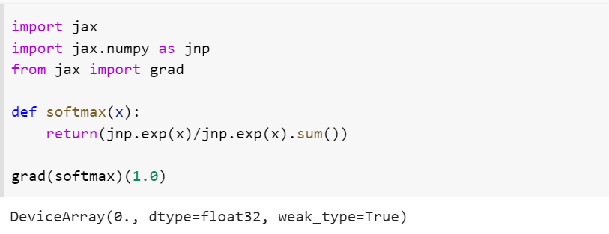
Automatic Differentiation with grad

Slide 13
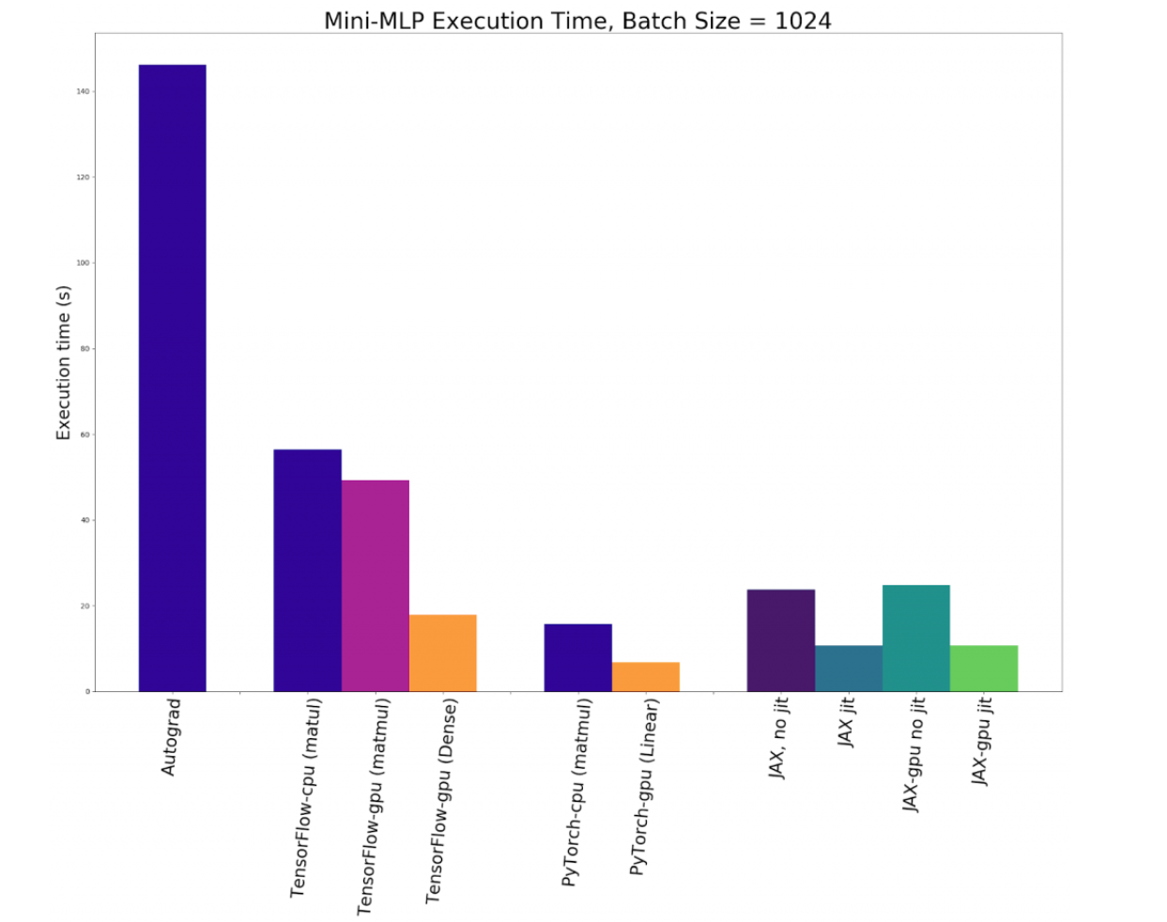
Pic Credit:dzone.com

Slide 14
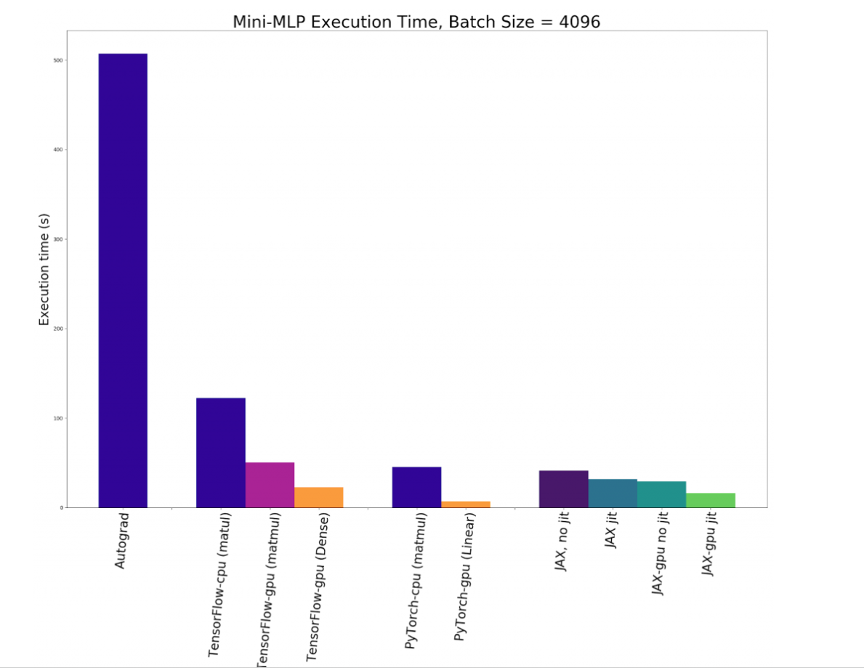
Pic Credit :dzone.com

Slide 15
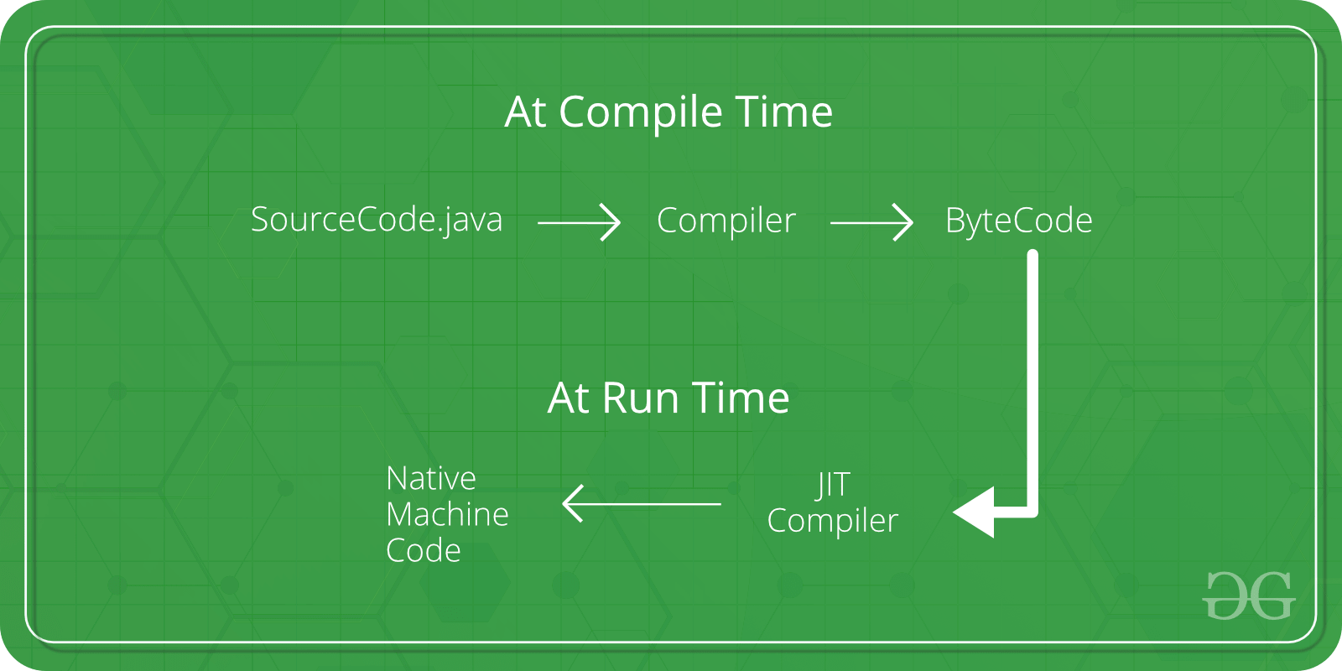
Just in Time Compilation(JIT)
JIT performs compilation at run time and involves both source code translation and bytecode translation into machine code .
JIT combines both ahead of time compilation and interpretation .
Advantages of JIT
Less Memory usage
Code Optimization on the go
Pic credit : geeksforgeeks

Slide 16
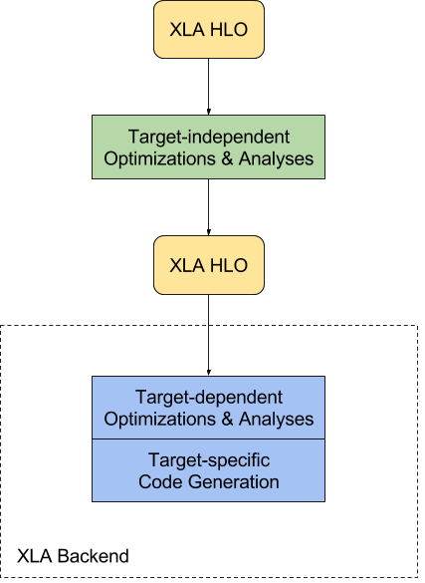
XLA – Accelerated Linear Algebra
XLA (Accelerated Linear Algebra) is a domain-specific compiler for linear algebra built by Google that can accelerate machine learning code without source code changes .
Advantages of XLA
Faster Execution Speed
Less Memory Usage
Better portability
Pic Credit : TensorFlow documentation

Slide 17
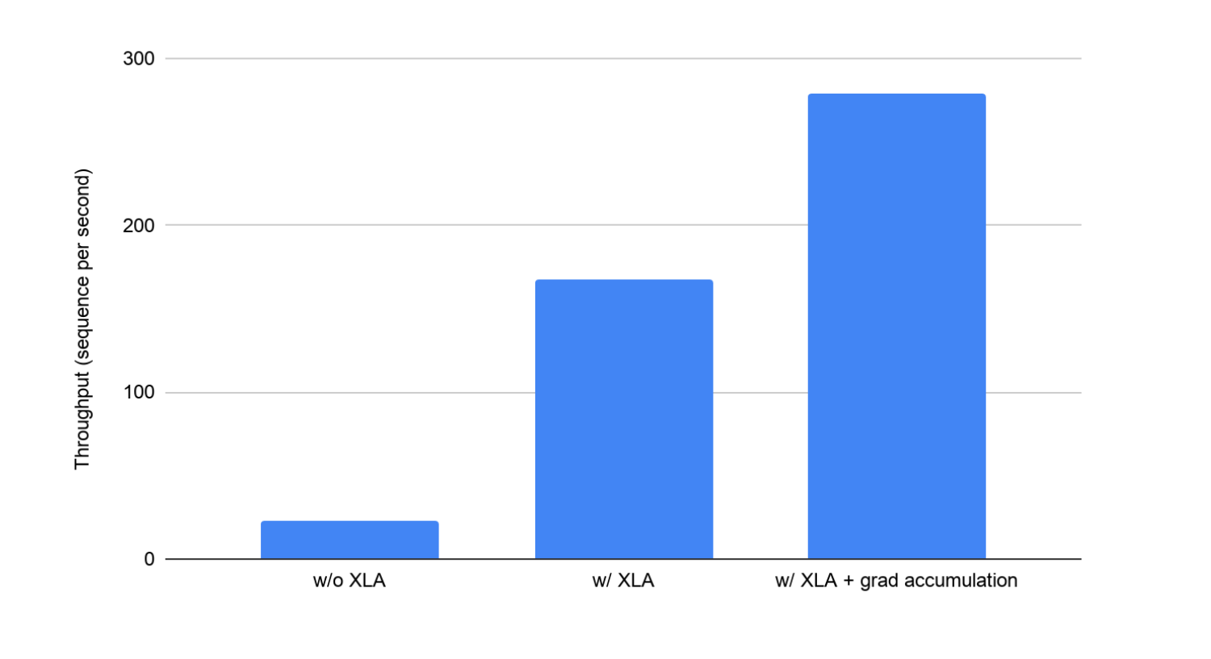
Pic credit : TensorFlow Documentation

Slide 18
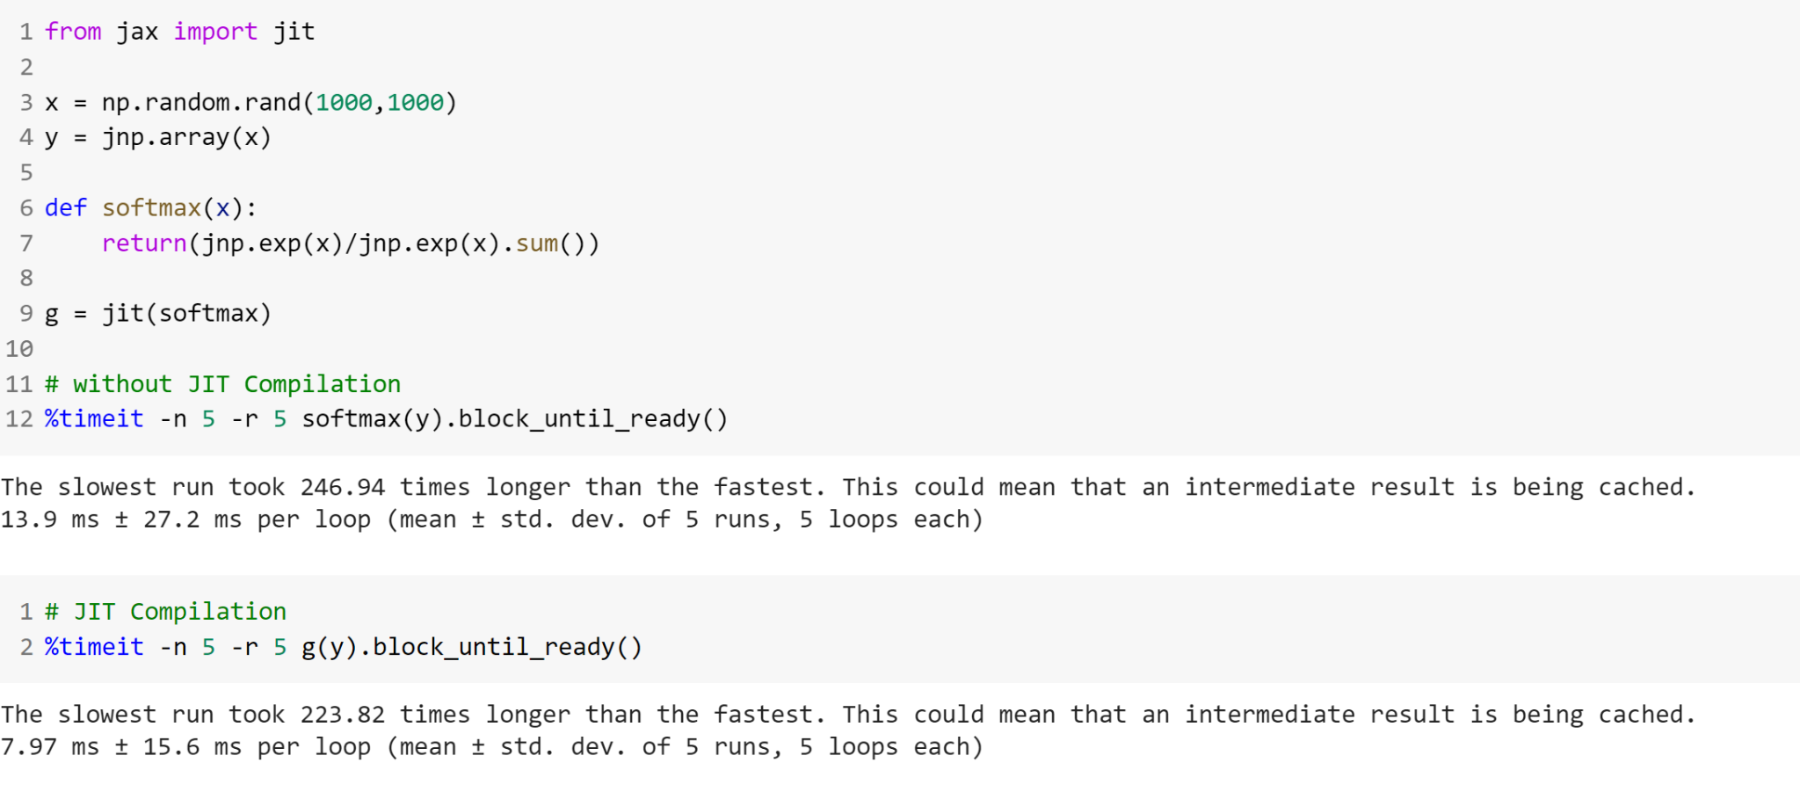
JIT Compilation and XLA

Slide 19
Automatic Vectorization
Automatic vectorization is a process where scalar implementation in the code is converted to vector implementation .
Vectorization can speed up the performance of code by eliminating loops .
Advantages of Vectorized Implementation
Efficient Code
Code is easier to debug

Slide 20
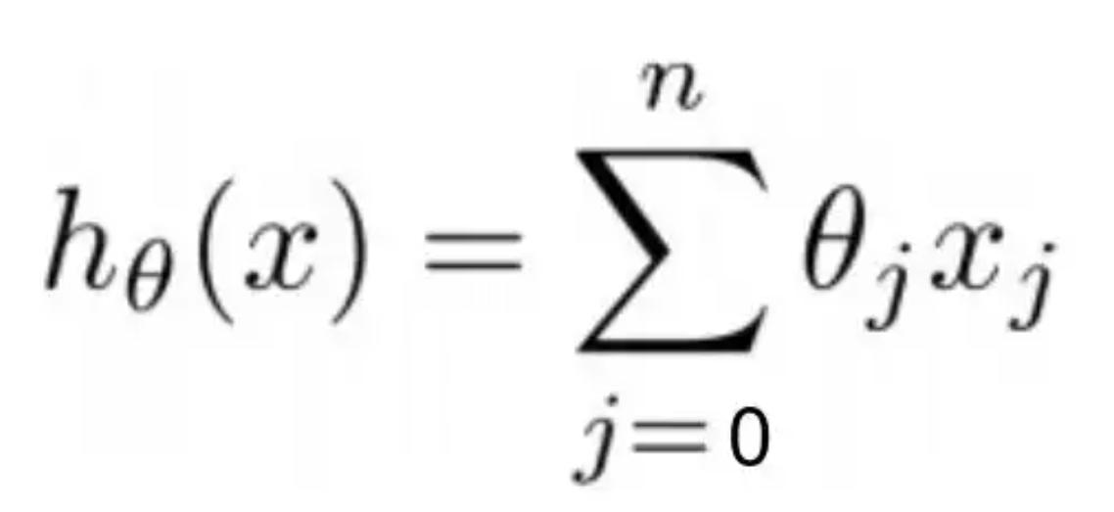
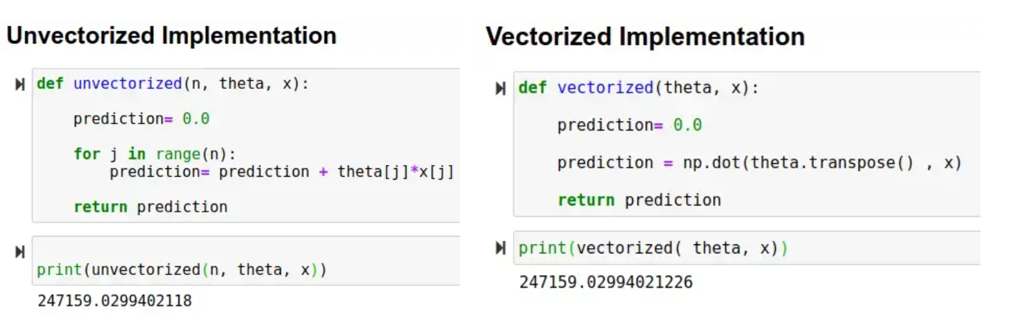
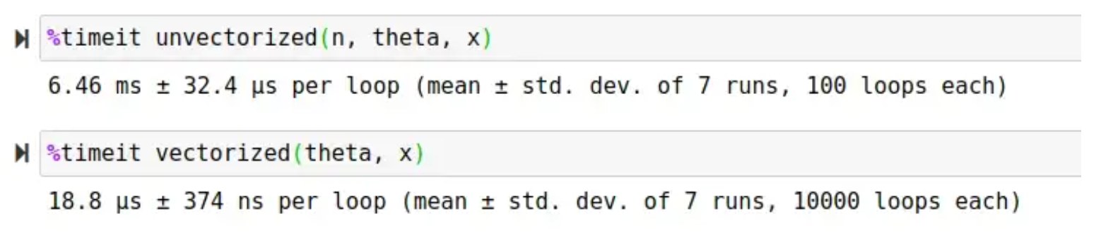

Slide 21
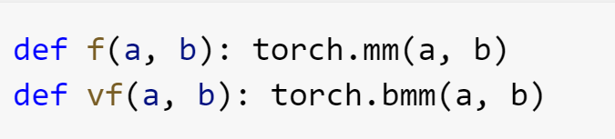

Manual Vectorization

Slide 22
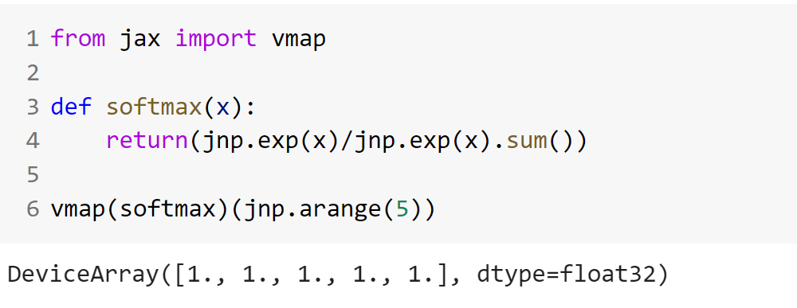
Automatic Vectorization using vmap

Slide 23
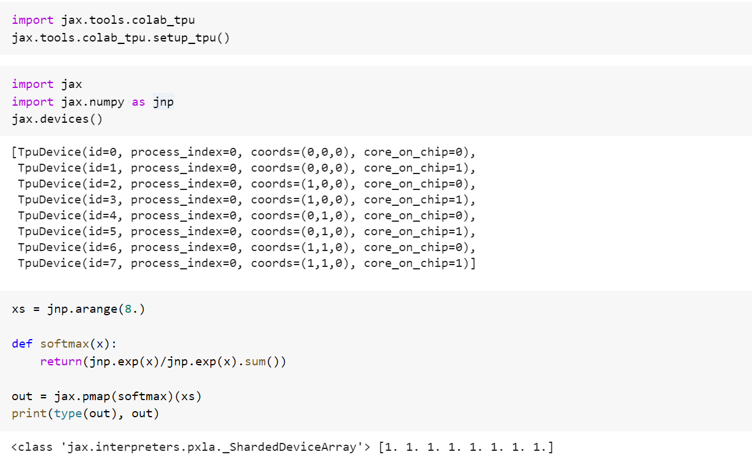
Parallel Evaluation using pmap

Slide 24
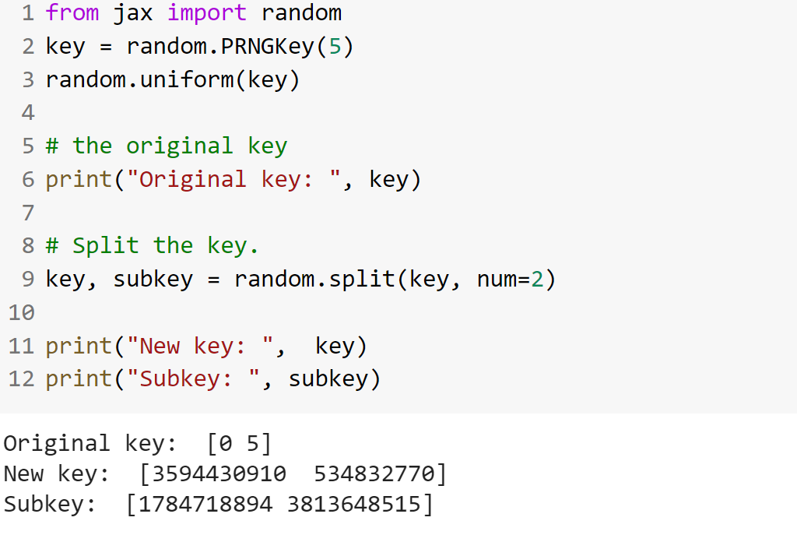
Pseudo Random Number Generation using PRNG

Slide 25
When should you use JAX?
Code works on TPU accelerator
Code uses higher order gradients
Speed is your end Goal

Slide 26
When shouldn’t you use JAX?
Standard ML pipeline
Constantly changing input shapes
Performance is not the end goal

Slide 27
References :
JAX documentation
Nicholas Vadivelu’s JAX resources
https://theaisummer.com/jax/#asynchronous-dispatch
https://blog.roboflow.com/jax-framework/#when-should-i-use-jax
https://www.deepmind.com/blog/using-jax-to-accelerate-our-research
https://roberttlange.github.io/posts/2020/03/blog-post-10/

Slide 28
References
https://dzone.com/articles/accelerated-automatic-differentiation-with-jax-how

Slide 29
Thank You

