Slide 1
Transformer Chatbot in TensorFlow 2.0
Usha Rengaraju

Slide 2
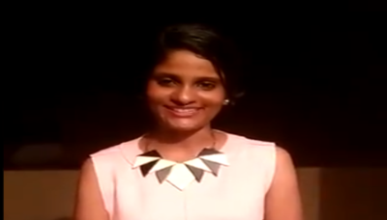
About Me
Kaggle Grandmaster
WiMLDS(Bangalore and Mysore)
TensorFlow User Group Organizer Mysuru
GDG Mysore Organizer Mysuru
Twitter : @URengaraju
Github : https://github.com/ushareng
Ambassador : Women TechMakers Mysuru , WiDS Mysuru(Women in Data Science)

Slide 3
Communities
WiMLDS Mysore :
https://www.meetup.com/Mysore-Women-in-Machine-Learning-and-Data-Science/
GDG Mysuru :
https://www.meetup.com/Google-Developers-group-Mysuru/
TensorFlow User Group Mysuru :
https://www.meetup.com/TFUG-Mysuru/

Slide 4
Pic Credit :
All pics in this presentation are cropped from The AI Hacker - Michael Phi’s “Illustrated Transformer “ Video

Slide 5
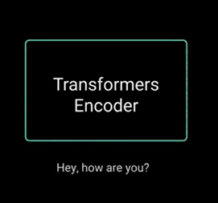
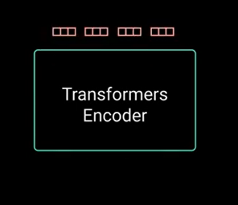
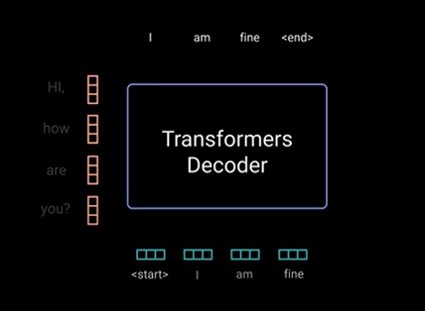
.

Slide 6
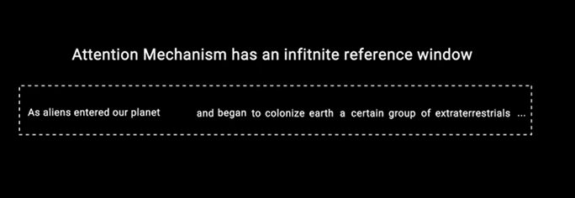
.

Slide 7
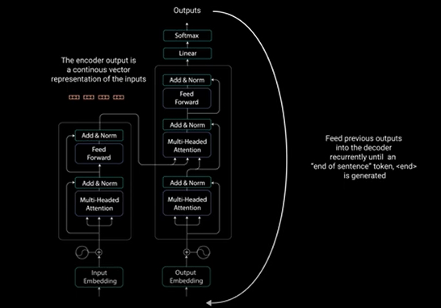
.

Slide 8
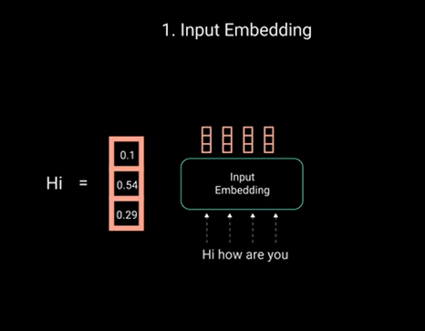
.

Slide 9
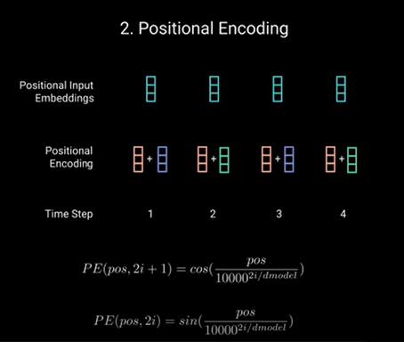
.

Slide 10
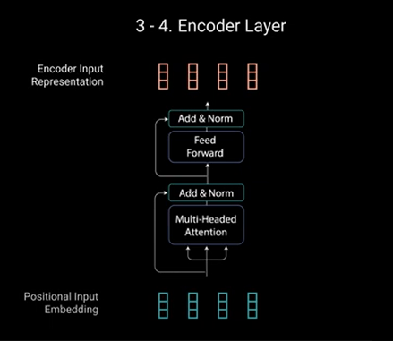
.

Slide 11
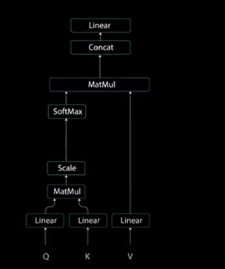
.

Slide 12
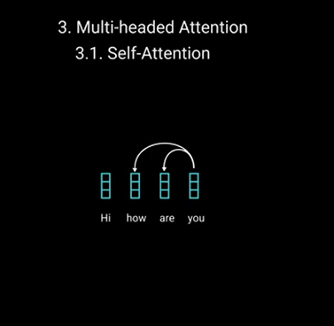
.

Slide 13
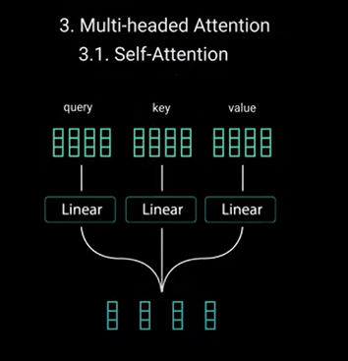
.

Slide 14
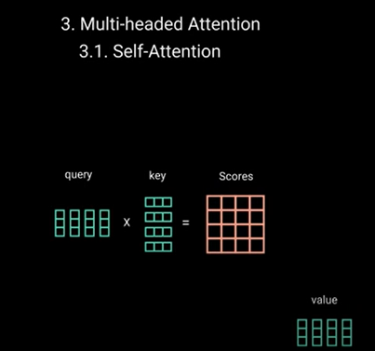
.

Slide 15
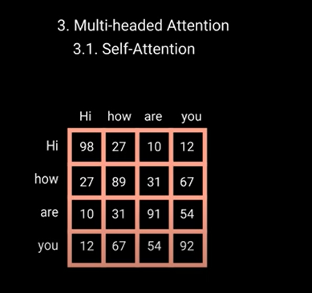
.

Slide 16
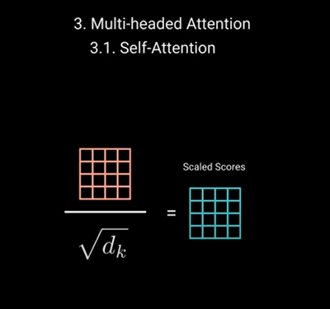
.

Slide 17
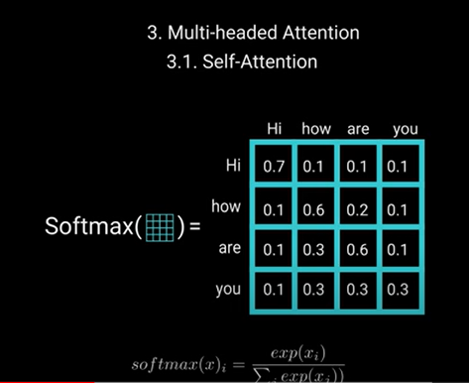
.

Slide 18
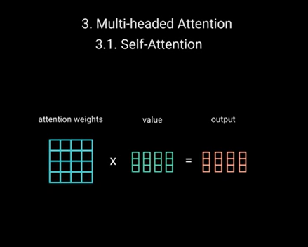
.

Slide 19
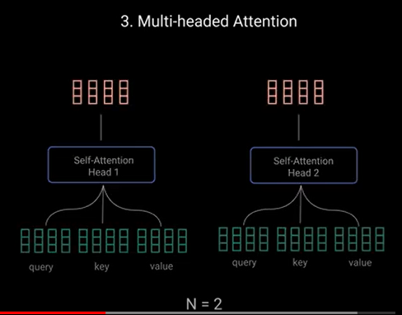
.

Slide 20
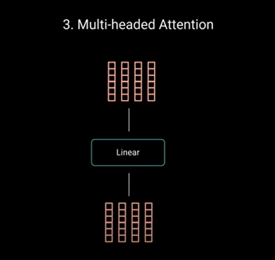
.

Slide 21
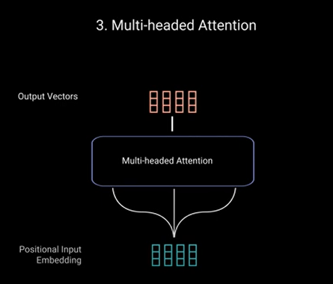
.

Slide 22
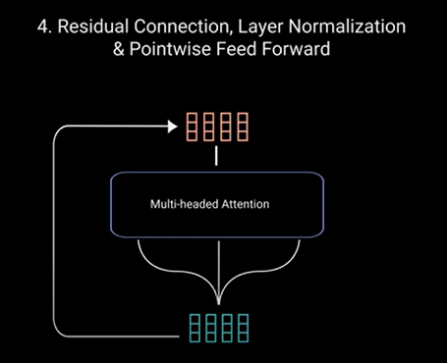
.

Slide 23
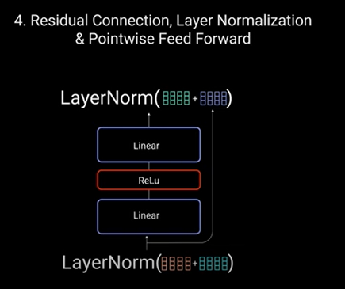
.

Slide 24
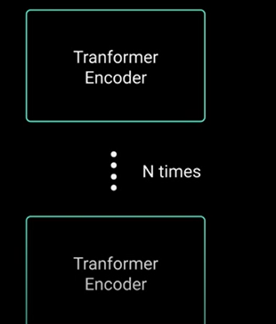
.

Slide 25
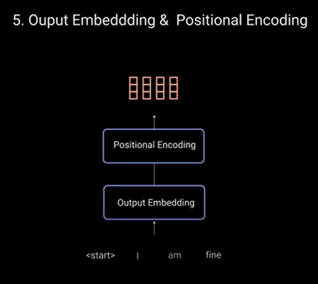
.

Slide 26
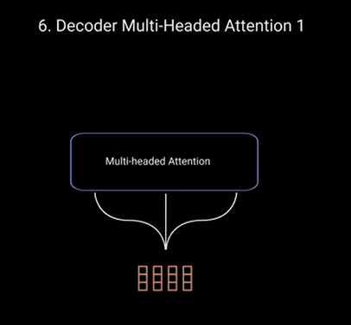
.

Slide 27
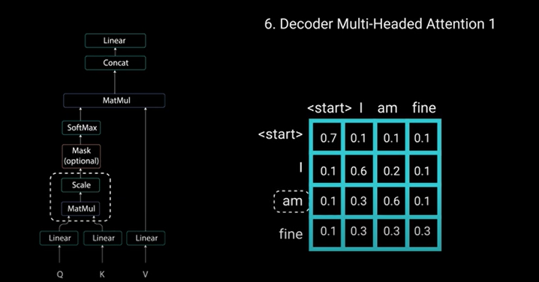
.

Slide 28
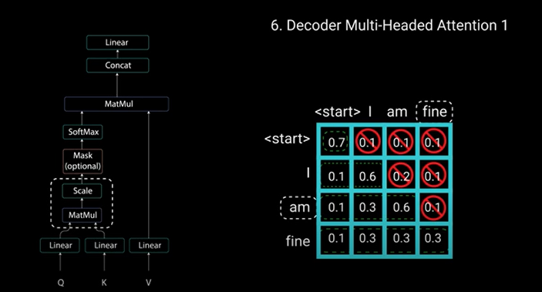
.

Slide 29
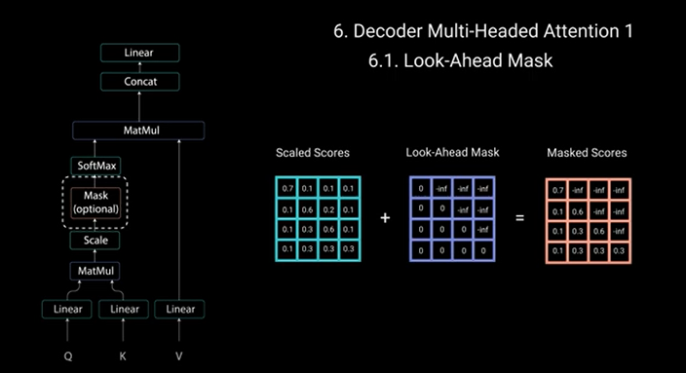
.

Slide 30
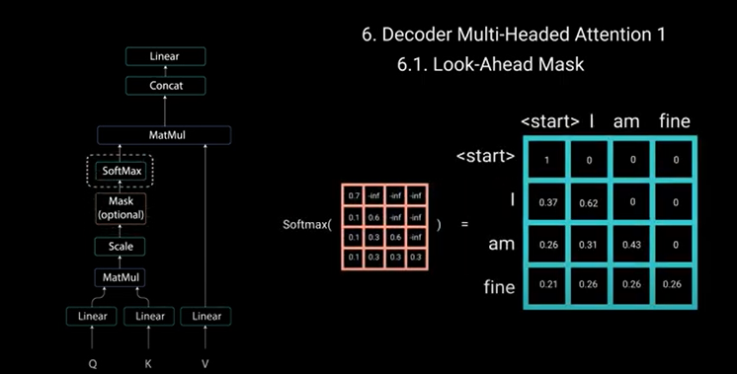
.

Slide 31
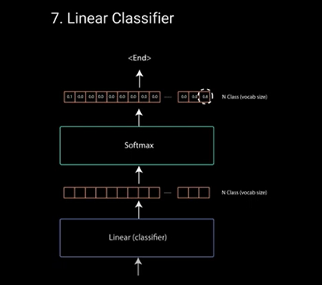
.

Slide 32
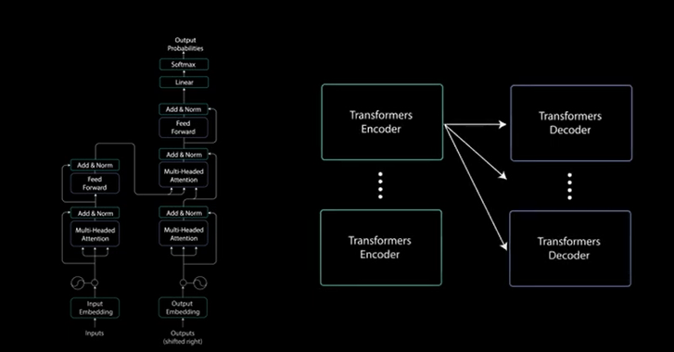
.

Slide 33
Thank You

