Slide 1
Building LLM powered applications using LangChain
Usha Rengaraju

Slide 2
Large Language Models
“A large language model (LLM) is a type of artificial intelligence (AI) algorithm that uses deep learning techniques and massively large data sets to understand, summarize, generate and predict new content. The term generative AI also is closely connected with LLMs, which are, in fact, a type of generative AI that has been specifically architected to help generate text-based content.”
Source : TechGig

Slide 3
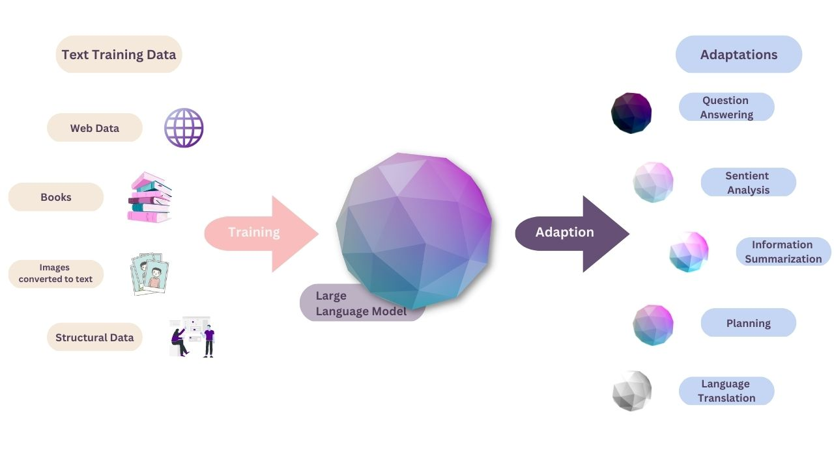
How do large language models work ?
Source : https://renaissancerachel.com/
.

Slide 4
Applications of Large Language Models
Dynamic chatbots, AI assistants in retail showrooms.
Understanding proteins , molecules , DNA and RNA in life science research
Marketing for customer segmentation
Anomaly detection and Fraud analysis in Fintech space
Legal paraphrasing and scribing

Slide 5
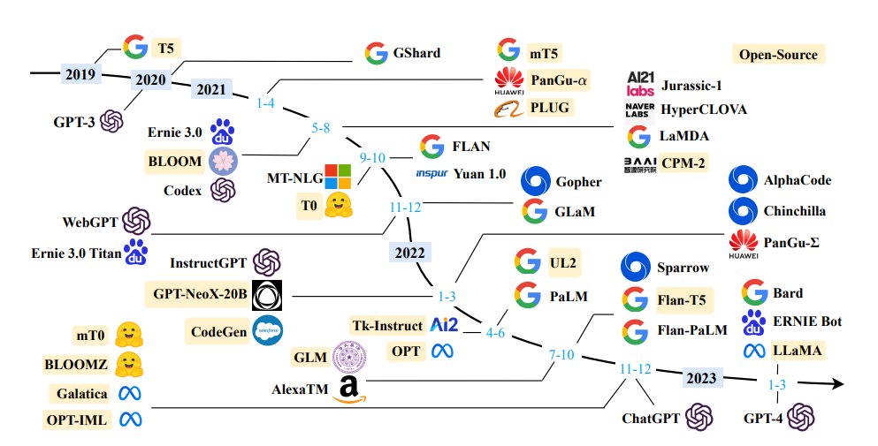
Open Source LLMs Image Source : Sung Kim

Slide 6

Image Source : Sam Witteveen

Slide 7
Challenges of Large Language Models Source: adjourn.com
Inconsistent accuracy
Lack of enterprise context
Limited controllability
Stale training data.
Personal data risk
Bias and Hallucinations

Slide 8
Prompt Engineering
Prompts
“Prompts are used as a means to interact with LLMs to accomplish a task. A prompt is a user-provided input to which the model is meant to respond. Prompts can include instructions, questions, or any other type of input, depending on the intended use of the model.”
Source : https://developer.nvidia.com/

Slide 9

Dalle 2 Prompt

Slide 10
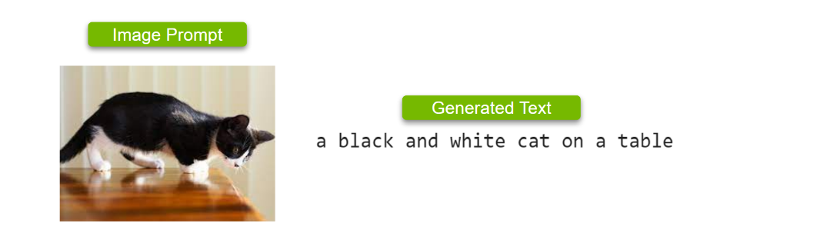
Image to Text prompt Source : https://developer.nvidia.com/

Slide 11
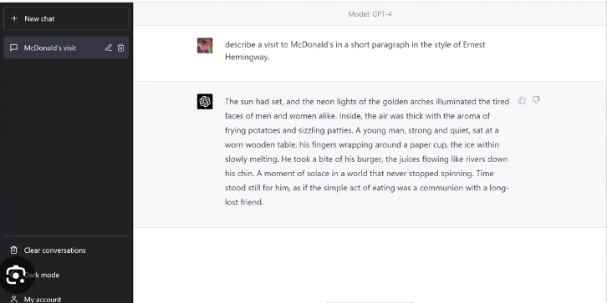
ChatGPT prompt

Slide 12
Prompt Engineering Source :https://www.promptingguide.ai/
“Prompt engineering is technique for developing and optimizing prompts to efficiently use language models (LMs) for a wide variety of applications and research topics. ”

Slide 13
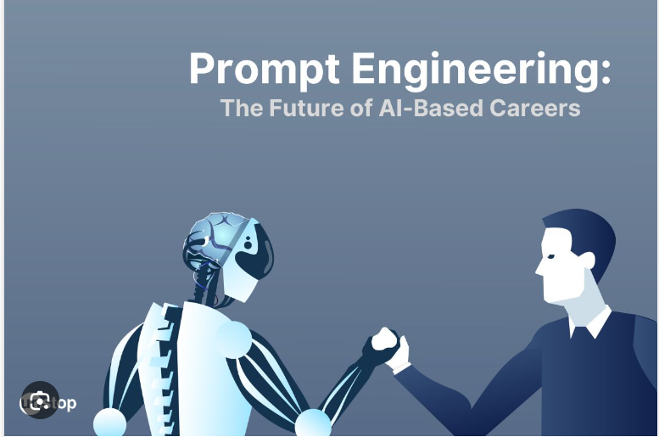
Image source : Unstop.com

Slide 14
Why prompt engineering is important ?
Spend Less Time and Money
Enhanced Creativity
Control over Output
Evaluating the limitations of LLMs

Slide 15
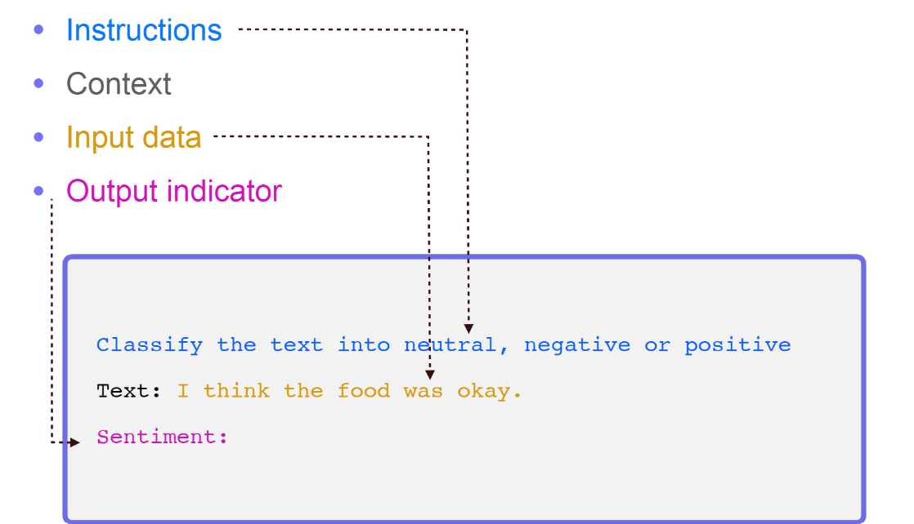
Image Source: dair.ai

Slide 16
Different Prompting Techniques

Slide 17
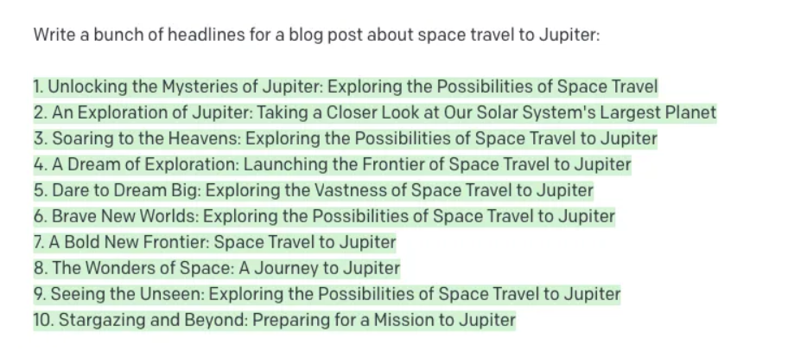
Zero Shot Prompting Image Source - MLearning.ai Tristan Wolff
Notes:
Image Credit : https://medium.com/mlearning-ai/from-zero-shot-to-chain-of-thought-prompt-engineering-choosing-the-right-prompt-types-88800f242137

Slide 18
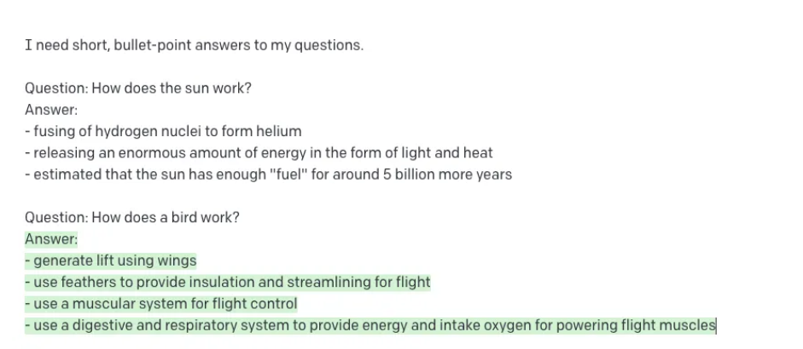
One shot Prompting Image Source - MLearning.ai Tristan Wolff

Slide 19
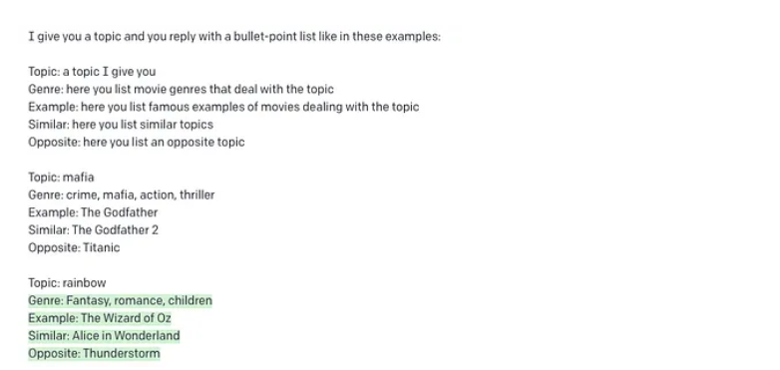
Few Shot Prompting Image Source - MLearning.ai Tristan Wolff

Slide 20
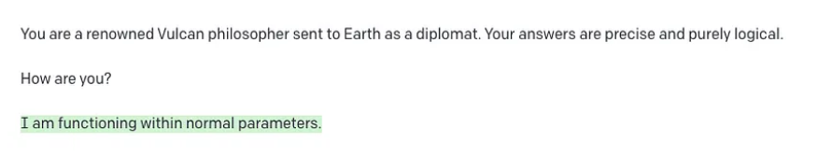
Role Prompting Image Source - MLearning.ai Tristan Wolff

Slide 21
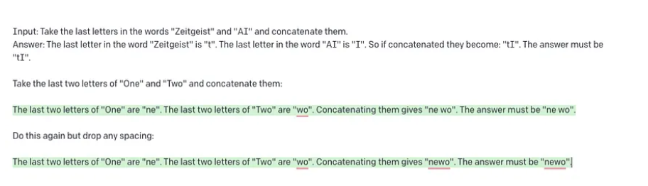
Chain of Thought Prompting Image Source - MLearning.ai Tristan Wolff

Slide 22
LangChain
LangChain is a framework for developing applications powered by language models. The LangChain framework is designed around the following principles.
Data-aware: connect a language model to other sources of data
Agentic: allow a language model to interact with its environment

Slide 23
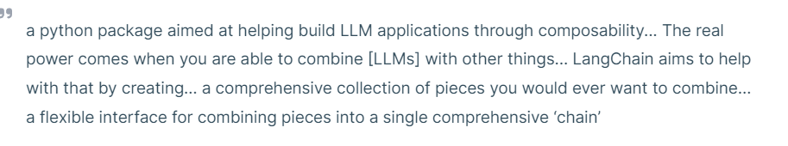
History Source : Golden.com
LangChain was created by Harrison Chase, with the first version released on October 24, 2022. In a tweet thread upon its release, Chase described LangChain as

Slide 24
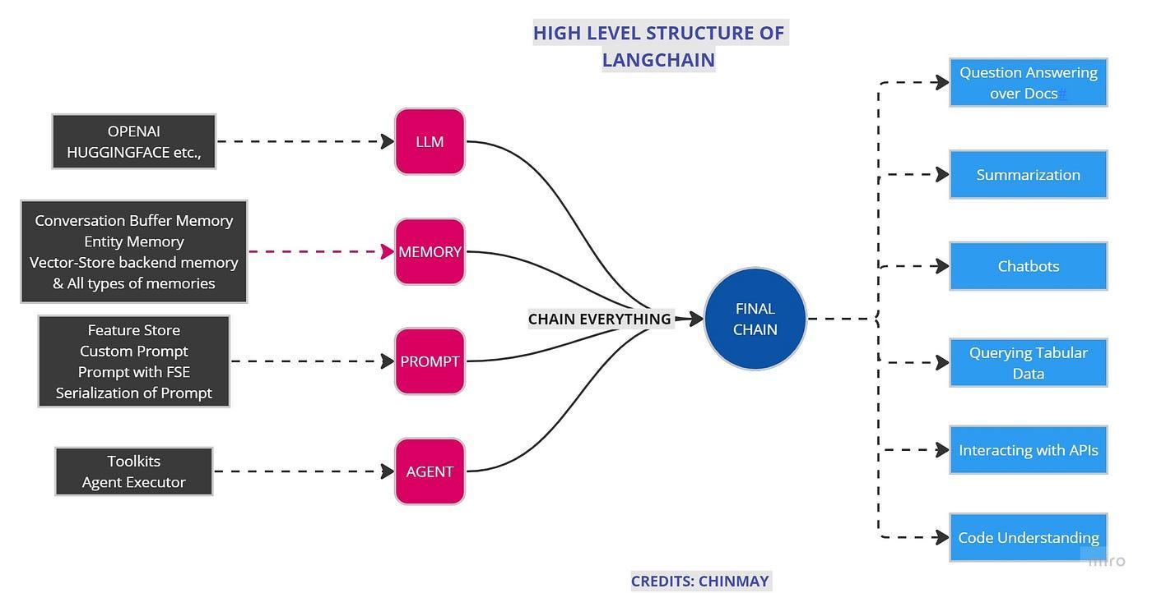
LangChain Components Image Source : Towards AI - Chinmay Bhalerao

