Slide 1


Slide 2

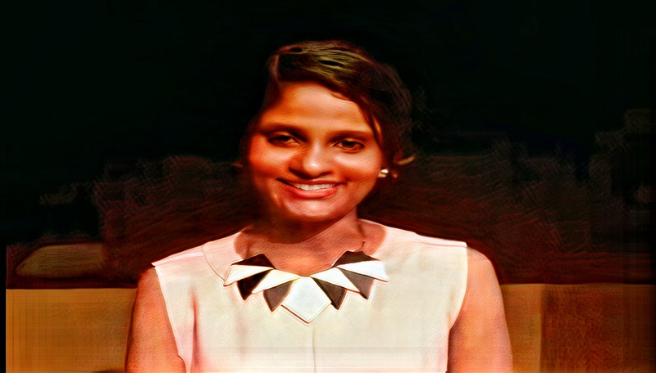
India’s First Women Kaggle Grandmaster
Twitter - @URengaraju
Leads 8 Communities in Bangalore and Mysuru
GDG Mysuru , WTM Mysuru , TFUG Mysuru ,
WiMLDS (Bangalore and Mysore) , AIMED , Lean in Bangalore , AI Circle , WiDS Mysuru Ambassador

Slide 3
TFUG Meetup Page:
https://www.meetup.com/TFUG-Mysuru/events/270757045/
GDG Mysore Meetup Page
https://www.meetup.com/Google-Developers-group-Mysuru/
WiMLDS Mysore Meetup page :
https://www.meetup.com/Mysore-Women-in-Machine-Learning-and-Data-Science/

Slide 4
Credits :
https://blog.tensorflow.org/2019/03/regression-with-probabilistic-layers-in.html
https://www.youtube.com/watch?v=BjUkL8DFH5Q
https://www.youtube.com/watch?v=BrwKURU-wpk&t=610s
https://arxiv.org/abs/1711.10604

Slide 5
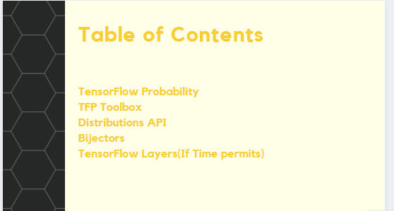

Slide 6
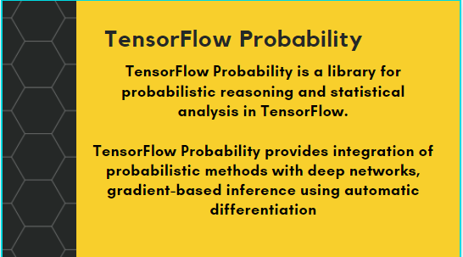

Slide 7
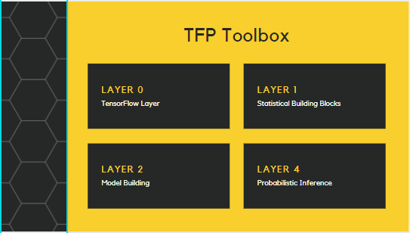

Slide 8
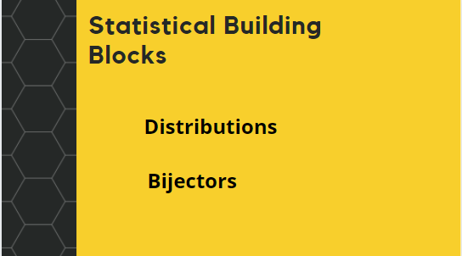

Slide 9
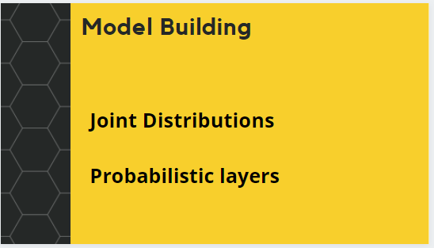

Slide 10
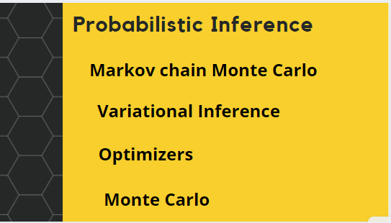

Slide 11
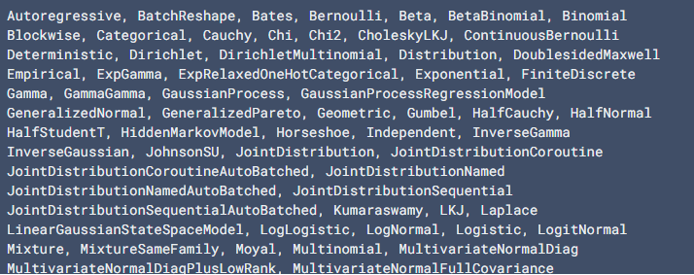
TensorFlow Distributions
Distributions (tfp.distributions): A large collection of probability distributions and related statistics with batch and broadcasting semantics.

Slide 12


A simple scalar-variate Distribution
A batch of scalar-variate Distributions

Slide 13
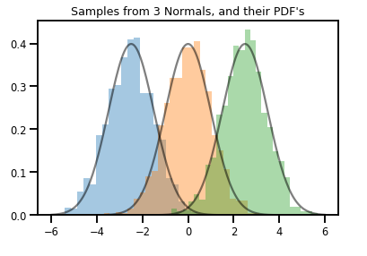

Slide 14

A vector-variate Distribution

Slide 15
Batch Shape and Event Shape
Batch shape denotes a collection of Distributions with distinct parameters
Event shape denotes the shape of samples from the Distribution

Slide 16
Bijectors
Bijectors represent (mostly) invertible, smooth functions. They can be used to transform distributions, preserving the ability to take samples and compute log_probs. They can be in the tfp.bijectors module.
Each bijector implements at least 3 methods:
forward,
inverse, and
(at least) one of forward_log_det_jacobian and inverse_log_det_jacobian.

Slide 17
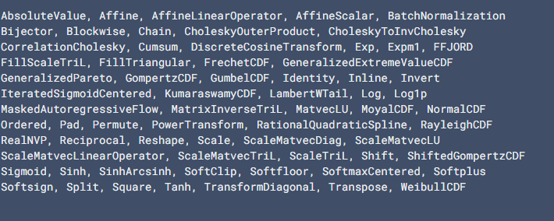

Slide 18

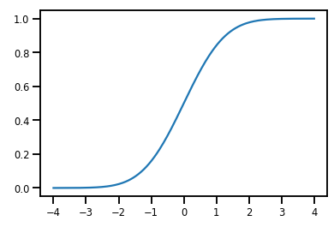
A Simple Bijector

Slide 19
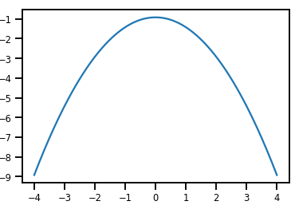
.

Slide 20
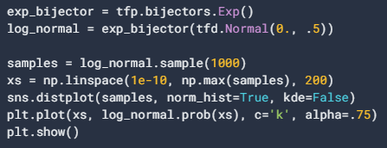
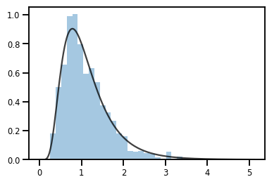
A Bijector transforming a Distribution

Slide 21

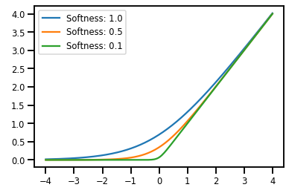
Batching Bijectors
Caching

Slide 22
TensorFlow Layers
Probabilistic layers (tfp.layers): Neural network layers with uncertainty over the functions they represent, extending TensorFlow layers.

Slide 23
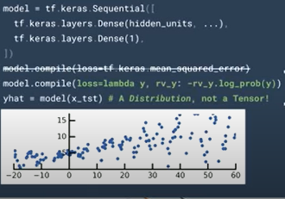
Motivation
.

Slide 24
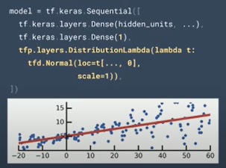

Slide 25
Thank - You

