Slide 1
Decentralized Machine Learning Using TensorFlow Federated
-- Usha Rengaraju

Slide 2
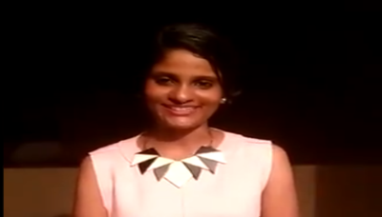
About Me
Kaggle Grandmaster
WiMLDS(Bangalore and Mysore)
TensorFlow User Group Organizer Mysuru
GDG Mysore Organizer Mysuru
Twitter : @URengaraju
Github : https://github.com/ushareng
Ambassador : Women TechMakers Mysuru , WiDS Mysuru(Women in Data Science)

Slide 3
Communities
WiMLDS Mysore :
https://www.meetup.com/Mysore-Women-in-Machine-Learning-and-Data-Science/
GDG Mysuru :
https://www.meetup.com/Google-Developers-group-Mysuru/
TensorFlow User Group Mysuru :
https://www.meetup.com/TFUG-Mysuru/

Slide 4
Pic Credit :
All pics in this presentation are cropped from Official TensorFlow Videos from youtube : https://www.youtube.com/watch?v=m17IgaHaoTI&t=2s

Slide 5
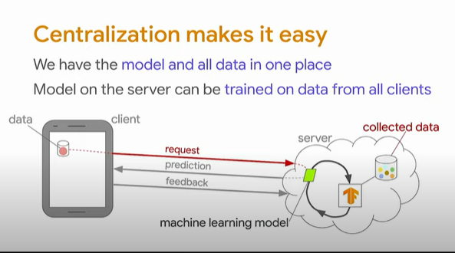
.

Slide 6
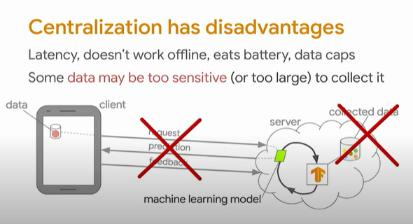

Slide 7
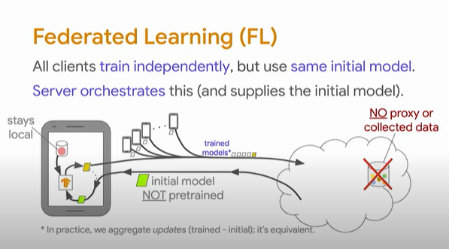

Slide 8
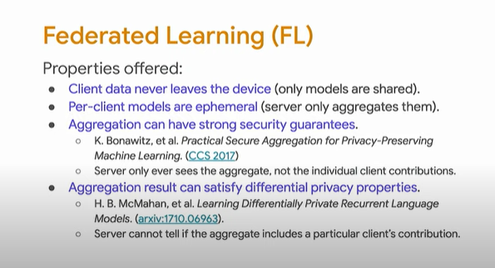

Slide 9
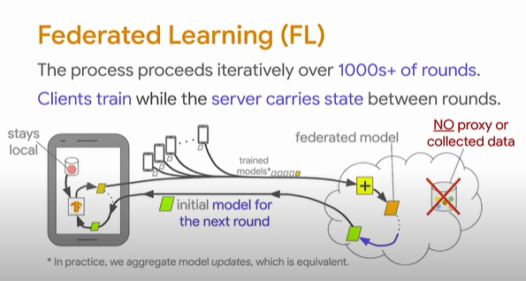

Slide 10
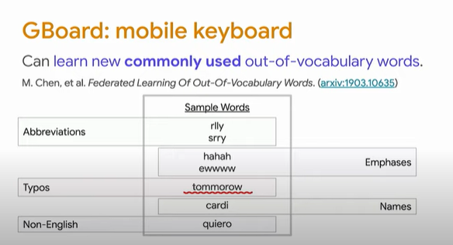

Slide 11
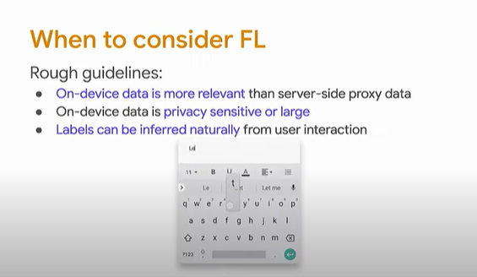

Slide 12
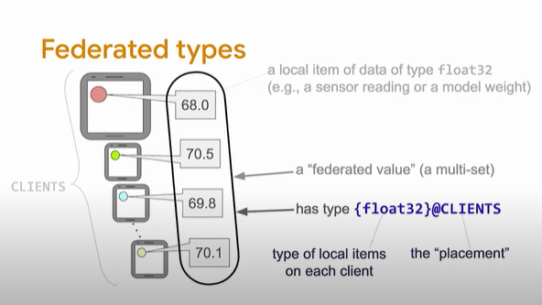

Slide 13
