Slide 1
Neurodiversity and Mental Hygiene
-- Usha Rengaraju

Slide 2
Credit : Pictures and content of the slide have been inspired from multiple online resources

Slide 3
What is Neurodiversity ?
Neurodiversity is a concept that the brain differences are just that: differences. So conditions like ADHD and autism aren’t “abnormal.” They’re simply variations of the human brain.

Slide 4


Slide 5
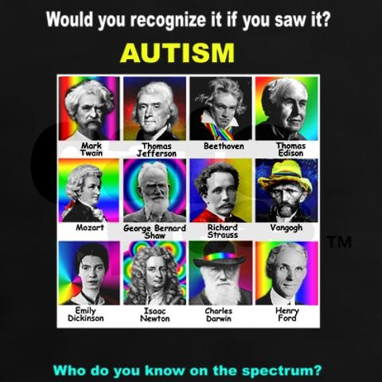

Slide 6
“Genuine inclusion is not about ticking off another box on some diversity checklist: We must make sure that we are aligning people of all abilities and support needs to their strengths. We all benefit when we have opportunities to interact with minds different from our own.”

Slide 7
Autism-Friendly Employers?
Microsoft
SAP
Freddie Mac
Ford
Ernst and Young
Walgreens
Home Depot and CVS caremark
AMC

Slide 8
People with autism often have desirable qualities for employers.
High intelligence
Careful attention to detail,
Intense commitment to high quality work
Out of the box thinking.
Ability to Hyperfocus
Higher Energy Levels

Slide 9
SAP’s program also foregoes the traditional interview process for a month-long screening and workshop. The program focuses on soft skills, teamwork, communication and workplace etiquette. Here, the candidate is the one who determines what form the interview takes, whether that be a stroll around the campus, a one-on-one interview or talking in a group.
Once hired, a mentor makes sure new employees in the program have a successful transition. SAP also introduces autism awareness to its entire company, to make sure that the rest of its employees are familiar with the basic truths and misconceptions about autism.
Neurodiverse employees at the technology company SAP helped create a technical fix that saved the company nearly $40 million.

Slide 10
Mental Hygiene
Rejection
Pay attention to Emotional Pain
Stop Emotional Bleeding
Rumination
Protect your Self Esteem

Slide 11
Resources
Harvard Business Review article on Neurodiversity
Washington Post article on Neurodiversity
Work of Guy WInch

