Slide 1
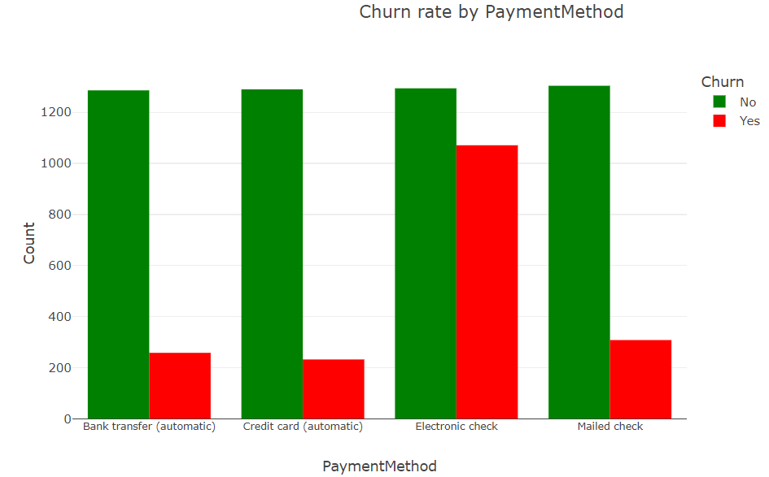
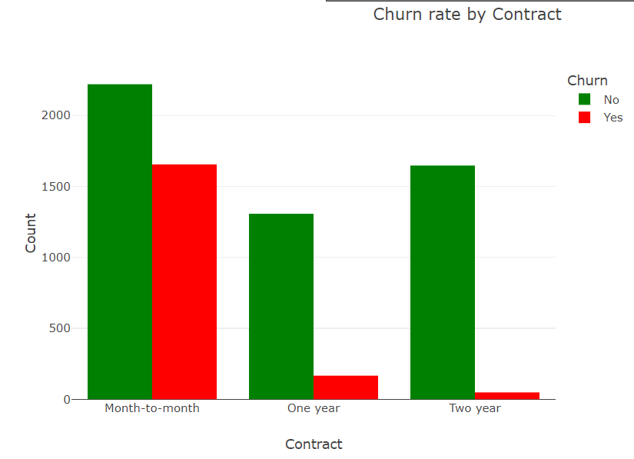
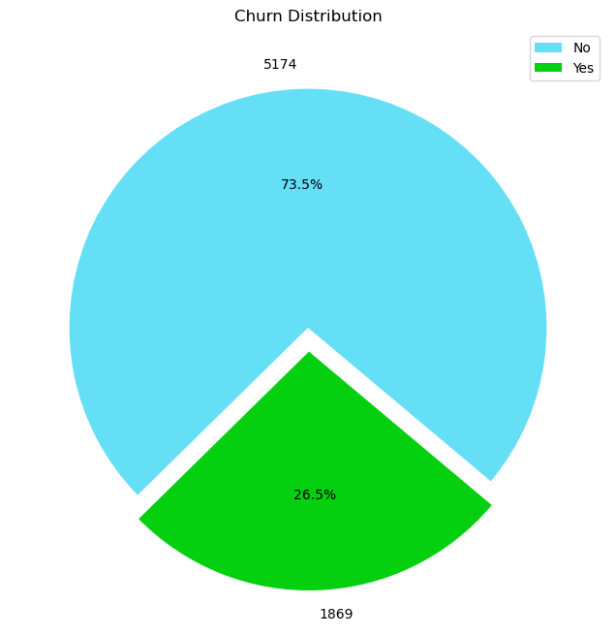
Telco Customer Churn Prediction Using
Machine Learning Algorithms
Introduction
Customer churn, in a business context, refers to the phenomenon where customers discontinue their association with a company or stop using its products or services. It is a critical metric for businesses, reflecting the rate at which customers leave over a specific period. High customer churn can signify dissatisfaction, competition challenges, or a need for improved customer engagement and retention strategies. Analysing and understanding the factors influencing customer churn are essential for organizations seeking to enhance customer loyalty, satisfaction, and overall business sustainability.
Dataset
The dataset used for this analysis contains Telco customer churn data of 7043 customers. It is also known as IBM Watson dataset which acquired from Kaggle website. Each row of the dataset represents the customers, and the columns represents its 21 attributes including gender, tenure, phone service, online security, contract, payment methods etc. That provides crucial information related to demographics, contractual dynamics, and usage patterns, offering a comprehensive view of customer engagement. This dataset serves as a valuable resource for exploring factors influencing customer churn, providing insights that can be used for strategic decision making and implementing effective customer retention strategies. This dataset does not contain any personal data or any information which need ethical approval.
Methodology
Model’s result comparison will help to find & implement the best machine learning model for the customer churn prediction.
Project
This project focuses on predicting customer churn within the telecommunications sector utilizing the provided dataset from Kaggle. The primary aim is to develop a robust machine learning model that accurately predicts instances of customer churn. Implementation involves preprocessing the dataset, exploring relevant features, and employing predictive modelling techniques such as classification algorithms to build an effective churn prediction model. By leveraging historical data, the analysis seeks to identify patterns and factors contributing to churn, allowing businesses to proactively address customer retention strategies and enhance overall customer satisfaction within the telecommunications industry.
Exploratory Data Analysis
By observing the graph, we can understand. Nearly a quarter of the customers left in a month. So going to analyze the model with various evaluation matrix to extract the insight for the customer retention.
Preliminary Result
Below shows the tabular representation of the preliminary results for Decision Tree, Random Forest, and SVM models. It summarizes the key evaluation metrics for each model, including Accuracy, Precision, Recall, and F1-score.
SVM appears to have the highest accuracy among the three models, indicating better overall performance.
Random Forest has a relatively balanced precision and recall for "Yes" class, making it a reasonable choice.
Decision Tree has lower precision and recall for "Yes," suggesting it might need further tuning
Next Steps
Fine tuning the model for better result.
Implement and test the other machine learning model i.e XG boost and KNN
Hyper parameter tuning the SVM model using the Ada Boost technique referred from the Literature review
Compared the results and finalize the model
Data Collection
Data Preprocessing:
Exploratory Data Analysis (EDA)
Train-Test Split:
Model Selection
Model Evaluation
Hyperparameter Tuning
Prediction
 | Decision Tree | Random Forest | SVM
Accuracy | 0.72 | 0.77 | 0.79
Precision | 0.48 | 0.60 | 0.66
Recall | 0.47 | 0.46 | 0.48
F1 | 0.47 | 0.52 | 0.56
Results Interpretation
Reference
https://www.researchgate.net/profile/Saran-A/publication/310757545_A_Survey_on_Customer_Churn_Prediction_using_Machine_Learning_Techniques/links/5bb5fb8a299bf13e605e2ae9/A-Survey-on-Customer-Churn-Prediction-using-Machine-Learning-Techniques.pdf
https://journalofbigdata.springeropen.com/articles/10.1186/s40537-019-0191-6
https://www.researchgate.net/publication/273439405_A_Comparison_of_Machine_Learning_Techniques_for_Customer_Churn_Prediction
https://www.easpublisher.com/get-articles/3872#:~:text=The%20study%20found%20that%20the,predictors%20of%20churn%20%5B1%5D.
Fig: Target Feature Visualization

