Slide 1
Startup Funding Success Prediction and Investor Pattern Analysis
R · Shiny · Random Forest
Ushasree
160124771017
Chaitanya Bharathi Institute of Technology (CBIT)
Notes:
Introduce the project: an analysis of Indian startup funding with an R Shiny dashboard and a Random Forest model.

Slide 2
Case Study Overview & Problem Statement
PROBLEM
NEED
PROPOSED SYSTEM
Funding is concentrated in a few cities, sectors and investors
Raw Kaggle records are messy: spelling variants and missing amounts
No quick, data-driven view of these patterns
See where funding flows and who funds it
Judge whether a deal is likely above or below the median amount
One interactive tool instead of manual spreadsheets
Startup Funding Analytics:
A Shiny dashboard with funding analysis and a Random Forest that classifies each deal as Higher or Lower than the median amount
Notes:
Funding is concentrated; raw data is messy; we need a clear view and a simple prediction.

Slide 3
Project Objectives
Four goals driving the startup funding analysis
01
Clean & Standardise
02
Analyse Funding Patterns
Fix messy labels, amounts and dates in the raw Kaggle file.
Study funding by year, industry, city, investment type and investor.
03
Predict Funding Category
04
Deploy a Shiny Dashboard
Random Forest classifies a deal as Higher or Lower than the median amount.
Filters, charts, model results and a prediction form in one app.
Notes:
Four goals: clean, analyse, predict, deploy.

Slide 4
Dataset Overview
Indian startup funding records from Kaggle, January 2015 to January 2020
startup_funding.csv
Prediction setup
Source
Kaggle: Indian Startup Funding
Target
amount_category: Higher or Lower than the median amount
Size
3,044 rows × 10 columns
Features
Industry, city, investment type, year
Fields used
Date, startup, industry, city, investors, investment type, amount (USD)
Records used
2,071 with a valid amount and date
Period
2 Jan 2015 to 13 Jan 2020
Scope
Funded startups only, no rejected ones
Notes:
One real Kaggle dataset; the synthetic sample file was only for testing the interface.

Slide 5
Data Preparation
From a messy raw file to analysis-ready data
3,044
971
2,073
0
records
missing amounts (31.9%)
valid amounts
duplicate rows
Remove escape junk
Standardise labels
01
02
Strip stray \xc2\xa0 and \n sequences
Bengaluru→Bangalore, eCommerce spellings, Seed/Angel
Clean amounts and dates
Handle missing values
03
04
Remove commas, "undisclosed"→NA, parse dd/mm/yyyy
Blank categories become "Unknown"
Notes:
Nearly a third of amounts are missing, so amount-based work uses 2,073 valid records.

Slide 6
Proposed Methodology
End-to-end workflow from raw data to dashboard
01
Data Cleaning & Preprocessing
Escape removal · label standardisation · amount and date parsing · duplicate check
app.R · prepare_data()
02
Analysis & Visualisation
Records by year, industry, city, investment type and investors · summary tables
ggplot2 inside Shiny
03
Model Development
80/20 split, set.seed(123) · industry, city, investment type, year · target Higher / Lower
randomForest, ntree = 300
04
Dashboard & Versions
5 tabs, 4 filters, CSV download · named versions app_v1_original.R and app_v2_cleaned.R
shiny, shinydashboard
Notes:
Four stages from cleaning to the deployed dashboard.

Slide 7
End-to-End System Flow
Analysis & Charts
Input: Kaggle CSV file
Clean & Standardise
Shiny Dashboard
Random Forest Model
Dashboard output: filters · charts · model metrics · "Try a Prediction" form · filtered CSV download
Notes:
Data flows from the CSV through cleaning into analysis and the model, then into the dashboard.

Slide 8
Funding Patterns
Activity peaked in 2016 and is concentrated in four cities
Funding records by year
Top cities by records
Bangalore, Mumbai, New Delhi and Gurgaon account for about 73% of records. 2020 covers January only.
Notes:
Records peaked in 2016. Four cities hold about 73 percent of all records.

Slide 9
Industries & Investors
A few sectors and repeat investors dominate recorded deals
Top industries by records
Most frequent investors
Median deal is 1.75 million USD against a mean of 18.4 million: a few very large deals skew the totals. "Undisclosed Investors" is excluded.
Notes:
Consumer Internet, Technology and eCommerce lead. Sequoia and Accel are most frequent.

Slide 10
Model Performance
Random Forest, 415 test records, Higher vs Lower than the median amount
85.8%
0.780
Confusion matrix (test set)
Actual \ Predicted | Lower | Higher
Lower | 161 | 55
Higher | 4 | 195
Accuracy
Precision (Higher)
0.980
0.869
Finds 195 of 199 large deals; 55 small deals are wrongly called Higher.
Recall (Higher)
F1 (Higher)
Version 1 (investment type not detected): accuracy 0.60 → Version 2 (cleaned data): accuracy 0.858
Notes:
Accuracy 85.8 percent against a 50 percent baseline. Fixing one column name raised accuracy from 0.60.

Slide 11
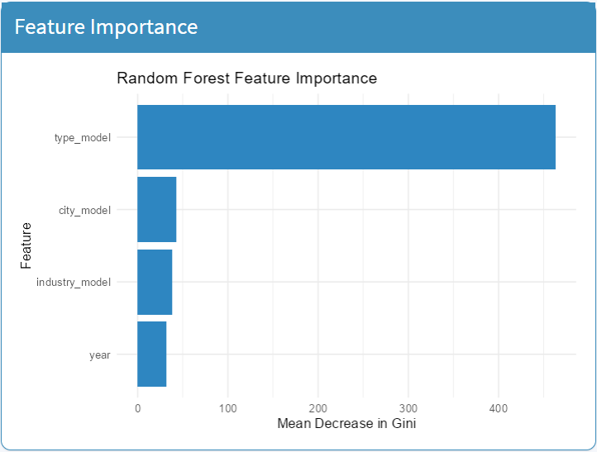
What Drives the Prediction
Feature importance from the dashboard (Mean Decrease in Gini)
Investment type dominates
About 81% of Private Equity deals are above the median vs about 6% of Seed/Angel deals.
City, industry and year matter less
Each contributes far less than investment type.
Read with care
Stage and amount are linked, so part of the accuracy is built in. This is not a forecast of what a startup will raise.
Notes:
Investment type is by far the most important feature, and stage and amount are linked.

Slide 12
Key Takeaway
Clean Data
Funding Patterns
Random Forest
Shiny Dashboard
Recorded funding is concentrated in a few cities, sectors and investors, and a Random Forest separates higher from lower deal amounts with 85.8% accuracy.
Limitations
31.9% of amounts are missing · only funded startups appear · few features available
Future work: standardise investor names, add more features, compare other models
Notes:
Close with the main message and the limitations.

