Slide 1
The Opioid Epidemic in USA
Parthavi Kaka
Ushasree Boora
Harshit Ambalkar
Harsh Kathiriya

Slide 2
What Are Opioids?
Opioids are a classification of drug that is derived from, or a synthetic version of, opium.
The opioid epidemic specifically refers to the growing number of deaths and hospitalizations from opioids, including prescriptions, illicit drugs, and analogues.

Slide 3
Effects
Increase in deaths
Addiction
Disorder
More harmful to older people

Slide 4
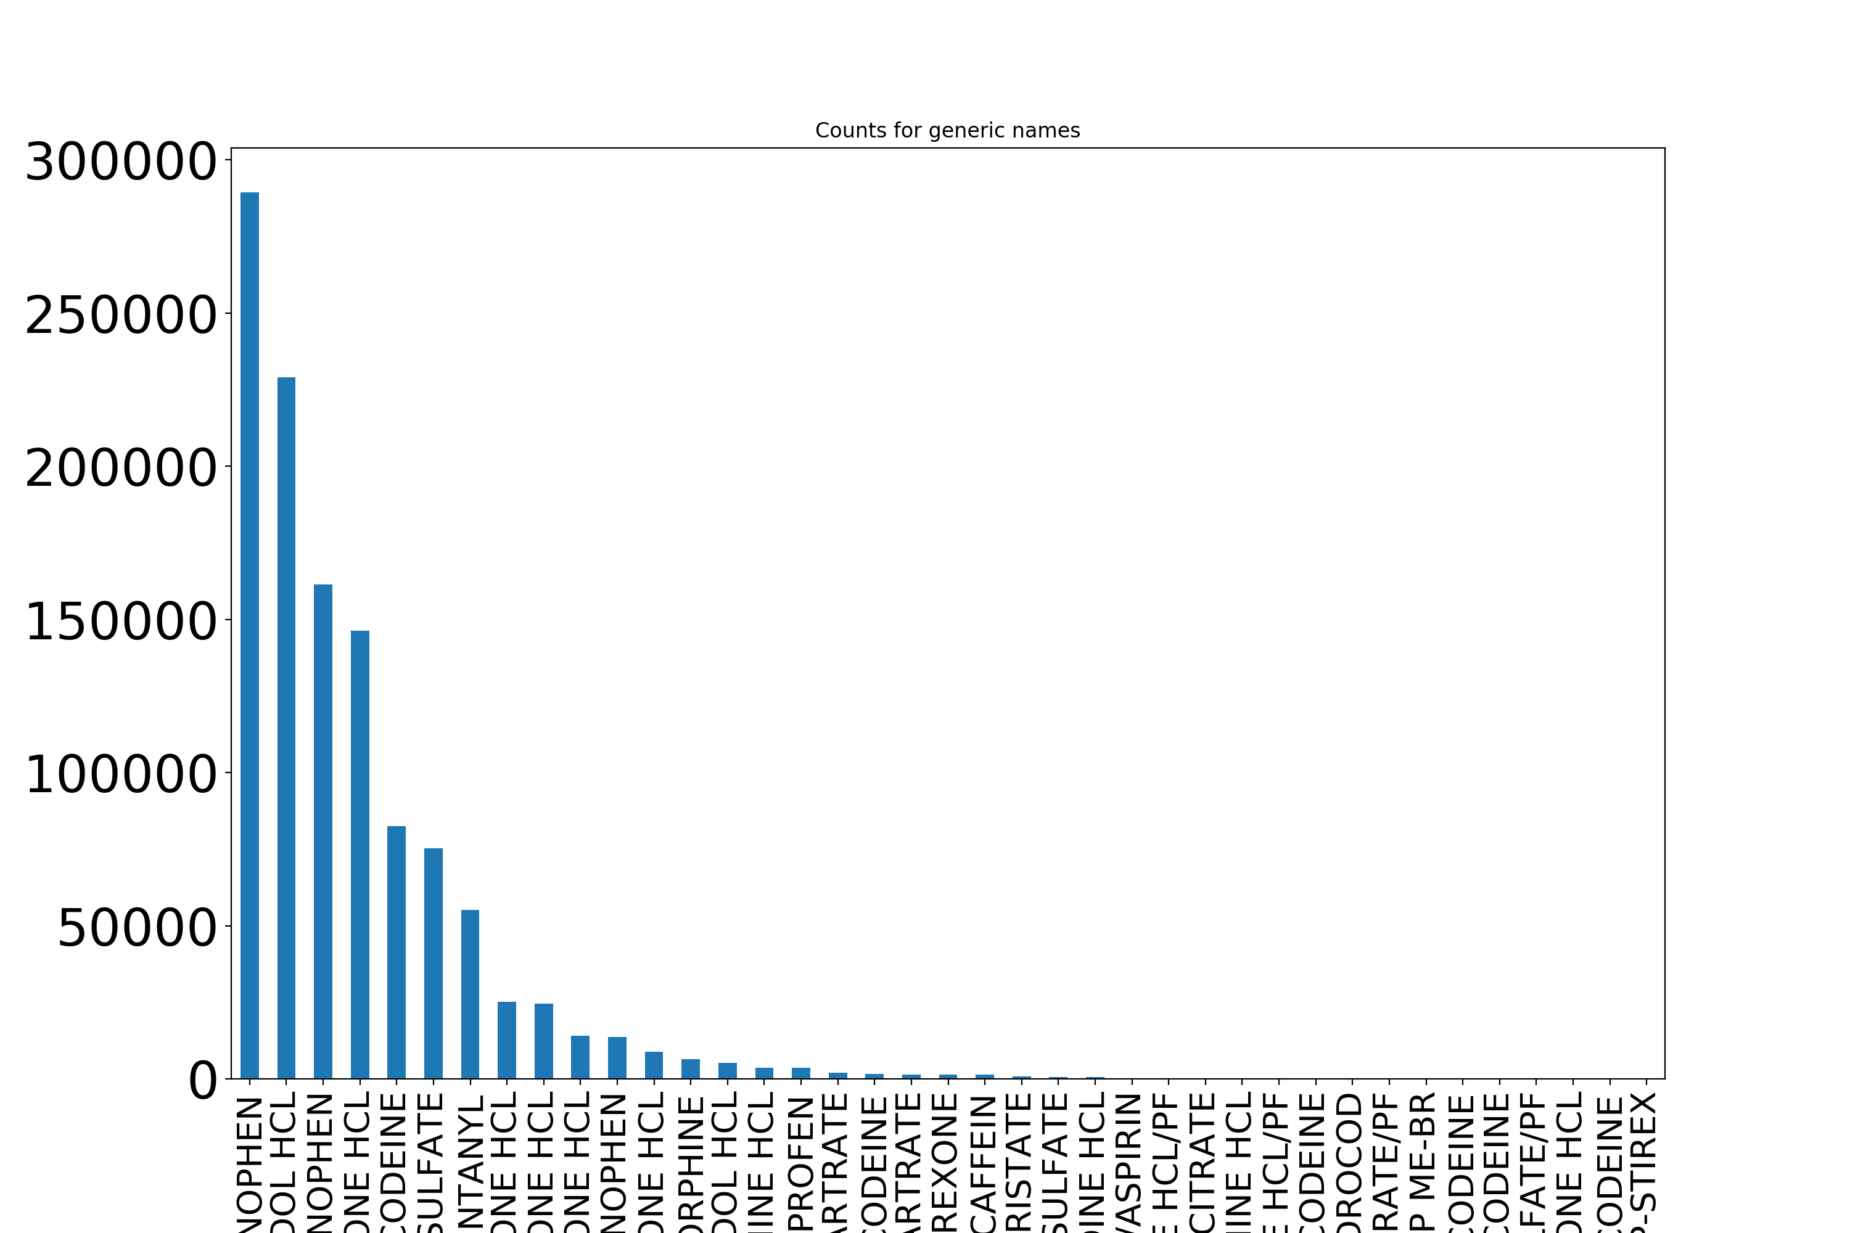

Slide 5
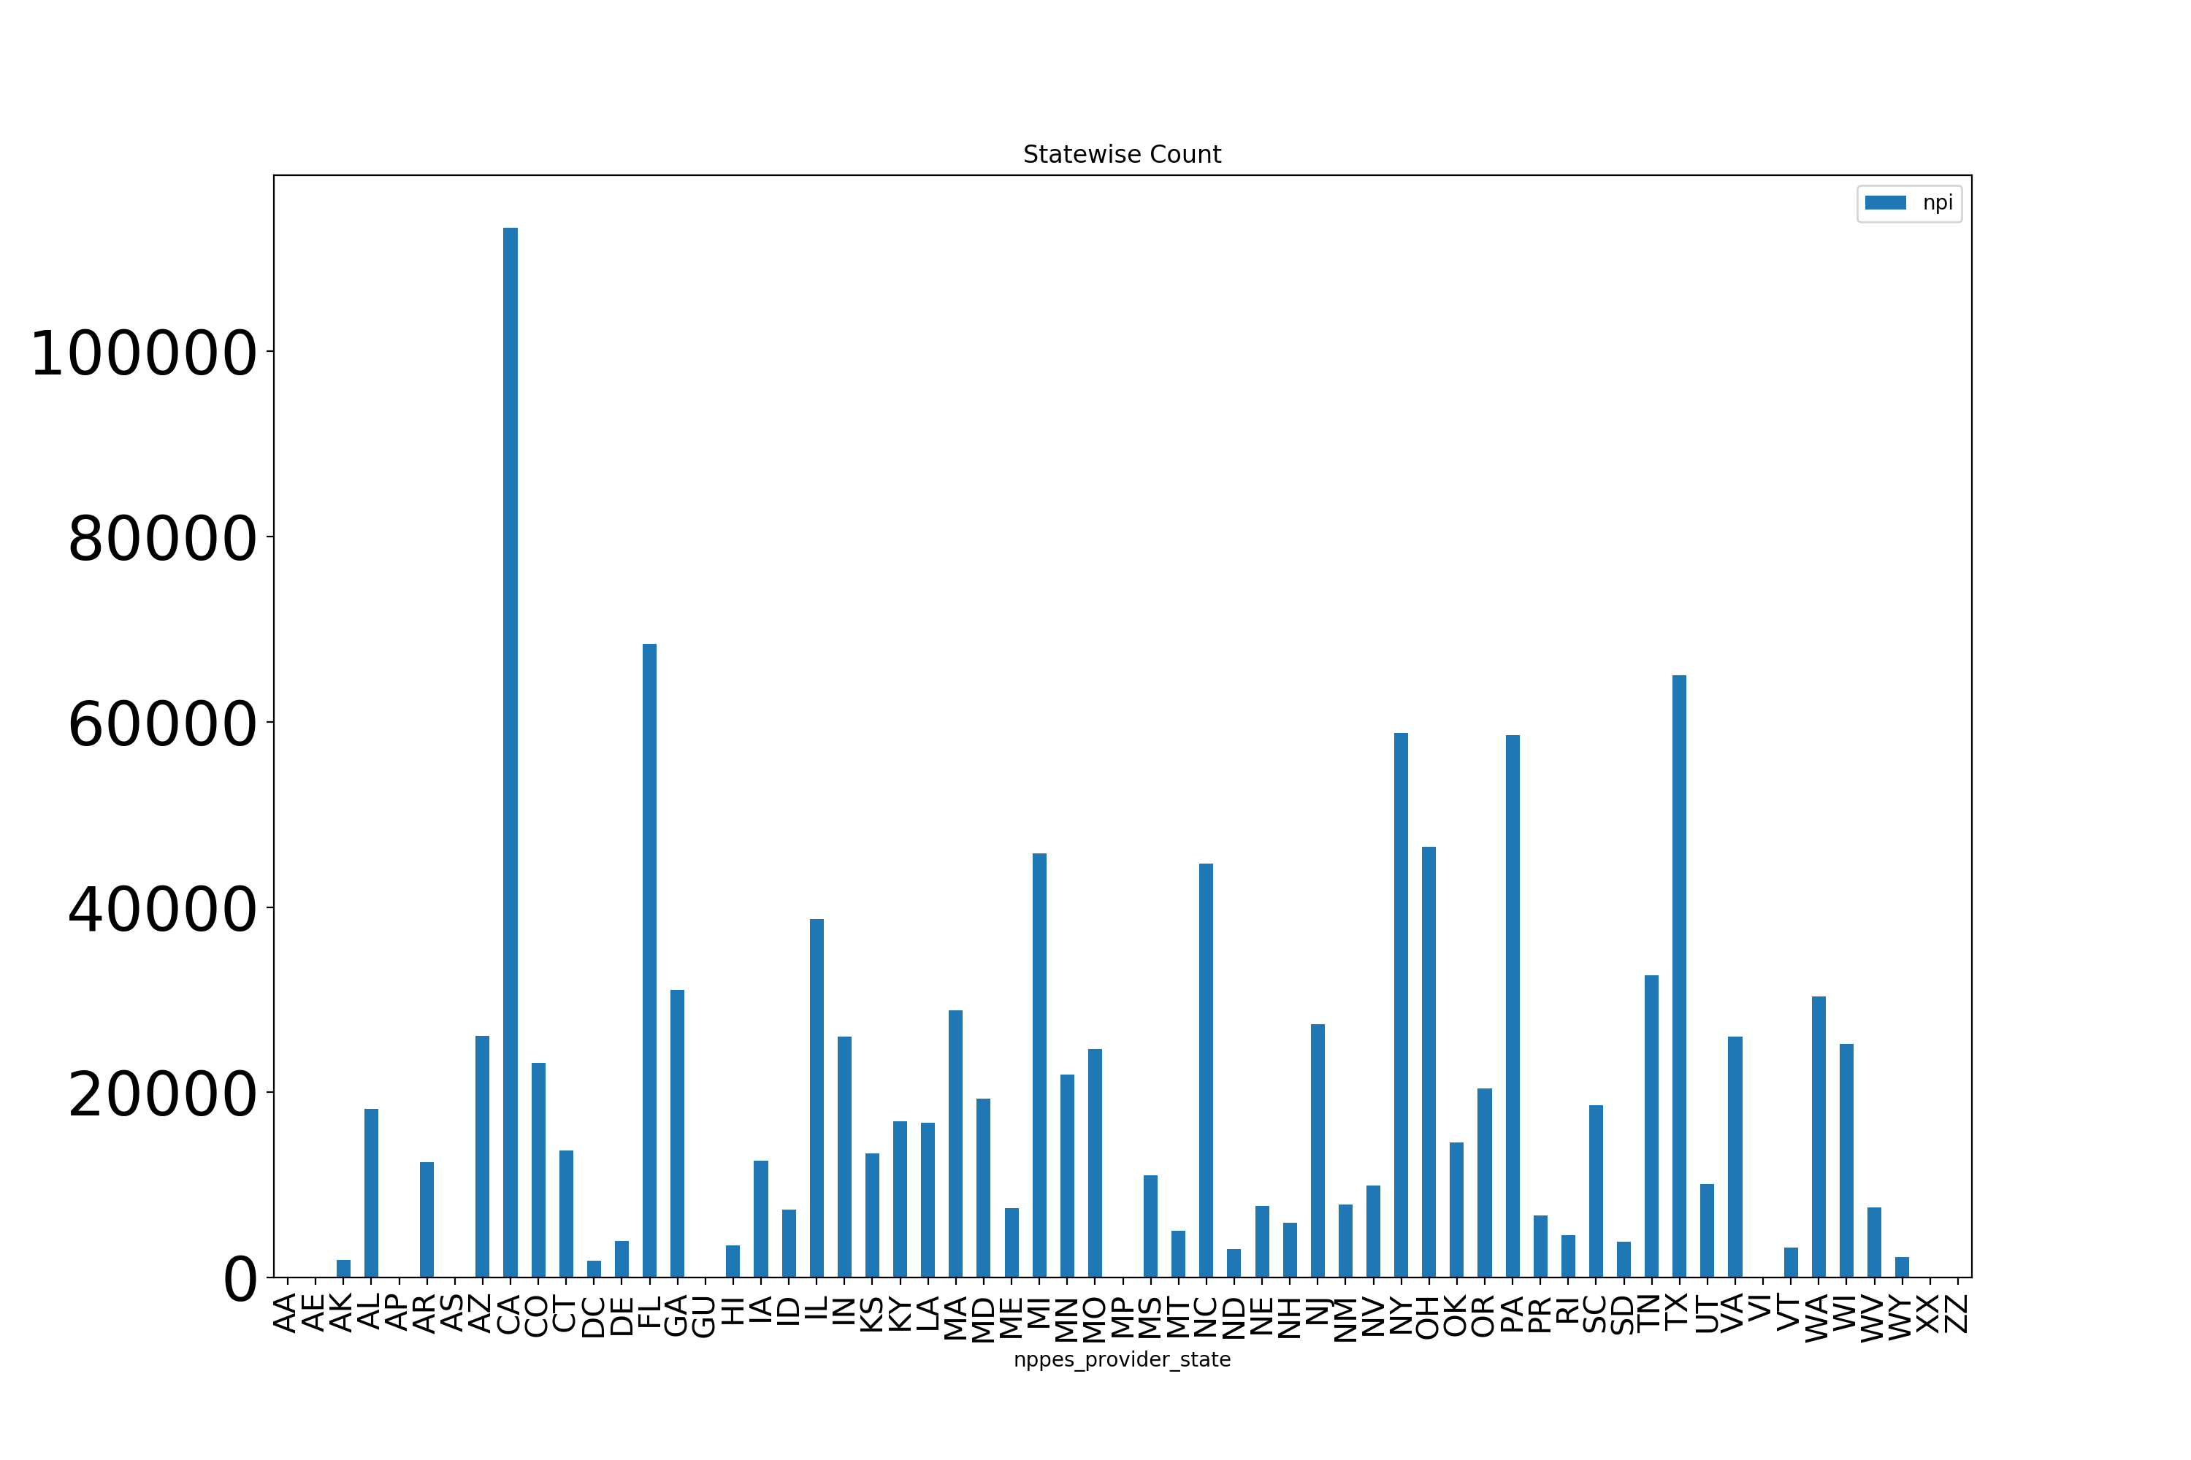

Slide 6
Reason
For what department?
How is it being used?
Commissions from manufacturers

Slide 7
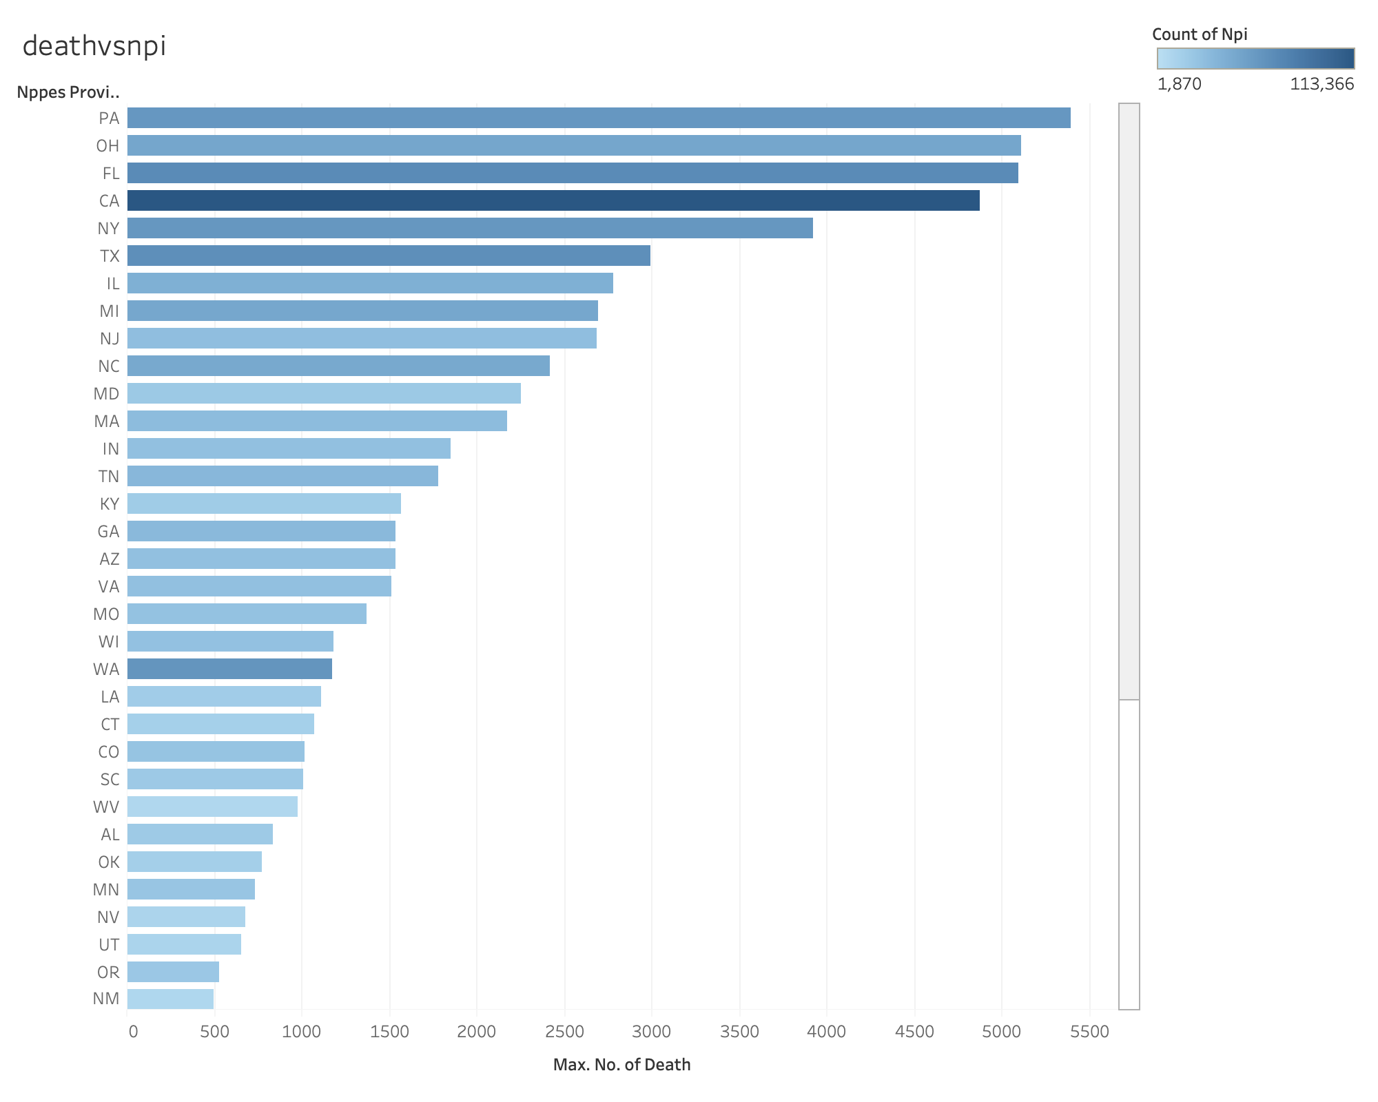

Slide 8
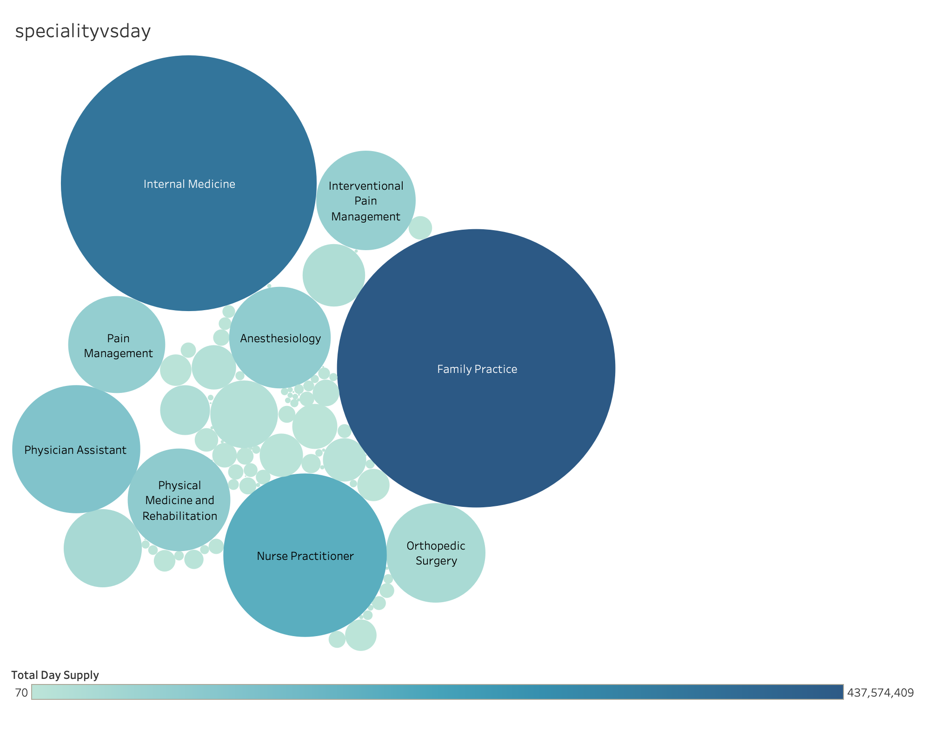

Slide 9
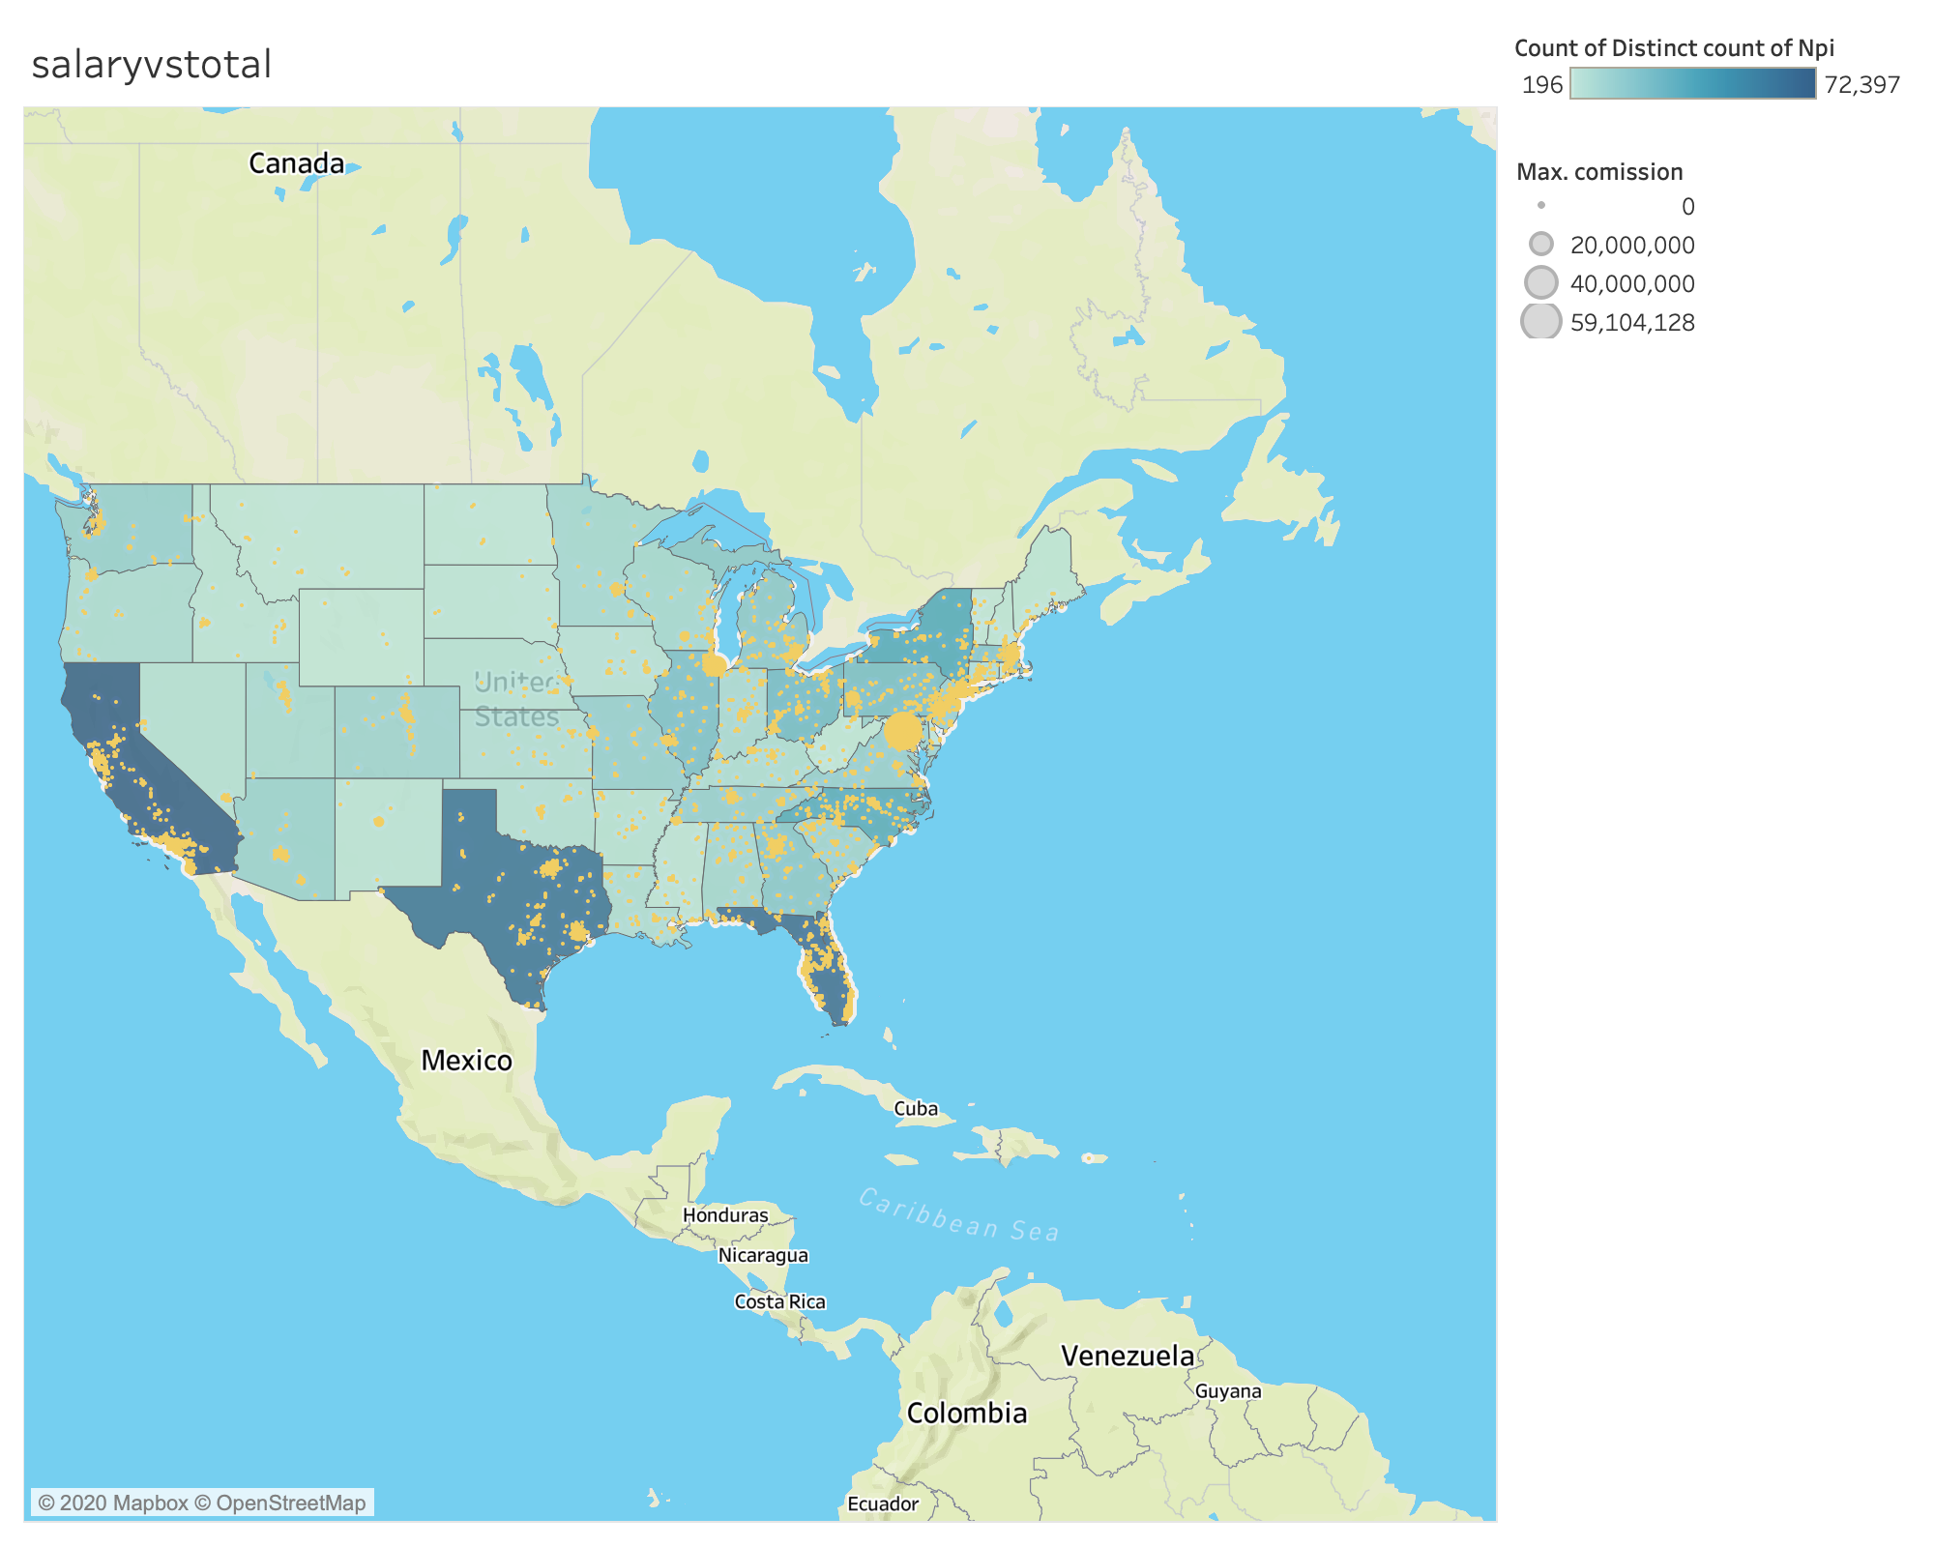
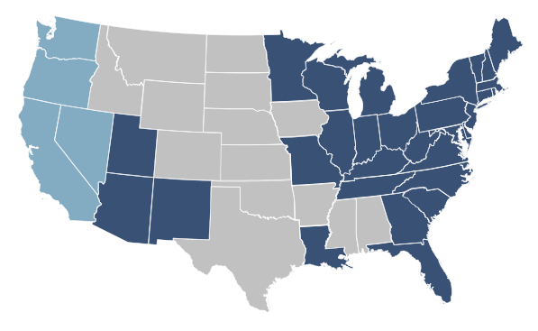
Drug Trafficking

Slide 10
Mitigation
Increase Awareness about safer alternatives
Conduct Webinars
Build helpful material for patients such as applications
Antidote usage for overdosage to prevent addiction

Slide 11
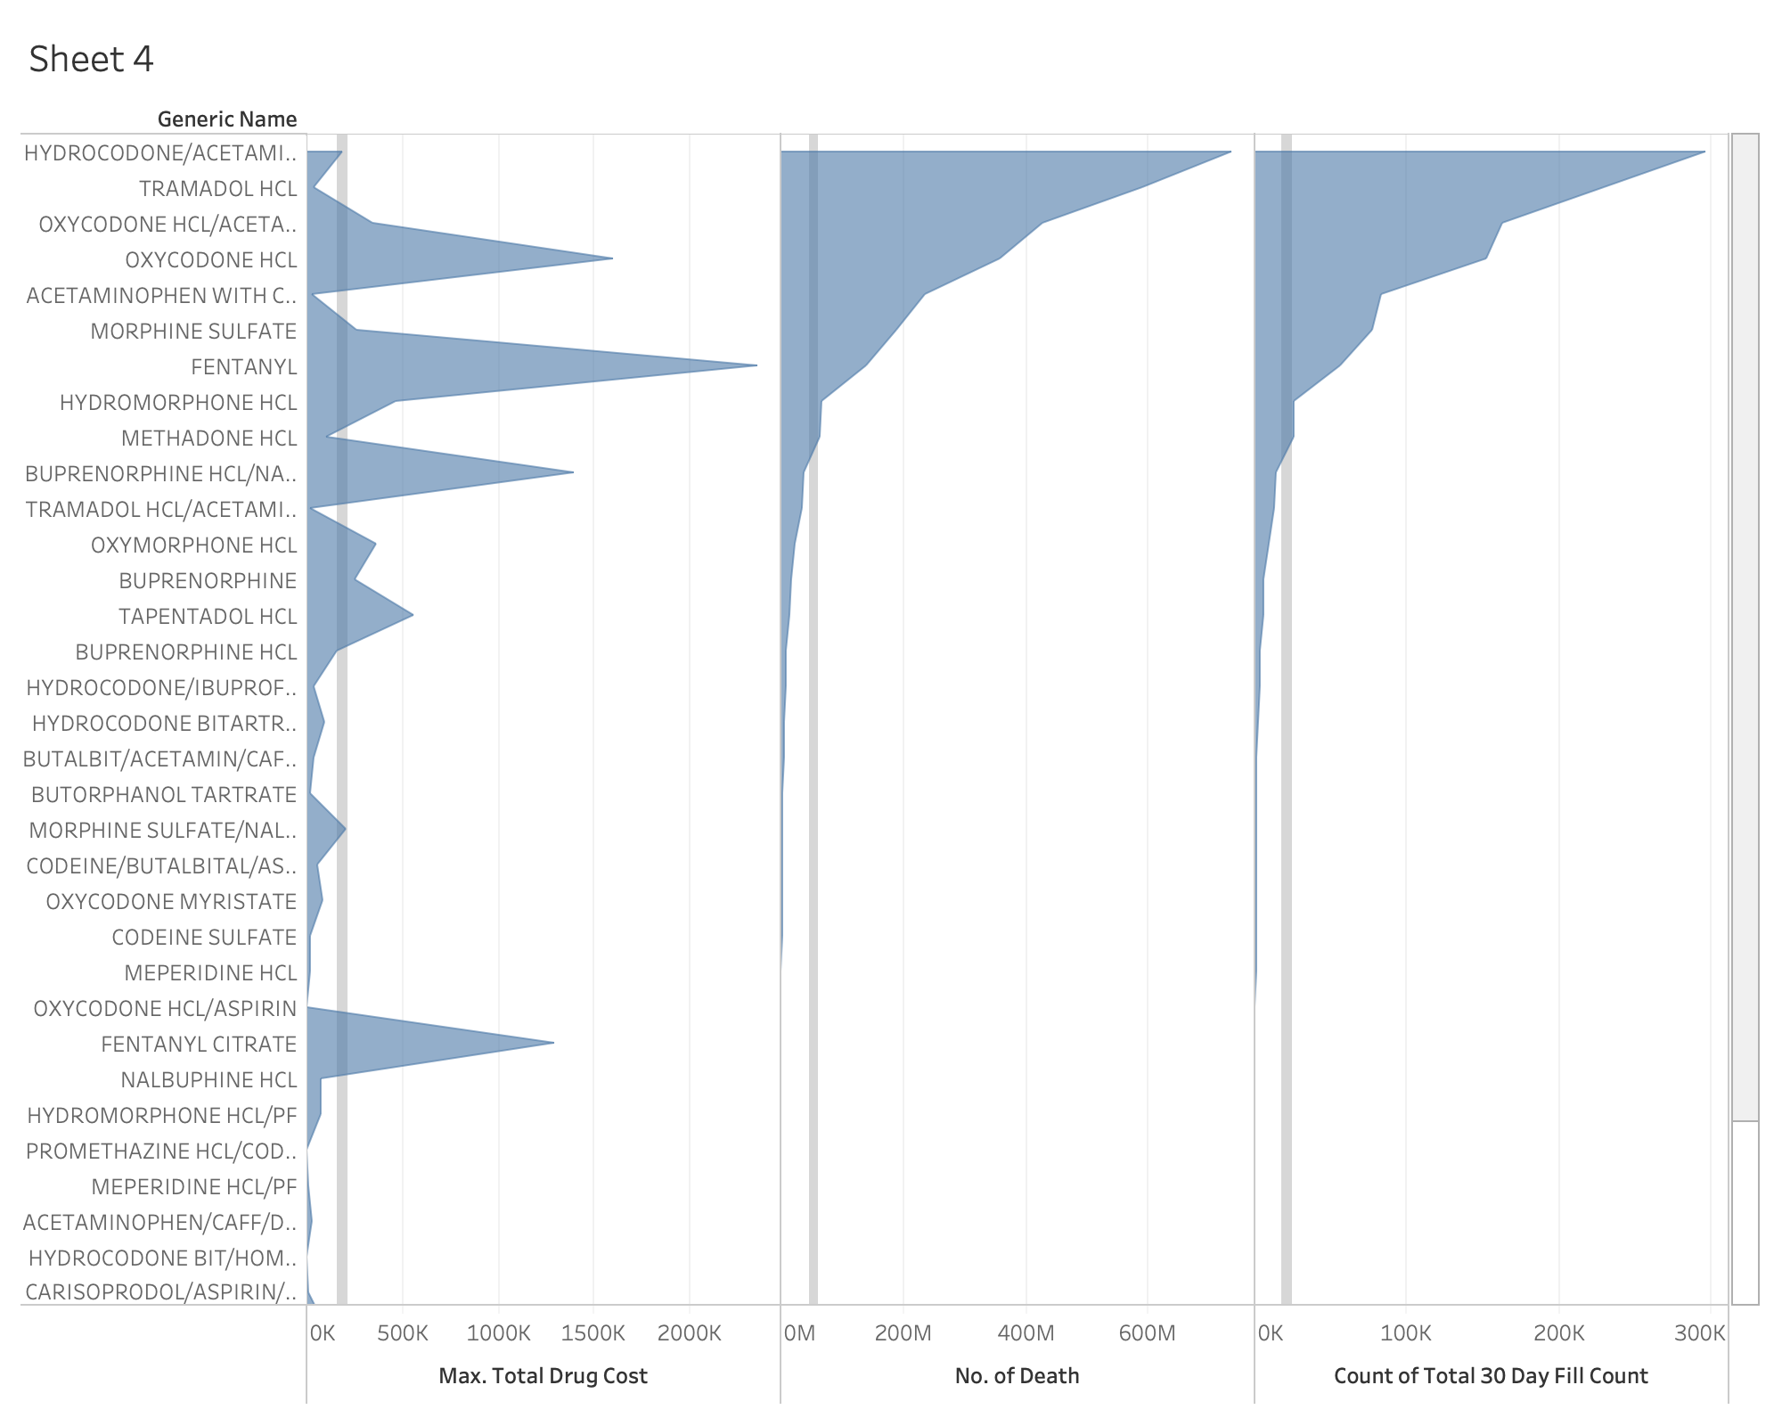

Slide 12
Thank you

