Slide 1


CommUnity: Seamless Community Interaction and Management
Team Members:
Usha Sri Ponaka
Rupa Malika Devi D
Sanchita Mondal
Surya Sivakumar
Mentor Name: Shankar

Slide 2
Introduction :
CommUnity is a modular, multi-tenant community management system designed to simplify housing society management.
The platform connects members, streamlines daily activities, and enhances community engagement.
This platform provides an efficient interface for both administrators and residents, management, facilitating interaction, and engagement within the community.
Key Features:
Simplify housing society management
Enhance communication between residents and administrators
Increase resident participation in community activities
Facilitate transparent financial transactions
Improve community safety and security

Slide 3
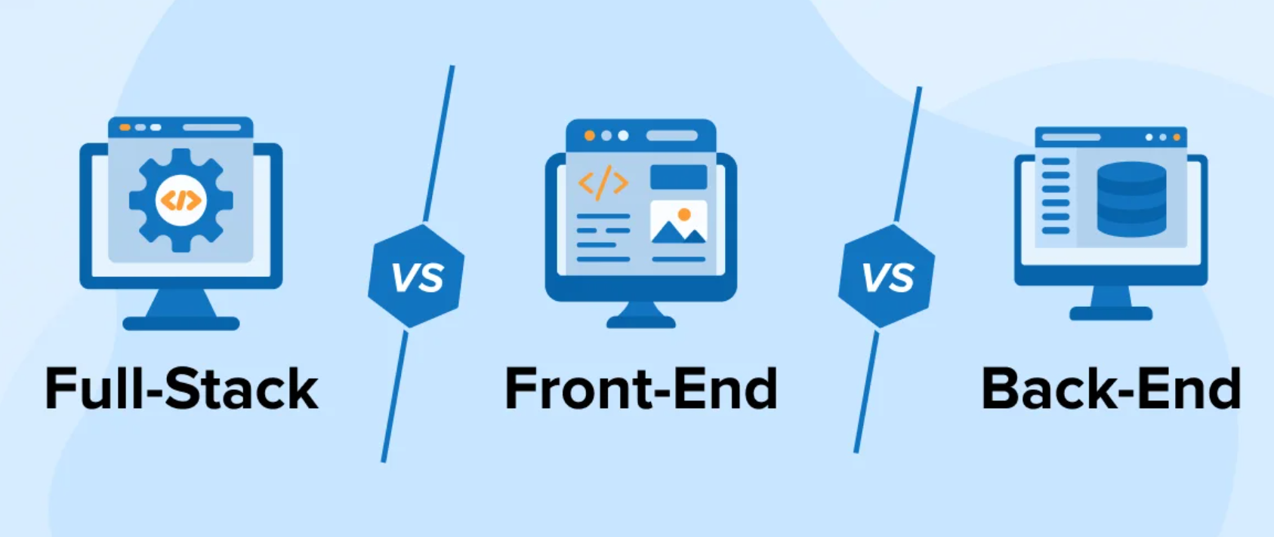
Technology Stack
Frontend:
React
Tailwind CSS
Material UI
Redux
Backend:
Spring Boot
Microservices Architecture
Database:
MySQL

Slide 4
Modules To Be Implemented
User Authentication and Registration
Resident and Society Management
Event and Notice Management
Complaint and Service Request Management
Maintenance Payment System

Slide 5
The Administrator Can:
Manage user registrations and approve resident accounts.
Add, update, and organize resident and flat details.
Create, update, and delete events, notices, and circulars.
Monitor and resolve complaints and service requests.
Generate maintenance bills and track payment statuses.
Access and manage emergency contact and security details.
View reports and analytics for better decision-making in community management.

Slide 6
The Resident Dashboard:
Register and Manage their Profile
View events, notices, posts
Log complaints and service requests
Make online maintenance payments
Provide feedback on events
Access security and emergency contacts

Slide 7
Conclusion
The "CommUnity" project effectively streamlines housing society management by enhancing communication, operations, and resident engagement With key features like user authentication, complaint handling, event management, and payment integration, it ensures transparency and efficiency. Leveraging modern technologies like Razorpay and JWT authentication, "CommUnity" offers a secure and convenient platform that sets a new standard for community management.

Slide 8
Future Enhancements
Mobile App Integration
Smart IoT Integration
Poll and Decision-Making Module
Advanced Security Features
Multilingual Support

Slide 9


