Slide 1
INST737
MILESTONE 1 - PROJECT PRESENTATION
09/25/2023
TEAM 5 Sadaf Nasir Davre
Tanya Gupta
Ushasri Bhogaraju
Professor: Dr. Vanessa Frias-Martinez

Slide 2

INTRODUCTION
The 30 year fixed rate mortgage home loans are the most common mortgage loan option in the United States. Its main advantage is the ‘Predictability’, the interest rate is locked for the entire 30- year term, and the monthly repayments are smaller. Fannie Mae is a federally backed institution that buys these and other mortgages from retail banks or lending institutions, and either holds them in its books or repackages them into ‘Mortgage Backed securities(MBS)’, for selling to investors. It maintains the Fannie Mae Data Dynamics site and publishes and maintains a variety of large datasets to comply with regulatory requirements and also facilitate analysis by various parties such as home buyers, investors and analysts.

Slide 3
RESEARCH QUESTIONS
Can we accurately predict the ‘Interest Rate’ applied to a mortgage loan by a lending institution, using criterion such as the Quantum of loan, Loan-To-Value ratio, Debt-To-Income ratio, Loan Purpose, Number of Borrowers and Credit Score of the Borrower/s, using the Fannie Mae Acquisition and Performance 2022Q4 dataset?
Do all the borrower criteria such as the Quantum of loan, Loan-To-Value ratio, Debt-To-Income ratio, Loan Purpose, Number of Borrowers and Credit Score of the Borrower/s have equal influence over ‘Interest Rate’? If not, which criteria have more effect on Interest Rate?
Do all lending institutions (presumed to be the ‘Seller’ in the dataset), evaluate the criterion variables similarly and fix the interest rate?

Slide 4

SIGNIFICANCE OF THE RESEARCH QUESTIONS
Technical perspective
Societal impact perspective

Slide 5
STATE OF THE ART
1. "Expectations and Interest Rates on Mortgage Loans" by Kay Mitusch and Dieter Nautz
2. “The Variation of Mortgage Interest Rates” by Alfred N. Page
3.“Short-term Prediction of Mortgage Default using Ensembled Machine Learning Models” by Jesse C. Sealand
4."A Few Useful Things to Know About Machine Learning" by Pedro Domingos

Slide 6
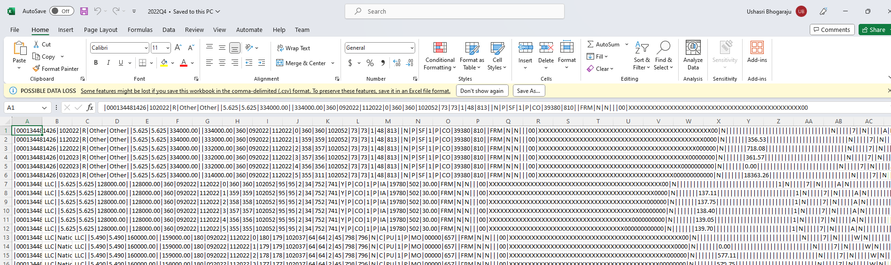
ORIGINAL DATASET
We aimed to examine a substantial financial dataset offering multiple criteria variables suitable for training machine learning models using diverse methods to accurately forecast an outcome variable. We selected a dataset from the Fannie Mae Single Family Acq and Perf Dataset 2022Q4, as it contains a variety of variable types necessary for our study. It has 1391558 observations and 108 variables, which we transformed to a Final Data set of 271368 observations and 29 variables

Slide 7

DATA CLEANING
Data Extraction and Transformation was done using R Code in RStudio environment
Data Transformation Steps
Step 1: Extracting Column Headers
Step 2: Inserting Headers into Primary Dataset
Step 3: Subsetting Required Columns
Step 4: Filtering Rows based on a criteria
Data Cleaning Steps
Step 5: Rectification of Data Types
Step 6: Checking for Null Values
Outlier Detection - Handling Null Values - Final Dataset
Notes:
Data Extraction and Transformation:
Extracted, reduced, filtered, and transformed data from '2022Q4.zip' and 'crt-file-layout-and-glossary.xlsx'.
Primary dataset: 1,390,558 rows, 108 variables.
Layout file: 108 rows, 10 columns with metadata.
Merged and transformed data to create the final dataset.
Data Shape:
Final dataset: 271,368 rows, 29 variables.
Null Value Checking:
Checked for Null values in the final dataset.
Utilized the 'summary()' command and 'is.na()' function.
Prepared to handle Null values in predictor variable columns.
Data Visualization:
Planned to use Box and Scatter plots to detect outliers.
Outlier analysis will be discussed in the Data Visualization section.
Data Cleaning Steps:
Extracted column headers from 'crt-file-layout-and-glossary.xlsx'.
Inserted headers into '2022Q4.zip' dataset, creating 'FM_AP_R_2022Q4.csv'.
Subsetted required columns, resulting in 'Trimmed_FM_AP_R_2022Q4.csv'.
Eliminated duplicates to retain unique rows.
Rectified data types, converting int date columns.
Checked for Null values, removed rows with Null values, and produced 'Transformed_FM_AP_R_2022Q4.csv'.
Final Dataset for Analysis:
Final dataset shape: 270,993 rows, 29 variables.
Variables identified for analysis: 13 without Null values.

Slide 8
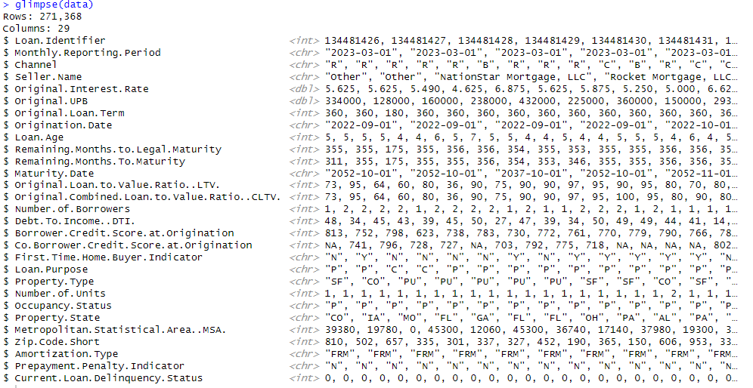
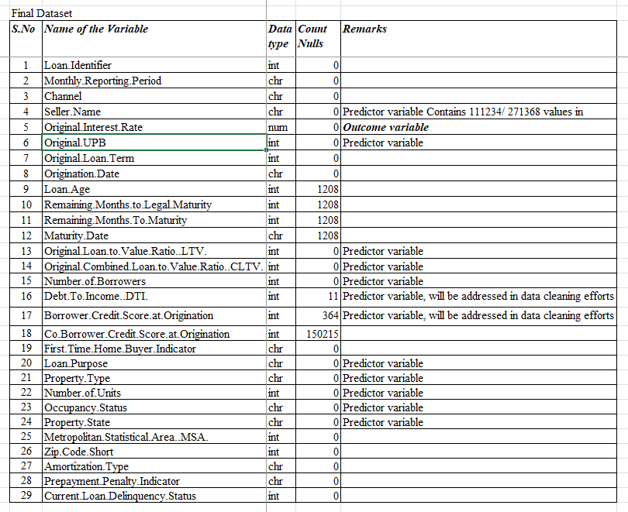
FINAL DATASET
We transformed the Original Fannie Mae Single Family Acq and Perf Dataset, 2022Q4 with 1,391,558 observations of 108 variables, to a Final Data set of 271368 observations and 29 variables. This is a shortlisted dataset arrived at after subsetting columns to retain interesting variables, filtering for Mar ‘23 data to retain unique Loans, and performing date type field conversion. Null values count as under:

Slide 9
SOFTWARE ENGINEERING
Fannie Mae Research:
Used Fannie Mae Wiki to understand its role in the mortgage industry.
Data Dynamics Exploration:
Watched a YouTube video to learn about Data Dynamics and its resources.
SF Loan Performance Dataset:
Read the tutorial on the Data Dynamics page to grasp dataset usage.
Troubleshooting Data:
Referenced R documentation and Posit Community posts for data transformation issues.
Instructional Team Help:
Sought assistance from the instructional team when stuck, alongside self-troubleshooting efforts.
Introduction_to_R_ggplot2 Workshop Material was revisited to enhance understanding of ggplot lib

Slide 10
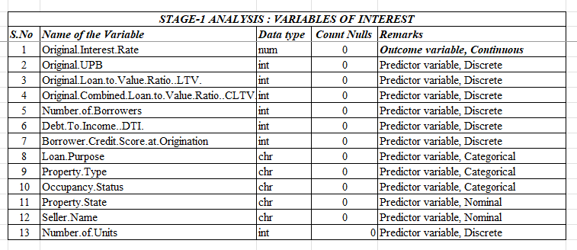
STAGE-1 VARIABLES OF INTEREST
Our final dataset set of 271368 observations and 29 variables, is a shortlisted dataset that contains interesting variables but our primary focus is on a set of 13 variables, with Interest rate as the outcome variable and 12 predictor variables. Rows with null values for these variables were removed

Slide 11
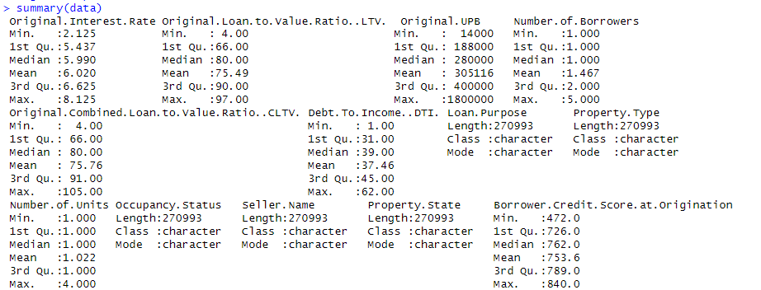
STATISTICAL ANALYSIS OF VARIABLES OF INTEREST
Here we produce the Statistical analysis, of only the outcome and Predictor variables after removing Null values. The shape of this dataset is : 270,993 observations, and 13 variables
Outcome Variable: Original Interest Rate
Distribution: Continuous
Min: 2.125
Max: 8.125
Mean: 6.020
Median: 5.990
Predictor Variables:
Number: 12, Numerical: 7, Categorical: 3, Nominal: 2
Outliers exist

Slide 12
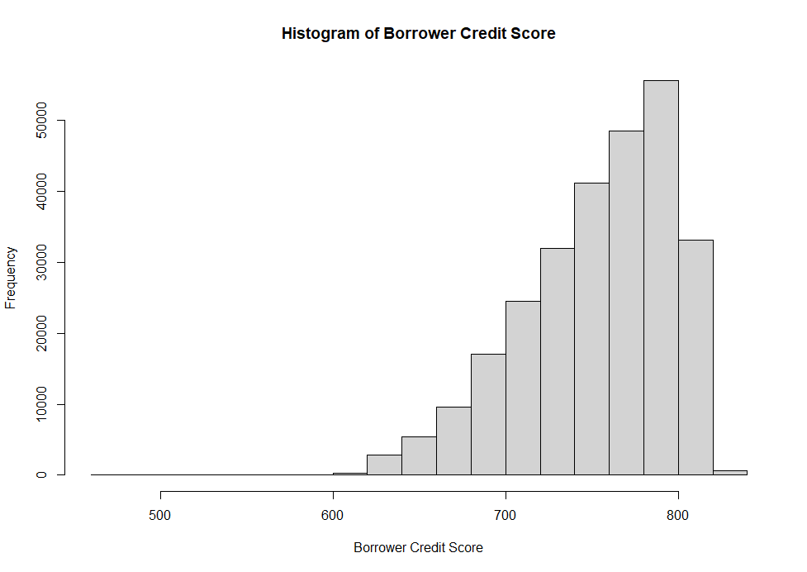
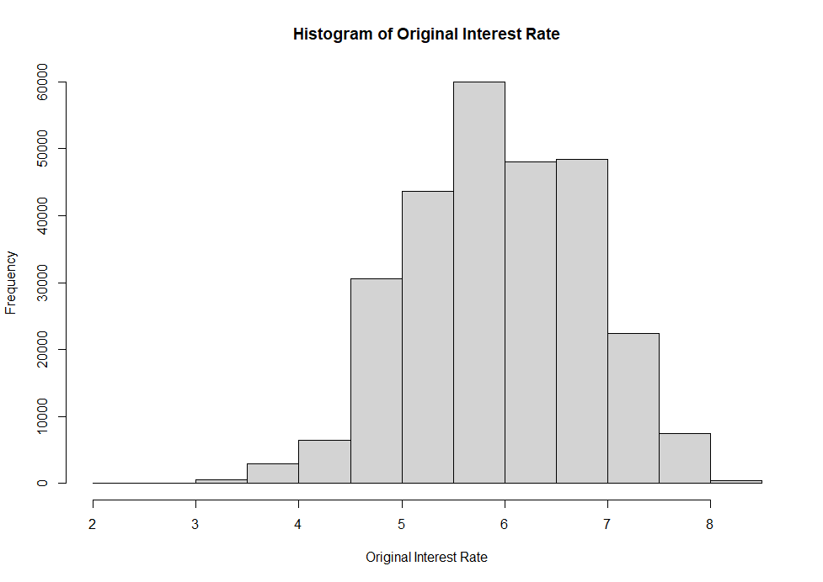
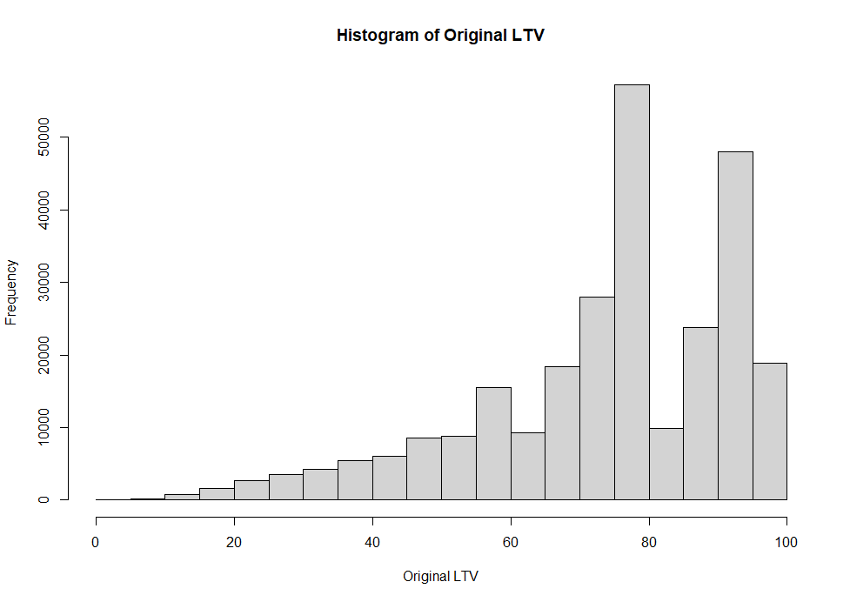
INTEREST RATE, CREDIT SCORE, LTV RATIO DISTRIBUTIONS

Slide 13
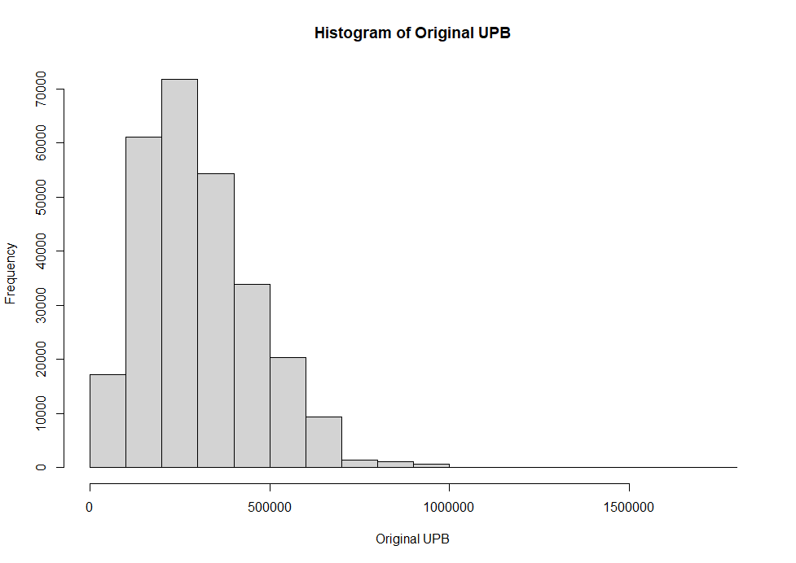
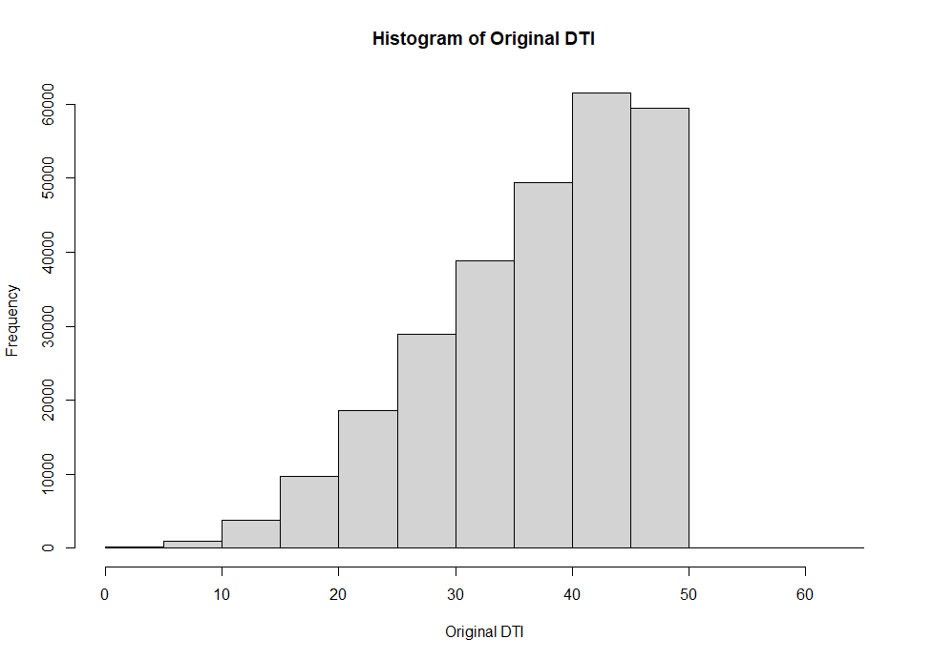
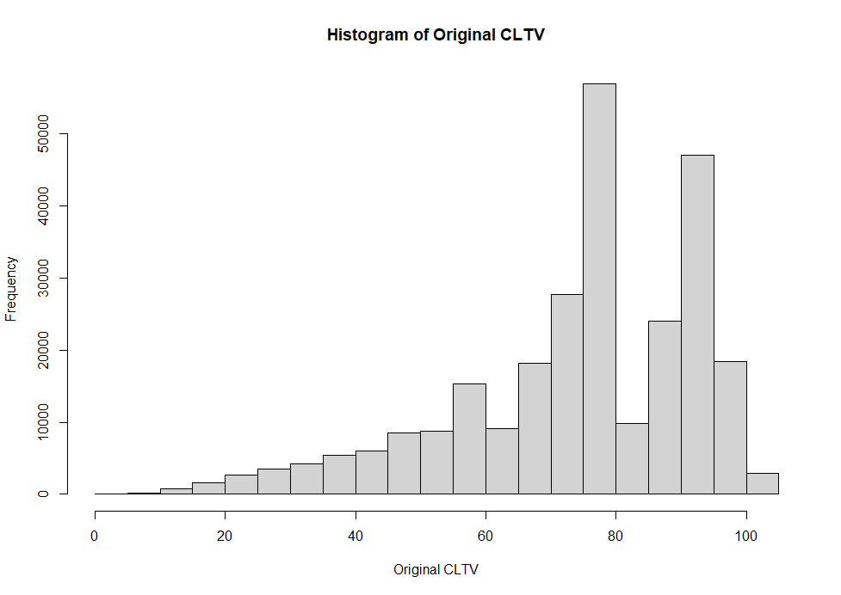
DTI, LOAN QUANTUM, CLTV DISTRIBUTIONS

Slide 14
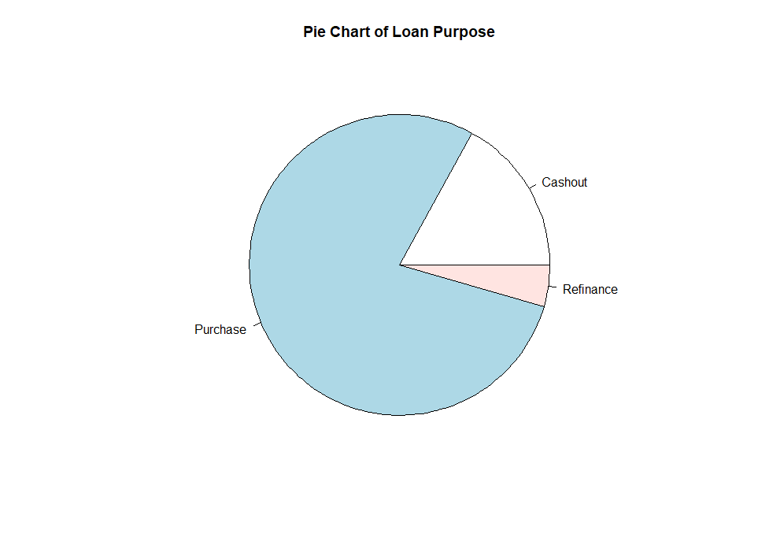
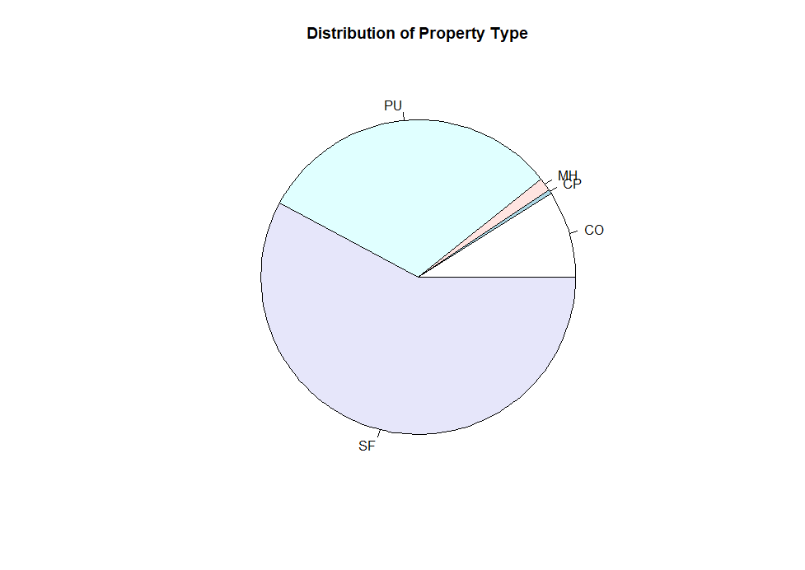
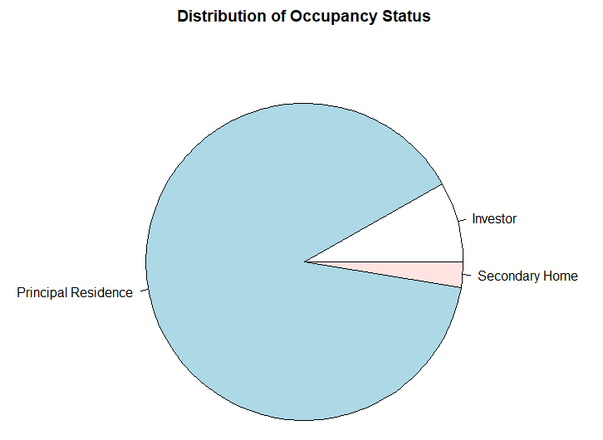
LOAN PURPOSE, PROPERTY TYPE OCCUPANCY STATUS-WISE LOANS
CO = condominium
CP = co-operative
PU = Planned Urban Development
MH = manufactured home
SF = single-family home

Slide 15
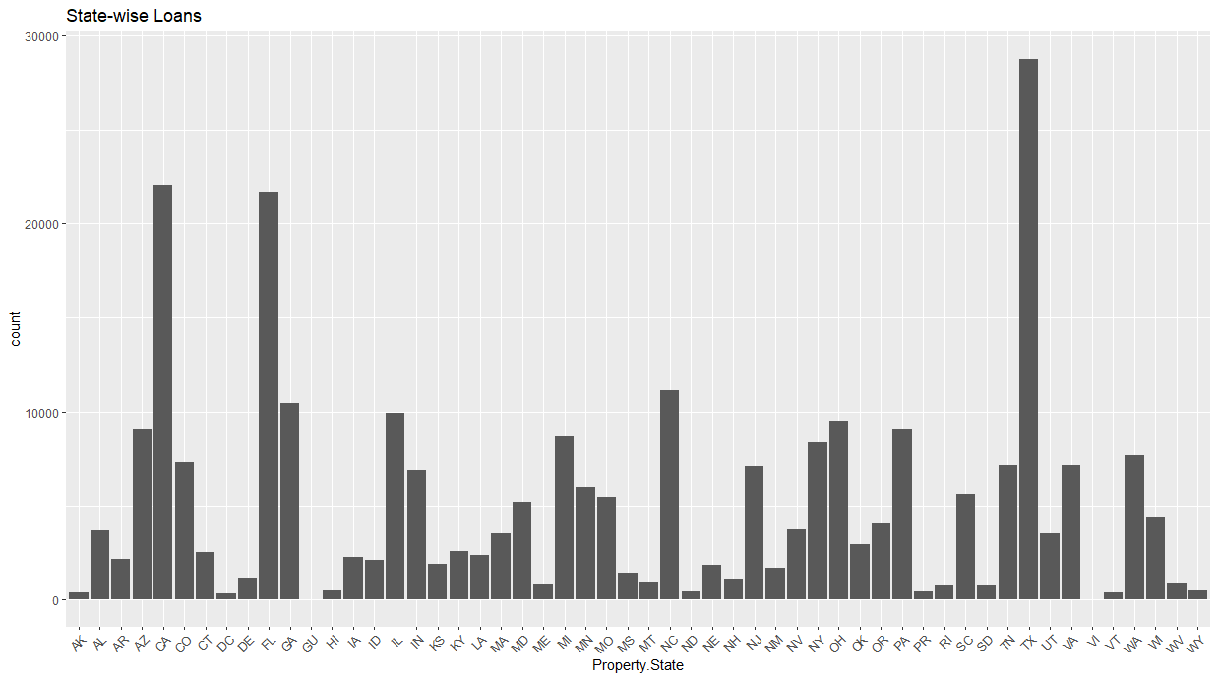
LOANS BY PROPERTY STATE

Slide 16
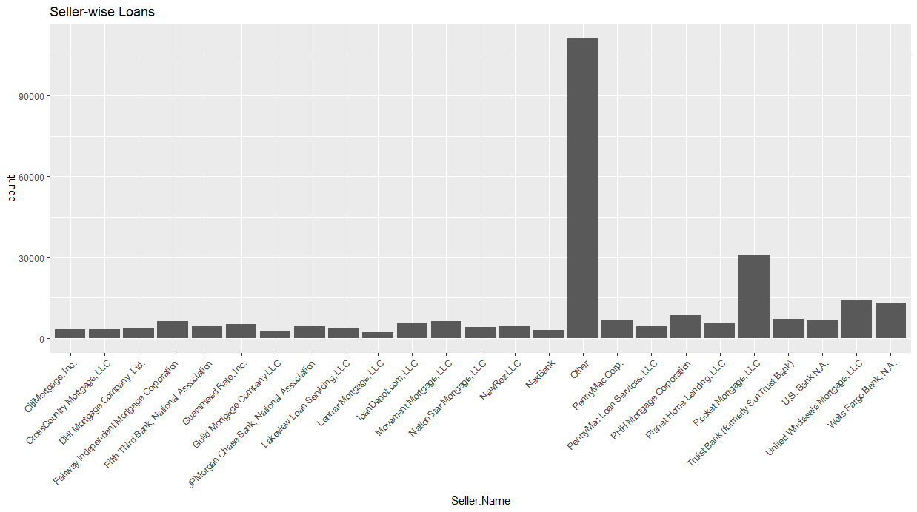
LOANS BY SELLER NAME

Slide 17
LEARNINGS
We made all kinds of mistakes in this process and learned a lot. Some of these may not be significant but we did spend some time decoding these situations!
Column Names changed inadvertently!: Since R replaces spaces between column names with . periods, unintended spaces resulted in unwanted . (period) and a relook of all the code!
Commands arguments Change!: We realized R is a continuously changing software and the arguments we thought were right and used yesterday, may not work today!
Code instead of Data! :If R displays unfamiliar code with View(data) command instead of your data, check if you loaded a dafaframe into the ‘data’ variable! :)

Slide 18
REFERENCES
Fannie Mae Wikipedia site
https://youtu.be/iKSvAsm3ago?si=TQL7e7AI03ERo1hw
https://capitalmarkets.fanniemae.com/tools-applications/data-dynamics
https://community.rstudio.com/
https://www.r-project.org/other-docs.html
Mitusch, K., & Nautz, D. (1995). Expectations and Interest Rates on Mortgage Loans. Empirical Economics, 20, 667-680.
Page, A. N. (1964). The Variation of Mortgage Interest Rates. The Journal of Business, 37(3), 280-294.
Sealand, J. C.(2018). Short-term Prediction of Mortgage Default using Ensembled Machine Learning Models: Summary.
Domingos, P. (2012). A Few Useful Things to Know About Machine Learning: Summary.
In addition to the above, we used code from our Class Presentation slides and lectures as well as the presentation from the workshop on Introduction to R ggplot2 Workshop https://umd.box.com/v/IntroRggplot2 conducted by Ms.Yishan Ding of UMD libraries

Slide 19


