Slide 1

INST737 MILESTONE-3 PRESENTATION
TEAM5
Sadaf Davre
Tanya Gupta
Ushasri Bhogaraju

Slide 2
THE RUN UPTO MILESTONE -3
Research questions :
Can we accurately predict the ‘Interest Rate’ using Fannie Mae loan dataset variables?
Do all the borrower criteria have equal importance in predicting Interest Rate?
Can we accurately predict the class of Occupancy Status using variables in the Loan dataset?
Dataset Transformation:
Discovered that our original variables were weak predictors of Interest rate
Infused bond rate, fed funds rate and benchmark mortgage rate
Turns out that benchMarkMortgageRate and fedFundsRate have near perfect negative correlation
Answers to RQ from MS-2:
We discovered that RandomForest Model suited our dataset best, as it could handle multicollinearity and make superior predictions for interest rate. We could plot the most Predictive features easily
Best classifier was the Decision Tree model with 10 Boosting. However, NIR was 90%, indicating that under sampling of observations for most prevalent class must be done for better results for all classes

Slide 3
DATA PREPROCESSING
Research so far reveals that,
Having multi collinear IVs does not add value
All our classifiers did better with the most prevalent class, therefore a balanced dataset may yield better prediction results for all classes
Based on these learnings, we performed the following data preprocessing steps
Eliminate multicollinear variable benchMarkMortgageRate and No of Units variable (singular value) from our dataset
Apply randomization and under sampling techniques to create a more balanced dataset using R.
For training SVMs as classifiers, categorical IVs were encoded using one-hot encoding.
To train Neural Network models, all numerical variables were normalized and categorical IVs were encoded

Slide 4
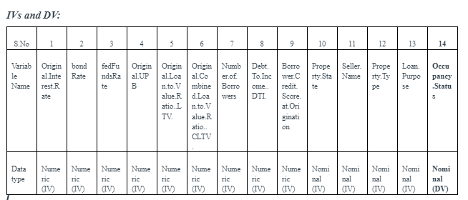
MS-3 : APPLYING LINEAR SVMs AS CLASSIFIERS
Aim: Train a SVM linear classifier and use it to predict the class of outcome variable ‘Occupancy Status’
Approach : One-vs-One, the ksvm() function trains a binary classifier for every possible pair of classes

Slide 5
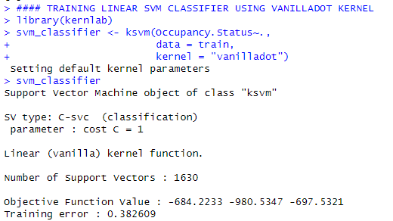
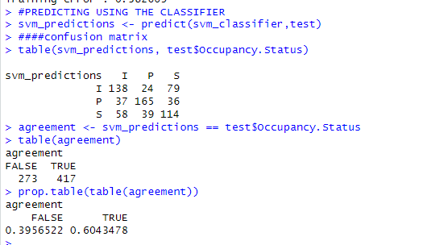
LINEAR SVM MODEL – KSVM FUNCTION WITH VANILLADOT KERNEL

Slide 6
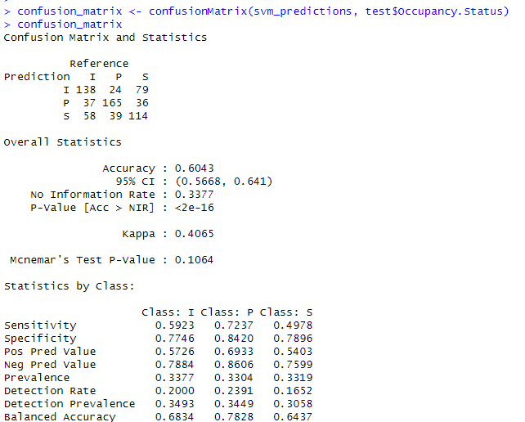
PREDICTION RESULTS WITH LINEAR SVM– CONFUSION MATRIX
Precision or Positive Predictive value = True Positives / (True Positives + False Positives). Precision gives us the rate of correct positive predictions among the total positive predictions it made for a class, by answering how many are actually positive in that class?. The precision of this model is 57.26% for I class, 69.33% for P class and 54.03% for S class.
Recall or Sensitivity = True Positives / (True Positives + False Negatives). Recall tells us that of all the instances that are actually positive for a class in the dataset, how many did this classifier predict correctly as positives for that class? The model recall for I class is 59.23%, 72.37% for P class and 49.78% for S class. This model has better values for recall than precision indicating that many of the positives this model identifies are actually negatives.
Specificity or True negative rate = True Negatives / (True Negatives + False Positives). Specificity answers the question, of all the actual negative instances for a class in the dataset, how many did this classifier correctly predict as negatives. This rate is 77.46% for I class, 84.20% for P class and 78.96% for S, meaning, the model is better at identifying negatives as negatives than it is at identifying positives as positives.
Accuracy: (TP + TN)/ TP + TN + FP + FN) is the measure of model accuracy which is 60.43 % meaning that the model was successful in correctly predicting 60.43% of all instances
F1 = 2*(Precision * Recall)/(Precision + Recall) is the harmonic mean of precision and recall and provides a balanced approach to model evaluation.

Slide 7
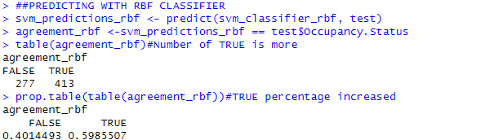
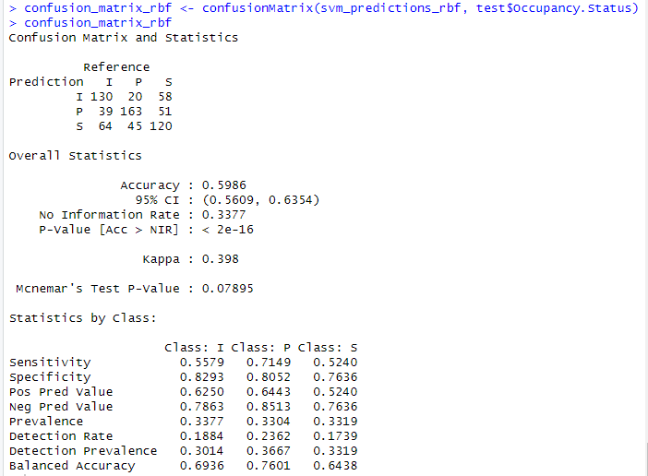
MS-3 : APPLYING NON-LINEAR SVM KERNEL ‘rbf’ & SUMMARY SVMs
Model accuracy is 59.86%, Precision, Recall and Specificity values are also slightly lower compared to linear model.
Summary of SVMs: In our case, using the non-linear ‘rbf’ kernel did not improve results.
However, the SVM classifier performed better than all Milestone-2 models. One reason may be that we introduced balance in the dataset and gave equal opportunities to the model to learn all classes.
Another may be that we used more IVs in this model, while we used fewer in the Decision Tree classifier.

Slide 8
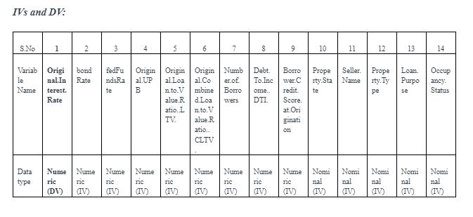
NEURAL NETWORKS
Aim: Train Neural Network regression models to predict ‘Interest rate’ and using different hidden layers, identify the best model
Approach : Use different sets of IVs and train default NN model (1 hidden layer and 1 neuron) to identify the best performing model. Train variants of this model with different hidden layers and predict values of the outcome variable

Slide 9
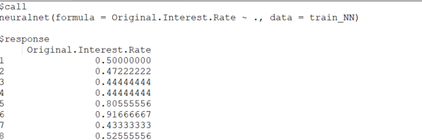
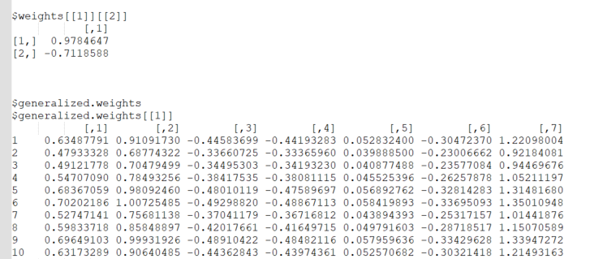
NEURAL NETWORKS- DEFAULT HIDDEN LAYER & NEURON
Model default, 1 hidden Layer, with 1 Neuron.
$response : predictions on training data, 2070 values corresponding with number of observations in training data
$weights: 93, 92 for input layer neurons(IVs) + 1 for hidden layer neuron.
Bias terms or offsets shown in the Weights matrix : 1 for hidden layer neuron
$act.fct : The algorithm uses a sigmoid function. It differs for each neuron. For a value of ‘x’ for weighted sum for each input neuron, the activation function is given by 1/(1 + exp(-x))
$err.fct: The error function calculates the sum of squared errors for a regression model. (function (x, y) { 1/2 * (y - x)^2 }) The value of SSE for this model is 11.4204
For 1 hidden layer(default) 1 bias term

Slide 10
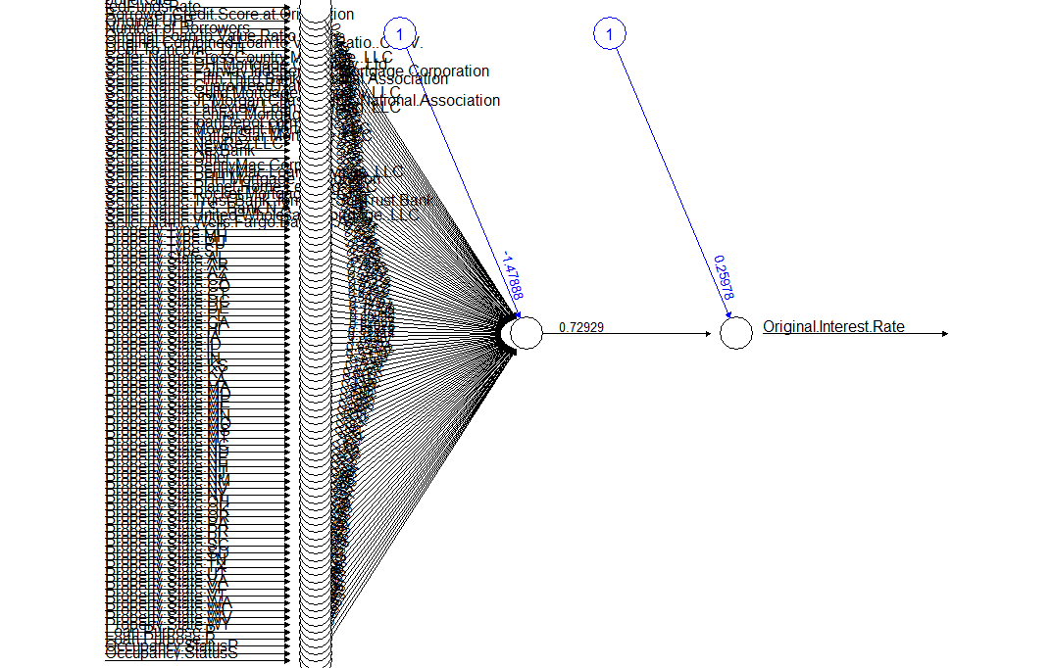
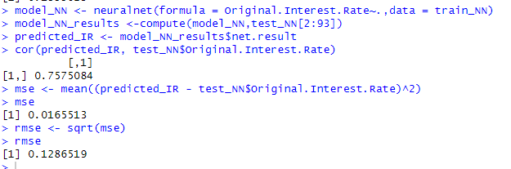
NEURAL NETWORK (DEFAULT) PLOT AND PREDICTION RESULTS

Slide 11
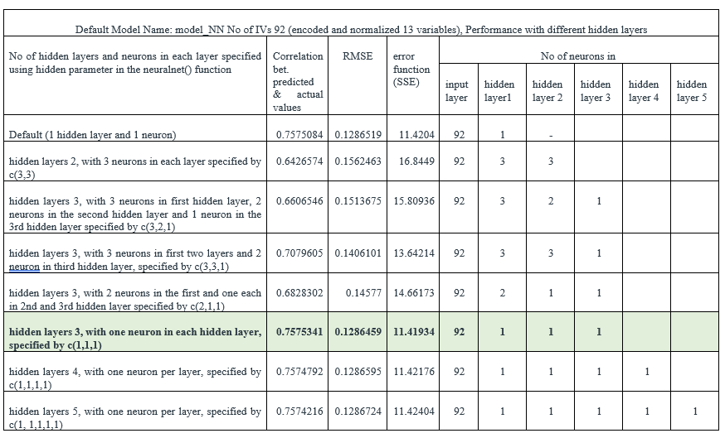
NEURAL NETWORKS, DIFFERENT HIDDEN LAYERS- SUMMARY

Slide 12
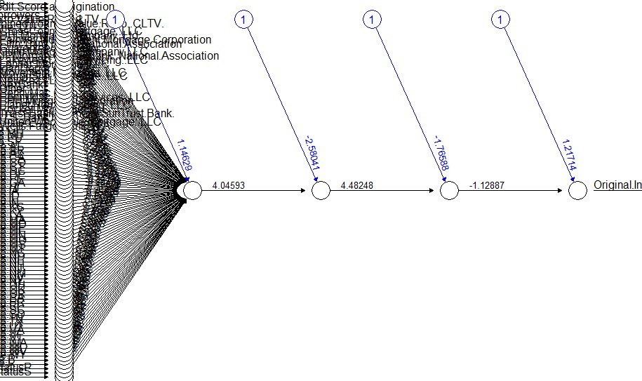
NEURAL NETWORKS, BEST MODEL PLOT, SUMMARY NEURAL NETWORKS
Our Best model has 3 hidden layers, with one neuron in each
The error function is minimal at 11.41934
the correlation between predicted and actual values of the outcome variable on unseen test data is 0.7575341
The RMSE value is also minimal at 0.1286459
Summary Neural Networks : Using different combination of hidden layers, we identified our best model as one with 3 hidden layers with 1 neuron each. However, this model performed almost similarly to the default model. No significant improvement in results when hidden layers were increased.

Slide 13
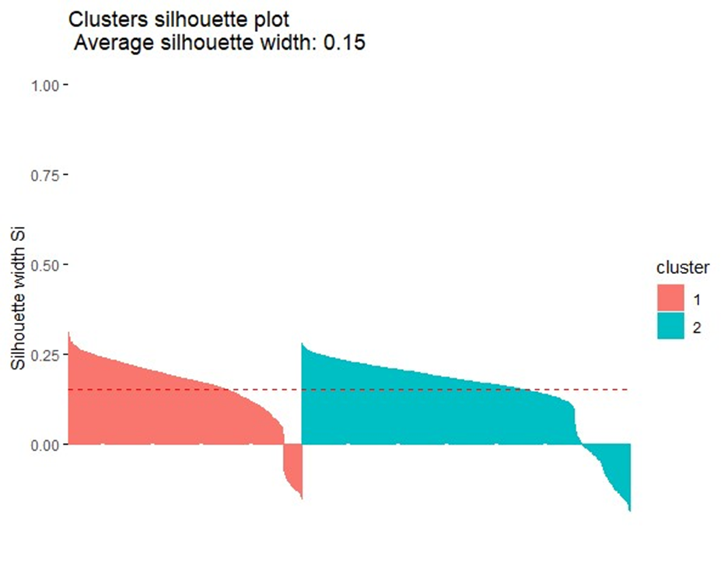
CLUSTERING TECHNIQUES, PAM CLUSTERING
Data : We have mixed data types in the dataset so used the daisy() function to calculate the Gower distances between data points.
Optimal Clusters: Using the pamk() function, we could find that the optimal number of clusters for our dataset are 2
Number of elements in each cluster :The first cluster had 1145 elements, the second had 1615 elements
Comparison of means: For the numerical variables, the means for all features were higher in cluster-1, but for the nominal variables, there is no such demarcation between clusters

Slide 14
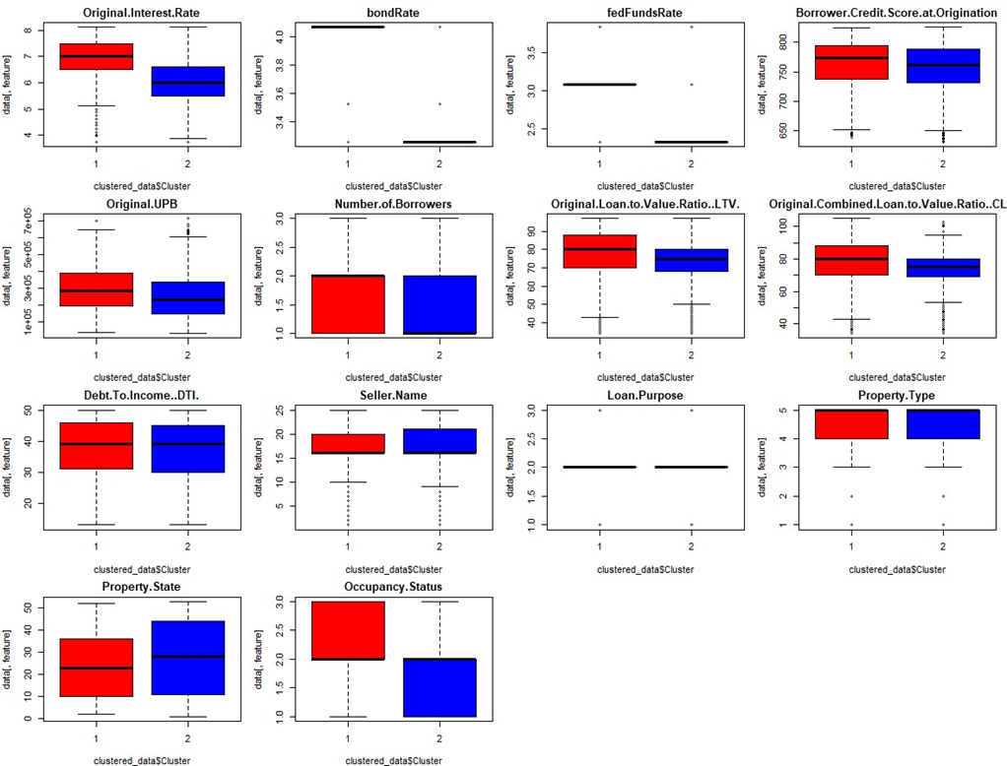
PAM CLUSTERING, COMPARISON OF CLUSTERS

Slide 15
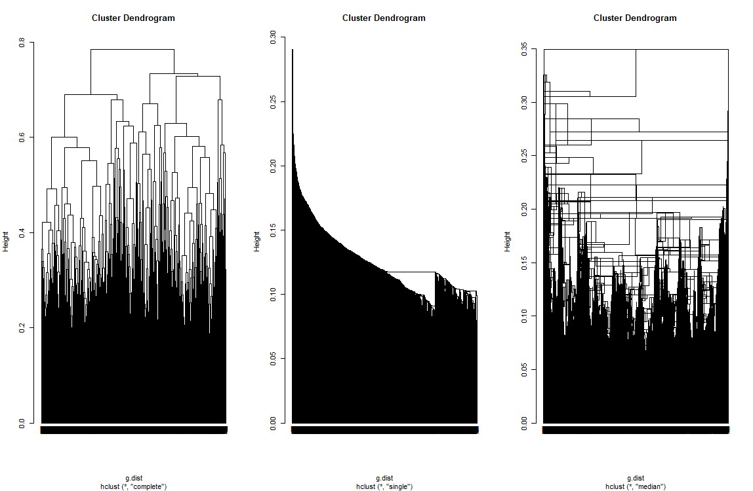
HIERARCHICAL CLUSTERING
Complete Linkage
Single Linkage
Median Linkage

Slide 16
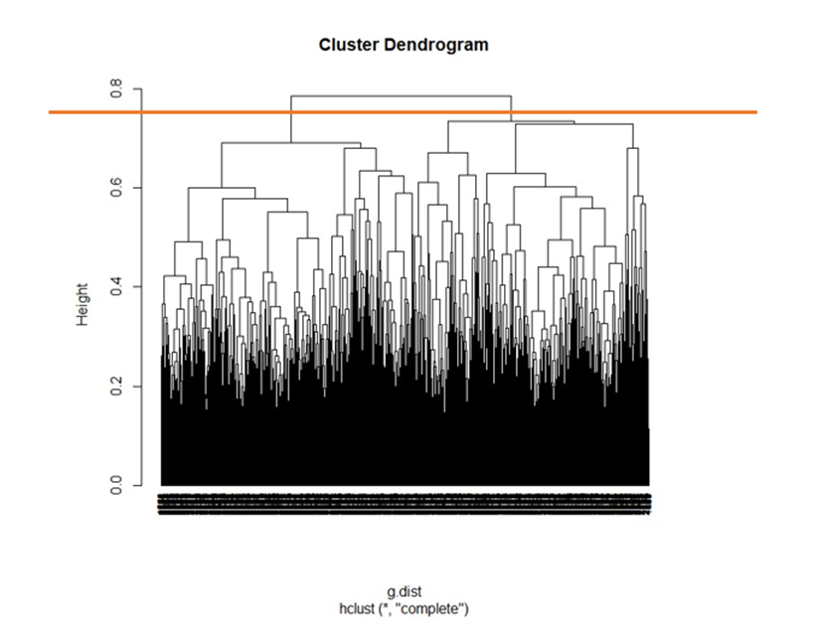
HIERARCHICAL CLUSTERING
Optimal Clusters: Visual inspection of the dendrogram reveals that optimal clusters are at the height of 0.75
Number of elements in each cluster :The first cluster had 1330 elements, the second had 1430 elements.
Comparison of means: The difference between means is higher for this algorithm meaning that it could better identify distinctiveness. The difference between means for Original interest rate between the two clusters in this algorithm is 1.09% where as it was 0.82% for PAM algorithm.

Slide 17
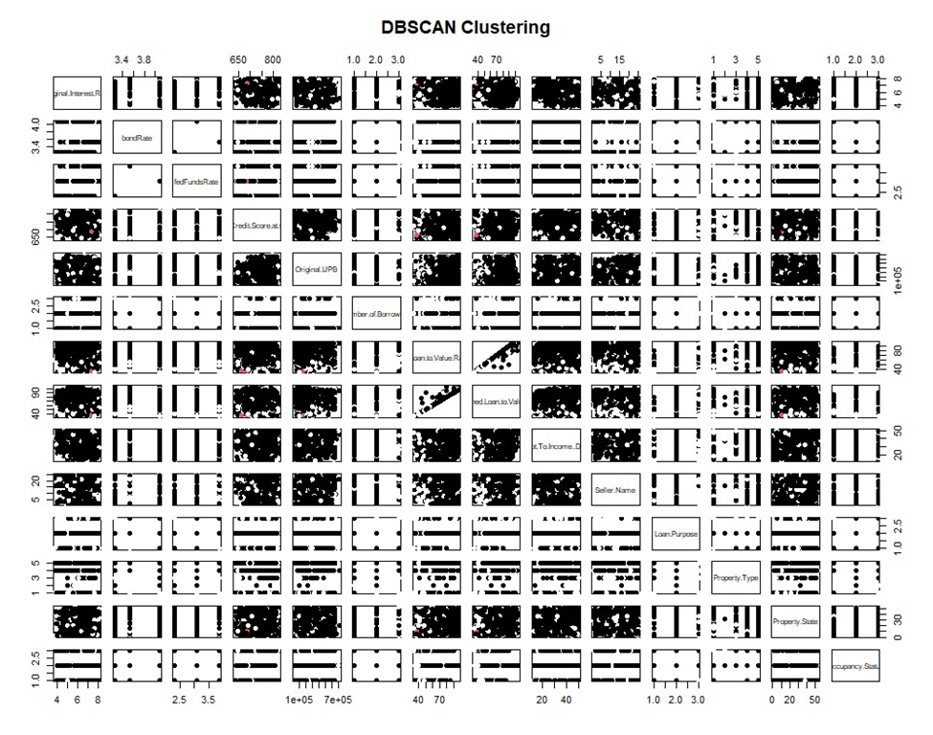
DBSCAN CLUSTERING, SCATTER PLOT MATRIX, SUMMARY
Optimal Clusters: Arrived at using different values for epsilon and minimum points so as to minimize noise points, eps=0.18 and minimum points = 7
Number of elements in each cluster :The first cluster had 2581 elements, the second had 5 elements. There were 174 noise points not belonging to any cluster
Comparison of means: In the DBSCAN clustering technique, the difference between means of features between clusters was lesser than both PAM and hierarchical clustering indicating that for our particular dataset, this algorithm is not able to identify distinctiveness and categorize into separate clusters

Slide 18
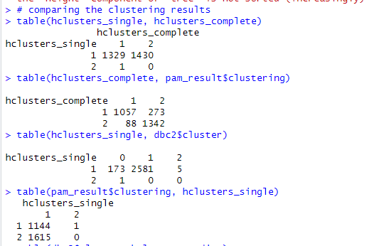
COMPARISON OF CLUSTERING RESULTS
Cluster assignments from the hierarchical single linkage method and complete linkage method agree on 1329 data points in cluster-1. For cluster-2 there is no agreement on any data point.
Cluster assignments from the hierarchical complete linkage method and the PAM algorithm clusters agree on 1057 data points in cluster-1. In respect to cluster-2 they agree on 1342 data points.
Cluster assignments from the hierarchical single linkage method and the DBSCAN clusters agree on 2581 points and in cluster-1, where as they agree on 0 points for cluster 2.
The PAM clusters and the hierarchical single linkage clusters agree on 1144 data points in cluster-1 whereas they agree on 0 points for cluster-2.

Slide 19
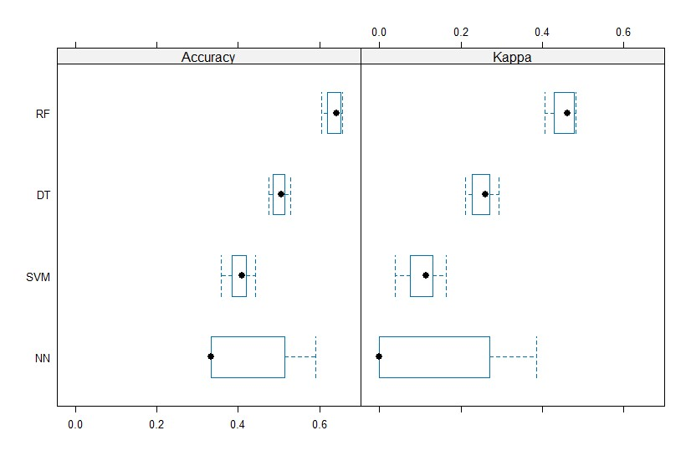
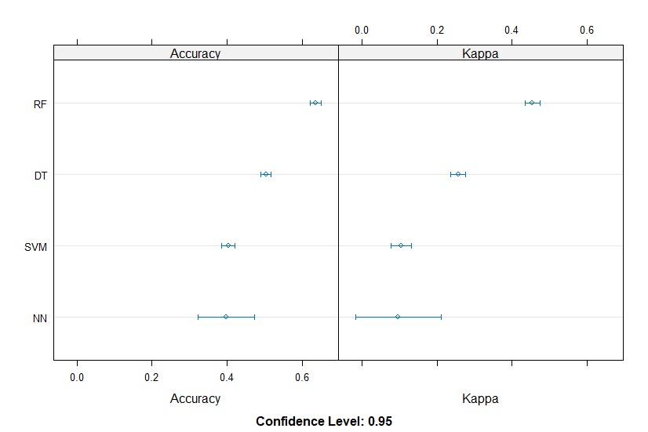
COMPARATIVE ANALYSIS, K- FOLD CROSS VALIDATION METHOD
Random Forest (RF) leads with high accuracy, demonstrating robust predictive ability.
Decision Trees (DT) offer a fair balance but vary more across folds, suggesting some instability.
Support Vector Machines (SVM) and Neural Networks (NN) lag in performance, with NN being particularly erratic, which may reflect overfitting issues.
Kappa scores reinforce RF's top spot with consistent reliability, while NN struggles with predictability.
Summary: Overall, k-fold CV results suggest RF as the most dependable model for generalization on unseen data.

Slide 20
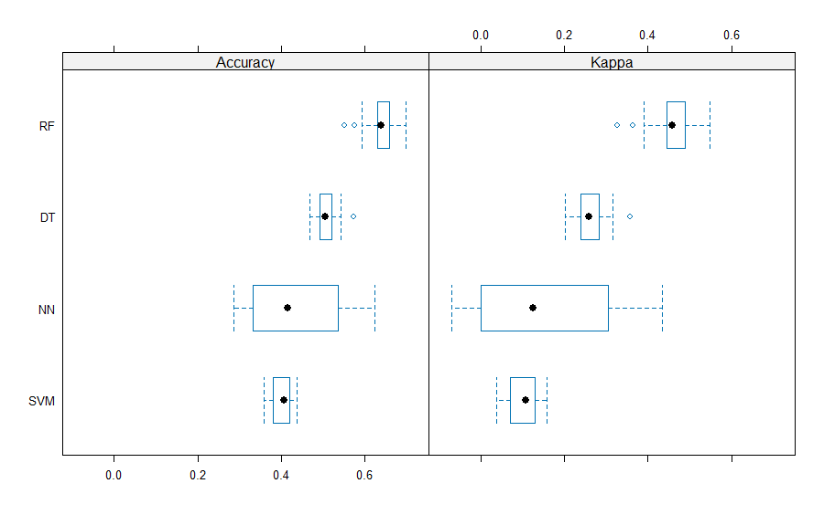
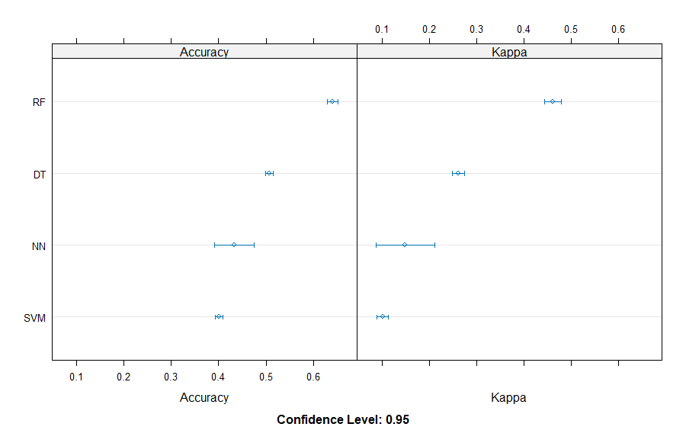
COMPARATIVE ANALYSIS, K-FOLD REPEATED CVs
Random Forest (RF) demonstrates top-tier accuracy and stability, confirming its suitability for complex datasets.
Decision Trees (DT) offer good accuracy with some variability, indicating potential for tuning.
Neural Networks (NN) and Support Vector Machines (SVM) exhibit lower performance, with NN showing signs of overfitting.
RF's high Kappa scores suggest a strong predictive quality that is likely to generalize well to new data.
Summary: Random Forest (RF) emerges as the most robust and consistent model across repeated k-fold cross-validation, outperforming others in accuracy and reliability for our dataset analysis.

Slide 21
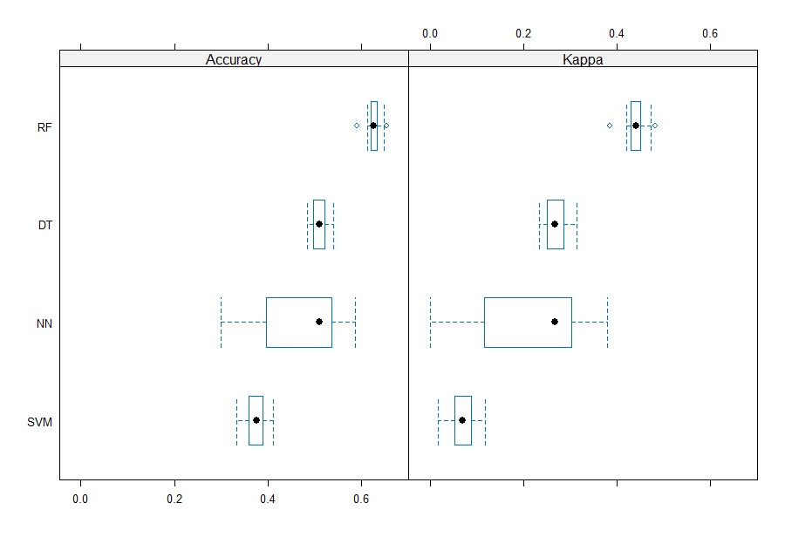
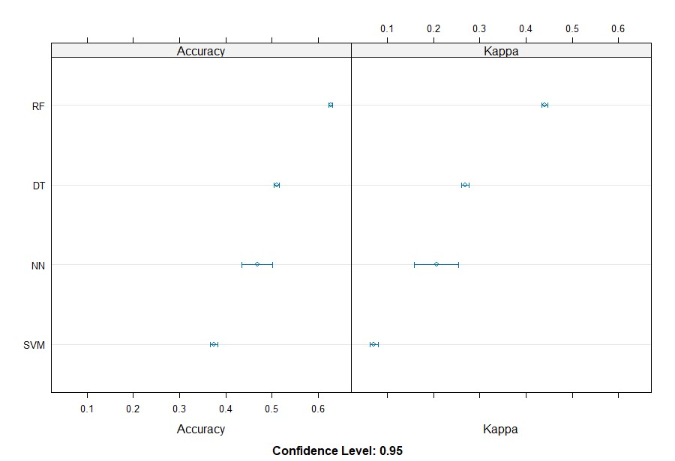
COMPARATIVE ANALYSIS, BOOT -STRAPPING CROSS VALIDATION
Random Forest (RF) excels in both median accuracy and Kappa score, highlighting its strong and reliable predictive capabilities.
Decision Trees (DT) show commendable performance, albeit with some variability that suggests room for model refinement.
Neural Networks (NN) display moderate stability but could benefit from adjustments to reduce overfitting.
Support Vector Machines (SVM) trail with lower scores, indicating a need for in-depth model tuning and validation.
Summary :Random Forest (RF) stands out as the most accurate and reliable model, with Decision Trees (DT) as a viable alternative; Neural Networks (NN) require further tuning, while Support Vector Machines (SVM) lag behind in consistent predictive performance across bootstrap validation.

Slide 22
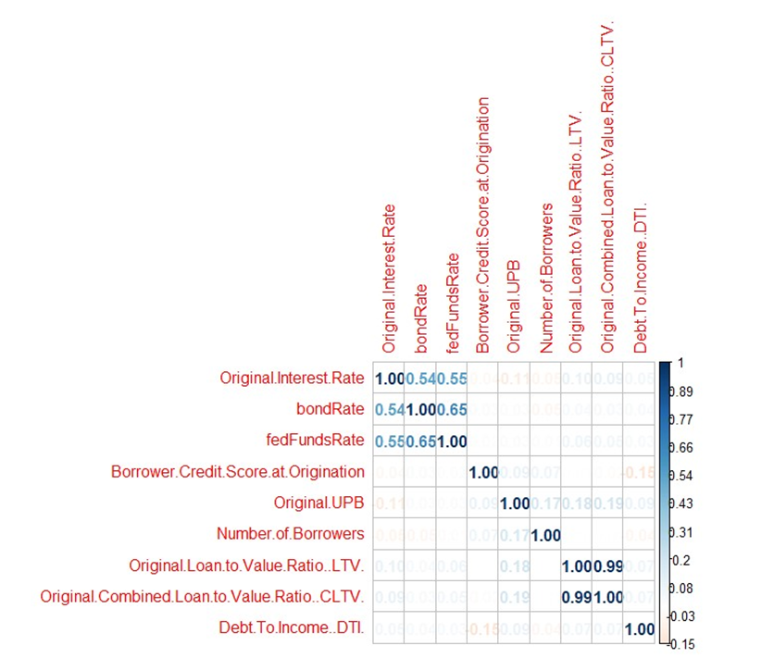
FILTER FEATURE SELECTION - FILTER METHOD, LINEAR MODEL WITH NUMERIC IVs
Strong Correlations: Original.Interest.Rate closely linked with bondRate and fedFundsRate, indicating potential predictive power;
LTV and CLTV overlap suggests one might be redundant.
Initial Regression Insights: BondRate and fedFundsRate emerge as significant influencers of Original.Interest.Rate. Original.UPB shows significance but limited practical influence.
Streamlined Model Focus: Post refinement, only bondRate and fedFundsRate are retained, dropping less impactful variables like Original.LTV and DTI.
Refined Model Performance: With an R-squared of 0.3729, the streamlined model effectively captures about 37% of the variability in Original.Interest.Rate, a solid performance for complex financial datasets.
Overall Analysis: Filter feature selection points to a focused, more efficient regression model with bondRate and fedFundsRate as key, significant predictors of interest rates.

Slide 23
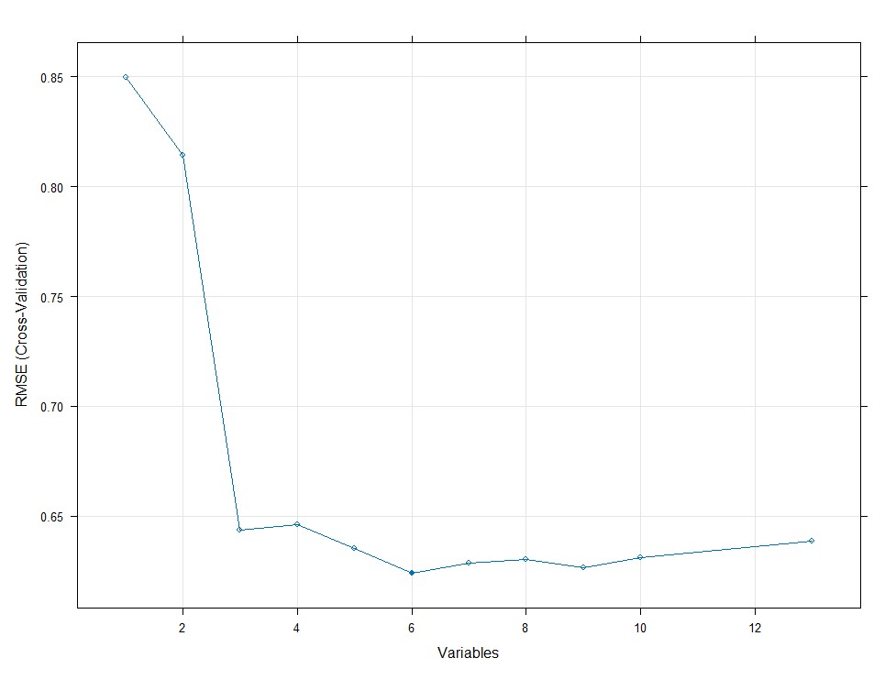
FILTER FEATURE SELECTION - RANDOM FORESTS AND RECURSIVE FEATURE ELIMINATION
The RFE is a hybrid feature selection method that employs elements of both filter and wrapper methods.
We trained a RFE Control function using Caret package and used the rfe() function in R to deploy RFE
The model began with our 14 IVs and recursively eliminated 8 features, in the order of their importance in predicting Original Interest Rate.
RMSE values are used as this model is a regression Random Forest Model
The graph shows the RMSE cross-validation the model employed to arrive at the best set of variables. As we can see from the graph, for 6 variables, the RMSE is lowest.

Slide 24
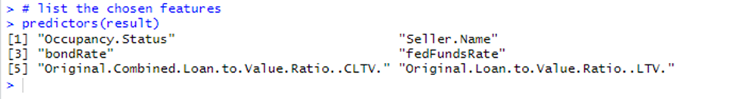
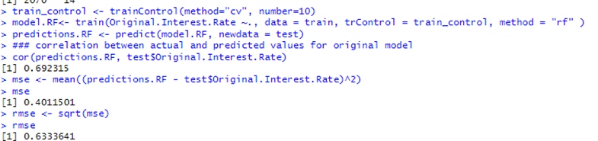
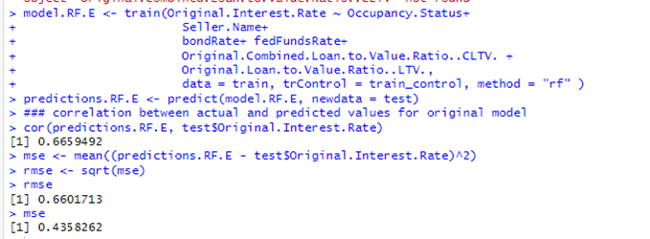
FILTER FEATURE SELECTION - RANDOM FORESTS AND RECURSIVE FEATURE ELIMINATION
The model eliminated 8 features and retained Occupancy Status, Seller Name, bondRate, fedFundsRate, Original CLTV and Original LTV as the most important in predicting the outcome variable.
Our first Random Forest model with all the features produced a correlation of 0.69 between predicted and actual values with a RMSE of 0.63
The model retaining only the most predictive features derived from the results of RFE method produced a correlation of 0.67 with an RMSE of 0.43
Summary: The slight compromise of reduction in correlation of 0.02 gave us an improvement in RMSE of 0.2 with a great reduction in model complexity from 14 features to 6 features.

Slide 25
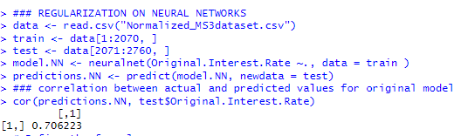
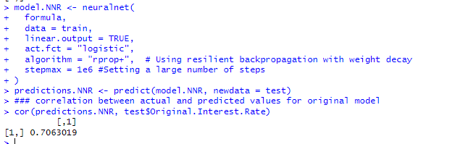
FEATURE SELECTION, REGULARIZATION ON NEURAL NETWORK MODEL
Initial Neural Network Model: Achieved a correlation of 0.706 in predicting Original.Interest.Rate, showing strong initial predictive capability.
Regularization with Rprop-WD: Implemented to refine the model, adapting learning rates and penalizing larger weights to reduce overfitting.
Performance Enhancement: Post-regularization, correlation marginally increased to 0.7063, indicating improved model accuracy and generalization.
Effectiveness of Regularization: The slight but noteworthy increase in accuracy post-Rprop-WD application underscores the value of regularization in complex neural network models.
Overall Impact: Regularization, although resulting in modest improvements, demonstrates potential for making neural network predictions more aligned with actual outcomes, crucial for high-stakes applications.

Slide 26
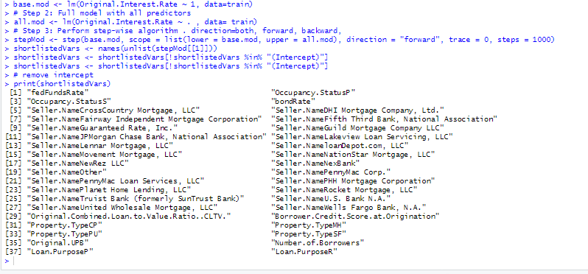
FEATURE SELECTION - WRAPPER - SFS METHOD
Base Model: We created a base model with only the intercept value
All Model : Our original model with all 14 predictors showed risk of overfitting and complexity.
Step Model with Stepwise Forward Selection: We created a step model utilizing R's Step() function, systematically adding variables to minimize AIC. This model focused on impactful predictors like 'bondRate' and 'fedFundsRate'.
Refined Final Model: Streamlined variable selection, highlighting key predictors such as 'Occupancy.Status' and 'bondRate', enhancing model's interpretability.
Insightful Findings: Seller names emerged as unexpected yet significant predictors, indicating lender-specific interest rate trends.
Overall, the stepwise selection approach effectively distilled a more accurate and interpretable model, optimizing for both simplicity and predictive power.

Slide 27
References:
https://www.youtube.com/playlist?list=PLTjw8tvMu8SK-IKUWbakfejaC9PW7HSoR
http://journal.r-project.org/archive/2010-1/RJournal_2010-1_Guenther+Fritsch.pdf
https://www.pluralsight.com/guides/encoding-data-with-r
https://www.rdocumentation.org/packages/cluster/versions/2.1.4/topics/daisy

Slide 28


