Slide 1

What is Programming?
DEFINITION
Programming is the process of giving step-by-step instructions to a computer so it can do tasks.
Goal: Solve problems by writing code that a computer can understand and execute.
INTRODUCTION TO PROGRAMMING

Slide 2
JAVASCRIPT AND HTML
Two essential building blocks of the web — working together to create interactive, structured web pages.
JAVASCRIPT (JS)
HTML
A programming language used to make web pages interactive and dynamic.
JavaScript runs in the browser and responds to user actions clicks, form inputs, animations, and more.
Together with HTML: HTML builds the structure of the page, while JavaScript adds behavior and interactivity (buttons, forms, animations).
HyperText Markup Language is the standard language for structuring and displaying content on the web.
HTML defines the skeleton of a web page: headings, paragraphs, images, links, and other elements.
Together with JS: HTML provides the content and structure, while JavaScript brings it to life with dynamic behavior.

Slide 3

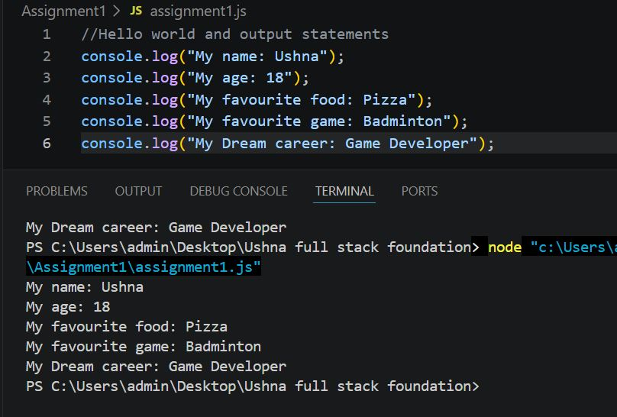


console.log - Printing Messages
What is console.log()?
console.log() prints messages to the browser's console for debugging. It is one of the most essential tools in JavaScript, allowing developers to inspect values, trace code execution, and identify errors during development.

Slide 4
Variables, Numbers, and Strings
Variable: A container that stores data
Variables store data values. Numbers hold numeric data. Strings hold text inside quotes.
VARIABLE
1.
2.
3.
var age = 18;
var name = "Ushna";
console.log(name + " is " + age + " years old.");
var age = 18;
NUMBER
var score = 100;

Slide 5

IF-ELSE AND COMPARISON OPERATORS
var score = 75;
if (score >= 90) {
console.log("Grade: A");
} else if (score >= 80) {
console.log("Grade: B");
} else if (score >= 70) {
console.log("Grade: C");
} else {
console.log("Grade: D");
}
Output: Grade: C

Slide 6

Summary
Programming Fundamentals
Programming = giving computers clear instructions
JavaScript adds interactivity to HTML pages
console.log() helps you see messages and debug
Variables store data; numbers vs strings differ by quotes and type
Use if-else with comparison operators to make decisions
Thank You for Listening!

