Slide 1

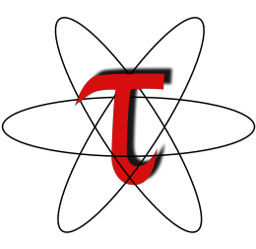
The TAU Profiler
Part1：Introduction
人工智能技术学院
缪青海
miaoqh@ucas.ac.cn

Slide 2
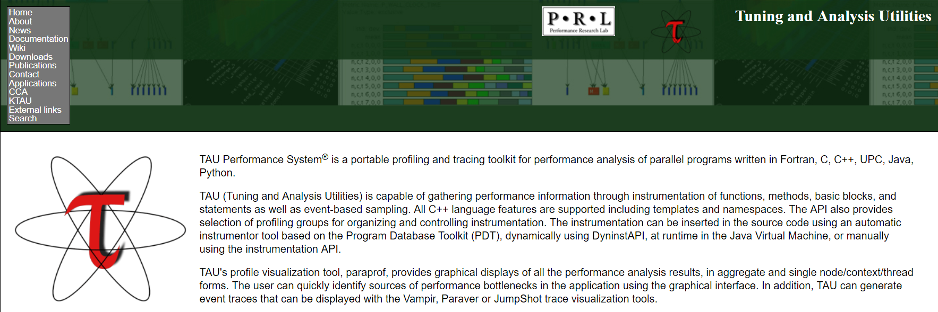
TAU
https://www.cs.uoregon.edu/research/tau/home.php

Slide 3
Content
Overview
Instrumentation
Profiling
Tracing
Analyzing
Application Scenario

Slide 4
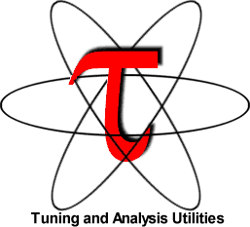
TAU Performance System®
Tuning and Analysis Utilities (TAU)
Comprehensive performance profiling and tracing
  Integrated, scalable, flexible, portable
  Targets all parallel programming/execution paradigms
Integrated performance toolkit
  Instrumentation, measurement, analysis, visualization
  Widely-ported performance profiling / tracing system
  Performance data management and data mining
  Open source (BSD-style license)
Easy to integrate in application frameworks

Slide 5
What is TAU?
TAU is a performance evaluation tool. It supports parallel profiling and tracing
  Profiling shows you how much (total) time was spent in each routine;
  Tracing shows you when the events take place in each process along a timeline.
Profiling and tracing can measure time as well as hardware performance counters (cache misses, instructions) from your CPU

Slide 6
What is TAU?
TAU can automatically instrument your source code using a package called PDT for routines, loops, I/O, memory, phases, etc.
TAU runs on most HPC platforms and it is free (BSD style license)
TAU has instrumentation, measurement and analysis tools
  paraprof is TAU’s 3D profile browser
To use TAU’s automatic source instrumentation, you may set a couple of environment variables and substitute the name of your compiler with a TAU shell script

Slide 7
What Can TAU Do?
How much time is spent in each application routine and outer loops? Within loops, what is the contribution of each statement?
How many instructions are executed in these code regions? Floating point, Level 1 and 2 data cache misses, hits, branches taken?
What is the peak heap memory usage of the code? When and where is memory allocated/de-allocated? Are there any memory leaks?

Slide 8
What Can TAU Do?
How much time does the application spend performing I/O? What is the peak read and write bandwidth of individual calls, total volume?
What is the contribution of different phases of the program? What is the time wasted/spent waiting for collectives, and I/O operations in Initialization, Computation, I/O phases?
How does the application scale? What is the efficiency, runtime breakdown of performance across different core counts?

Slide 9
Some Features in TAU
tau_exec: A tool to simplify TAU’s usage
PDT: New parsers from ROSE Compiler, LLNL [Dan Quinlan, CASC]
Power profiling in TAU
Support for accelerators: CUDA, OpenCL, Intel Xeon Phi Co-processor
Event based sampling
OpenMP instrumentation using OpenMP Tools Interface with Intel compilers (OMPT)
Support for Intel TBB, CILK, and MPC [paratools.com/mpc]
ParaProf 3D topology displays

Slide 10
What does TAU support?
Python
OpenCL
C/C++
UPC
CUDA
GPI
Fortran
MPI
OpenACC
Java
pthreads
Intel MIC
OpenMP
Intel
GNU
PGI
Sun
LLVM
Cray
MinGW
AIX
Linux
Windows
OS X
NVIDIA Kepler
ARM

Slide 11
How does TAU work?
  Instrumentation:
  Adds probes to perform measurements
    Source code instrumentation using pre-processors and compiler scripts
    Wrapping external libraries (I/O, MPI, Memory, CUDA, OpenCL, pthread)
    Rewriting the binary executable

Slide 12
How does TAU work?
Measurement:
  Profiling or Tracing using wallclock time or hardware counters:
    Direct instrumentation (Interval events measure exclusive or inclusive duration)
    Indirect instrumentation (Sampling measures statement level contribution)
    Throttling and runtime control of low-level events that execute frequently
    Per-thread storage of performance data
    Interface with external packages (e.g. PAPI hw performance counter library)

Slide 13
How does TAU work?
  Analysis:
  Visualization of profiles and traces
    3D visualization of profile data in paraprof, perfexplorer tools
    Trace conversion & display in external visualizers (Vampir, Jumpshot, ParaVer)

Slide 14
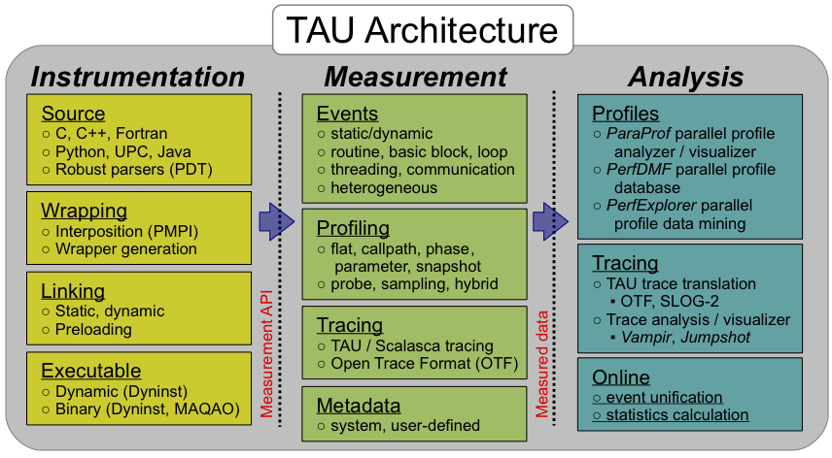
How does TAU work?

Slide 15
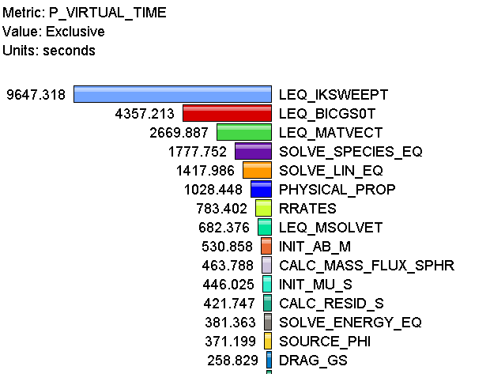
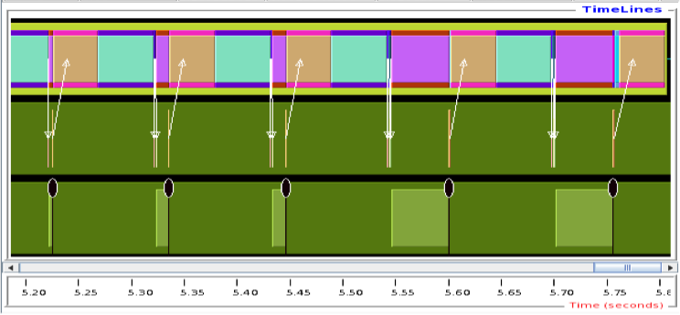
Profiling and Tracing
Profiling
Tracing
Profiling shows you how much (total) time was spent in each routine
Tracing shows you when the events take place on a timeline
Metrics can be time or hardware performance counters (cache misses, instructions)
TAU can automatically instrument your source code using a package called PDT for routines, loops, I/O, memory, phases, etc.

Slide 16
Inclusive vs. Exclusive Measurements
Performance with respect to code regions
Exclusive measurements for region only
Inclusive measurements includes child regions
int foo()
{
int a;
a =a + 1;
bar();
a =a + 1;
return a;
}
exclusive
duration
inclusive
duration

Slide 17
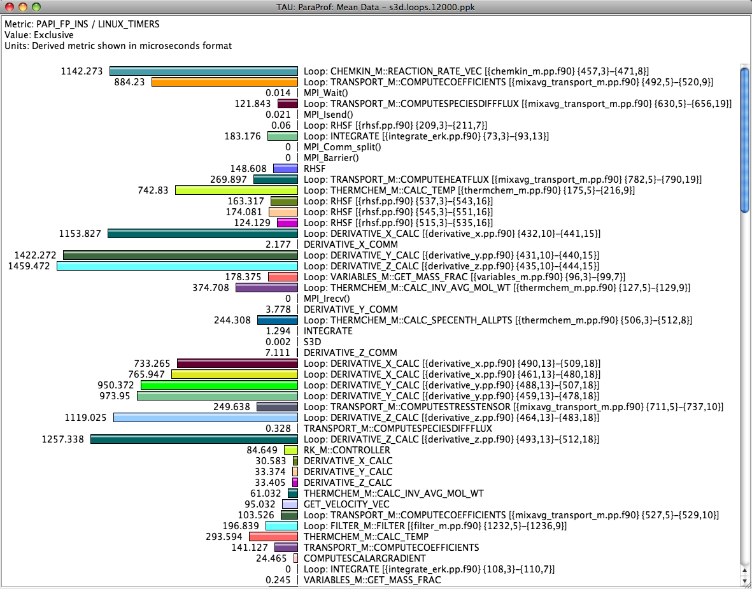
Identifying Potential Bottlenecks
low mflops in
loops?

Slide 18
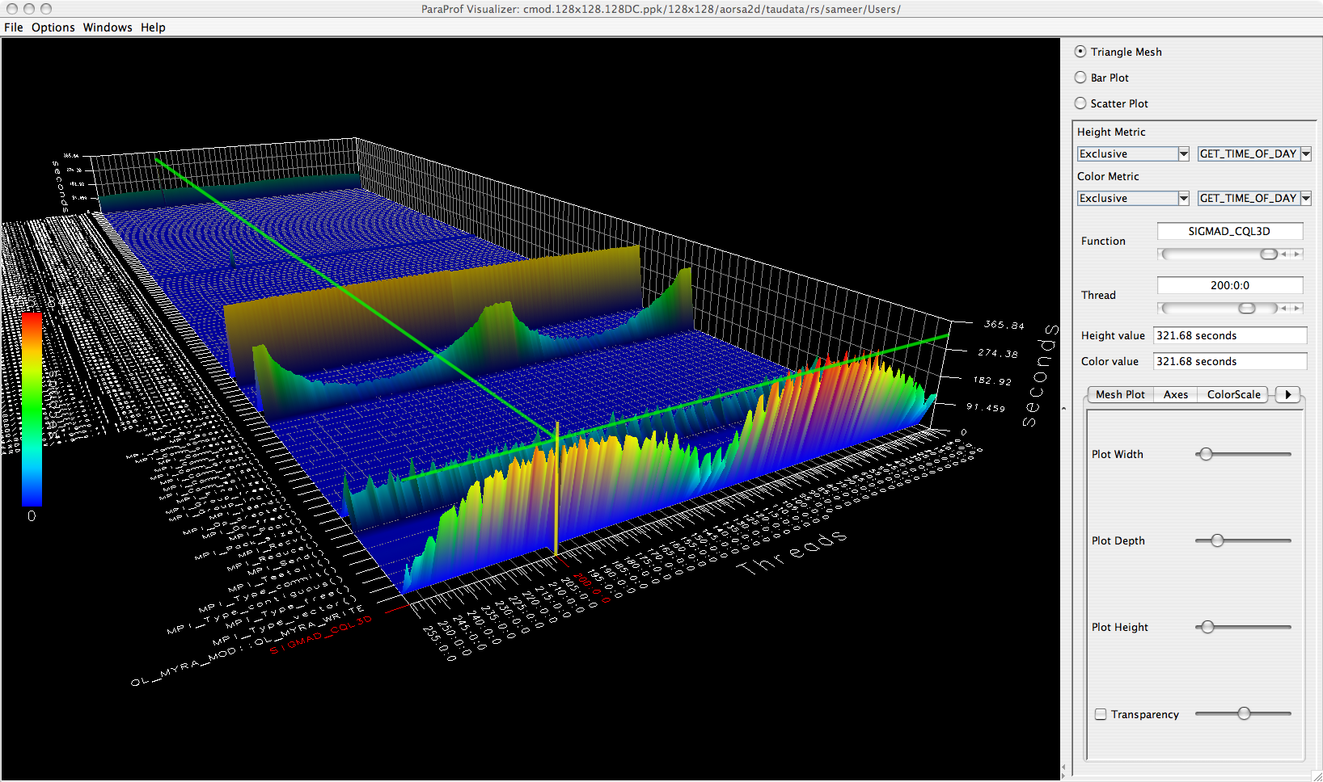
ParaProf 3D Profile Browser

Slide 19
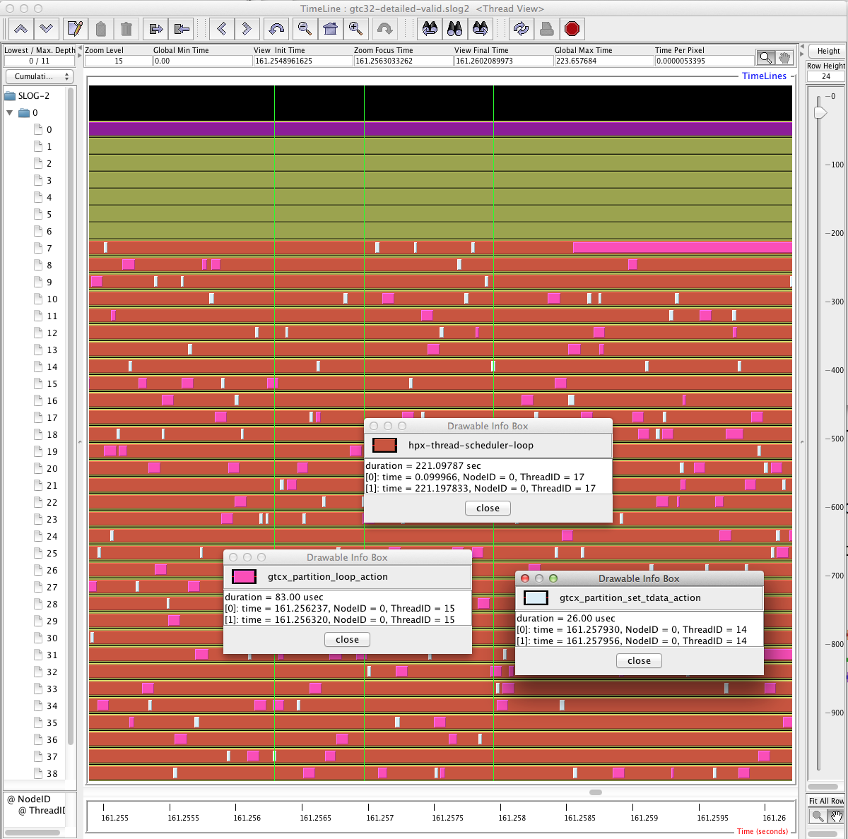
Jumpshot Trace Visualizer in TAU

Slide 20
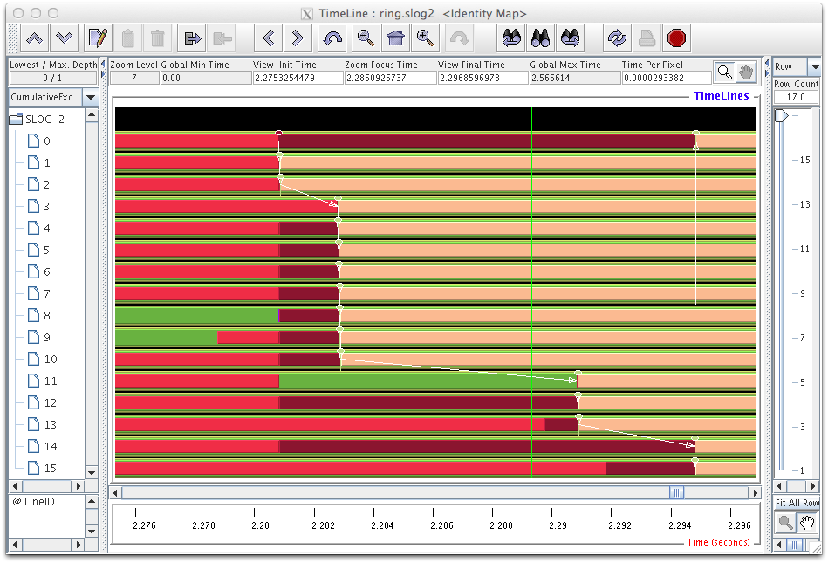
Tracing Communication in Jumpshot
% export TAU_MAKEFILE=$TAU/Makefile.tau-icpc-papi-mpi-pdt
% cmake –DCMAKE_CXX_COMPILER=tau_cxx.sh; make –j 8
% export TAU_TRACE=1
% mpirun –np 16 ./a.out ; tau_treemerge.pl; tau2slog2 tau.trc tau.edf –o a.slog2
% jumpshot a.slog2 &

Slide 21
Content
Overview
Instrumentation
Profiling
Tracing
Analyzing
Application Scenario

Slide 22
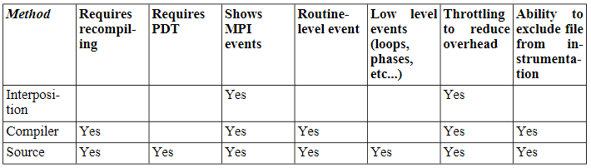
Types of Instrumentation
TAU provides three methods：
  <1>Library interposition using tau_exec.
  <2>Compiler directives.
  <2>Source transformation using PDT.

Slide 23
<1> Using tau_exec
Dynamic instrumentation：
  Achieved through library pre-loading.
  Can be used on both uninstrumented and instrumented binaries.
Place tau_exec before the executable:
  %> tau_exec -io ./a.out
  %> mpirun -np 4 tau_exec -io ./a.out

Slide 24
TAU scripted compilation
Tau_exec：
  Simple but less detailed.
For more detailed profiles, TAU provides two means to compile your application with TAU:
  Compiler Based Instrumentation
    through your compiler.
  Source Based Instrumentation
    through source transformation using PDT.

Slide 25
Compiler Based Instrumentation
TAU provides these scripts:
  tau_cc.sh, tau_cxx.sh, tau_upc.sh, tau_f77.sh and tau_f90.sh to compile programs.
You might use tau_cc.sh to compile a C program by typing:
%> module load tau
%> tau_cc.sh -tau_options=-optCompInst
samplecprogram.c

Slide 26
Compiler Based Instrumentation
On machines where a TAU module is not available, you will need to set the tau makefile and/or options:
Makefile:
  can be found in the /[arch]/lib directory of your TAU distribution.
  for example / x86_64/lib/Makefile.tau-mpi-pdt .
%>tau_cc.sh -tau_makefile=[path to makefile] \
-tau_options=[option] samplecprogram.c

Slide 27
Compiler Based Instrumentation
You can also use a Makefile specified in an environment variable.
To run tau_cc.sh so it uses the Makefile specified by environment variable TAU_MAKEFILE.
%>export TAU_MAKEFILE=[path to tau]/[arch]/lib/[makefile]
%>export TAU_OPTIONS=-optCompInst
%>tau_cc.sh sampleCprogram.c

Slide 28
Source Based Instrumentation
TAU provides these scripts:
  tau_cc.sh, tau_cxx.sh, tau_upc.sh, tau_f77.sh and tau_f90.sh to compile programs.
You might use tau_cc.sh to compile a C program by typing:
NOTE:
  When setting the TAU_MAKEFILE make sure the Makefile name contains pdt.
%> module load tau
%> tau_cc.sh samplecprogram.c

Slide 29
Options to TAU compiler scripts
There are some commonly used options available to the TAU compiler scripts.
Either set them via the TAU_OPTIONS environment variable or the -tau_options = option to tau_cc.sh.
-optVerbose
  Enable verbose output (default: on)
-optKeepFiles
  Do not remove intermediate files
-optShared
  Use shared library of TAU (consider when using tau_exec)

Slide 30
Content
Overview
Instrumentation
Profiling
Tracing
Analyzing
Application Scenario

Slide 31
Profiling
Profiling shows the summary statistics of performance metrics that characterize application performance behavior.
Examples of performance metrics are:
  the CPU time associated with a routine,
  the count of the secondary data cache misses associated with a group of statements,
  the number of times a routine executes, etc.

Slide 32
Running the Application
After instrumentation and compilation are completed, the profiled application is run to generate the profile data file.
  By default, profiles are placed in the current directory or set PROFILEDIR.
  set the TAU_VERBOSE to see the steps the TAU takes when your application is running.
% setenv TAU_VERBOSE 1
% setenv PROFILEDIR /home/sameer/profiledata
% mpirun -np 4 matrix

Slide 33
Reducing Overhead
TAU automatically throttles short running functions in an effort to reduce the amount of overhead.
  This feature may be turned off by setting the environment variable TAU_THROTTLE =0 .
The default rules TAU uses to determine which functions to throttle is:
  numcalls > 100000 && usecs/call < 10
% setenv TAU_THROTTLE_NUMCALLS 2000000
% setenv TAU_THROTTLE_PERCALL 5

Slide 34
Profiling each event callpath
You can enable callpath profiling by setting the environment variable:
In this mode TAU will recorded the each event callpath to the depth set by the environment variable (default is two).
Because instrumentation overhead will increase with the depth of the callpath, you should use the shortest call path that is sufficient.
TAU_CALLPATH
TAU_CALLPATH_DEPTH

Slide 35
Using Hardware Counters
Performance counters exist on many modern microprocessors.
  cache misses, floating point operations, etc.
The Performance Data Standard and API (PAPI) package provides a uniform interface to access these performance counters.[http://icl.cs.utk.edu/papi/].
To use these counters, you must:
  First, find out which PAPI events your system supports.
  Next, test the compatibility between each metric you wish papi to profile.
  Next, make sure that you are using a makefile with papi in its name.

Slide 36
Content
Overview
Instrumentation
Profiling
Tracing
Analyzing
Application Scenario

Slide 37
Tracing
Typically, profiling shows the distribution of execution time across routines.
  It can show the code locations associated with specific bottlenecks,
  but it can not show the temporal aspect of performance variations.
Tracing the execution of a parallel program shows when and where an event occurred, in terms of the process that executed it and the location in the source code.

Slide 38
Generating Event Traces
To enable tracing with TAU, set the environment variable TAU_TRACE to 1.
Similarly you can enable/disable profile with the TAU_PROFILE variable.
Set the output directory with a environment variable:
% setenv TRACEDIR /users/sameer/tracedata

Slide 39
Content
Overview
Instrumentation
Profiling
Tracing
Analyzing
Application Scenario

Slide 40
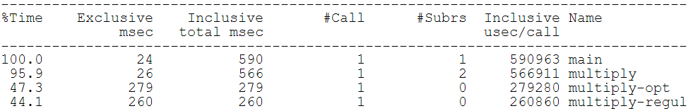
Analyzing -- Text summary
For a quick view summary of TAU performance, use
It reads and prints a summary of the TAU data in the current directory.
%> cd MULTI__P_WALL_CLOCK_TIME
%> pprof

Slide 41
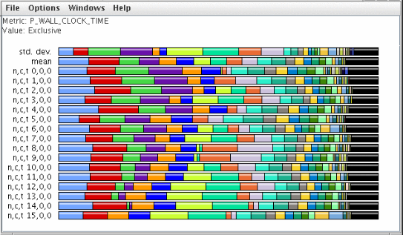
Analyzing -- ParaProf
To launch ParaProf, execute paraprof from the command line where the profiles are located.

Slide 42
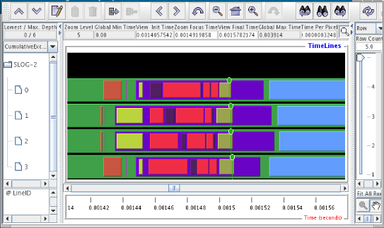
Analyzing -- Jumpshot
To use Argonne's Jumpshot (bundled with TAU), first merge and convert TAU traces to slog2 format:
% tau_treemerge.pl
% tau2slog2 tau.trc tau.edf -o tau.slog2
% jumpshot tau.slog2

Slide 43
Content
Overview
Instrumentation
Profiling
Tracing
Analyzing
Application Scenario

Slide 44
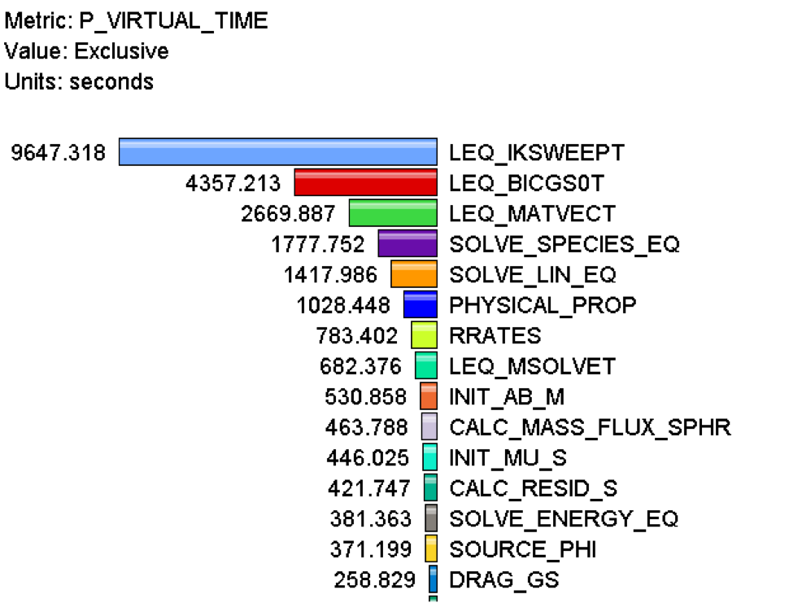
Application Scenario (1)
Q. What routines account for the most time? How much?
A. Create a flat profile with wallclock time.

Slide 45
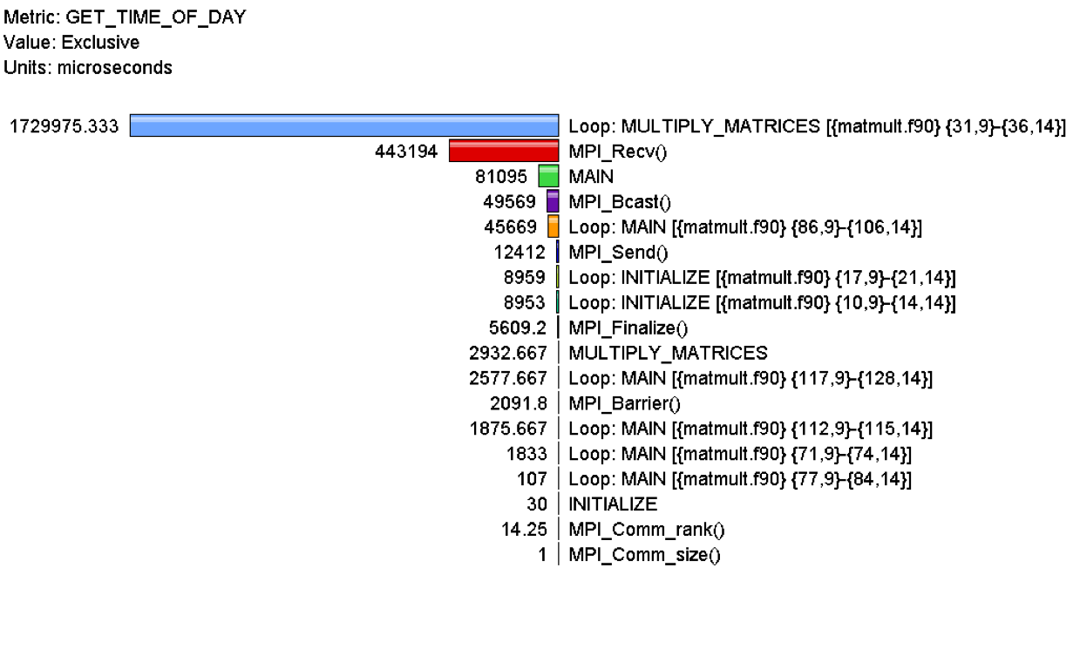
Application Scenario (2)
Q. What loops account for the most time? How much?
A. Create a flat profile with loop instrumentation.

Slide 46
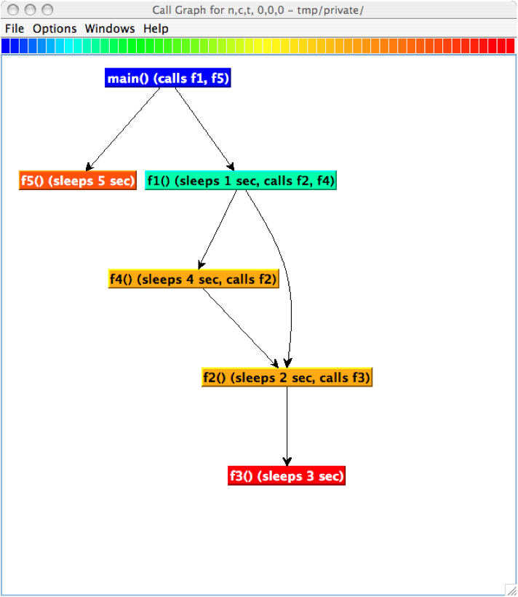
Application Scenario (3)
Q. Who calls MPI_Barrier() Where?
A. Create a callpath profile with given depth.

Slide 47
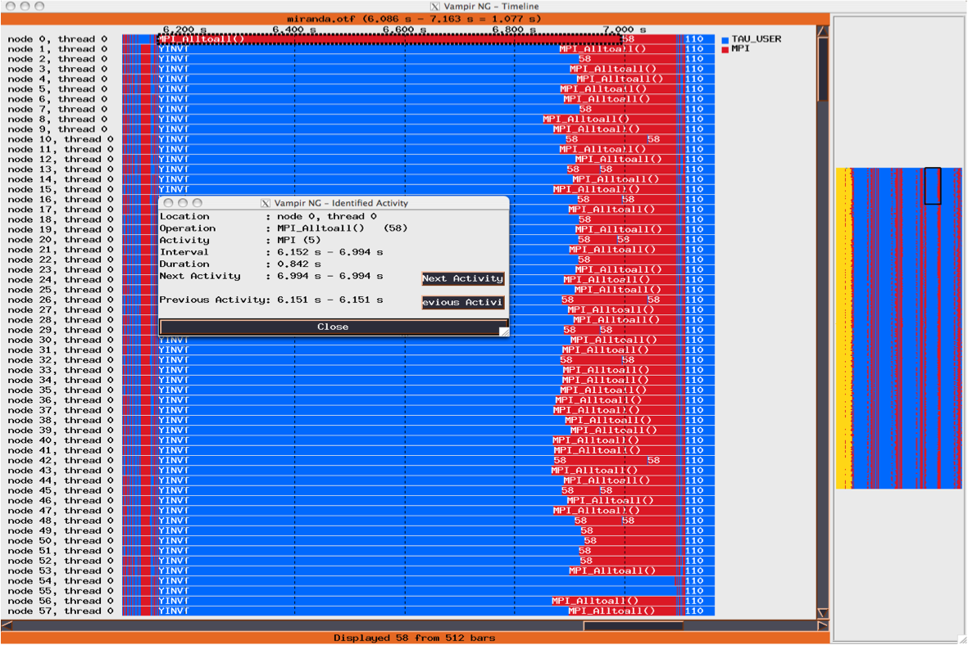
Application Scenario (4)
Q. What happens in my code at a given time ?
A. Create an event tree.

Slide 48
Application Scenarios
Q. How do I instrument Python Code?
A. Create an python wrapper library.
Q. How does my application scale?
A. Examine profiles in PerfExplorer.
Q. What MFlops am I getting in all loops?
A. Create a flat profile with PAPI_FP_INS/OPS and time with loop instrumentation.

Slide 49
Using TAU: Simplest Case
Uninstrumented code:
  % mpirun –np 8 ./a.out
With TAU:
  % mpirun –np 8 tau_exec ./a.out
  % paraprof

Slide 50
references
TAU User Guide
  https://www.cs.uoregon.edu/research/tau/docs/newguide/bk01pt01.html
TAU Website:
  http://tau.uoregon.edu
Sameer Shende, TAU Performance System, Performance Research Lab, University of Oregon.
  http://tau.uoregon.edu/tau.ppt

