Slide 1

Introduction to OpenMP
Part2. Core Features
人工智能技术学院
缪青海
miaoqh@ucas.ac.cn

Slide 2
Content
Getting started with OpenMP
Core features of OpenMP
Work with OpenMP
Advanced topics on OpenMP

Slide 3
Core features of OpenMP
Creating threads
  the Pi program
Synchronization
  Pi program revisited
Parallel Loops
  making the Pi program simple

Slide 4
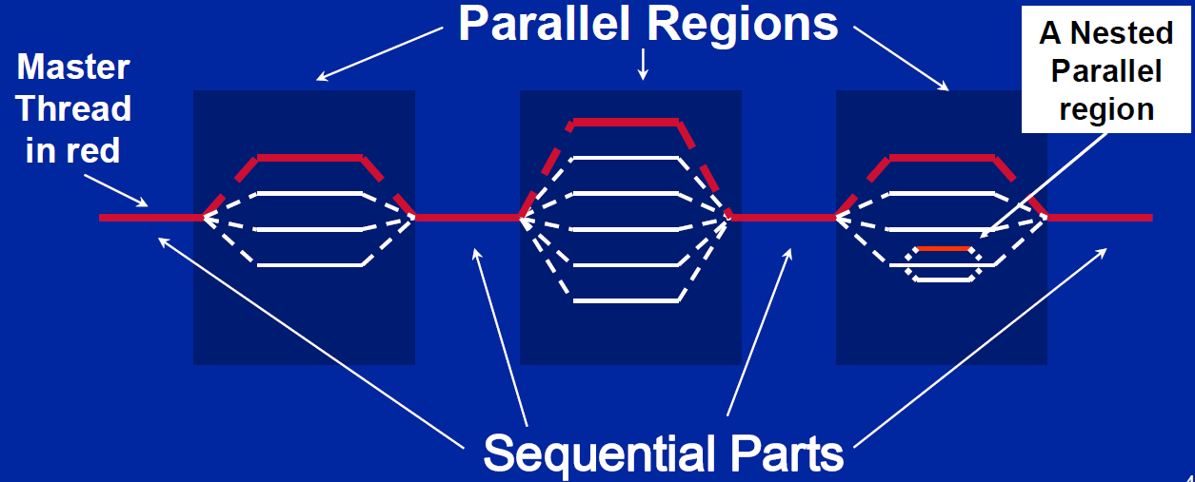
OpenMP Programming Model
Fork-Join Parallelism:
  Master thread spawns a team of threads as needed.
  Parallelism added incrementally until performance goals are met: i.e. the sequential program evolves into a parallel program.

Slide 5
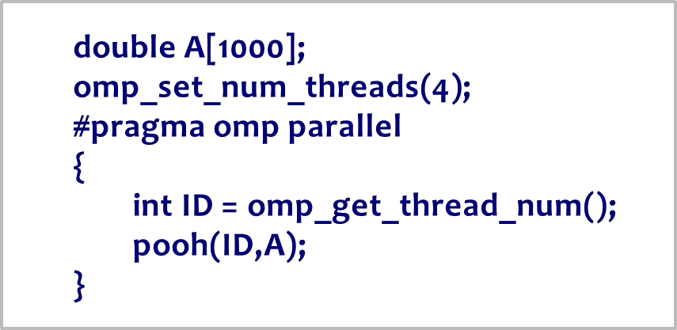
Thread Creation: Parallel Regions
Create threads in OpenMP with the parallel construct.
For example, create 4 thread parallel region:
  Each thread calls pooh(ID,A) for ID = 0 to 3

Slide 6
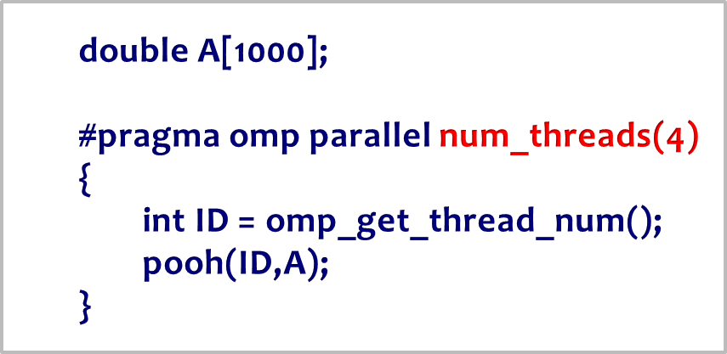
Thread Creation : Parallel Regions
Create threads in OpenMP with the parallel construct.
For example, create 4 thread parallel region:
  Each thread calls pooh(ID,A) for ID = 0 to 3

Slide 7
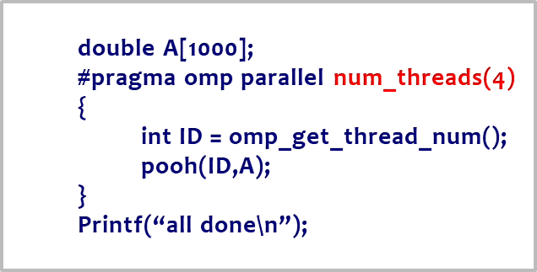
Thread Creation : Parallel Regions
Each thread executes the same code redundantly.
double A[1000];
A single
copy of A is
shared
between all
threads.
omp_set_num_threads(4)
pooh(0,A)
pooh(1,A)
pooh(2,A)
pooh(3,A)
printf(“all done\n”);

Slide 8
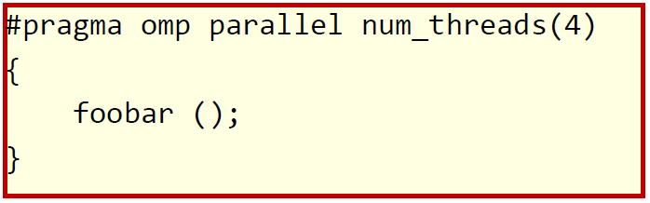
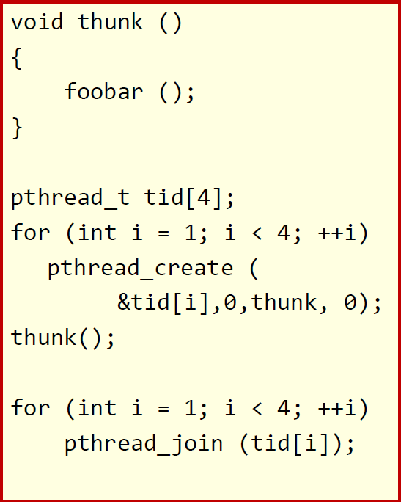
what the compiler does
All known OpenMP implementations use a thread pool so full cost of threads creation and destruction is not incurred for reach parallel region.
Only three threads are created
because the last parallel section will be invoked from the parent thread.

Slide 9
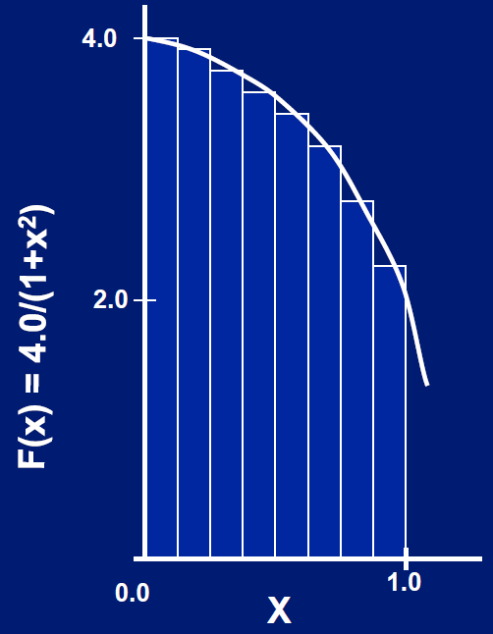
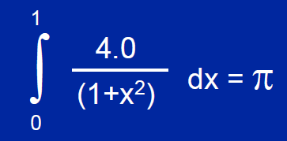
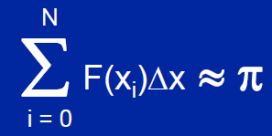
Test1: PI by Numerical Integration
Mathematically, we know that:
Approximate as a sum of rectangles:
Where each rectangle has width Δx and height F(xi) at the middle of interval i.

Slide 10
Test 1: Serial PI Program
  static long num_steps = 100000;
  double step;
  int main ()
  {
  int i; double x, pi, sum = 0.0;
  step = 1.0/(double) num_steps;
  for (i=0;i< num_steps; i++){
  x = (i+0.5)*step;
  sum = sum + 4.0/(1.0+x*x);
  }
  pi = step * sum;
  }
Code: test1_Pi/pi.c

Slide 11
Test1 aim
Create a parallel version of the pi program using a parallel construct. Pay close attention to :
  Shared versus private variables.
Runtime library routines:
  int omp_get_num_threads();
  int omp_get_thread_num();
  double omp_get_wtime();
Number of threads in the team
Thread ID or rank
Time in Seconds since a fixed
point in the past

Slide 12
Test1-1: A simple parallel PI Program
  #include <omp.h>
  static long num_steps = 100000; double step;
  #define NUM_THREADS 2
  int main ()
  {
  int i, nthreads; double pi, sum[NUM_THREADS];
  step = 1.0/(double) num_steps;
  omp_set_num_threads(NUM_THREADS);
  #pragma omp parallel
  {
  int i, id,nthrds; double x;
  id = omp_get_thread_num();
  sum[id]=0.0
  nthrds = omp_get_num_threads();
  if (id == 0) nthreads = nthrds;
    for (i=id; i< num_steps; i= i+nthrds){
    x = (i+0.5)*step;
    sum[id] += 4.0/(1.0+x*x);
    }
  }
  for(i=0, pi=0.0; i<nthreads; i++) pi += sum[i] * step;
  }
Promote scalar to an
array dimensioned by
number of threads to
avoid race condition.
Only one thread copy value, avoid writing conflicts to a address.
trick in SPMD to create a cyclic distribution of loop iterations.

Slide 13
Test1-1 : Algorithm strategy
The SPMD (Single Program Multiple Data) design pattern:
  Run the same program on P processing elements where P can be arbitrarily large.
  Use the rank … an ID ranging from 0 to (P-1) … to select between a set of tasks and to manage any shared data structures.
The most commonly used pattern in the history of parallel programming.
  Code:
    test1_Pi/solutions/ pi_spmd_simple.c

Slide 14
Test1-1 : Results
CPU:
  Intel Core i5 1.7 Ghz
Memory:
  4G DDR3 1.333 Ghz
OS:
  Apple OS X 10.7.3
Complier:
  Intel icpc
作业示例
threads | Time(s)
1 | 1.86
2 | 1.03
3 | 1.08
4 | 0.97

Slide 15
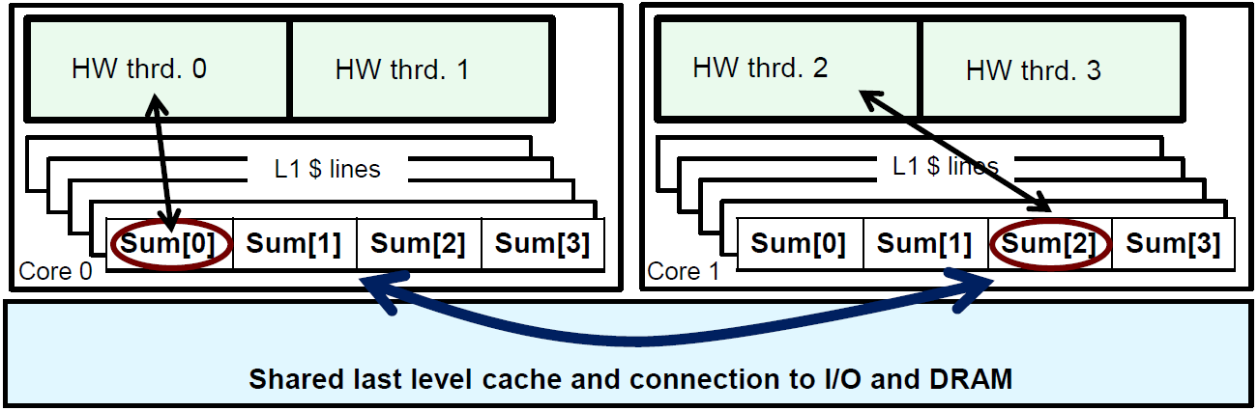
Test1-1 : False sharing
Why such poor scaling? False sharing!
If independent data elements happen to sit on the same cache line, each update will cause the cache lines to “slosh back and forth” between threads …
This is called “false sharing”.

Slide 16
Test1-1 : False sharing
Why such poor scaling? False sharing!
If you promote scalars to an array to support creation of an SPMD program, the array elements are contiguous in memory and hence share cache lines … Results in poor scalability.
  Solution: Pad arrays so elements you use are on distinct cache lines.

Slide 17
Test1-1 : A simple parallel PI Program
  #include <omp.h>
  static long num_steps = 100000; double step;
  #define PAD 8 // assume 64 byte L1 cache line size
  #define NUM_THREADS 2
  int main ()
  {
  int i, nthreads; double pi, sum[NUM_THREADS][PAD];
  step = 1.0/(double) num_steps;
  omp_set_num_threads(NUM_THREADS);
  #pragma omp parallel
  {
  int i, id,nthrds; double x;
  id = omp_get_thread_num();
  nthrds = omp_get_num_threads();
  if (id == 0) nthreads = nthrds;
  for (i=id, sum[id]=0.0; i< num_steps; i= i+nthrds){
    x = (i+0.5)*step;
    sum[id][0] += 4.0/(1.0+x*x);
    }
  }
  for(i=0, pi=0.0; i<nthreads; i++) pi += sum[i][0] * step;
  }
Pad the array so each sum value is in a different cache line.

Slide 18
Test1-1 : is padding necessary?
Padding arrays requires deep knowledge of the cache architecture.
Move to a machine with different sized cache lines and your software performance falls apart.
  There has got to be a better way to deal with false sharing.

Slide 19
Core features of OpenMP
Creating threads
  the Pi program
Synchronization
  Pi program revisited
Parallel Loops
  making the Pi program simple

Slide 20
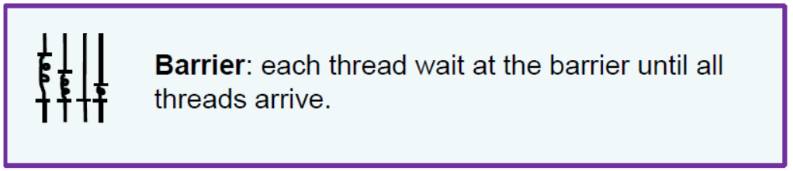
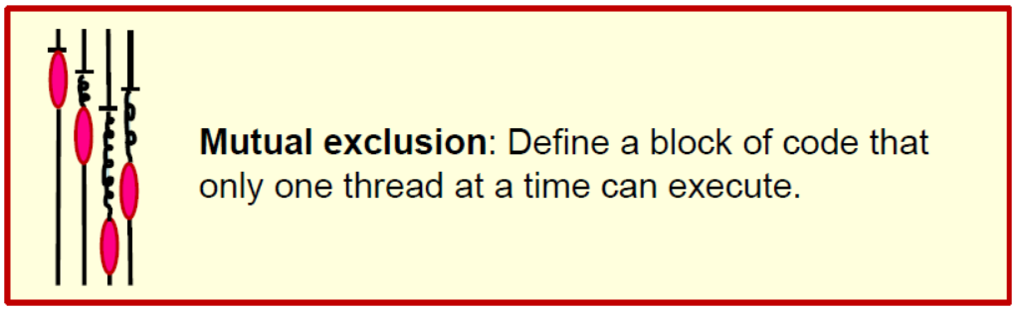
Synchronization
Bringing one or more threads to a well defined and known point in their execution.

Slide 21
Synchronization
High level synchronization:
  – critical
  – atomic
  – barrier
  – ordered
Low level synchronization
  – flush
  – locks (both simple and nested)
Synchronization is used
to impose order constraints and to protect access to shared data.

Slide 22
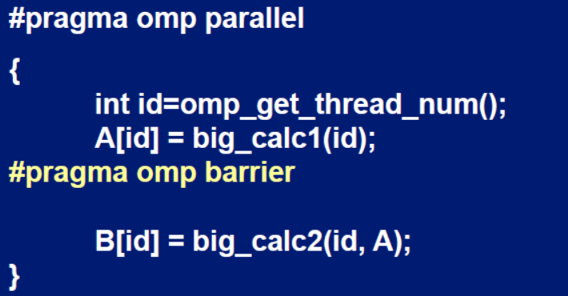
Synchronization: Barrier
Barrier: Each thread waits until all threads arrive.

Slide 23
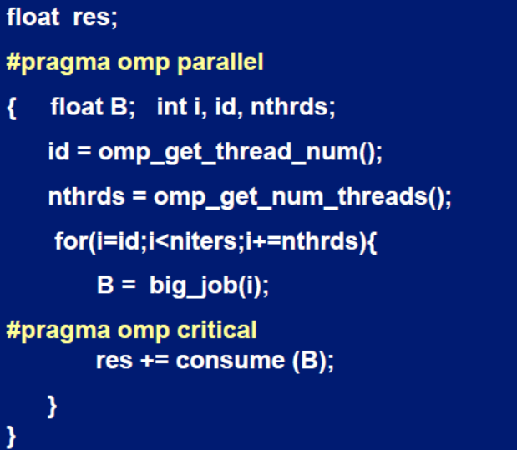
Synchronization: Critical
Mutual exclusion: Only one thread at a time can enter a critical region.
Threads wait their turn – only one at a time calls consume()

Slide 24
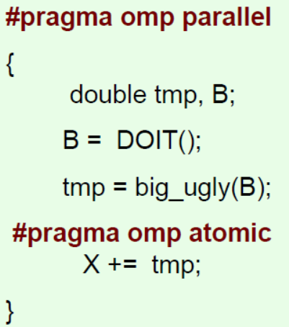
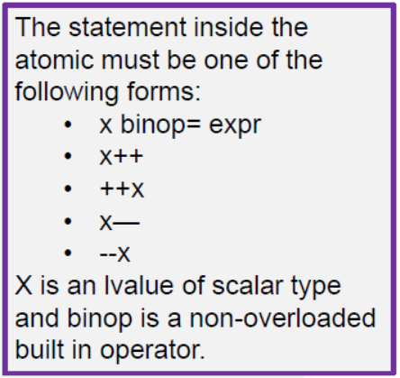
Synchronization: Atomic (basic form)
Atomic provides mutual exclusion but only applies to the update of a memory location.

Slide 25
Test1-2
Test1-1 used an array to create space for each thread to store its partial sum.
If array elements happen to share a cache line, this leads to false sharing.
  – Non-shared data in the same cache line so each update invalidates the cache line … in essence “sloshing independent data” back and forth between threads.
Modify your “pi program” from test1-1 to avoid false sharing due to the sum array.
  Code: test1_Pi/solutions/ pi_spmd_final.c

Slide 26
Test1-2: A simple parallel PI Program
  #include <omp.h>
  static long num_steps = 100000; double step;
  #define NUM_THREADS 2
  int main ()
  {
  int i, nthreads; double pi, sum[NUM_THREADS];
  step = 1.0/(double) num_steps;
  omp_set_num_threads(NUM_THREADS);
  #pragma omp parallel
  {
  int i, id,nthrds; double x;
  id = omp_get_thread_num();
  nthrds = omp_get_num_threads();
  if (id == 0) nthreads = nthrds;
    for (i=id, sum[id]=0.0; i< num_steps; i= i+nthrds){
    x = (i+0.5)*step;
    sum[id] += 4.0/(1.0+x*x);
    }
  }
  for(i=0, pi=0.0; i<nthreads; i++) pi += sum[i] * step;
  }
Promote scalar to an
array dimensioned by
number of threads to
avoid race condition.
Recall
Only one thread copy value, avoid writing conflicts to a address.
trick in SPMD to create a cyclic distribution of loop iterations.

Slide 27
#include <omp.h>
static long num_steps = 100000; double step;
#define NUM_THREADS 2
void main ()
{ double pi; step = 1.0/(double) num_steps;
omp_set_num_threads(NUM_THREADS);
#pragma omp parallel
{
int i, id,nthrds; double x, sum;
id = omp_get_thread_num();
nthrds = omp_get_num_threads();
if (id == 0) nthreads = nthrds;
id = omp_get_thread_num();
nthrds = omp_get_num_threads();
for (i=id, sum=0.0;i< num_steps; i=i+nthreads){
x = (i+0.5)*step;
sum += 4.0/(1.0+x*x);
}
#pragma omp critical
pi += sum * step;
}
}
Using a critical section to remove impact of false sharing
Create a scalar local to each thread to accumulate partial sums.
No array, so no false sharing.
Must protect summation into pi in a critical region so updates don’t conflict.

Slide 28
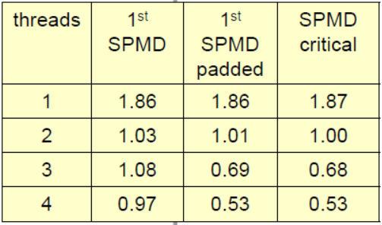
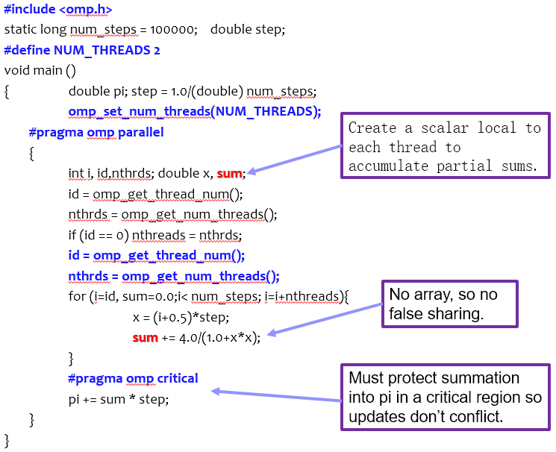
Test1-2: results

Slide 29
#include <omp.h>
static long num_steps = 100000; double step;
#define NUM_THREADS 2
void main ()
{ double pi; step = 1.0/(double) num_steps;
omp_set_num_threads(NUM_THREADS);
#pragma omp parallel
{
int i, id,nthrds; double x, sum;
id = omp_get_thread_num();
nthrds = omp_get_num_threads();
if (id == 0) nthreads = nthrds;
id = omp_get_thread_num();
nthrds = omp_get_num_threads();
for (i=id, sum=0.0;i< num_steps; i=i+nthreads){
x = (i+0.5)*step;
sum += 4.0/(1.0+x*x);
}
sum = sum*step;
#pragma atomic
pi += sum;
}
}
Using an atomic to remove impact of false sharing
Create a scalar local to each thread to accumulate partial sums.
No array, so no false sharing.
Must protect summation into pi so updates don’t conflict.

Slide 30
Core features of OpenMP
Creating threads
  the Pi program
Synchronization
  Pi program revisited
Parallel Loops
  making the Pi program simple

Slide 31
SPMD vs. Worksharing
A parallel construct by itself creates an SPMD program … i.e., each thread redundantly executes the same code.
How do we split up pathways through the code between threads within a team?
  This is called worksharing
    – Loop construct
    – Sections/section constructs
    – Single construct
    – Task construct

Slide 32
Loop Worksharing constructs
The loop worksharing construct splits up loop iterations among the threads in a team
#pragma omp parallel
{
#pragma omp for
for (i=0; i<N; i++){
NEAT_STUFF(i);
}
}
The variable I is made “private” to each thread by default. You could do this explicitly with a “private(I)” clause

Slide 33
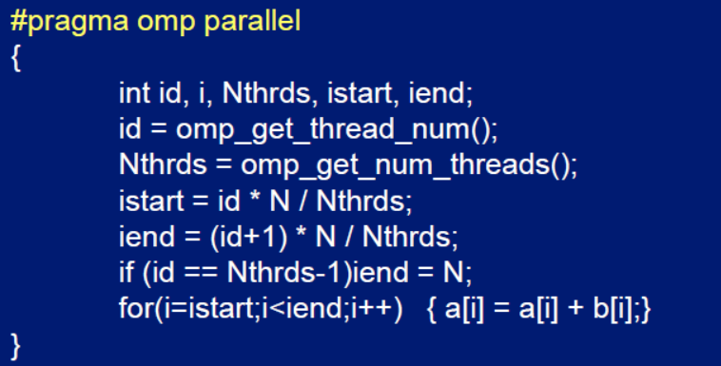

Loop Worksharing constructs
Serial
OpenMP parallel region
OpenMP parallel
region and a
worksharing for
construct

Slide 34
Loop Worksharing constructs
The schedule clause：affects how loop iterations are mapped onto threads.
  schedule(static [,chunk])
    – Deal-out blocks of iterations of size “chunk” to each thread.
  schedule(dynamic[,chunk])
    – Each thread grabs “chunk” iterations off a queue until all iterations have been handled.

Slide 35
Loop Worksharing constructs
The schedule clause：
  schedule(guided[,chunk])
    – Threads dynamically grab blocks of iterations. The size of the block starts large and shrinks down to size “chunk” as the calculation proceeds.
  schedule(runtime)
    – Schedule and chunk size taken from the OMP_SCHEDULE environment variable (or the runtime library).
  schedule(auto)
    – Schedule is left up to the runtime to choose (does not have to be any of the above).

Slide 36
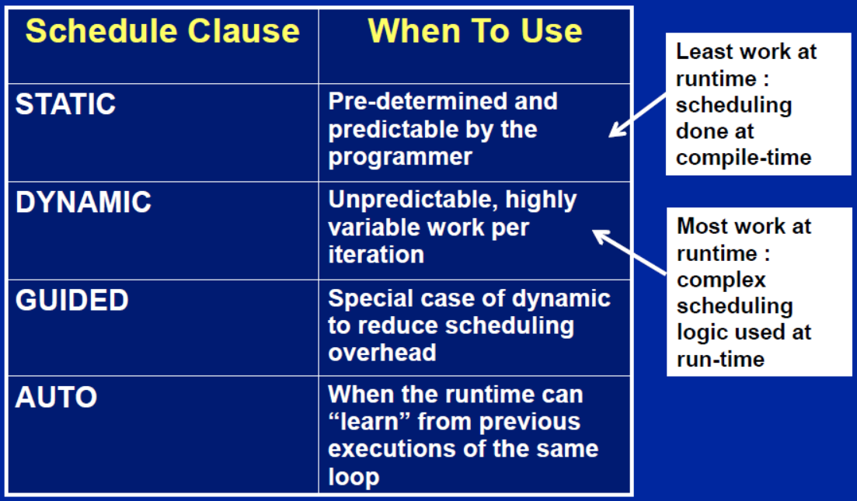
Loop Worksharing constructs
The schedule clause：when to use?

Slide 37
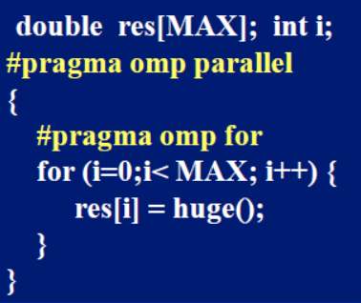
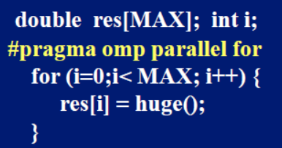
Loop Worksharing constructs
OpenMP shortcut:
  Combined parallel/worksharing construct

Slide 38
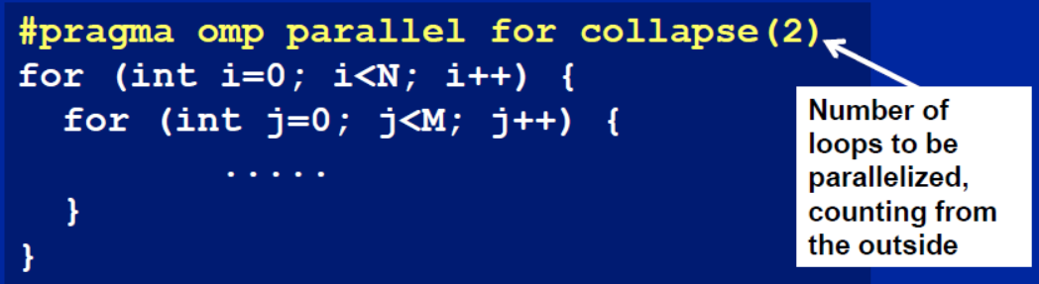
Nested loops
For perfectly nested rectangular loops we can parallelize multiple loops in the nest with the collapse clause:
Will form a single loop of length NxM and then parallelize that.

Slide 39
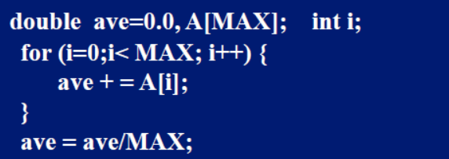
Reduction
How do we handle this case?
We are combining values into a single accumulation variable (ave) … there is a true dependence between loop iterations that can’t be trivially removed.
This is a very common situation … called a “reduction”.
Support for reduction operations is included in most parallel programming environments.

Slide 40
Reduction
OpenMP reduction clause:
  reduction (op : list)
Inside a parallel or a work-sharing construct:
  – A local copy of each list variable is made and initialized depending on the “op” (e.g. 0 for “+”).
  – Updates occur on the local copy.
  – Local copies are reduced into a single value and combined with the original global value.

Slide 41
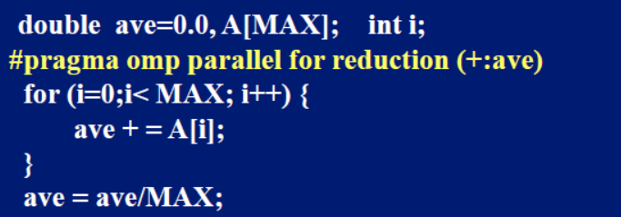
Reduction
OpenMP reduction clause:
  reduction (op : list)
The variables in “list” must be shared in the enclosing parallel region.

Slide 42
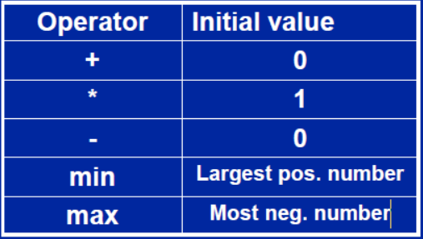
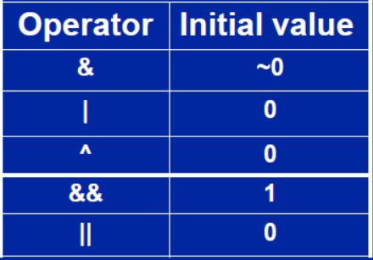
Reduction: operands/initial-values

Slide 43
Test1-3: Pi with loops
Go back to the serial pi program and parallelize it with a loop construct.
Your goal is to minimize the number of changes made to the serial program.

Slide 44
Serial PI Program
  static long num_steps = 100000;
  double step;
  int main ()
  {
  int i; double x, pi, sum = 0.0;
  step = 1.0/(double) num_steps;
  for (i=0;i< num_steps; i++){
  x = (i+0.5)*step;
  sum = sum + 4.0/(1.0+x*x);
  }
  pi = step * sum;
  }

Slide 45
Test1-3 : Pi with loop and reduction
  #include <omp.h>
  static long num_steps = 100000;double step;
  int main ()
  {
  int i; double x, pi, sum = 0.0;
  step = 1.0/(double) num_steps;
    #pragma omp parallel
    {
    double x;
    #pragma omp for reduction(+:sum)
    for (i=0;i< num_steps; i++){
    x = (i+0.5)*step;
    sum = sum + 4.0/(1.0+x*x);
    }
    }
  pi = step * sum;
  }
Create a team of threads
a scalar local to each thread
setting up a
reduction into sum.
Code: test1_Pi/solution/pi_loop.c

Slide 46
references
Tim Mattson, A “Hands-on” Introduction to OpenMP, Intel Corp.
Mark Bull, Parallel Programming with OpenMP, EPCC, University of Edinburgh, UK.
迟学斌等，并行计算与实现技术，科学出版社。

