Slide 1
Signal Encoding Techniques
(信号编码技术..或称调制技术)
张宝贤：无线网络技术——第三次课程
《无线通信与网络》第六章

Slide 2
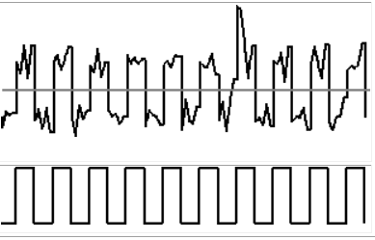
为什么引入调制技术？
Digital data, digital signal
  0: 传输一个低电平信号；1传输一个高电平信号
  Equipment less complex and expensive than digital-to-analog modulation equipment
Analog data, digital signal
  Permits use of modern digital transmission and switching equipment
  模拟信号先要进行数字化然后在导向或非导向的媒质上传输，可以改善传输质量并可以利用TDM方式。对于无线传输来说，得到的数字信号必须调制到一个模拟载波上去。
  例子：PCM(脉冲编码调制), AM（增量调制）

Slide 3
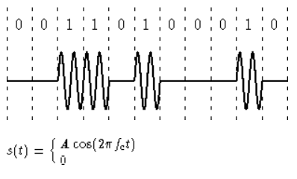
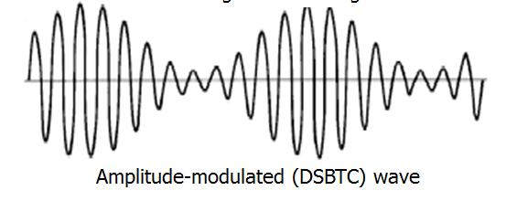
为什么引入调制技术？
Digital data, analog signal
  Some transmission media will only propagate analog signals
  E.g., optical fiber and unguided media （也就是说在无线传输环境下，数据数据必须先转换成模拟信号）
  例子：ASK, FSK, PSK
Analog data, analog signal
  Analog data in electrical form can be transmitted easily and cheaply
  Done with voice transmission over voice-grade lines
  也可以把模拟信号调制到高频载波上进行传输
  例子：AM, FM, PM
ASK: Amplitude-Shift Keying

Slide 4
调制准则
What determines how successful a receiver will be in interpreting an incoming signal?
  Signal-to-noise ratio
  Data rate
  Bandwidth
An increase in data rate increases bit error rate
An increase in SNR decreases bit error rate
An increase in bandwidth allows an increase in data rate （但根据仙农信道容量公式，这是有上限的）

Slide 5
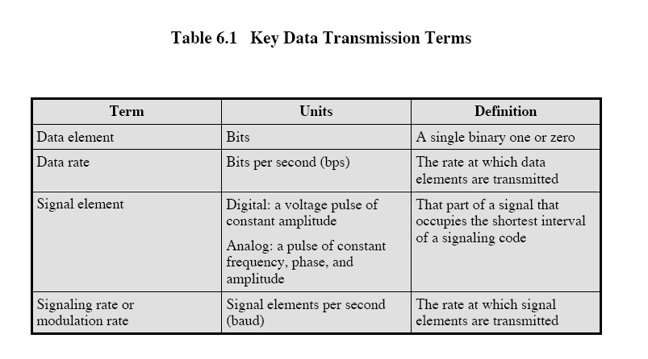
（关键数字传输术语）
（码元）
(波特)

Slide 6
Factors Used to Compare
Encoding Schemes
Signal spectrum
  With lack of high-frequency components, less bandwidth required （如果一个信号没有高频成分）
  With no dc component, ac coupling via transformer possible （如果没有直流成分，那么通过变压器的交流偶合——可以进行电气隔离，降低干扰）
  Transfer function of a channel is worse near band edges
  （频带边缘的信道传输性能较差）
Clocking （时钟）
  Ease of determining beginning and end of each bit position
    通过独立的时钟信道—成本高
    通过发送信号的同步机制—通过适当的调制技术可以做到

Slide 7
Factors Used to Compare
Encoding Schemes
Signal interference and noise immunity
  Performance in the presence of noise
    某些码元在噪声环境下性能很好
      抗噪声能力通常用“误码率”来表示
Cost and complexity
  The higher the signal rate to achieve a given data rate, the greater the cost
    后面将会看到，某些码元要求信号速率>实际数据速率

Slide 8
Basic Encoding Techniques
Digital data to analog signal
  Amplitude-shift keying (ASK) （幅移键控）
    Amplitude difference of carrier frequency
  Frequency-shift keying (FSK) （频移键控）
    Frequency difference near carrier frequency
  Phase-shift keying (PSK) （相移键控）
    Phase of carrier signal shifted

Slide 9
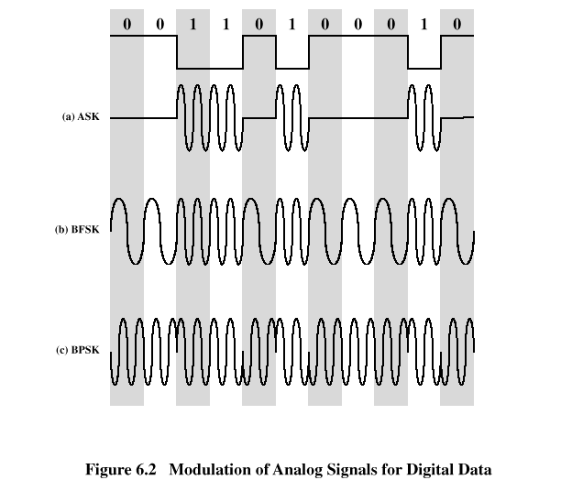
Basic Encoding Techniques
(A) ASK
(B) BFSK
(C) BPSK

Slide 10
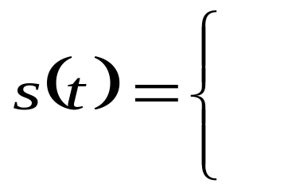
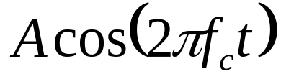
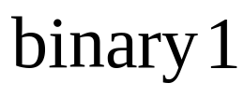

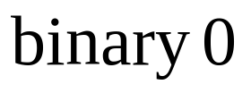
Amplitude-Shift Keying
One binary digit represented by presence of carrier, at constant amplitude
Other binary digit represented by absence of carrier
    where the carrier signal is Acos(2πf_{c}t)
10

Slide 11
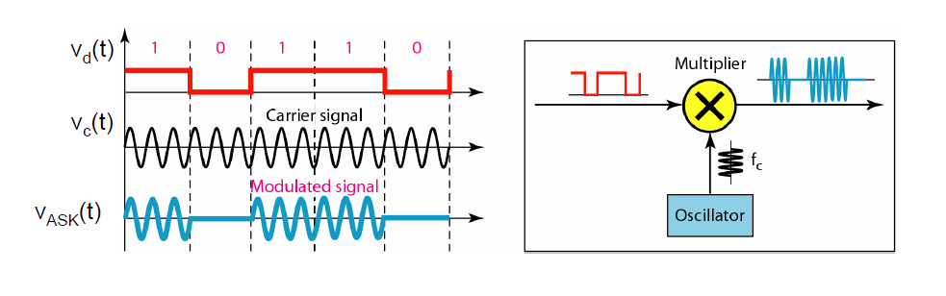
Amplitude-Shift Keying
ASK实现方式
10

Slide 12
Amplitude-Shift Keying
Susceptible to sudden gain changes （受突发的增益变化影响严重）
  噪声通常只影响信号幅度，因而ASK是受噪声影响最严重的调制技术
Inefficient modulation technique
On voice-grade lines, used up to 1200 bps (话音级链路上，最高能到1200 bps)
Used to transmit digital data over optical fiber
  发光二极管发送光信号，方式如下
    激光发送器通常有一个固定的偏流(bias)，它可以使器件发射出亮度较低的光信号。
      用这个较低的亮度表示一个信号
      用振幅较高的光波表示另一个信号

Slide 13
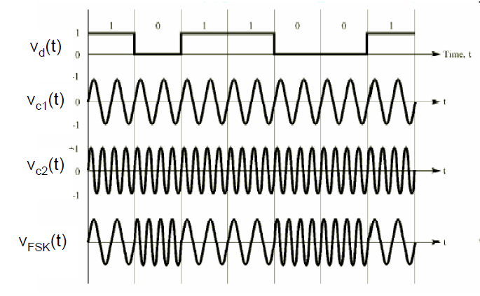
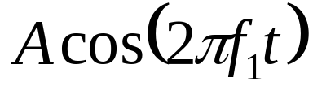
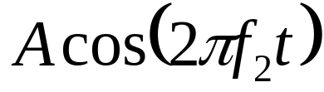
Binary Frequency-Shift Keying (BFSK) 二元频移键控
Two binary digits represented by two different frequencies near the carrier frequency
    where f₁ and f₂ are offset from carrier frequency f_{c} by equal but opposite amounts
FSK实现方式

Slide 14
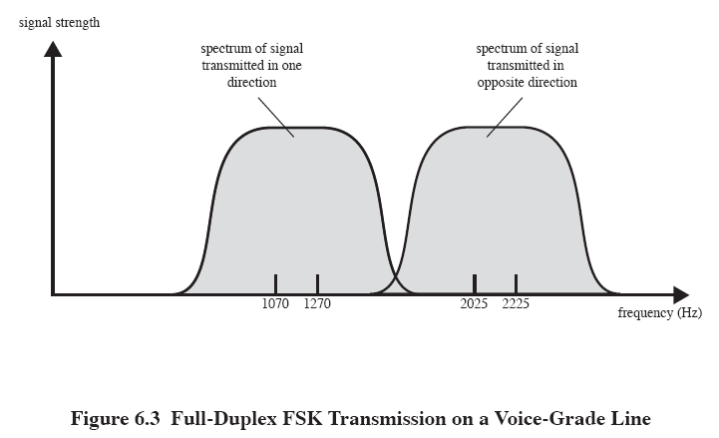
双方向上的频谱没什么交叠，
也就没什么干扰
1170
2125

Slide 15
Binary Frequency-Shift Keying (BFSK)
Less susceptible to error than ASK
  这是因为ASK空号时不传信号，因此信号功率比FSK低 50% (振幅相同时）
On voice-grade lines, used up to 1200bps
Used for high-frequency (3 to 30 MHz) radio transmission
Can be used at higher frequencies on LANs that use coaxial cable
易于实现——早期Modem都采用频移键控技术

Slide 16
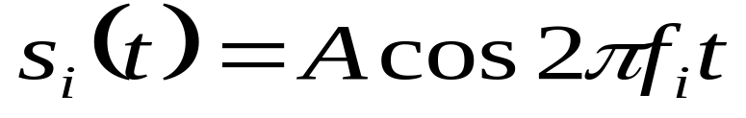
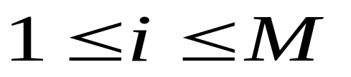
Multiple Frequency-Shift Keying (MFSK)多元频移键控
More than two frequencies are used
More bandwidth efficient but more susceptible to error
    f _{i} = f _{c} + (2i – 1 – M)f _{d}
    f _{c} = the carrier frequency （载波频率）
    f _{d} = the difference frequency （差分频率）
    M = number of different signal elements = 2 ^{L}
    L = number of bits per signal element
15

Slide 17
Multiple Frequency-Shift Keying (MFSK)
To match data rate of input bit stream, each output signal element is held for:
  T_{s}=LT seconds
    where T is the bit period (data rate = 1/T)
So, one signal element encodes L bits

Slide 18
Multiple Frequency-Shift Keying (MFSK)
Total bandwidth required
  2Mf_{d}
Minimum frequency separation required 2f_{d}=1/T_{s} , T_{s}指码元周期长度
Therefore, modulator requires a bandwidth of
  W_{d}=2 M f_{d}=M/T_{s}

Slide 19
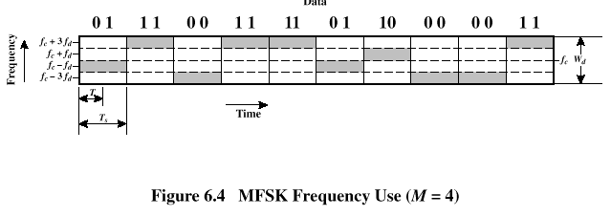
Multiple Frequency-Shift Keying (MFSK)
18

Slide 20
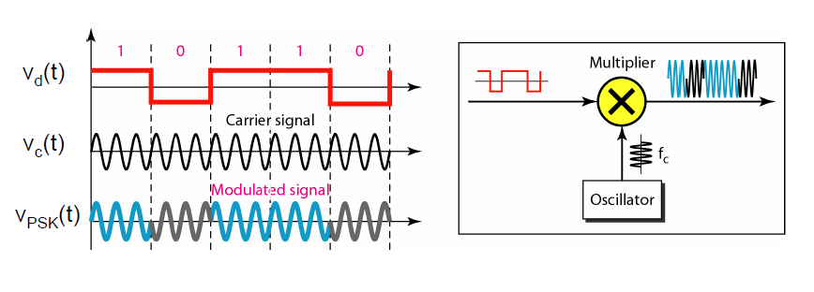
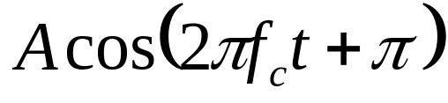
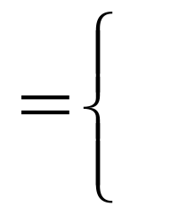
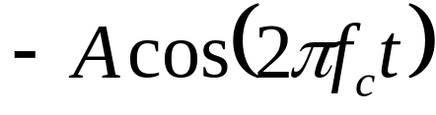
Phase-Shift Keying (PSK)
Two-level PSK (BPSK) （二元相移键控）
  Uses two phases to represent binary digits
BPSK实现方式
19

Slide 21
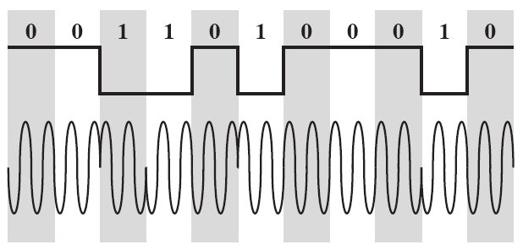
Phase-Shift Keying (PSK)
Differential PSK (DPSK)
  Phase shift with reference to previous bit
    Binary 0 – signal burst of same phase as previous signal burst
    Binary 1 – signal burst of opposite phase to previous signal burst

Slide 22
Phase-Shift Keying (PSK)
Differential PSK (DPSK) （Cont’d)
  不需要接收端有一个与发送端精确匹配的本地震荡器相位。
  只要前面接收到的比特相位正确，那么参照相位就是精确的
21

Slide 23
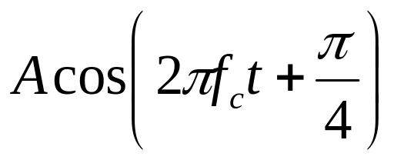
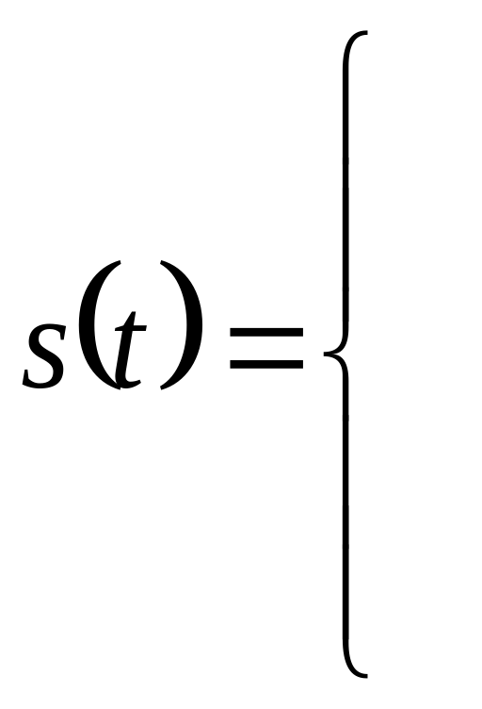

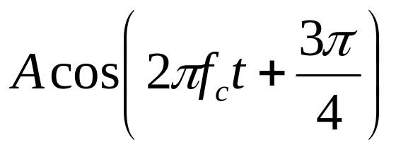

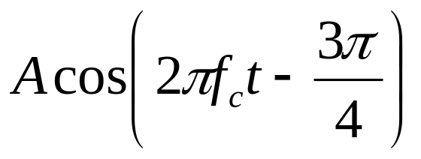

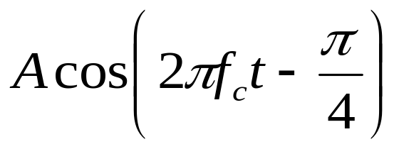

Phase-Shift Keying (PSK)
Four-level PSK (QPSK)（四元相移键控）
  Each element represents more than one bit

Slide 24
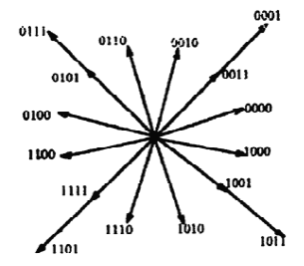
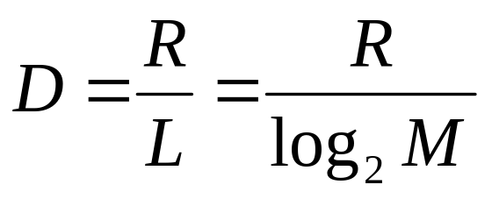
Phase-Shift Keying (PSK)
Multilevel PSK
  Using multiple phase angles with each angle having more than one amplitude, multiple signals elements can be achieved
    D = modulation rate, baud
    R = data rate, bps
    M = number of different signal elements = 2^{L}
    L = number of bits per signal element
在标准的9600 bps的调制解调器中，使用了12个
相位角度，其中有四个具有两种振幅值，因而
总共有16个不同的信号元素
23
Notes:
2010年9月12日——讲到此处

Slide 25
Performance [来自COUC01]
Bandwidth of modulated signal (B_{T})
  ASK, PSK B_{T}=(1+r)R
  FSK B_{T}=2×DF+(1+r)R
    R = bit rate
    0 < r < 1, which is related to how signal is filtered
    DF = f₂-f_{c}=f_{c}-f₁
24
Notes:
FSK, PSK信号都不受噪声在幅度方面的影响，PSK带宽要求小（与ASK相同），但PSK实现较为复杂。

Slide 26
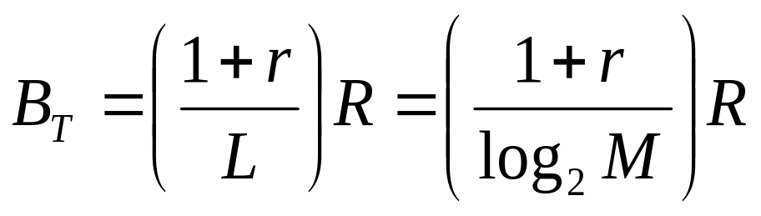
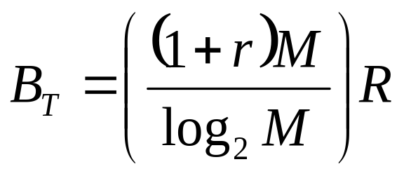
Performance
Bandwidth of modulated signal (B_{T})
  MPSK
  MFSK
    L = number of bits encoded per signal element
    M = number of different signal elements
从公式可以看出，MFSK所需带宽M倍于MPSK所需带宽。
25
Notes:
从公式可以看出，MFSK所需带宽M倍于MPSK所需带宽。。。。

Slide 27
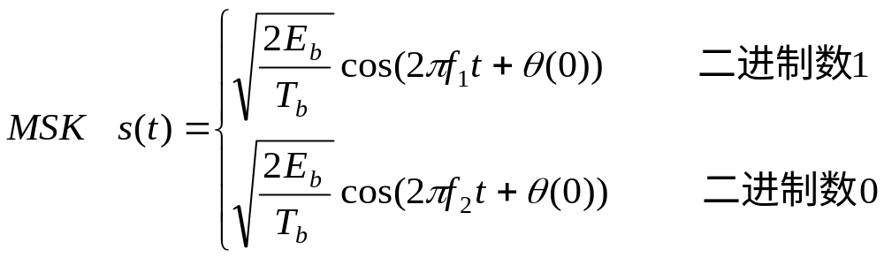
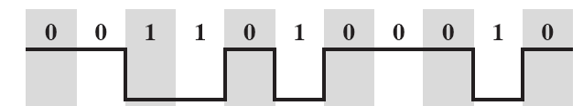
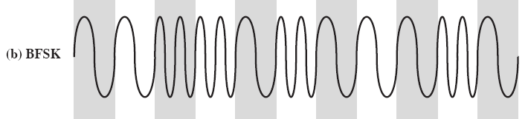
最小频移键控（Minimum Shift Keying: MSK)
在某些实际移动通信系统中应用
仅在有限差错性能损伤的情况下，提供了比BFSK更优的带宽效率
  E_{b}: 每比特信号能量； T_{b}是每比特持续时间
MSK的一个重要特征：连续相位移频键控
26

Slide 28
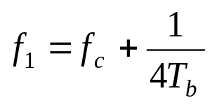
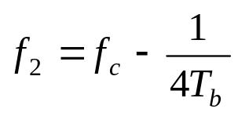
最小频移键控（续）
MSK满足如下条件
  以上两频率之间的这段空隙可以允许接收器能成功地检测信号的最小值。这也是MSK 中Minimum的含义
注释：在FSK方式中，两个相邻的频率跳变码元信号，其相位通
常是不连续的。
所谓MSK方式，就是FSK信号的相位始终保持连续变化的
一种特殊方式。

Slide 29
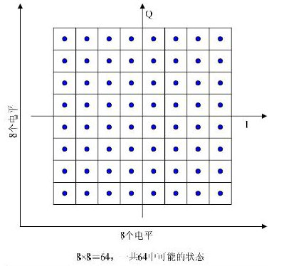
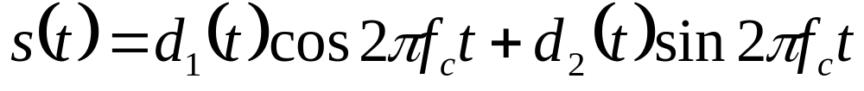
Quadrature Amplitude Modulation (QAM) 正交幅度调制
QAM is a combination of ASK and PSK
  Two different signals sent simultaneously on the same carrier frequency
    这两个载波通常是相位差为90度（π/2）的正弦波，因此被称作正交载波
从ASK or PSK简单的一维编码方式变换为二维编码，信号稳定性强，码间距离加大
用于ADSL传输等
常见的QAM形式有16-QAM、64-QAM、256-QAM等
QAM编码具有能充分利用带宽、抗噪声能力强等优点。
QAM复杂性高于PSK等——因为需要同时检测相位和幅度
64 QAM星座图

Slide 30
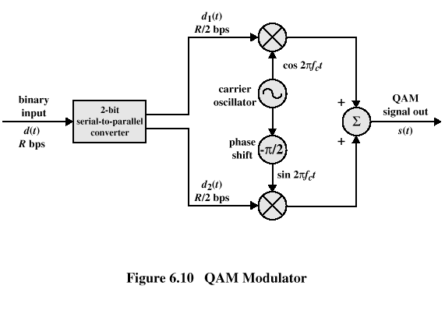
Quadrature Amplitude Modulation
2比特串并转换

Slide 31
Reasons for Analog Modulation
Modulation of digital signals
  When only analog transmission facilities are available, digital to analog conversion required
Modulation of analog signals
  A higher frequency may be needed for effective transmission。直接传送基带信号是不可能的——需要使用的天线的直径是几千米！
  Modulation permits frequency division multiplexing
30

Slide 32
Basic Encoding Techniques
Analog data to analog signal
  Amplitude modulation (AM)
  Angle modulation
    Frequency modulation (FM)
    Phase modulation (PM)

Slide 33
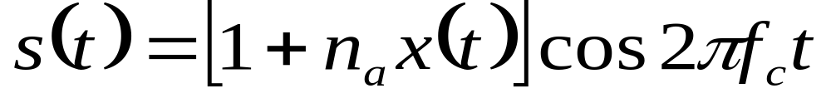
Amplitude Modulation
Amplitude Modulation
    cos2πf_{c}t = carrier
    x(t) = input signal
    n_{a} = modulation index
      Ratio of amplitude of input signal to carrier
    上式中的 “1”代表直流分量部分
  a.k.a double sideband transmitted carrier (DSBTC) （双边带发射载波）

Slide 34
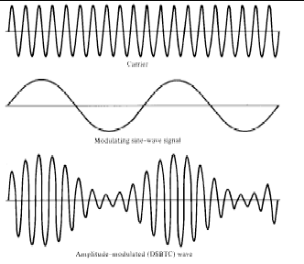
Carrier
Modulating Sine-wave signal
Amplitude-modulated (DSBTC) wave
33

Slide 35
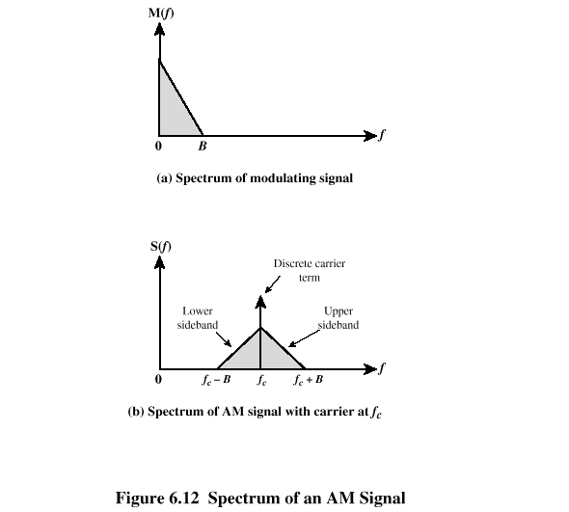
Spectrum of AM signal
上下边带都是原始
信号的副本
比如如果信号带宽
300—3000Hz
载频：60 kHZ
则上边带
60.3-63kHz
下边带
57-59.7kHz

Slide 36
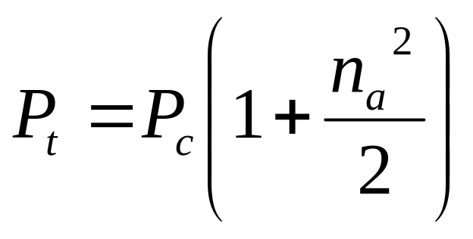
Amplitude Modulation
Transmitted power
    P_{t} = total transmitted power in s(t)
    P_{c} = transmitted power in carrier
n_{a} 越大，用来传送有用信息的能量越大
但 n_{a}必须<1,否则将发生信息丢失…因为包络线会
穿越x轴
35

Slide 37
Single Sideband (SSB)
Variant of AM is single sideband (SSB)
  Sends only one sideband
  Eliminates other sideband and carrier
Advantages
  Only half the bandwidth is required
  Less power is required
单边带通信优点：节约频带，节省功率，由于单边带发射
机不发送载频，提高了保密性。
单边带通信缺点：设备比较复杂。

Slide 38
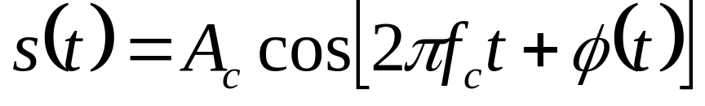
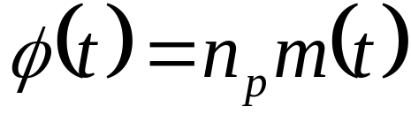
Angle Modulation
调频和调相是角度调制的特例
Angle modulation
Phase modulation
  Phase is proportional to modulating signal
    n_{p} = phase modulation index
37

Slide 39
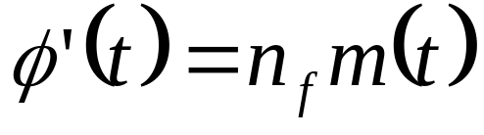
Angle Modulation
Frequency modulation
  Derivative of the phase is proportional to modulating signal （相位的导数与受调信号成正比）
    n_{f} = frequency modulation index

Slide 40
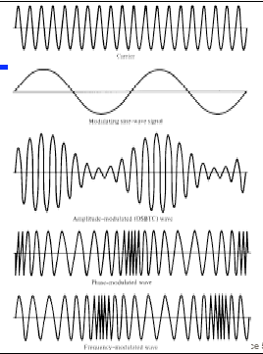
载波
调制正弦信号
调幅DSBTC
调相
调频
39

Slide 41
Angle Modulation
Compared to AM, FM and PM result in a signal whose bandwidth:
  is also centered at f_{c}
  but has a magnitude that is much different
    Angle modulation includes cos(φ(t)) which produces a wide range of frequencies
    注意：频率可以定义成为相位变化的速率
Thus, FM and PM require greater bandwidth than AM

Slide 42

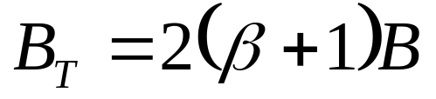
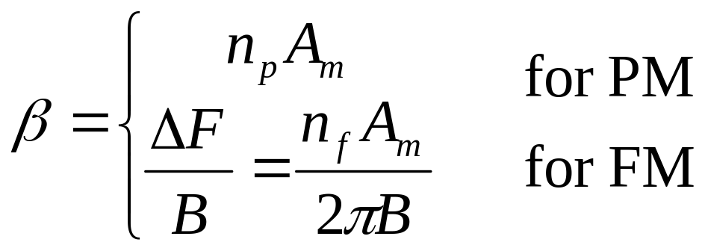
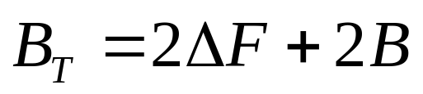
Bandwidth Requirements
Carson’s rule
  where
The formula for FM becomes
A_{m}是输入信号的最大值， n_{f}, n_{p}是调频、调幅指数
41

Slide 43
Basic Encoding Techniques
(数字化技术)
Analog data to digital signal (digital data)
  Pulse code modulation (PCM) 脉冲编码调制，或称脉码调制
  Delta modulation (DM) 增量调制

Slide 44

Analog Data to Digital Signal
（数字化，digitization）
Once analog data have been converted to digital signals, the digital data:
  (1) can be transmitted using NRZ-L. In this case, we have gone directly from analog data to digital signal
  (2) can be encoded as a digital signal using a code other than NRZ-L
  (3) can be converted to an analog signal, using previously discussed modulation techniques
    （3）的目的如下图所示

Slide 45
Pulse Code Modulation
(脉码调制，PCM)
Based on the sampling theorem
  如果采样频率高于信号最大主频的两倍，那么采样样本包含原始信号的所有信息。利用低通滤波器可以从这些采样序列中复原原始信号
Each analog sample is assigned a binary code
  Analog samples are called pulse amplitude modulation (脉幅调制PAM) samples
The digital signal consists of block of n bits, where each n-bit number is the amplitude of a PCM pulse
44

Slide 46

Pulse Code Modulation

Slide 47
Pulse Code Modulation
By quantizing the PAM pulse, original signal is only approximated
Leads to quantizing noise
Signal-to-noise ratio for quantizing noise [GIBS93]
Thus, each additional bit increases SNR by 6 dB, or a factor of 4
46

Slide 48

Pulse Code Modulation
线性编码：每个量化阶间隔距离相同
  对振幅较低的信号失真相对严重
非线性编码：
  对低振幅信号采用较多的量化阶
  对高振幅信号采用较少的量化阶
图6.16

Slide 49
Delta Modulation （增量调制）
Analog input is approximated by staircase function （阶梯函数）
  Moves up or down by one quantization level (δ) at each sampling interval
The bit stream approximates derivative of analog signal (rather than amplitude)
  1 is generated if function goes up
  0 otherwise
    注意：这样的结果是每个抽样值只编码为一位
48

Slide 50

Delta Modulation

Slide 51
Delta Modulation
Two important parameters （见上页图）
  Size of step assigned to each binary digit (δ)
  Sampling rate
Accuracy improved by increasing sampling rate
  However, this increases the data rate
Advantage of DM over PCM is the simplicity of its implementation
50

Slide 52
带宽／数据率分析
采用128位量化电平或7位编码
  话音信号占4kHz, 那么采样速率8000次/秒
    采用PCM编码的话，数据速率为56kbps
    根据Nyquist定理，56kbps数据速率可能需要的带宽的量级为28kHz.
  而如果采用10-bit PCM编码那么４.6ＭHz的电视信号将需要92Mbps的速率

Slide 53
为什么我们还使用数字化技术？
Growth in popularity of digital techniques for sending analog data
  Repeaters are used instead of amplifiers
    No additive noise （噪声积累）
  TDM is used instead of FDM
    No intermodulation noise will be introduced
  Conversion to digital signaling allows use of more efficient digital switching techniques
  Allow flexible but powerful data compression techniques be used

Slide 54
思考题（无需提交）
(1) 什么是差分编码
54

