Slide 1
Spread Spectrum（扩频技术）
张宝贤：无线网络技术——第三次课程
《无线通信与网络》第七章

Slide 2
Spread Spectrum
Input is first fed into a channel encoder (信道编码器）
  Produces analog signal with narrow bandwidth
Signal is further modulated using sequence of digits （数字序列）
  Spreading code or spreading sequence
    Generated by pseudonoise（伪噪声）, or pseudo-random number generator
Effect of modulation (调制) is to increase bandwidth of signal to be transmitted （扩频）
2

Slide 3
Spread Spectrum
On receiving end （接收方）
  Same digit sequence is used to demodulate the spread spectrum signal, and then
  Signal is fed into a channel decoder to recover data

Slide 4
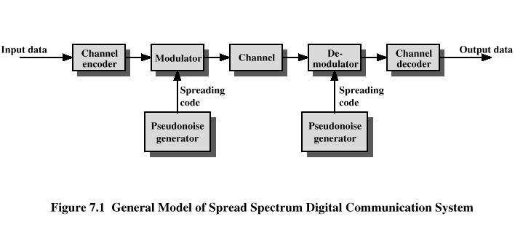
Spread Spectrum
窄带调制
扩频调制
信道编码器
信道解码器
扩展码
伪随机序列生成器
伪随机序列生成器
扩频数字通信系统的一般模型

Slide 5
Spread Spectrum
What can be gained from apparent waste of spectrum? 如此浪费带宽目的何在？
  Immunity from various kinds of noise and multipath distortion (抗干扰和多径失真）
  Can be used for hiding and encrypting signals （隐藏和加密信号）
  Several users can independently use the same higher bandwidth with very little interference （多用户可以独立地使用相同的较宽的带宽而几乎没有相互干扰）。。如：CDMA码分多址技术

Slide 6
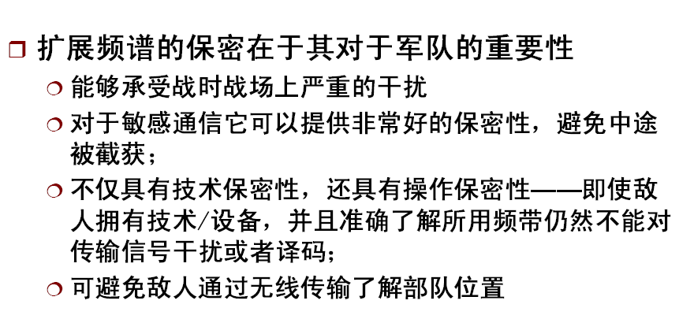
扩频在军事上的用途
6

Slide 7
Frequency Hoping Spread Spectrum (FHSS：跳频扩频)
Signal is broadcast over seemingly random series of radio frequencies
  A number of channels allocated for the FH signal（跳频信号）
  Width of each channel equals to bandwidth of input signal
Signal hops from frequency to frequency at fixed intervals
  Transmitter operates in one channel at a time
  Bits are transmitted using some encoding scheme
  At each successive interval, a new carrier frequency is selected

Slide 8
FHSS (Cont’d)
Channel sequence decided by spreading code
Receiver, hopping between frequencies in synchronization with transmitter, picks up message
Advantages
  Eavesdroppers hear only unintelligible blips （沙沙声）
  Attempts to jam signal on one frequency succeed only at knocking out a few bits (阻塞单个信道只能毁掉几个比特的信息。）

Slide 9
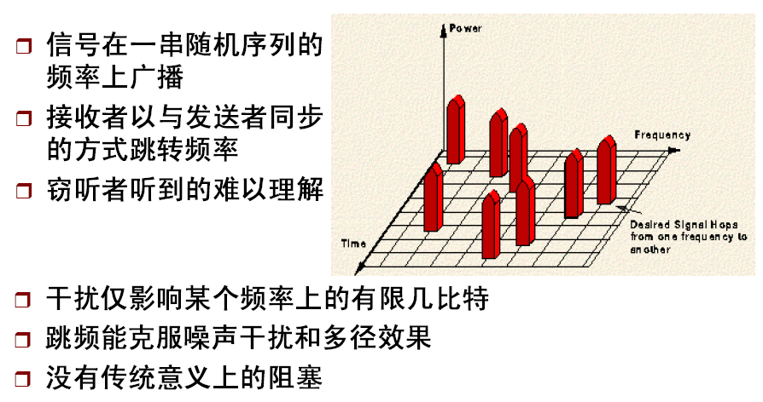
FHSS原理

Slide 10
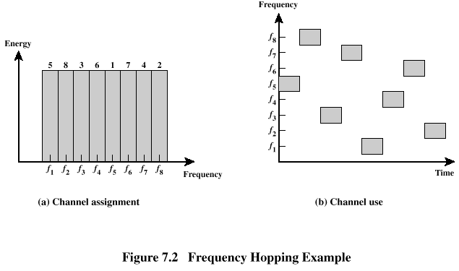
FHSS (Cont’d)
Example
数字为信道使用序列
第一个
Interval
用f₅
10

Slide 11
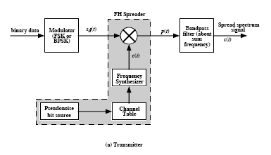
跳频扩频系统
11

Slide 12
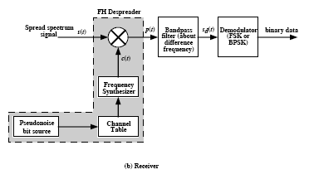
跳频扩频系统
12

Slide 13
FHSS Using MFSK
MFSK signal is translated to a new frequency every T_{c} seconds by modulating the MFSK signal with the FHSS carrier signal
For data rate of R:
  duration of a bit: T = 1/R seconds
  duration of signal element: T_{s} = LT seconds
T_{c} ≥ T_{s} - slow-frequency-hop spread spectrum
T_{c} < T_{s} - fast-frequency-hop spread spectrum
T_{s}: 码元速率/信号速率
T_{c}：Chip速率
13

Slide 14
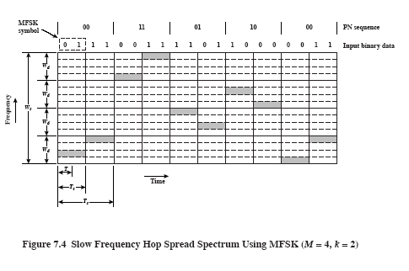
MFSK
码元
W_{d}
频带
W_{d}
W_{s}
W_{d}
W_{d}
T_{s}
Time
T_{c}
MFSK中M=4
PN有k位
14

Slide 15
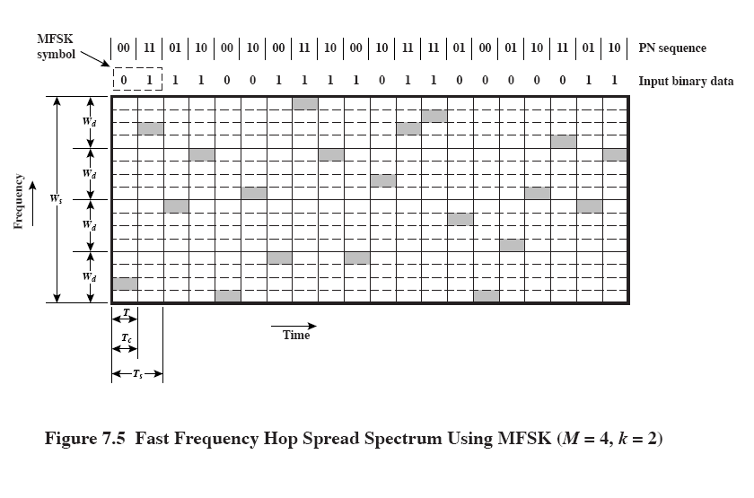
15

Slide 16
FHSS Performance Considerations
Large number of frequencies used
Results in a system that is quite resistant to jamming
  Jammer must jam ALL frequencies
  With fixed power, this reduces the jamming power in any one frequency band
    如果干扰功率S_{j}, 那么每一个频带上的干扰功率
    就是S_{j}/2^{k}, 2^{k}为频带总数量
16

Slide 17
Direct Sequence Spread Spectrum (DSSS，直接序列扩频)
Each bit in original signal （原始信号） is represented by multiple bits in the transmitted signal（所传信号）
Spreading code （扩频码）spreads signal across a wider frequency band
  Spread is directly proportional to number of bits used
One technique combines digital information stream with the spreading code bit stream using exclusive-OR (Figure 7.6)
0⊕0=0 0⊕1=1 1⊕0=1 1⊕1=0

Slide 18
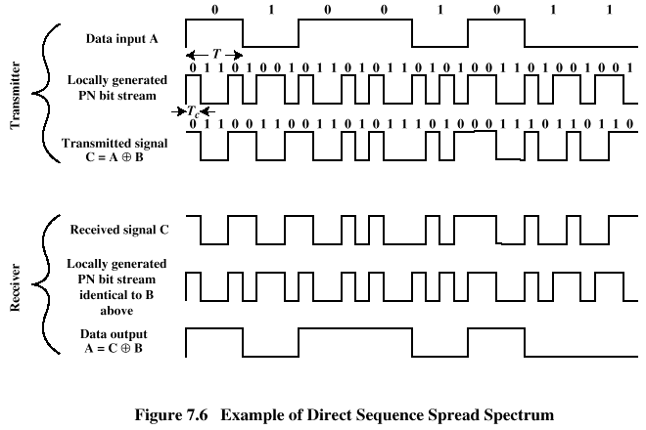
Direct Sequence Spread Spectrum (DSSS)
本例中扩频码片速率是信息流速率的四倍
18

Slide 19
DSSS Using BPSK
Multiply BPSK signal,
  s_{d}(t) = A d(t) cos(2π f_{c}t)
by c(t) [takes values +1, -1] to get
  s(t) = A d(t)c(t) cos(2π f_{c}t)
    A = amplitude of signal
    f_{c} = carrier frequency //载波频率
    d(t) = discrete function [+1, -1]
At receiver, incoming signal multiplied by c(t)
  Since, c(t) ⋅ c(t) = 1, incoming signal is recovered
发
送
端
接
收
端

Slide 20
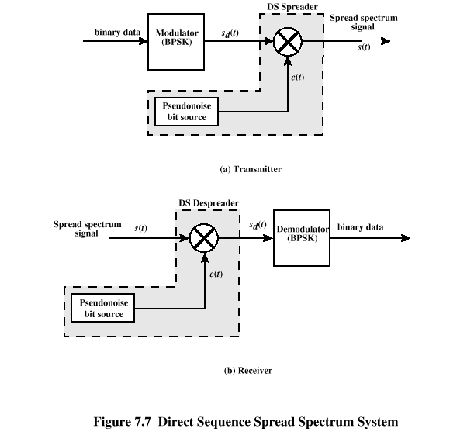
DSSS Using BPSK
扩频信号
二进制数据流
码片序列
伪噪声比特源
发送方
扩频信号
二进制数据流
码片序列
伪噪声比特源
接收方
20

Slide 21
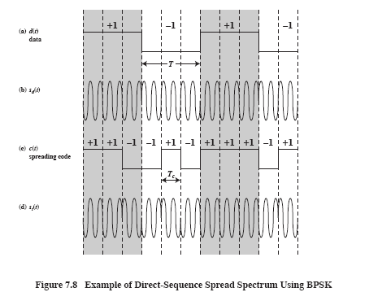
d(t)
数据
s_{d}(t)
c(t)
扩频码
s _{t}(t)
例子：上页图中发送节点是如何生成扩频信号的

Slide 22
Code-Division Multiple Access (CDMA)
Basic Principles of CDMA
  D = rate of data signal
  Break each bit into k chips
    Chips are a user-specific fixed pattern （码片是按用户分配的固定序列）
  Chip data rate of new channel = kD
22

Slide 23
CDMA Example
If k=6 and code is a sequence of 1s and -1s （注意：不是1s和0s）
  For a ‘1’ bit, A sends code as chip pattern
    <c1, c2, c3, c4, c5, c6>
  For a ‘0’ bit, A sends complement of code
    <-c1, -c2, -c3, -c4, -c5, -c6>
Receiver knows sender’s code and performs electronic decode function
    <d1, d2, d3, d4, d5, d6> = received chip pattern
    <c1, c2, c3, c4, c5, c6> = sender’s code (发送节点的扩频码)

Slide 24
CDMA Example
User A code = <1, –1, –1, 1, –1, 1>
  To send a 1 bit = <1, –1, –1, 1, –1, 1>
  To send a 0 bit = <–1, 1, 1, –1, 1, –1>
User B code = <1, 1, –1, – 1, 1, 1>
  To send a 1 bit = <1, 1, –1, –1, 1, 1>
Receiver receiving with A’s code
  (A’s code) 乘以 (received chip pattern)
    User A ‘1’ bit: 6 → 1
    User A ‘0’ bit: -6 → 0
    User B ‘1’ bit: 0 → unwanted signal ignored
    (最后一行指，如果B发送了“1”，如果用A的码字去解的话， 得出结果为0）
24

Slide 25
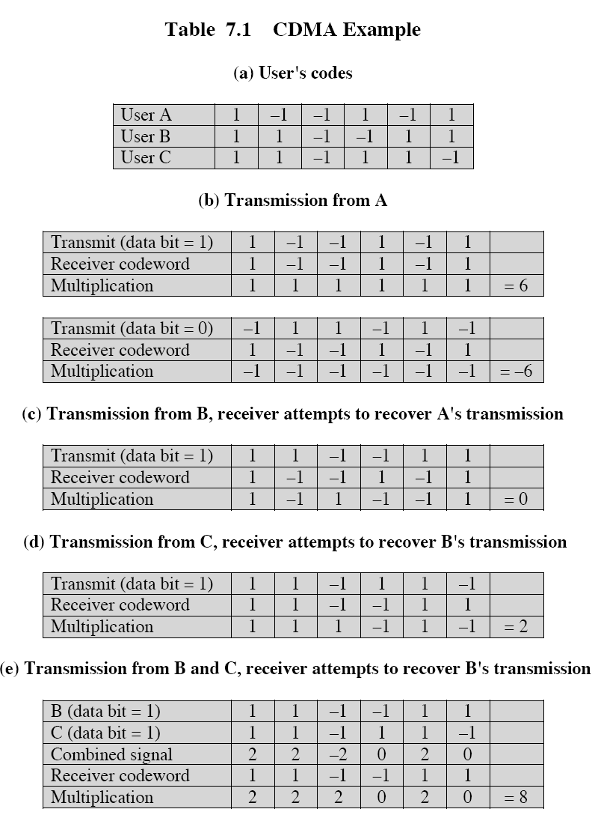

Slide 26
CDMA性能
CDMA接收机能够过滤掉来自不希望(unwanted)的用户的影响，或使它们表现为一种低电平噪声．
  远／近问题
    多个用户竞争同一信道时，或一个或多个竞争信号功率太高，或许因为非常接近接收器（“远／近”问题），系统就会坏掉．
26

Slide 27
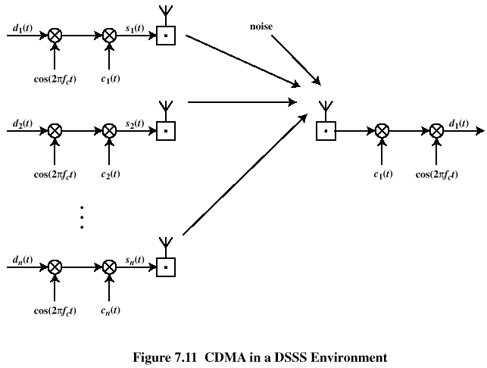
CDMA for Direct Sequence Spread Spectrum
发送端：所有的信号都扩频
到整个宽频谱之上
接收端：希望接收的用户的
信号通过“扩展码”相乘，解调
结果：接收信号变窄；其它信号
仍保持在整个宽频带上

Slide 28
Categories of Spreading Sequences
Spreading Sequence Categories
  PN sequences （随机序列）
  Orthogonal codes（正交码）
For FHSS systems
  PN sequences most common
For DSSS CDMA systems
  PN sequences
  Orthogonal codes
28

Slide 29
PN Sequences
PN generator produces periodic sequence that appears to be random
PN Sequences
  Generated by an algorithm using initial seed
  Sequence isn’t statistically random but can pass many test of randomness
  Sequences referred to as pseudorandom numbers or pseudonoise sequences
  Unless algorithm and seed are known, the sequence is impractical to predict

Slide 30
Important PN Properties
Randomness
  Uniform distribution
    Balance property
      在一个长序列里１的数量应接近1/2
    Run property
      一个运行指的是一个全１或全0的序列
      每一类运行中大约有1/2的运行，其长度为１，1/4长度为２；1/8长度为３
  Independence：序列中没有一个值能从其它值推测出
  Correlation property：如果一个周期的序列数与其任一循环逐位比较，相同项的数目与不同项的数目至多相差１．
Unpredictability
30

Slide 31
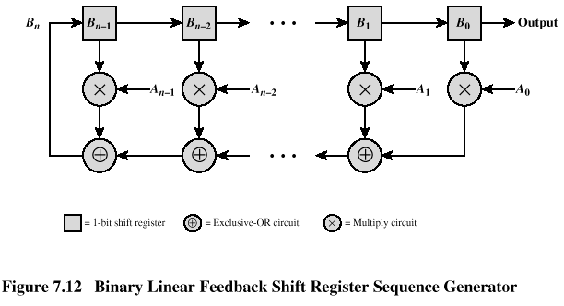
Linear Feedback Shift Register (LFSR) Implementation
LFSR优势：易于硬件实现；生成序列在较长周期内具有随机性
实际实现时没有乘法电路

Slide 32
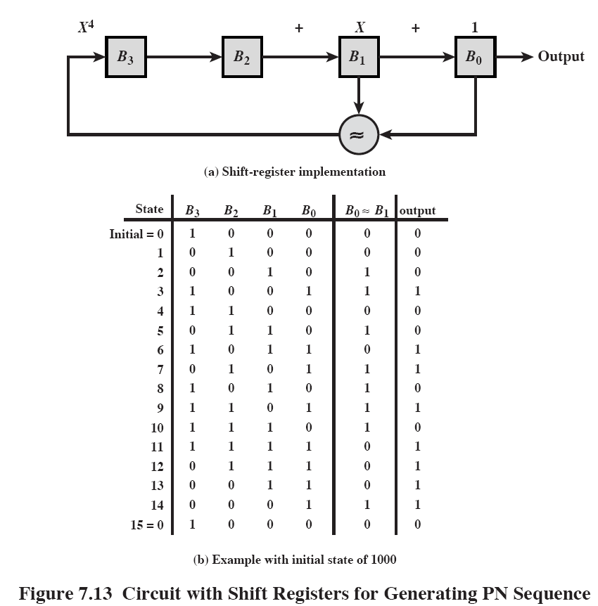

异或
此值将作为
下一次B₃的
输入
32

Slide 33
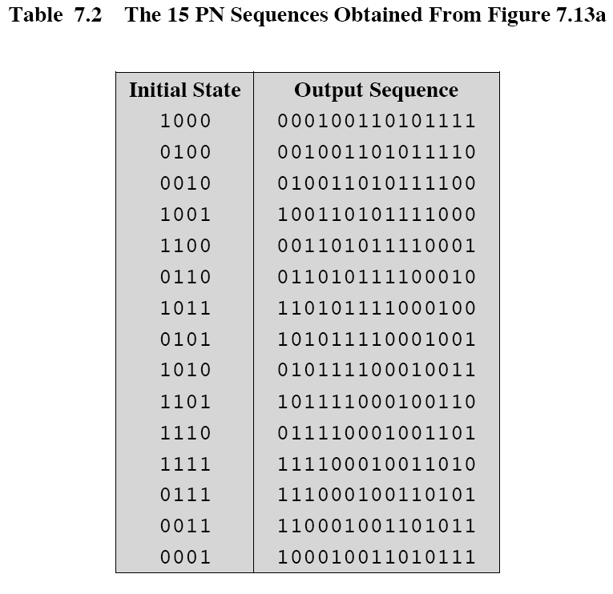
初始状态，m-序列的起始点也不同，但产生的序列
是一样的

Slide 34
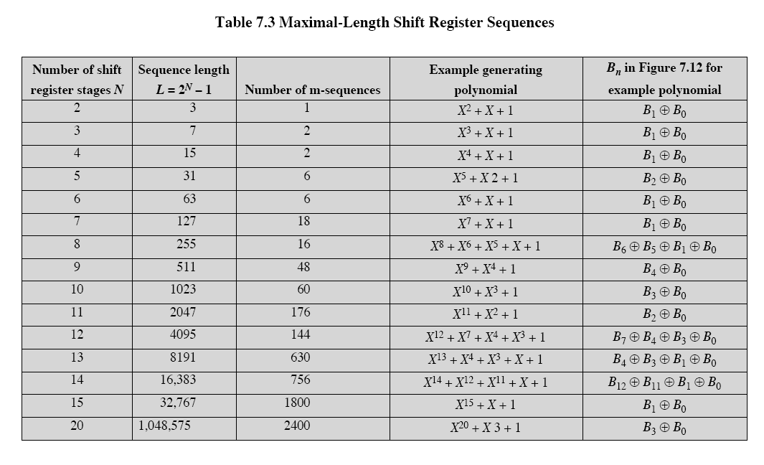
34

Slide 35
Properties of M-Sequences
前述所生成的序列称最大长度序列（Maximal-length sequences），或m-序列——在接收端同步方面具有重要意义
Property 1:
  Has 2^{n-1} ones and 2^{n-1}-1 zeros
Property 2:
  For a window of length n slid along output for N (=2^{n-1}) shifts, each n-tuple appears once, except for the all zeros sequence
Property 3:
  Sequence contains one run of ones, length n
  One run of zeros, length n-1
  One run of ones and one run of zeros, length n-2
  Two runs of ones and two runs of zeros, length n-3
  …
  2^{n-3} runs of ones and 2^{n-3} runs of zeros, length 1
35

Slide 36
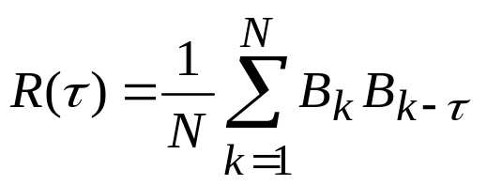
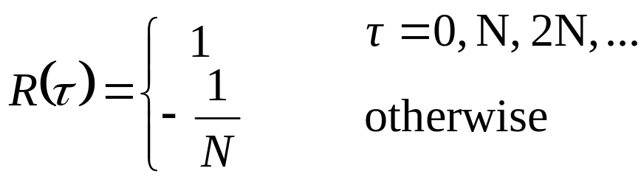
Properties of M-Sequences
  自相关函数（autocorrelation）
Property 4:
  The periodic autocorrelation of a ±1 m-sequence is
36

Slide 37
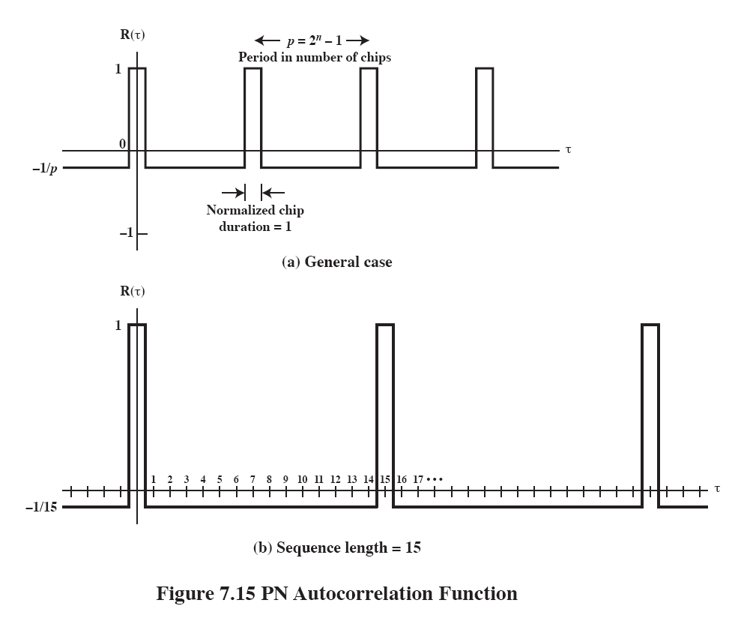

Slide 38
Definitions
Correlation （相关）
  The concept of determining how much similarity one set of data has with another
  Range between –1 and 1
    1 The second sequence matches the first sequence
    0 There is no relation at all between the two sequences
    -1 The two sequences are mirror images
Cross correlation (互相关）
  The comparison between two sequences from different sources rather than a shifted copy of a sequence with itself
38

Slide 39
Advantages in Cross Correlation
The cross correlation between an m-sequence and noise is low
  This property is useful for the receiver to filter out noise
The cross correlation between two different m-sequences is low
  This property is useful for CDMA applications
  Enables a receiver to discriminate among spread spectrum signals generated by other m-sequences
m-序列用于FHSS。但是，对于CDMA的直扩系统，m-序列仍不是最佳的

Slide 40
Gold Sequences
(用于CDMA)
Gold sequences constructed by the XOR of two m-sequences with the same clocking
Codes have well-defined cross correlation properties
Only simple circuitry needed to generate large number of unique codes
In following example (Figure 7.16a) two shift registers generate the two m-sequences and these are then bitwise XORed
40

Slide 41
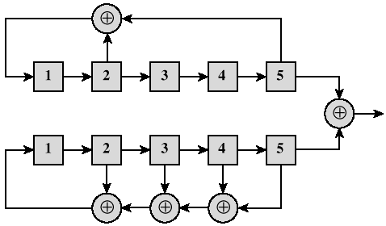
Gold Sequences

Slide 42
Gold Sequences
黄金序列有效性高于m-序列
  如对于n=13(N=2¹³-1=8191),存在６３０个m-序列，但其中存在着相关值R=703的序列对
  黄金序列能确保序列对的选取使得R≤(2^{(n+1)/2}+1)=129.
42
Notes:
n代表的是电路中移位寄存器的数量、N代表的是序列的长度。虽然R=703<<8191,但还是没有达到足够的小。

Slide 43
Orthogonal Codes
Orthogonal codes
  All pairwise cross correlations are zero
  Fixed- and variable-length codes used in CDMA systems
  For CDMA application, each mobile user uses one sequence in the set as its spreading code
    Provides zero cross correlation among all users
Types
  Walsh codes
  Variable-Length Orthogonal codes

Slide 44
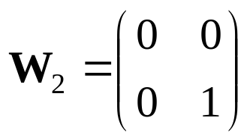
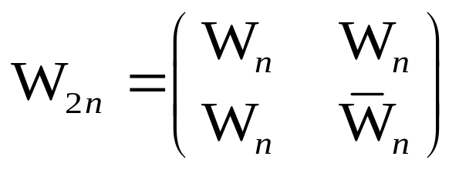
Walsh Codes
Set of Walsh codes of length n consists of the n rows of an n×n Walsh matrix, defined recursively:
  W₁ = (0)
    n = dimension of the matrix
  Every row is orthogonal to every other row and to the logical NOT of every other row
  使用Walsh序列要求严格同步（Tight synchronization）
    这是因为：Cross correlation between different shifts of Walsh sequences is not zero
    如果无法达到严格同步，则需要使用PN序列
44
Notes:
注意：计算互相关特性时，0 => -1; 1 => +1。

Slide 45
Typical Multiple Spreading Approach
（多重扩频方法）
多重扩频可以取得更好的扩频效果
  Spread data rate by an orthogonal code (channelization code) 信道化编码
    Provides mutual orthogonality among all users in the same cell (同一小区之内）
  Further spread result by a PN sequence (scrambling code) 扰码
    Provides mutual randomness (low cross correlation) between users in different cells（不同小区之间）

Slide 46
思考题（无需提交）
总结扩频通信（包括跳频扩频和直接序列扩频）的优点
46

