Slide 1

Introduction to MPI
Part2. Intermediate Topics
人工智能技术学院
缪青海
miaoqh@ucas.ac.cn

Slide 2
Content
  Non-blocking communication
  Group (collective) communication
  MPI Datatypes

Slide 3
Blocking vs. Non-blocking
MPI_SEND/MPI_RECV are blocking communication calls
  Return of the routine implies completion
  When these calls return the memory locations used in the message transfer can be safely accessed for reuse
  For “send” completion implies variable sent can be reused/modified
  Modifications will not affect data intended for the receiver
  For “receive” variable received can be read
MPI_ISEND/MPI_IRECV are non-blocking variants
  Routine returns immediately – completion has to be separately tested for
  These are primarily used to overlap computation and communication to improve performance

Slide 4
Blocking Communication
In blocking communication:
  MPI_SEND does not return until buffer is empty (available for reuse)
  MPI_RECV does not return until buffer is full (available for use)
A process sending data will be blocked until data in the send buffer is emptied.
A process receiving data will be blocked until the receive buffer is filled.
Exact completion semantics of communication generally depends on the message size and the system buffer size.

Slide 5
Blocking Communication
In blocking communication.
  MPI_SEND does not return until buffer is empty (available for reuse)
  MPI_RECV does not return until buffer is full (available for use)
Blocking communication is simple to use but can be prone to deadlocks
if (rank == 0) {
MPI_SEND(..to rank 1..)
MPI_RECV(..from rank 1..)
Usually deadlocks → else if (rank == 1) {
MPI_SEND(..to rank 0..) ← reverse send/recv
MPI_RECV(..from rank 0..)
}

Slide 6
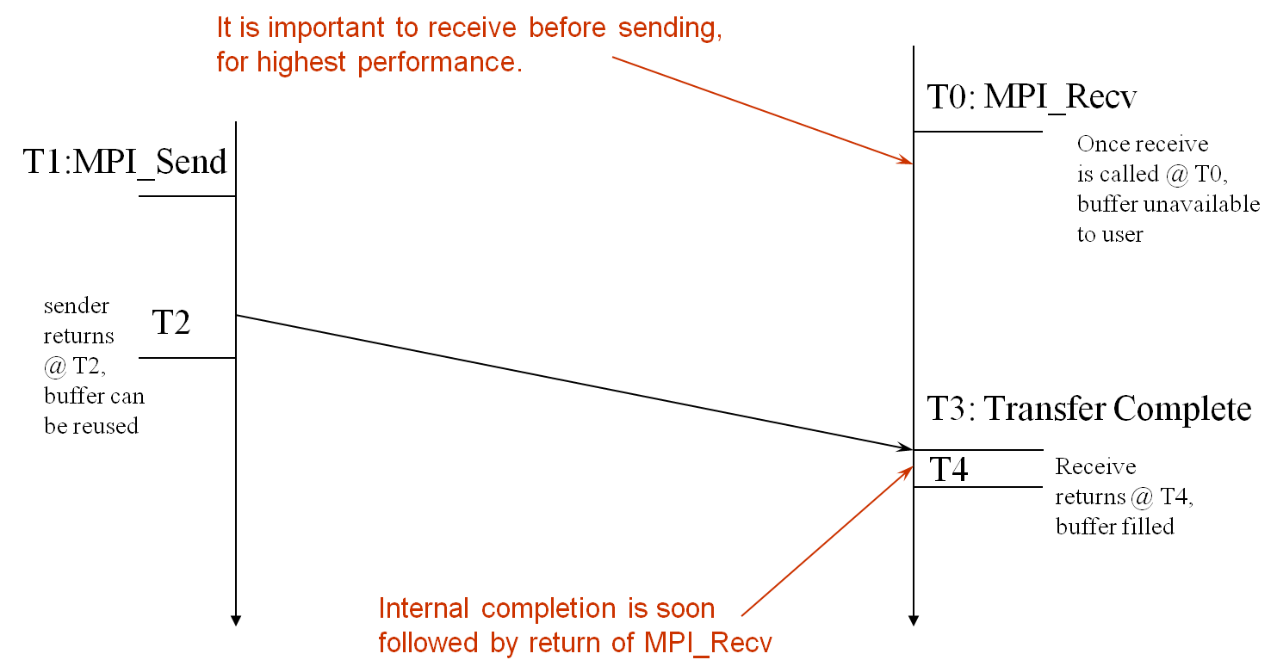
Blocking Send-Receive Diagram
time

Slide 7
Non-Blocking Communication
Non-blocking (asynchronous) operations return (immediately) ‘‘request handles” that can be waited on and queried
  MPI_ISEND(buf, count, datatype, dest, tag, comm, request)
  MPI_IRECV(buf, count, datatype, src, tag, comm, request)
  MPI_WAIT(request, status)
Non-blocking operations allow overlapping computation and communication
One can also test without waiting using MPI_TEST
  MPI_TEST(request, flag, status)
Anywhere you use MPI_SEND or MPI_RECV, you can use the pair of MPI_ISEND/MPI_WAIT or MPI_IRECV/MPI_WAIT

Slide 8
Multiple Completions
It is sometimes desirable to wait on multiple requests:
  MPI_Waitall(count, array_of_requests, array_of_statuses)
  MPI_Waitany(count, array_of_requests, &index, &status)
  MPI_Waitsome(incount, array_of_requests, outcount,
  array_of_indices, array_of_statuses)
There are corresponding versions of TEST for each of these

Slide 9
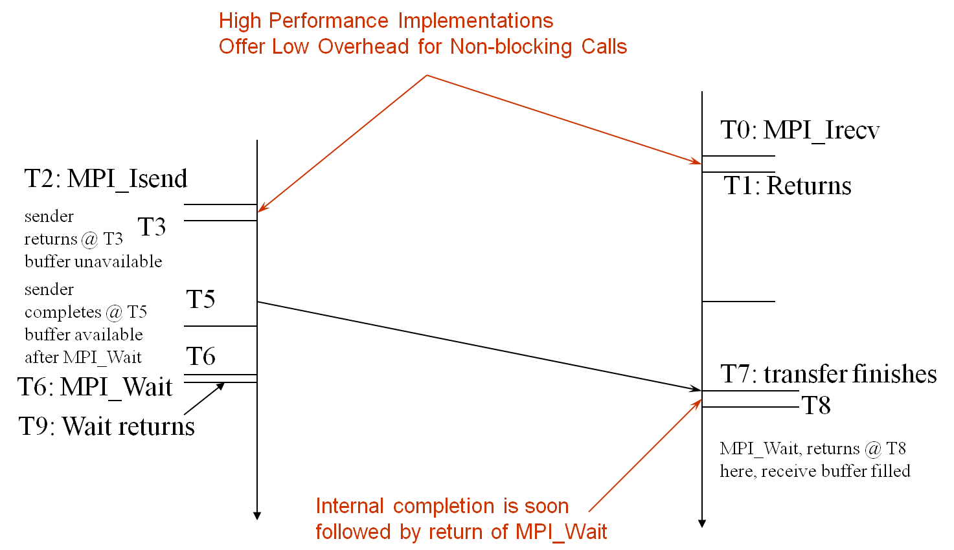
Non-Blocking Send-Receive Diagram
time

Slide 10
Message Completion and Buffering
For a communication to succeed:
  Sender must specify a valid destination rank
  Receiver must specify a valid source rank (including MPI_ANY_SOURCE)
  The communicator must be the same
  Tags must match
  Receiver’s buffer must be large enough

Slide 11
Message Completion and Buffering
A send has completed when the user supplied buffer can be reused
Just because the send completes does not mean that the receive has completed
  Message may be buffered by the system
  Message may still be in transit
*buf =3;
MPI_Send(buf, 1, MPI_INT …)
*buf = 4; /* OK, receiver will always receive 3 */
*buf =3;
MPI_Isend(buf, 1, MPI_INT …)
*buf = 4; /*Not certain if receiver gets 3 or 4 or anything else */
MPI_Wait(…);

Slide 12
A Non-Blocking example
P0
Blocking Communication
P1
P0
Non-blocking Communication
P1

Slide 13
A Non-Blocking example
int main(int argc, char ** argv)
{
[...snip...]
if (rank == 0) {
for (i=0; i< 100; i++) {
/* Compute each data element and send it out */
data[i] = compute(i);
MPI_Isend(&data[i], 1, MPI_INT, 1, 0, MPI_COMM_WORLD,
&request[i]);
}
MPI_Waitall(100, request, MPI_STATUSES_IGNORE)
}
else {
for (i = 0; i < 100; i++)
MPI_Recv(&data[i], 1, MPI_INT, 0, 0, MPI_COMM_WORLD,
MPI_STATUS_IGNORE);
}
[...snip...]
}

Slide 14
2D Poisson Problem
(i,j+1)
(i,j)
(i-1,j)
(i+1,j)
(i,j-1)

Slide 15
Regular Mesh Algorithms
Many scientific applications involve the solution of partial differential equations (PDEs)
Many algorithms for approximating the solution of PDEs rely on forming a set of difference equations
  Finite difference, finite elements, finite volume
The exact form of the differential equations depends on the particular method
  From the point of view of parallel programming for these algorithms, the operations are the same
Five-point stencil is a popular approximation solution

Slide 16
Necessary Data Transfers

Slide 17
Necessary Data Transfers

Slide 18
Necessary Data Transfers
Provide access to remote data through a halo exchange (5 point stencil)

Slide 19
Understanding Performance:
Unexpected Hot Spots
  Basic performance analysis looks at two-party exchanges
  Real applications involve many simultaneous communications
  Performance problems can arise even in common grid exchange patterns
  Message passing illustrates problems present even in shared memory
    Blocking operations may cause unavoidable memory stalls

Slide 20
Mesh Exchange
Exchange data on a mesh
9
10
11
6
7
8
3
4
5
0
1
2
Notes:
No periodic exchange

Slide 21
Sample Code
for (i = 0; i < n_neighbors; i++) {
MPI_Send(edge, len, MPI_DOUBLE, nbr[i], tag, comm);
}
for (i = 0; i < n_neighbors; i++) {
MPI_Recv(edge, len, MPI_DOUBLE, nbr[i], tag, comm, status);
}
What is wrong with this code?

Slide 22
Deadlocks!
All of the sends may block, waiting for a matching receive (will for large enough messages)
The variation of
if (has up nbr)
MPI_Recv( … up … )
…
if (has down nbr)
MPI_Send( … down … )
sequentializes (all except the bottom process blocks)

Slide 23
Fix 1: Use Irecv
for (i = 0; i < n_neighbors; i++) {
MPI_Irecv(edge, len, MPI_DOUBLE, nbr[i], tag,
comm, requests[i]);
}
for (i = 0; i < n_neighbors; i++) {
MPI_Send(edge, len, MPI_DOUBLE, nbr[i], tag, comm);
}
MPI_Waitall(n_neighbors, requests, statuses);
Does not perform well in practice. Why?

Slide 24
Mesh Exchange
Exchange data on a mesh
Step 1
Step 1
Step 1
Step 1
Step 1
Step 1
Step 1
Step 1
Step 1
Step 1
Step 1
Step 1

Slide 25
Mesh Exchange
Exchange data on a mesh
Step 2
Step 2
Step 2
Step 2
Step 2
Step 1
Step 2
Step 1
Step 1
Step 1
Step 1
Step 1

Slide 26
Mesh Exchange
Exchange data on a mesh
Step 2
Step 3
Step 2
Step 3
Step 3
Step 2
Step 3
Step 2
Step 2
Step 2
Step 2
Step 2

Slide 27
Mesh Exchange
Exchange data on a mesh
Step 2
Step 3
Step 2
Step 3
Step 3
Step 3
Done
Step 3
Step 3
Done
Step 3
Done

Slide 28
Mesh Exchange
Exchange data on a mesh
Done
Done
Done
Done
Step 4
Step 3
Done
Step 3
Done
Done
Done
Done

Slide 29
Mesh Exchange
Exchange data on a mesh
Done
Done
Done
Done
Done
Done
Done
Step 4
Done
Done
Done
Done

Slide 30
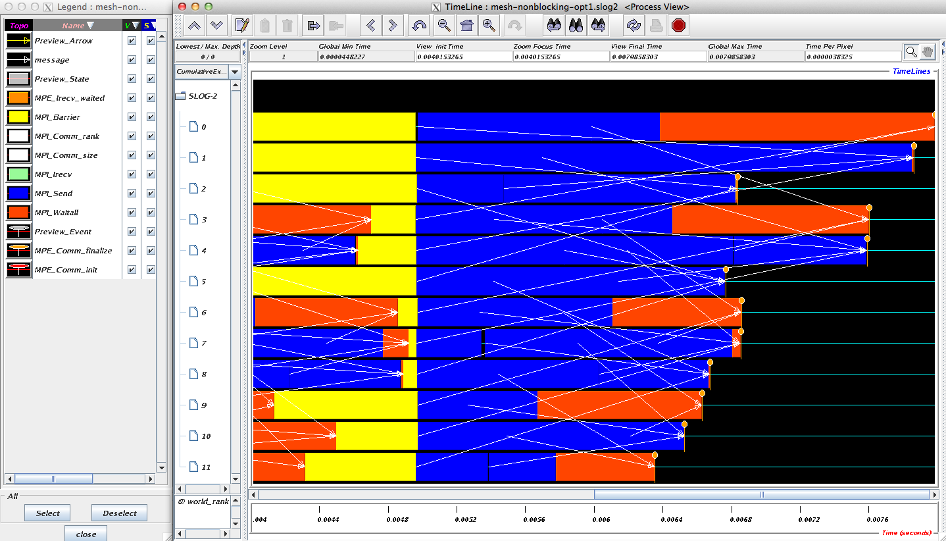
Timeline from IB Cluster

Slide 31
Fix 2: Use Isend and Irecv
for (i = 0; i < n_neighbors; i++) {
MPI_Irecv(edge, len, MPI_DOUBLE, nbr[i], tag,
comm, requests[i]);
}
for (i = 0; i < n_neighbors; i++) {
MPI_Isend(edge, len, MPI_DOUBLE, nbr[i], tag, comm,
requests[n_neighbors + i]);
}
MPI_Waitall(2 * n_neighbors, requests, statuses);

Slide 32
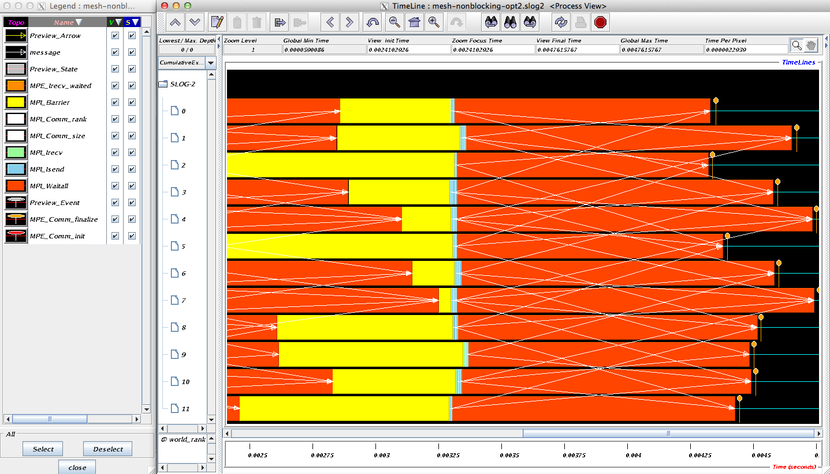
Timeline from IB Cluster
Note processes 4 and 7 are the only interior processors; these perform more communication than the other processors

Slide 33
Lesson: Defer Synchronization
Send-receive accomplishes two things:
  Data transfer
  Synchronization
In many cases, there is more synchronization than required
Use non-blocking operations and MPI_Waitall to defer synchronization
Tools can help out with identifying performance issues
  MPE, Tau and HPCToolkit are popular profiling tools
  Jumpshot tool uses their datasets to show performance problems graphically
  Display message queue state using Totalview

Slide 34
Code Example
code/mpi_helloNBsend.c
code/mpi_send_recv_nonblocking.c
  mpicc mpi_xxx.c –o test
  mpiexec –n 2 ./test

Slide 35
Content
  Non-blocking communication
  Group (collective) communication
  MPI Datatypes

Slide 36
Collective Operations in MPI
Collective operations are called by all processes in a communicator.
MPI_BCAST
  distributes data from one process (the root) to all others in a communicator.
MPI_REDUCE
  combines data from all processes in the communicator and returns it to one process.
In many numerical algorithms, SEND/RECV can be replaced by BCAST/REDUCE, improving both simplicity and efficiency.

Slide 37
MPI Collective Communication
Communication and computation is coordinated among a group of processes in a communicator.
Tags are not used; different communicators deliver similar functionality.
Non-blocking collective operations in MPI-3
Three classes of operations:
    synchronization
    data movement
    collective computation

Slide 38
Synchronization
MPI_BARRIER(comm)
  Blocks until all processes in the group of the communicator comm call it.
  A process cannot get out of the barrier until all other processes have reached barrier.

Slide 39
Collective Data Movement
P0
A
A
P1
Broadcast
A
P2
A
P3
A
P0
A
B
C
D
Scatter
A
P1
B
P2
C
Gather
P3
D

Slide 40
More Collective Data Movement
P0
A
A
B
C
D
P1
B
Allgather
A
B
C
D
P2
C
A
B
C
D
P3
D
A
B
C
D
P0
A0
A1
A2
A3
A0
B0
C0
D0
P1
B0
B1
B2
B3
Alltoall
A1
B1
C1
D1
P2
C0
C1
C2
C3
A2
B2
C2
D2
P3
D0
D1
D2
D3
A3
B3
C3
D3

Slide 41
Collective Computation
P0
A
f(ABCD)
P1
Reduce
B
P2
C
P3
D
P0
A
f(A)
P1
B
Scan
f(AB)
P2
C
f(ABC)
P3
D
f(ABCD)

Slide 42
MPI Collective Routines
Many Routines:
  MPI_ALLGATHER, MPI_ALLGATHERV, MPI_ALLREDUCE, MPI_ALLTOALL, MPI_ALLTOALLV, MPI_BCAST, MPI_GATHER, MPI_GATHERV, MPI_REDUCE, MPI_REDUCESCATTER, MPI_SCAN, MPI_SCATTER, MPI_SCATTERV
“All” versions deliver results to all participating processes
“V” versions (stands for vector) allow the chunks to have different sizes
MPI_ALLREDUCE, MPI_REDUCE, MPI_REDUCESCATTER, and MPI_SCAN take both built-in and user-defined combiner functions

Slide 43
MPI Built-in Collective Computation
MPI_MAX
MPI_MIN
MPI_PROD
MPI_SUM
MPI_LAND
MPI_LOR
MPI_LXOR
MPI_BAND
MPI_BOR
MPI_BXOR
MPI_MAXLOC
MPI_MINLOC
Maximum
Minimum
Product
Sum
Logical and
Logical or
Logical exclusive or
Bitwise and
Bitwise or
Bitwise exclusive or
Maximum and location
Minimum and location

Slide 44
Defining your own Collective Operations
Create your own collective computations with:
MPI_OP_CREATE(user_fn, commutes, &op);
MPI_OP_FREE(&op);
user_fn(invec, inoutvec, len, datatype);
The user function should perform:
inoutvec[i] = invec[i] op inoutvec[i];
for i from 0 to len-1
The user function can be non-commutative, but must be associative

Slide 45
Example: Calculating Pi
Calculating pi via numerical integration
  Divide interval up into subintervals
  Assign subintervals to processes
  Each process calculates partial sum
  Add all the partial sums together to get pi
1
1
“n” segments
Width of each segment (w) will be 1/n
Distance (d(i)) of segment “i” from the origin will be “i * w”
Height of segment “i” will be sqrt(1 – [d(i)]^2)

Slide 46
Example: PI in C
#include <mpi.h>
#include <math.h>
int main(int argc, char *argv[])
{
[...snip...]
/* Tell all processes, the number of segments you want */
MPI_Bcast(&n, 1, MPI_INT, 0, MPI_COMM_WORLD);
w = 1.0 / (double) n;
mypi = 0.0;
for (i = rank + 1; i <= n; i += size)
mypi += w * sqrt(1 – (((double) i / n) * ((double) i / n));
MPI_Reduce(&mypi, &pi, 1, MPI_DOUBLE, MPI_SUM, 0,
MPI_COMM_WORLD);
if (rank == 0)
printf("pi is approximately %.16f, Error is %.16f\n", 4 * pi, fabs((4 * pi) - PI25DT));
[...snip...]
}

Slide 47
Code Example
code/
  cpi.c
  mpi_scatter.c
  mpi_reduce_pi.c
  mpi_group_communicater.c

Slide 48
Content
  Non-blocking communication
  Group (collective) communication
  MPI Datatypes

Slide 49
Necessary Data Transfers
Provide access to remote data through a halo exchange (5 point stencil)

Slide 50
The Local Data Structure
Each process has its local “patch” of the global array
  “bx” and “by” are the sizes of the local array
  Always allocate a halo around the patch
  Array allocated of size (bx+2)x(by+2)
by
bx

Slide 51
Introduction to Datatypes in MPI
Datatypes allow to (de)serialize arbitrary data layouts into a message stream
  Networks provide serial channels
  Same for block devices and I/O
Several constructors allow arbitrary layouts
  Recursive specification possible
  Declarative specification of data-layout
    “what” and not “how”, leaves optimization to implementation (many unexplored possibilities!)
  Choosing the right constructors is not always simple

Slide 52
Simple/Predefined Datatypes
Equivalents exist for all C, C++ and Fortran native datatypes
  C int → MPI_INT; C float → MPI_FLOAT
  C double → MPI_DOUBLE
  C uint32_t → MPI_UINT32_T
For more complex or user-created datatypes, MPI provides routines to represent them as well
  Contiguous
  Vector/Hvector
  Indexed/Indexed_block/Hindexed/Hindexed_block
  Struct
  Some convenience types (e.g., subarray)

Slide 53
Derived Datatype Example
0
1
2
3
4
5
6
7
8
9
10
11
12
13
14
15
16
17
18
19
20
21
22
23
contig
contig
contig
indexed
vector
struct

Slide 54
MPI_Type_contiguous
MPI_Type_contiguous(int count, MPI_Datatype oldtype,
MPI_Datatype *newtype)
Contiguous array of oldtype
Should not be used as last type (can be replaced by count)
0
1
2
3
4
5
6
7
8
9
10
11
contig
0
1
2
3
4
5
6
7
8
9
10
11
12
13
14
15
16
17
18
struct
struct
struct
contig

Slide 55
MPI_Type_vector
MPI_Type_vector(int count, int blocklength, int stride,
MPI_Datatype oldtype, MPI_Datatype *newtype)
Specify strided blocks of data of oldtype
Very useful for Cartesian arrays
0
1
2
3
4
5
6
7
8
9
10
11
vector
0
1
2
3
4
5
6
7
8
9
10
11
12
13
14
15
16
17
18
19
20
struct
struct
struct
struct
vector

Slide 56
MPI_Type_create_hvector
MPI_Type_create_hvector(int count, int blocklength,
MPI_Aint stride, MPI_Datatype oldtype,
MPI_Datatype *newtype)
Create non-unit strided vectors
Useful for composition, e.g., vector of structs
0
1
2
3
4
5
6
7
8
9
10
11
12
13
14
15
16
17
18
19
struct
struct
struct
struct
hvector

Slide 57
MPI_Type_create_indexed_block
MPI_Type_create_indexed_block(int count, int blocklength,
int *array_of_displacements, MPI_Datatype
oldtype, MPI_Datatype *newtype)
Pulling irregular subsets of data from a single array
  dynamic codes with index lists, expensive though!
  blen=2
  displs={0,5,8,13,18}
0
1
2
3
4
5
6
7
8
9
10
11
12
13
14
15
16
17
18
19
20
Indexed_block

Slide 58
MPI_Type_indexed
MPI_Type_indexed(int count, int *array_of_blocklengths,
int *array_of_displacements, MPI_Datatype
oldtype, MPI_Datatype *newtype)
Like indexed_block, but can have different block lengths
  blen={1,1,2,1,2,1}
  displs={0,3,5,9,13,17}
0
1
2
3
4
5
6
7
8
9
10
11
12
13
14
15
16
17
18
19
20
indexed

Slide 59
MPI_Type_create_struct
MPI_Type_create_struct(int count, int array_of_blocklengths[],
MPI_Aint array_of_displacements[],
MPI_Datatype array_of_types[],
MPI_Datatype *newtype)
Most general constructor, allows different types and arbitrary arrays (also most costly)
0
1
2
3
4
struct

Slide 60
MPI_Type_create_subarray
MPI_Type_create_subarray(int ndims, int array_of_sizes[],
int array_of_subsizes[], int array_of_starts[],
int order, MPI_Datatype oldtype,
MPI_Datatype *newtype)
Convenience function for creating datatypes for array segments
Specify subarray of n-dimensional array (sizes) by start (starts) and size (subsize)
(0,0)
(0,1)
(0,2)
(0,3)
(1,0)
(1,1)
(1,2)
(1,3)
(2,0)
(2,1)
(2,2)
(2,3)
(3,0)
(3,1)
(3,2)
(3,3)

Slide 61
MPI_BOTTOM and MPI_Get_address
MPI_BOTTOM
  is the absolute zero address
  Portability (e.g., may be non-zero in globally shared memory)
MPI_Get_address
  Returns address relative to MPI_BOTTOM
  Portability (do not use “&” operator in C!)
Very important to
  build struct datatypes
  If data spans multiple arrays

Slide 62
Commit, Free, and Dup
MPI_Type_commit
  Types must be committed before use
  Only the ones that are used!
  may perform heavy optimizations (and will hopefully)
MPI_Type_free
  Free MPI resources of datatypes
  Does not affect types built from it
MPI_Type_dup
  Duplicates a type
  Library abstraction (composability)

Slide 63
Other DDT Functions
Pack/Unpack
  Mainly for compatibility to legacy libraries
  You should not be doing this yourself
Get_envelope/contents
  Only for expert library developers
  Libraries like MPITypes¹ make this easier
MPI_Create_resized
  Change extent and size (dangerous but useful)

Slide 64
Datatype Selection Order
Simple and effective performance model:
  More parameters == slower
predefined < contig < vector < index_block < index < struct
Some (most) MPIs are inconsistent
  But this rule is portable
Advice to users:
  Try datatype “compression” bottom-up
W. Gropp et al.: Performance Expectations and Guidelines for MPI Derived Datatypes

Slide 65
Code Example
code/
  mpi_dedrived_datatype_continous.c
  mpi_dedrived_datatype_index.c
  mpi_dedrived_datatype_struct.c
  mpi_dedrived_datatype_vector.c

Slide 66
MPI Summary
Parallelism is critical today, given that that is the only way to achieve performance improvement with the modern hardware.
MPI is an industry standard model for parallel programming
  A large number of implementations of MPI exist (both commercial and public domain)
  Virtually every system in the world supports MPI
Gives user explicit control on data management.
Widely used by many scientific applications with great success.

Slide 67
references
Parallel Programming with MPI, Argonne National Laboratory, http://www.anl.gov/events/parallel-programming-mpi.
A Comprehensive MPI Tutorial Resource, https://github.com/wesleykendall/mpitutorial.
迟学斌等，并行计算与实现技术，科学出版社。

