Slide 1

Introduction to OpenMP
Part1. Getting Started
人工智能技术学院
缪青海
miaoqh@ucas.ac.cn

Slide 2
Content
Getting started with OpenMP
Core features of OpenMP
Work with OpenMP
Advanced topics on OpenMP

Slide 3

Introduction
OpenMP is one of the most common parallel programming models in use today.
It is relatively easy to use which makes a great language to start with when learning to write parallel software.

Slide 4
OpenMP Overview
The OpenMP Architecture Review Board.
API for Writing Multithreaded Applications.
  A set of complier directives and library routines for parallel application programmers.
  Greatly simplifies writing multi-threaded programs in Fortran, C and C++.
  Standardizes last 20 years of SMP practice.

Slide 5
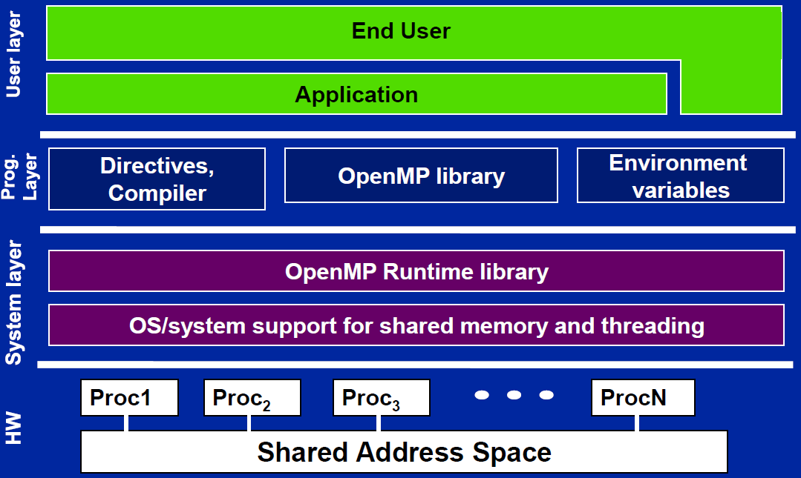
OpenMP Solution Stack

Slide 6
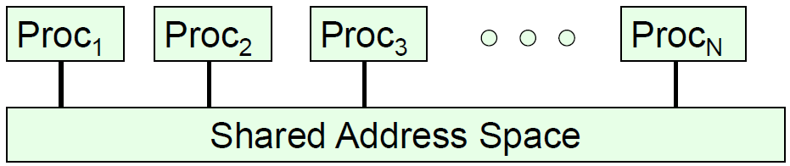
Shared memory computer
Symmetric multiprocessor (SMP):
  a shared address space with “equal-time” access for each processor, and the OS treats every processor the same way.
Non Uniform address space multiprocessor (NUMA)
  Different memory regions have different access costs … think of memory segmented into “Near” and “Far” memory.

Slide 7
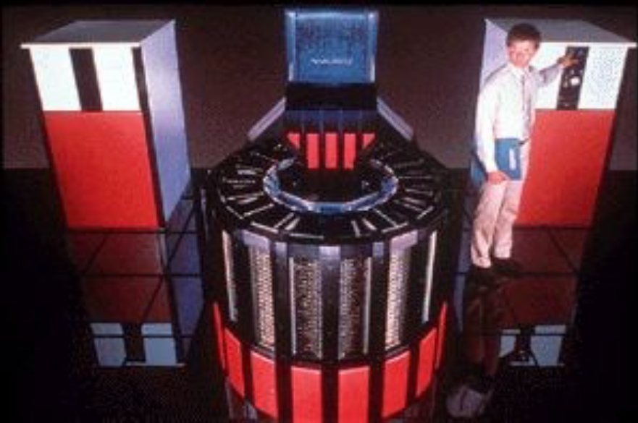
Shared memory computer
Symmetric multiprocessor (SMP): Cray-2
The last large scale SMP computer.
Released in 1985 with 4 “heads”, 1.9 GFLOPS peak performance
fasted supercomputer in the world until 1990

Slide 8
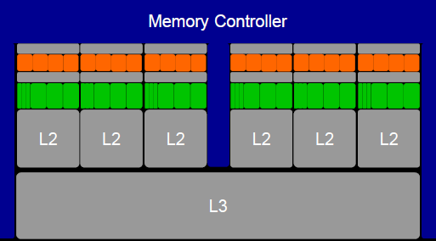
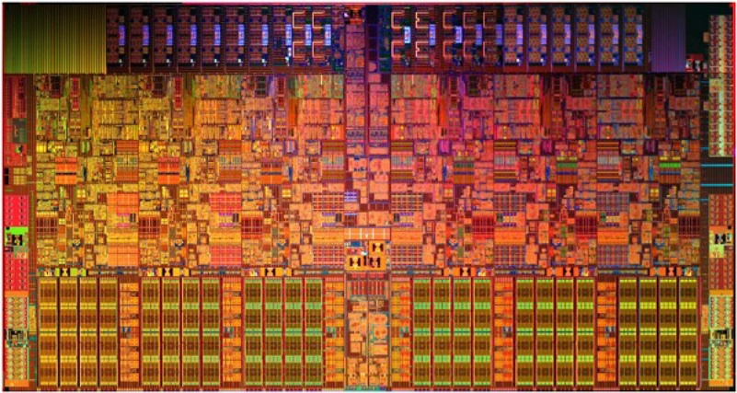
Shared memory computer
Intel i7-970, is it an SMP ?
6 cores, 2-way multithreaded, 6-wide superscalar, quad-issue, 4-wide SIMD (on 3 of 6 pipelines)
4.5 KB (6 x 768 B) “Architectural” Registers, 192 KB (6 x 32 KB) L1 Cache, 1.5 MB (6 x 256 KB) L2 cache, 12 MB L3 Cache
MESIF Cache Coherence, Processor Consistency Model

Slide 9
Shared memory computer
Intel i7-970, is it an SMP ?
6 cores, 2-way multithreaded, 6-wide superscalar, quad-issue, 4-wide SIMD (on 3 of 6 pipelines)
4.5 KB (6 x 768 B) “Architectural” Registers, 192 KB (6 x 32 KB) L1 Cache, 1.5 MB (6 x 256 KB) L2 cache, 12 MB L3 Cache
MESIF Cache Coherence, Processor Consistency Model
It is NUMA.

Slide 10
Shared memory computer
Shared memory computers are everywhere … most laptops and servers have multicore multiprocessor CPUs.
The shared address space and programming models encourage us to think of them at SMP systems.
Reality is more complex … any multiprocessor CPU with a cache is a NUMA system.
Start out by treating the system as an SMP and just accept that much of your optimization work will address cases where that case breaks down.

Slide 11
Process & Threads
Process:
  An instance of a program execution，
  The execution context of a running program … i.e. the resources associated with a program’s execution.
Threads:
  Threads are “light weight processes”，
  Threads share Process state among multiple threads … this greatly reduces the cost of switching context.

Slide 12
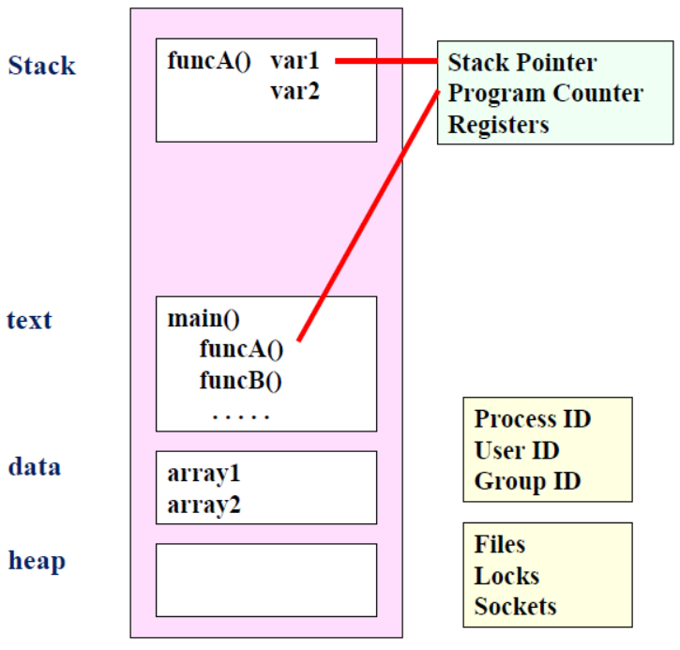
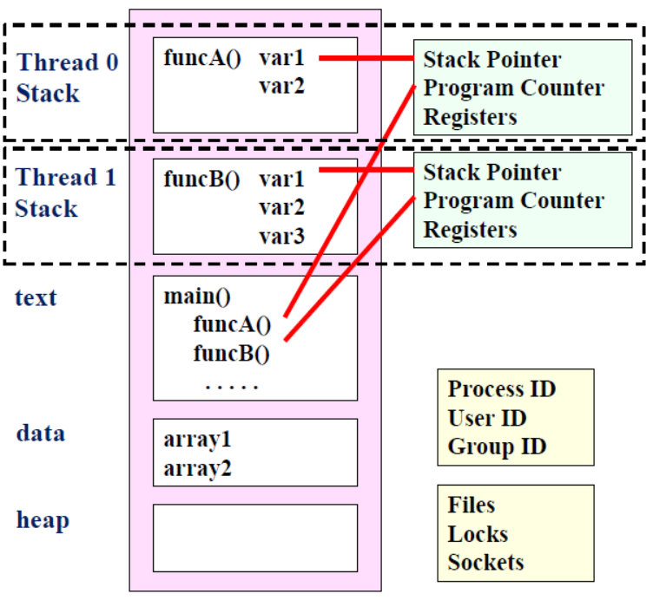
Process & Threads
Process
Threads

Slide 13
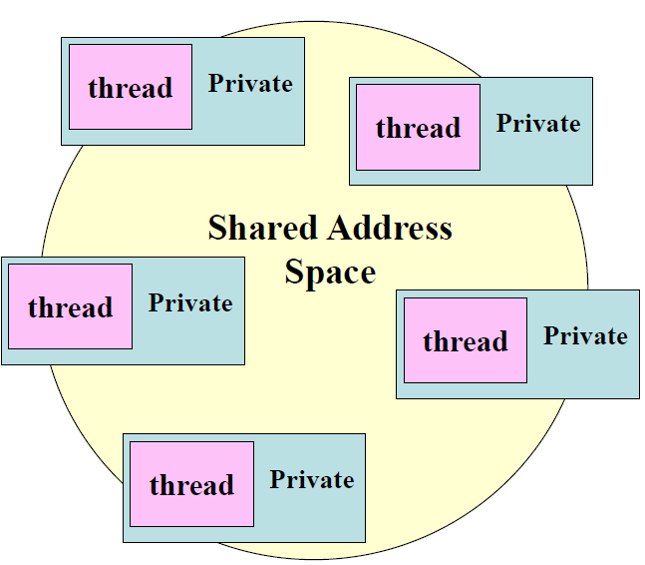
Shared memory program
An instance of a program:
  One process and lots of threads
  Threads interact through reads/writes to a shared address space.
  OS scheduler decides when to run which threads … interleaved for fairness
  Synchronization to assure every legal order results in correct results.

Slide 14
OpenMP getting started
Assumptions
  Knowledge of C/C++ programming language.
  New to parallel programming.
  Access to a Complier that support OpenMP.

Slide 15
OpenMP core syntax
Most of the constructs in OpenMP are:
compiler directives
Example
#pragma omp construct [clause [clause]…]
#pragma omp parallel num_threads(4)

Slide 16
OpenMP core syntax
Function prototypes and types in the file:
  #include <omp.h>
Most OpenMP apply to “structured block”:
  a block of one or more statements with one point of entry at the top and one point of exit at the bottom.

Slide 17
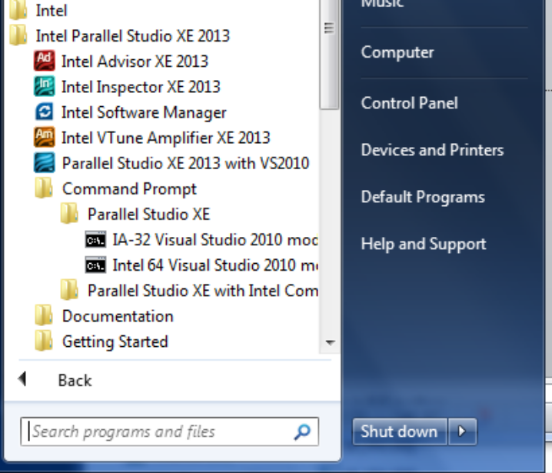
OpenMP Compiler
Intel on Windows:
Launch SW dev environment
cd to the directory that holds your source code
Build software for program foo.c
􀂋 icl /Qopenmp foo.c
Set number of threads environment variable
􀂋 set OMP_NUM_THREADS=4
Run your program
􀂋 foo.exe

Slide 18
OpenMP Compiler
MS Visual Studio:
Start “new project”;
Select win 32 console project;
  Drag and drop your source file into the source folder on the visual studio solution explorer
  Activate OpenMP;
    Go to project properties/configuration properties/C.C++/language … and activate OpenMP
  Set number of threads inside the program
  Build the project and Run

Slide 19
OpenMP Compiler
Linux and OS X with gcc:
  export OMP_NUM_THREADS=4
  gcc -fopenmp foo.c
  ./a.out

Slide 20
Hello world
Part A:
  #include <stdio.h>
  int main()
  {
    int ID = 0;
    printf(“ hello(%d) ”, ID);;
    printf(“ world(%d) \n”, ID);
    return 0;
  }

Slide 21
Hello world
Part B:
  #include <stdio.h>
  #include <omp.h>
  int main()
  {
    #pragma omp parallel
    {
      int ID = omp_get_thread_num();
      printf(“ hello(%d) ”, ID);;
      printf(“ world(%d) \n”, ID);
    }
    return 0;
  }

Slide 22

Hello world
Output:
  #include <stdio.h>
  #include <omp.h>
  int main()
  {
    #pragma omp parallel
    {
      int ID = omp_get_thread_num();
      printf(“ hello(%d) ”, ID);;
      printf(“ world(%d) \n”, ID);
    }
    return 0;
  }

Slide 23
OpenMP How do threads interact?
OpenMP is a multi-threading, shared address model.
  – Threads communicate by sharing variables.
Unintended sharing of data causes race conditions:
  – race condition: when the program’s outcome changes as the threads are scheduled differently.

Slide 24
OpenMP How do threads interact?
To control race conditions:
  – Use synchronization to protect data conflicts.
Synchronization is expensive so:
  – Change how data is accessed to minimize the need for synchronization.

Slide 25

OpenMP resources
http://www.openmp.org

Slide 26
references
Tim Mattson, A “Hands-on” Introduction to OpenMP, Intel Corp.
Mark Bull, Parallel Programming with OpenMP, EPCC, University of Edinburgh, UK.
迟学斌等，并行计算与实现技术，科学出版社。

