Slide 1
Data Scientists Income Analysis:T-Test
Urlana Suresh Kumar

Slide 2
01
Introduction to T-test

Slide 3
T-Test
A t test is a statistical test that is used to compare the means of two groups. It is often used in hypothesis testing to determine whether a process or treatment actually has an effect on the population of interest, or whether two groups are different from one another.
t test example: You want to know whether the mean petal length of iris flowers differs according to their species. You find two different species of irises growing in a garden and measure 25 petals of each species. You can test the difference between these two groups using a t test and null and alterative hypotheses.
1) The null hypothesis (H₀) is that the true difference between these group means is zero.
2) The alternate hypothesis (H_{a}) is that the true difference is different from zero.

Slide 4
When to use a T test
A t test can only be used when comparing the means of two groups (a.k.a. pairwise comparison).
The t test is a parametric test of difference, meaning that it makes the same assumptions about your data as other parametric tests. The t test assumes your data: 1) are independent 2) are (approximately) normally distributed 3) have a similar amount of variance within each group being compared

Slide 5
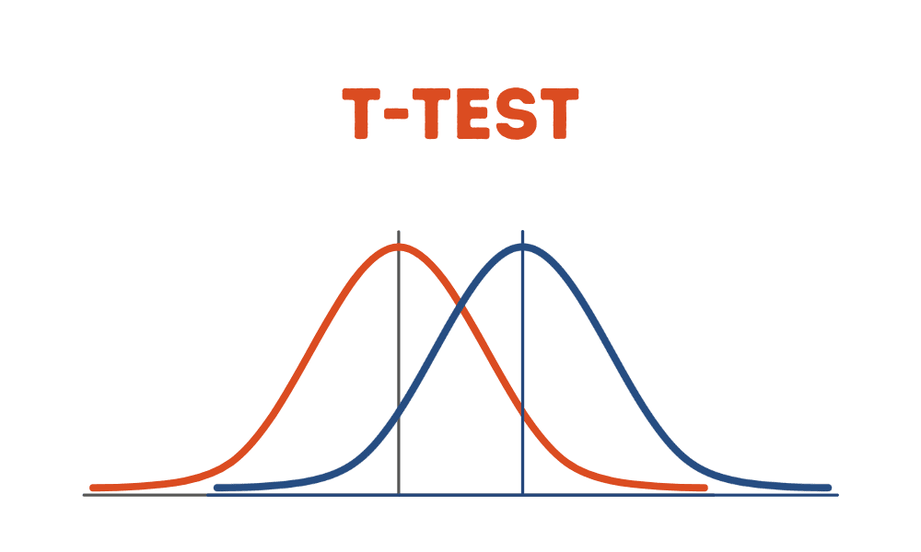
What type of t test should I use?
When choosing a t test, you will need to consider two things: whether the groups being compared come from a single population or two different populations, and whether you want to test the difference in a specific direction.

Slide 6
One-sample, two-sample, or paired t test? 1) If the groups come from a single population (e.g., measuring before and after an experimental treatment), perform a paired t test. 2) If the groups come from two different populations perform a two-sample t test (a.k.a. independent t test). 3) If there is one group being compared against a standard value (e.g., comparing the acidity of a liquid to a neutral pH of 7), perform a one-sample t test. One-tailed or two-tailed t test? 1) If you only care whether the two populations are different from one another, perform a two-tailed t test. 2) If you want to know whether one population mean is greater than or less than the other, perform a one-tailed t test.

Slide 7
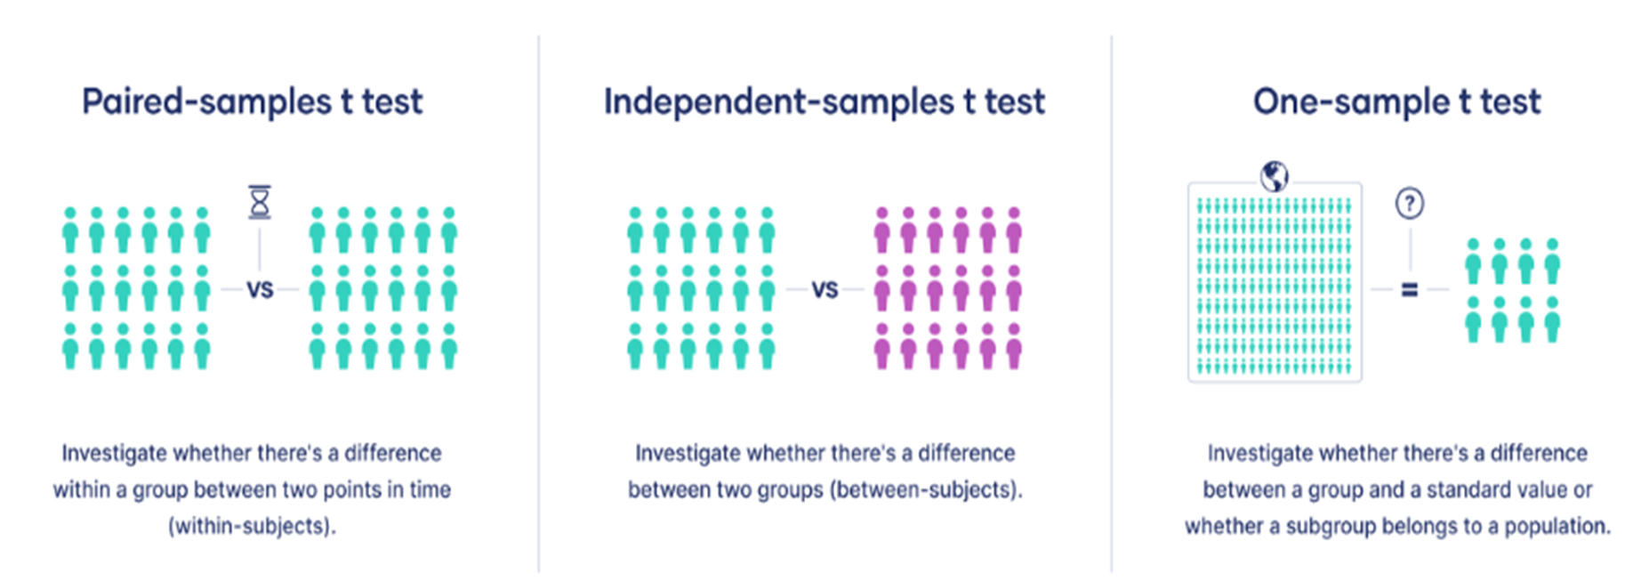
Awesome words

Slide 8
02
Performing T Test

Slide 9
The t test estimates the true difference between two group means using the ratio of the difference in group means over the pooled standard error of both groups. You can calculate it manually using a formula, or use statistical analysis software.
Performing a t Test

Slide 10
A larger t value shows that the difference between group means is greater than the pooled standard error, indicating a more significant difference between the groups.
You can compare your calculated t value against the values in a critical value chart to determine whether your t value is greater than what would be expected by chance. If so, you can reject the null hypothesis and conclude that the two groups are in fact different

Slide 11
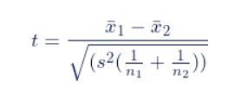
T Test Formula :
The formula for the two-sample t test (a.k.a. the Student’s t-test) is shown.
In this formula, t is the t value, x₁ and x₂ are the means of the two groups being compared, s₂ is the pooled standard error of the two groups, and n₁ and n₂ are the number of observations in each of the groups.

Slide 12
03
Objective

Slide 13
Objective
To Conduct a detailed salary analysis of data scientists using statistical tools, such as the t-test, to identify key factors influencing compensation. This analysis aims to provide insights into how experience, education, geographical location, and industry affect data scientist salaries, aiding organizations in making informed decisions on recruitment, talent retention, and compensation strategies.

Slide 14
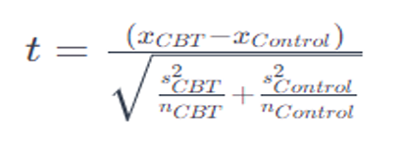

1. Null Hypothesis (H0): The null hypothesis typically assumes that there is no significant difference between the mean happiness score for India and the global average happiness score. 2. Alternative Hypothesis (Ha): The alternative hypothesis suggests that there is a significant difference between the mean happiness score for India and the global average happiness score. 3. Calculate Mean Scores: Sum up depression scores for each group,Divide by the number of participants to find the mean. 4. Difference Between Means: Subtract control group's mean from CBT group's mean. 5. Pooled Standard Deviation: Calculate using formula/statistical software. 6. Compute t-value: Use the t-value formula. 7. Degrees of Freedom: Calculate for an independent-samples t-test. 8. Find P-value: Use a t-distribution table/statistical table. 9. Interpret Results: P-value < 0.05: Reject H0. P-value ≥ 0.05: Fail to reject H0.
Communicate t-value, degrees of freedom, p-value, and effect size clearly.

Slide 15
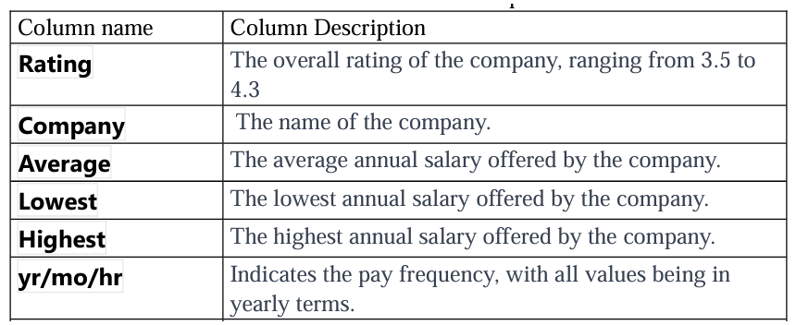
Dataset
The provided dataset appears to contain information about various companies, including their ratings and salary details. Each row in the dataset represents a different company, and the columns provide information about the company's rating and salary details.

Slide 16
04
Program

Slide 17
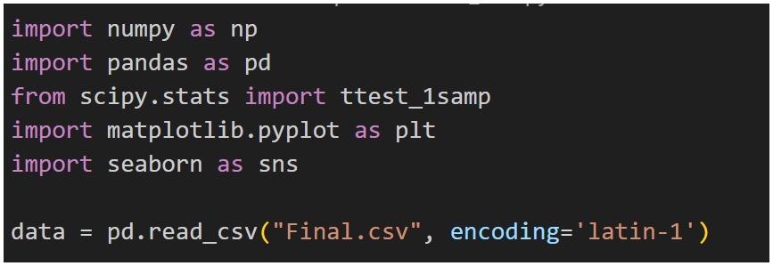
1. Importing Required Libraries and Loading Dataset

Slide 18
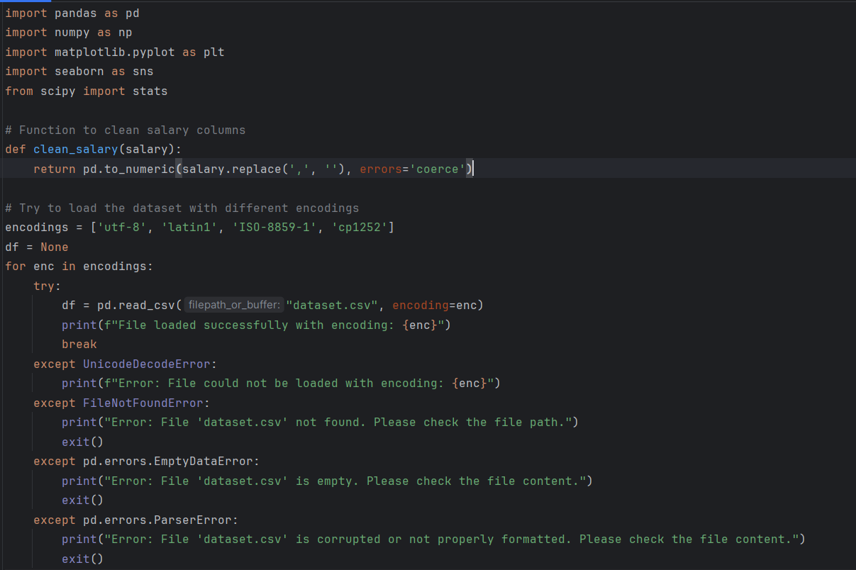
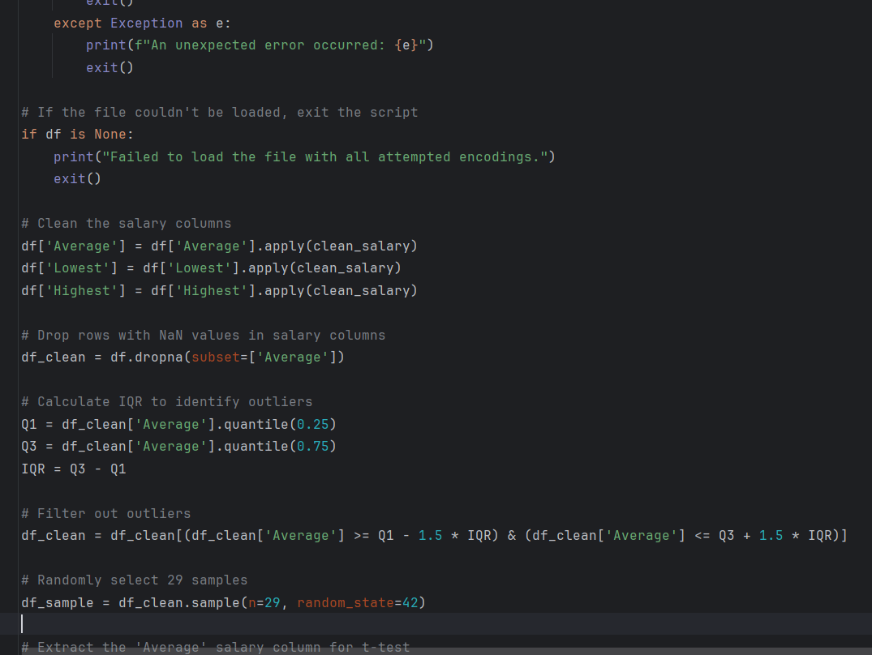
2. Performing The t test

Slide 19
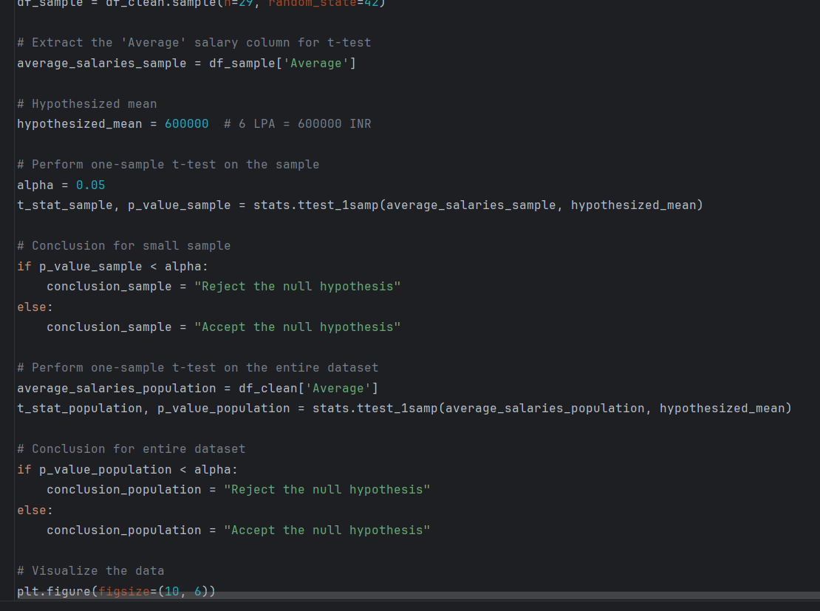
2. Performing The t test

Slide 20
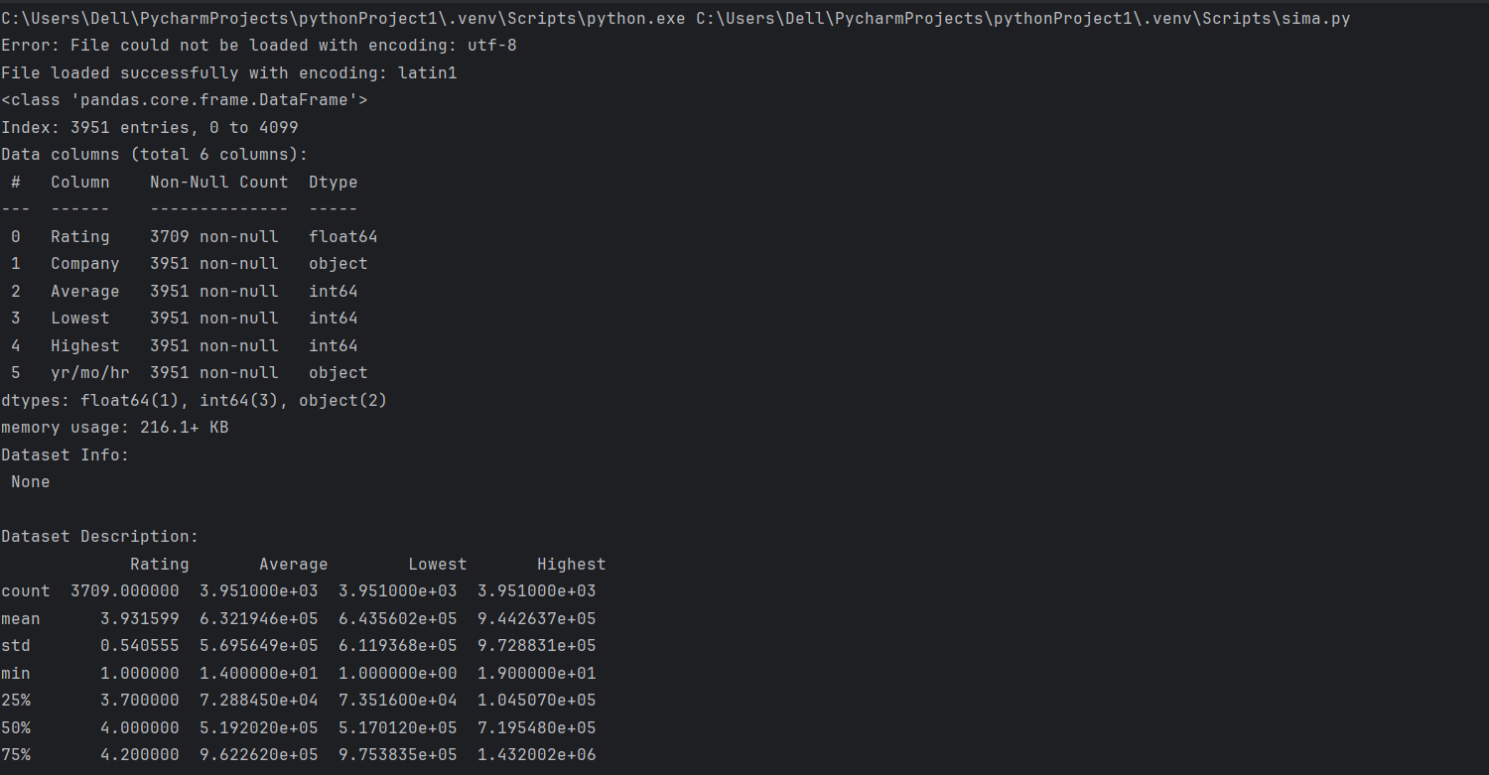
Output

Slide 21
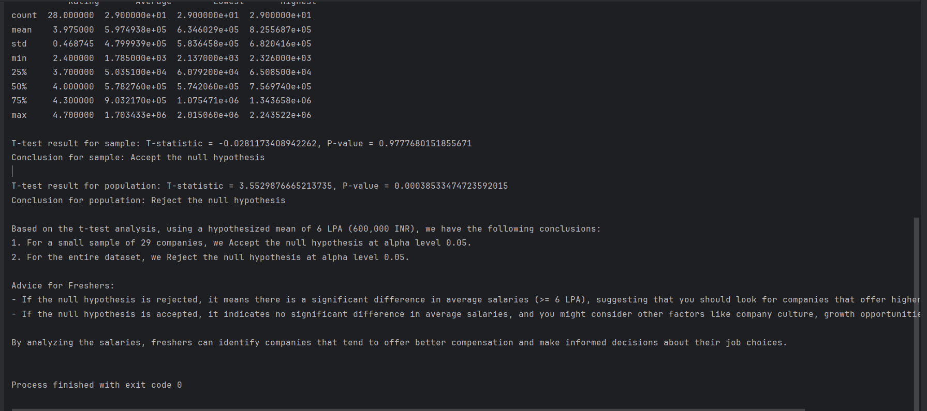
Output

Slide 22
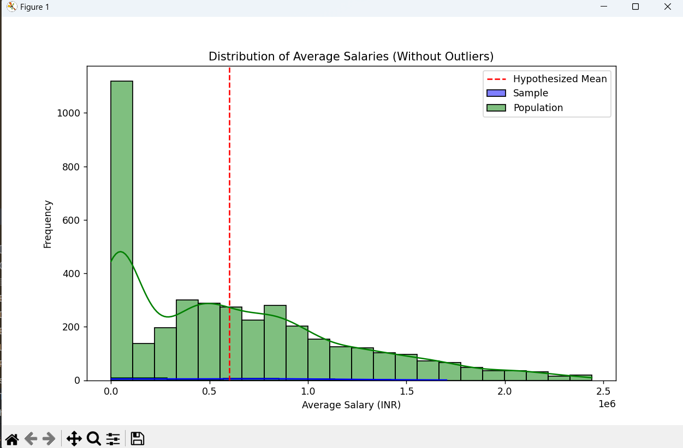
Output

Slide 23
05
Conclusions

Slide 24
Conclusion Drawn from T Test
After cleaning the data, the script randomly selects 29 samples and performs a one-sample t-test on
both thesample and the entire dataset to compare the average salaries against a hypothesized mean
of 600,000 INR (6 LPA). The t-test results help determine whether the average salaries significantly
differ from this hypothesized mean.
Finally, the code provides conclusions based on the t-test results. If the null hypothesis is rejected, it suggests that there is a significant difference in average salaries (>= 6 LPA), indicating that freshers should look for companies offering higher average salaries. If the null hypothesis is accepted, it means there is no significant difference in average salaries, and freshers should consider other factors like company culture, growth opportunities, and job stability when making job choices.

Slide 25
Thanks!!

