Slide 1
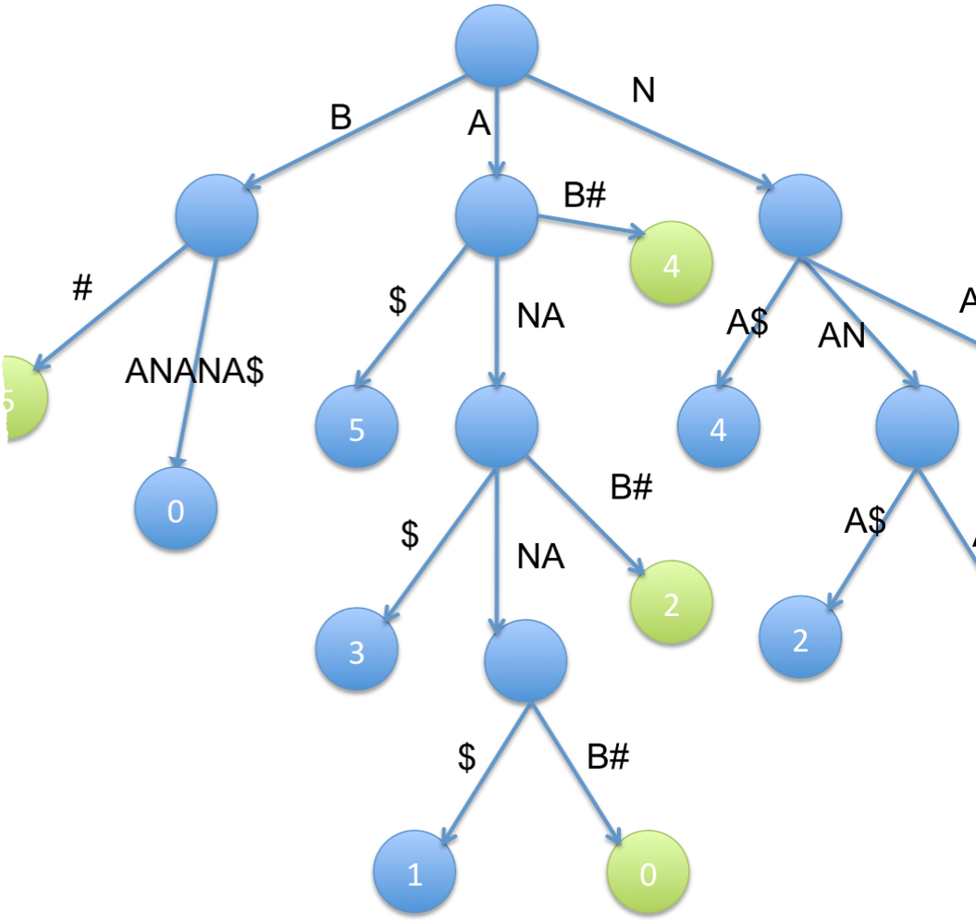
SUFFIX TREE CONSTRUCTION
Urlana Suresh Kumar

Slide 2
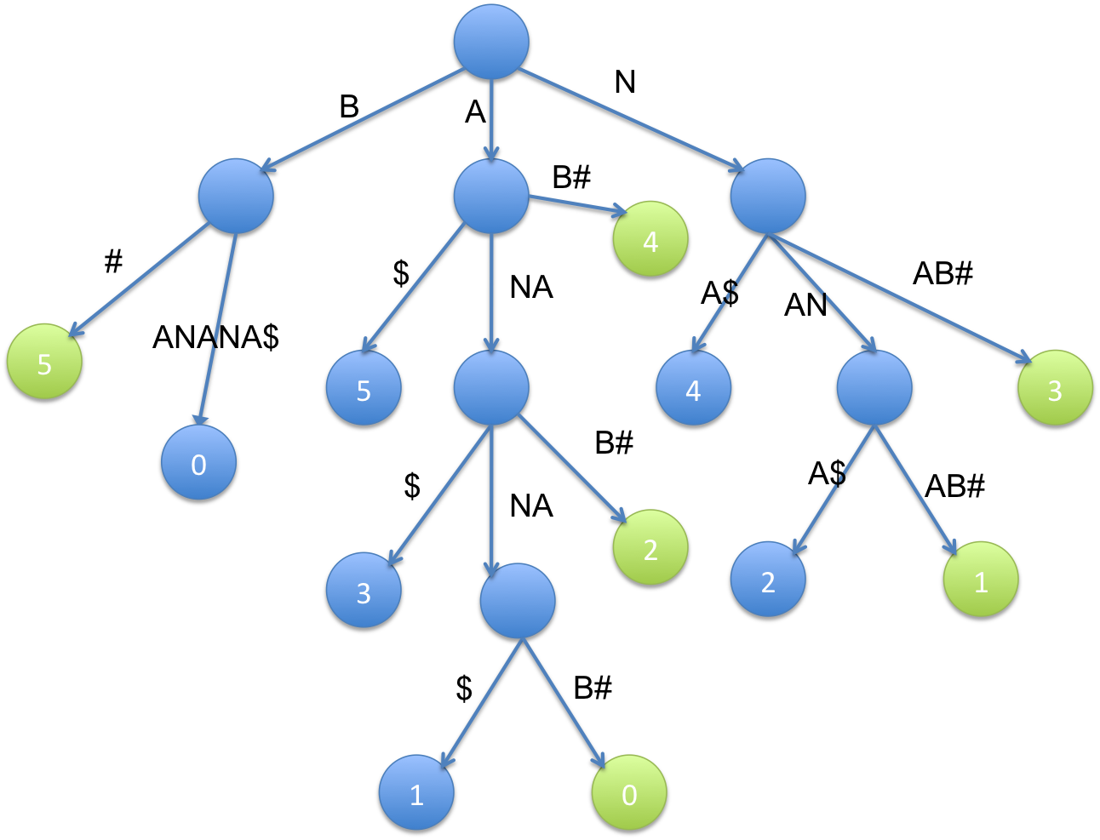
Suffix Tree :
A suffix tree is a tree-like structure that stores all the possible suffixes of that word (a suffix is a sequence of characters occurring at the end of the word). Each path from the root of the tree to a leaf node represents a different suffix of the original word.
For instance, if you have the word "banana," the suffix tree will store all the suffixes of this word, such as "banana," "anana," "nana," "ana," "na," and "a." The tree structure helps quickly locate and retrieve these suffixes or parts of them, enabling efficient string searches, substring queries, and other string-related operations.
This Photo by Unknown author is licensed under CC BY-SA.

Slide 3

Importance of Suffix Trees:
Pattern Matching and Searching:
Substrings Identification: Enables quick identification of substrings within a larger string.
Pattern Matching: Efficiently determines if a pattern exists within a text.
Algorithm Design:
Algorithmic Solutions: Serves as a fundamental data structure in designing various algorithms related to string manipulation.
This Photo by Unknown author is licensed under CC BY.

Slide 4
Ukkonenes algorithm :
Ukkonen's Algorithm is a method used to efficiently construct suffix trees. It's specifically designed to build suffix trees incrementally, adding characters to the input string one at a time. The algorithm avoids constructing the entire suffix tree at once, which can be memory-intensive and time-consuming for larger strings.
This Photo by Unknown author is licensed under CC BY-SA.

Slide 5

Why We Use Ukkonen's Algorithm for Suffix Tree Construction?
Efficiency: Ukkonen's Algorithm constructs the suffix tree in linear time, which means its runtime grows linearly with the size of the input string. This efficiency is crucial for handling large texts or sequences.
Optimal Space Complexity: Ukkonen's Algorithm achieves optimal space complexity for constructing suffix trees, ensuring that the memory requirements are proportional to the size of the input string.
Ease of Implementation: Although Ukkonen's Algorithm can be complex to understand initially, its step-by-step nature makes it feasible to implement compared to other algorithms that construct suffix trees in a batch or non-incremental manner.

Slide 6
Overview of the Code
Our Python code implements the construction and visualization of a suffix tree using Ukkonen's algorithm
1.Node Class:
Represents a node in the suffix tree.
Attributes include start and end indices defining the substring of the original text, suffix_link pointing to the node's suffix link, and children storing child nodes.

Slide 7
2.SuffixTree Class:
Manages the construction and visualization of the suffix tree.
Initializes with a root node, and key variables such as active_node, active_edge, active_length are used during the tree construction.
The build_suffix_tree method constructs the suffix tree for the given input text by iteratively extending it with each character.
The extend_suffix_tree method handles the extension of the suffix tree based on the current active point and the next character.
The draw_suffix_tree method recursively traverses the tree, drawing edges and labeling nodes for visualization.
The visualize_suffix_tree method initializes the Matplotlib figure and calls the drawing method to visualize the constructed suffix tree.

Slide 8
3.Example Usage:
Demonstrates how to use the SuffixTree class to construct a suffix tree for the input text "banana" and visualize it using Matplotlib.
4.Visualization:
Matplotlib is used to visualize the suffix tree. Edges are drawn between nodes, and labels indicate the substrings represented by each edge. The resulting tree visually captures the hierarchical structure of suffixes in the input string.
5.Ukkonen's Algorithm:
The code follows Ukkonen's algorithm, a linear-time algorithm for constructing suffix trees. It efficiently extends the tree as characters are processed one by one, handling edge splitting and node creation dynamically.

Slide 9
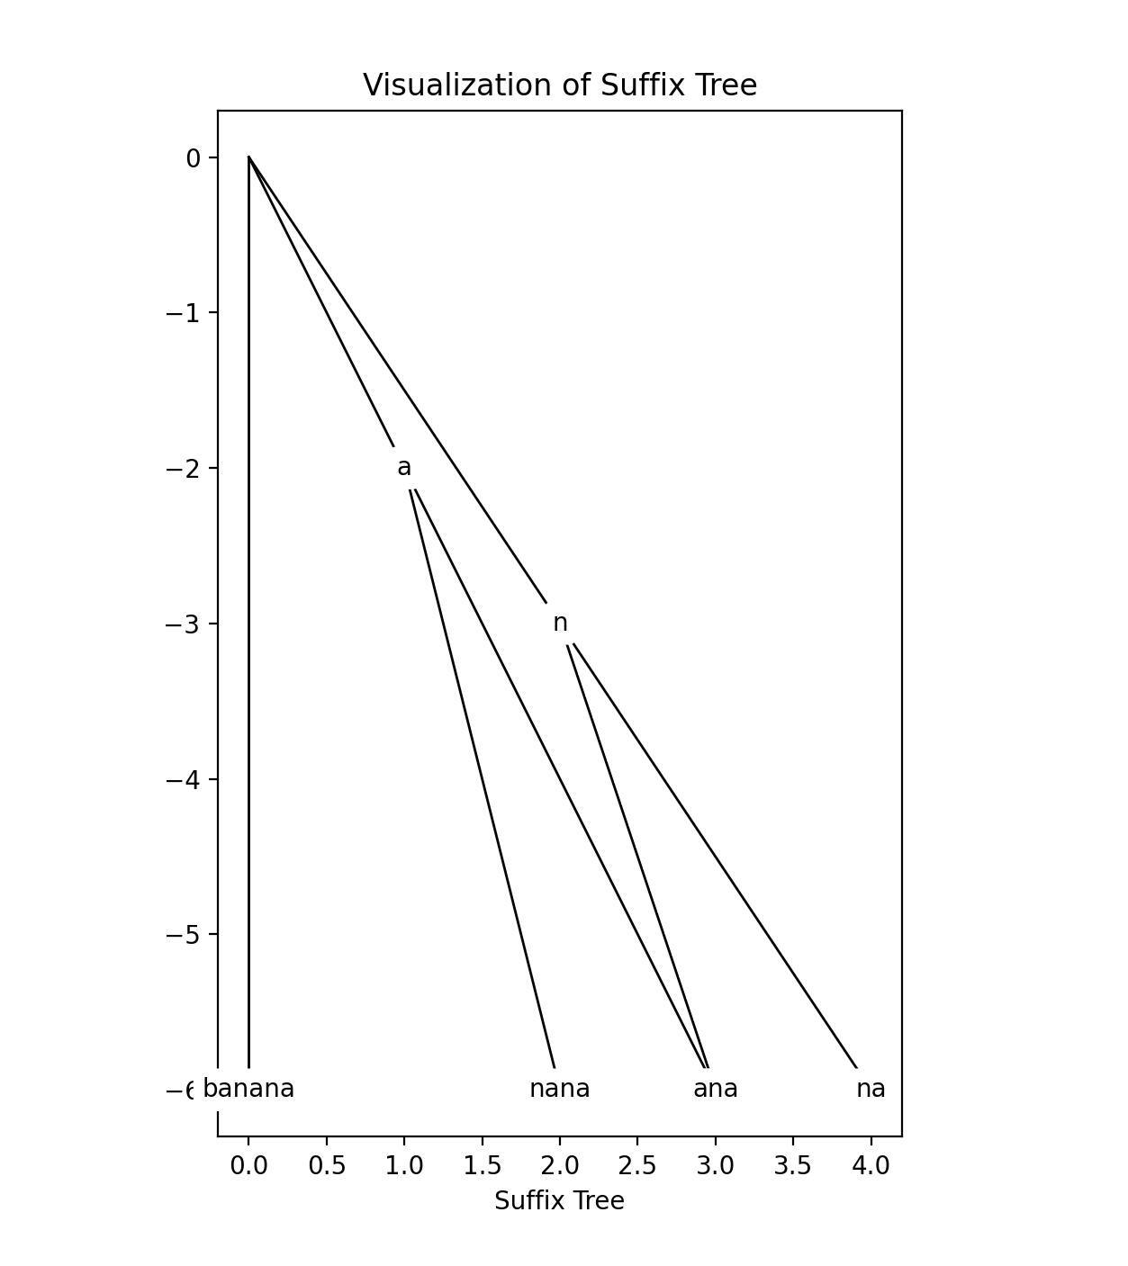
Output
The suffix tree visualization for the input "banana" reveals the hierarchical structure capturing all suffixes of the given string. The nodes and edges of the tree illustrate the internal nodes, leaves, and relationships between substrings. Notably, the suffix tree efficiently represents repeated patterns and substrings within the original text. The visual representation aids in understanding the construction process, showcasing the incremental addition of suffixes and the dynamic nature of the tree during Ukkonen's algorithm execution.

Slide 10

Real-World Applications Of Suffix Tree :
Bioinformatics: "In genomics, suffix trees efficiently search, align, and compare DNA sequences, aiding in the identification of similarities and patterns within genomes."​
Data Mining and Information Retrieval: "Suffix trees play a crucial role in analyzing large datasets, helping extract frequent patterns or substrings. This is valuable for tasks like finding repeated sequences in biological data or identifying patterns in text documents."​
Longest Common Substring: "Used to find the longest common substring among multiple strings, suffix trees have applications in plagiarism detection, identifying common genetic sequences in biology, and facilitating data analysis."​
Natural Language Processing (NLP): "In NLP, suffix trees contribute to text indexing, stemming, and analyzing linguistic patterns. Their applications extend to search engine algorithms, language modeling, and information retrieval systems."​
​ ​
​

Slide 11
Conclusion :
Efficient Storage: It Provides a compact representation of all suffixes of a string, optimizing memory usage.
Linear Time Construction: Ukkonen's Algorithm ensures linear-time construction relative to the input string length, making them suitable for handling large-scale data.
Cross-Domain Use: It has applications in bioinformatics, data compression, text processing, computational biology, and more.

