Slide 1
ASHRAE the Greate Energy Predictor III
Programming for data science Pohang University of Science and Technology (POSTECH)
Team :
8
Date :
2026-05-28

Slide 2
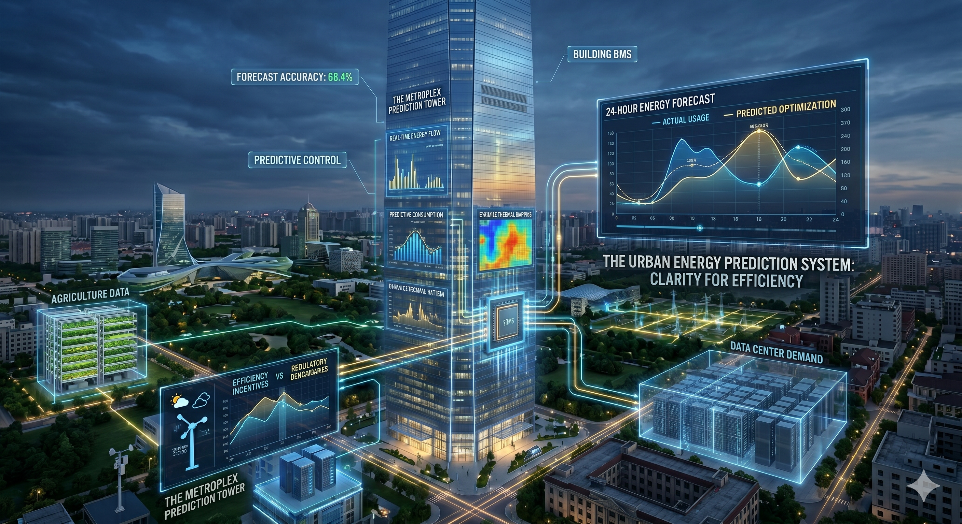
Introduction
Importance of energy prediction
We are facing an energy crisis, characterized by expanding demand from the intensifying effects of climate change, modern agriculture, and the exponential growth of global data servers.
To curb consumption, regulatory incentives for energy-efficiency is given.
Precise energy consumption forecasting has become essential
Image generated from Gemini
Notes:
We are navigating a systemic energy crisis, characterized by expanding demand from the intensifying effects of climate change, modern agriculture, and the exponential growth of global data servers. To curb consumption in massive urban structures like skyscrapers, policymakers are increasingly introducing regulatory incentives for energy-efficient buildings. Precise energy consumption forecasting has become essential, providing the predictive clarity required for effective resource management and the optimization of building efficiency.

Slide 3
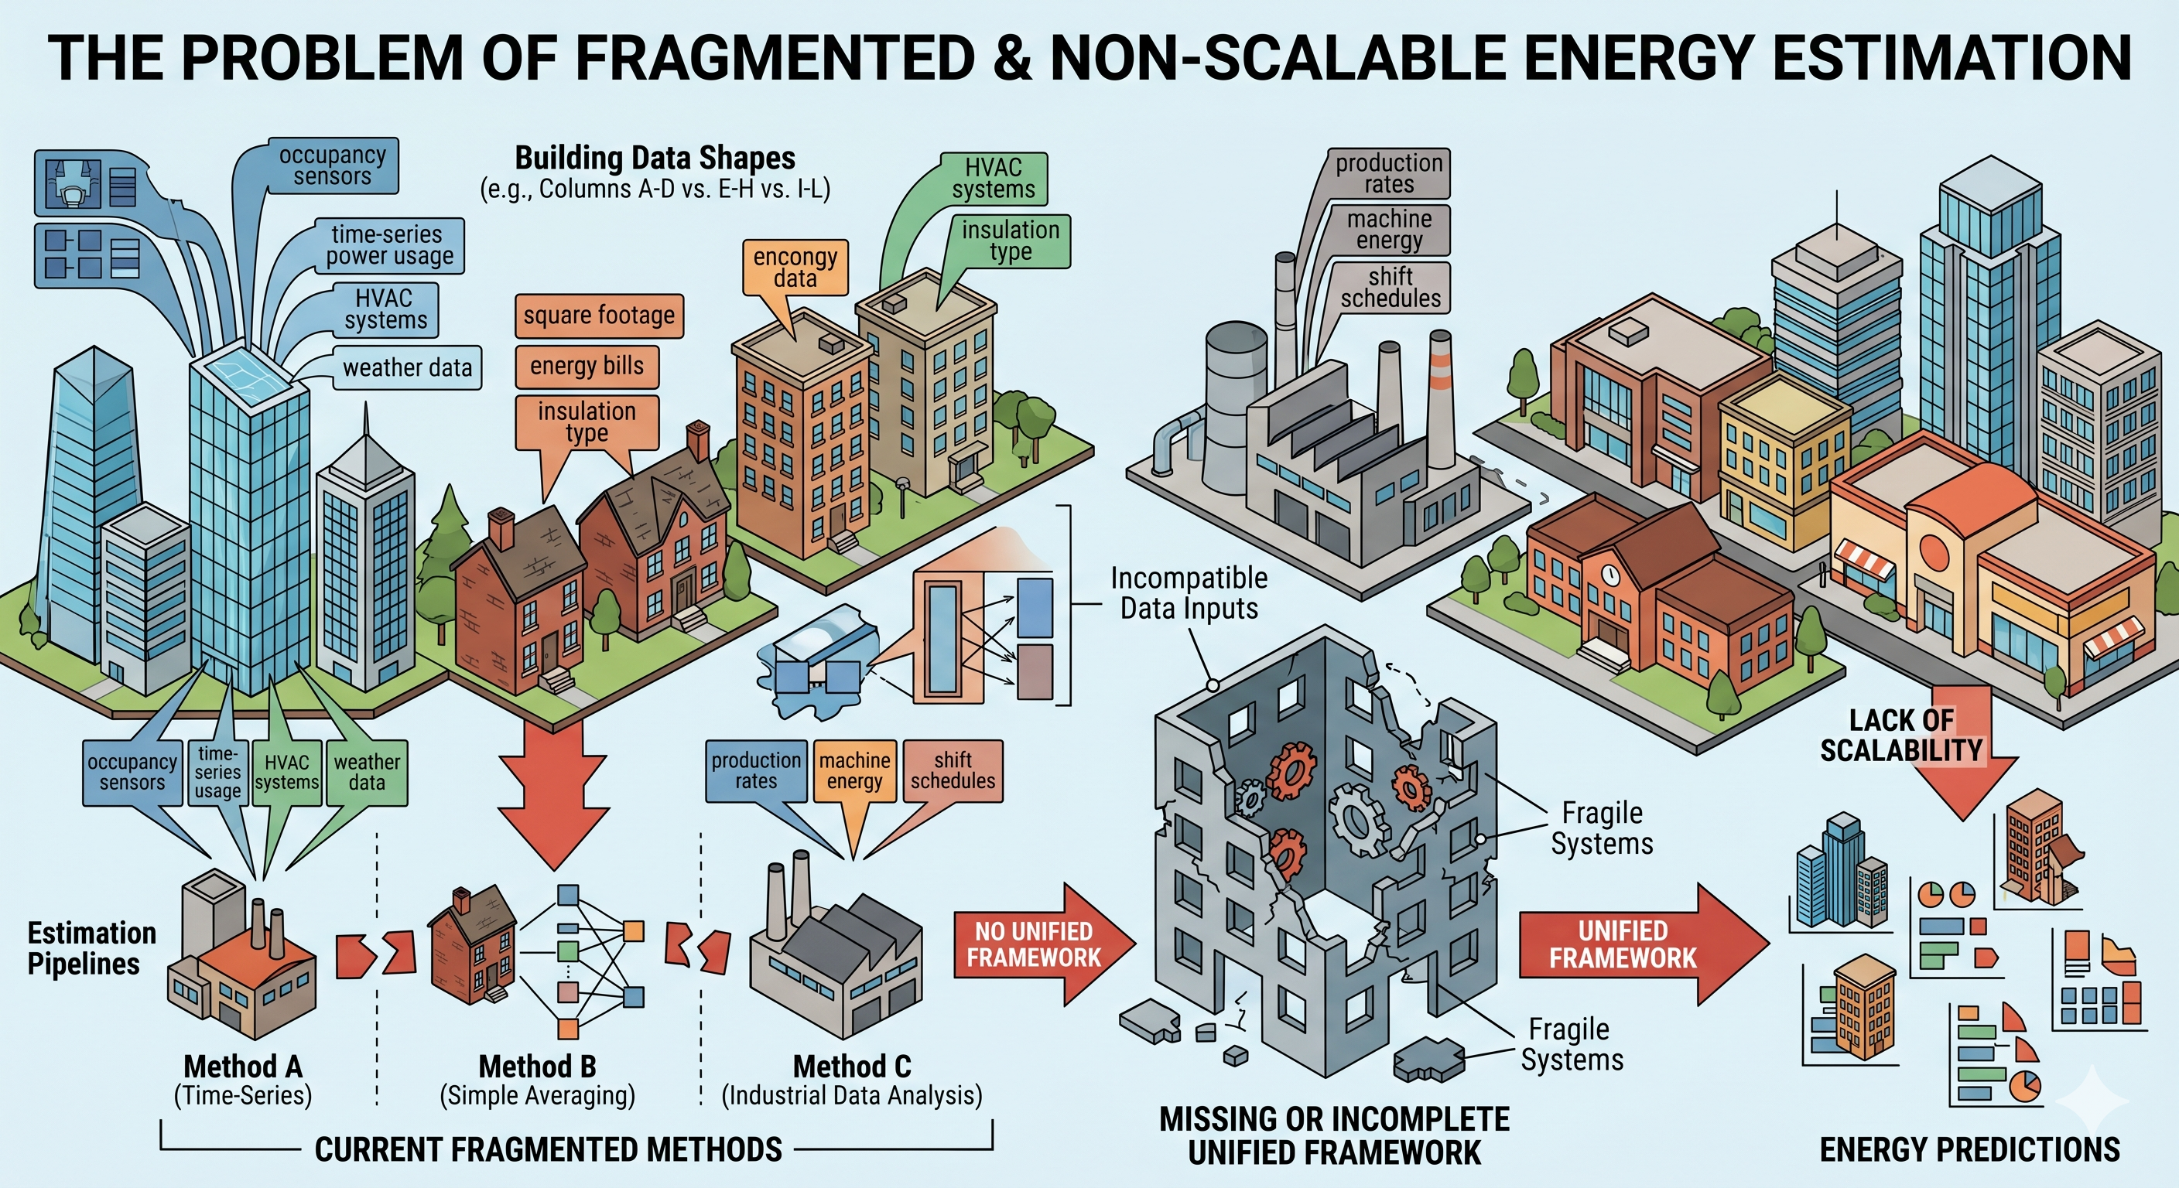
Challenges
Need for a unified predictive model
Problem in energy consumption prediction.
Current methods of estimation are fragmented and do not scale well. In other words, there is no unified framework that can handle the data with different shapes. Thus, it is hard to estimate the energy predictions for various types of building with different columns of data that can be provided.

Slide 4
Approach
Design of predictive model
Our approach to predict the building’s energy consumption.
We are dealing with tabulated data with missing fields with time series information (thermal intertia), using tree-based models will be beneficial. Then, ensemble the tree models to predict the energy consumption.
Pre-process 1) Statistically pruning 2) Synthetic imputation & solar alignment
Feature engineering 1) Lagged trajectories & target encoding 2) Thermodynamic proxy variables
Model choice : Light GBM / XGBoost ensemble.

Slide 5
Pre-processing data
Statistical data pruning
Our approach to predict the building’s energy consumption.
We are dealing with tabulated data with missing fields with time series information (thermal intertia), using tree-based models will be beneficial. Then, ensemble the tree models to predict the energy consumption.
Pre-process 1) Statistically pruning 2) Synthetic imputation & solar alignment
Feature engineering 1) Lagged trajectories & target encoding 2) Thermodynamic proxy variables
Model choice : Light GBM / XGBoost ensemble.

Slide 6
Feature engineering
Lagged trajectories
Our approach to predict the building’s energy consumption.
We are dealing with tabulated data with missing fields with time series information (thermal intertia), using tree-based models will be beneficial. Then, ensemble the tree models to predict the energy consumption.
Pre-process 1) Statistically pruning 2) Synthetic imputation & solar alignment
Feature engineering 1) Lagged trajectories & target encoding 2) Thermodynamic proxy variables
Model choice : Light GBM / XGBoost ensemble.

Slide 7
Model design
Ensemble of decision-tree models
Our approach to predict the building’s energy consumption.
We are dealing with tabulated data with missing fields with time series information (thermal intertia), using tree-based models will be beneficial. Then, ensemble the tree models to predict the energy consumption.
Pre-process 1) Statistically pruning 2) Synthetic imputation & solar alignment
Feature engineering 1) Lagged trajectories & target encoding 2) Thermodynamic proxy variables
Model choice : Light GBM / XGBoost ensemble.

Slide 8
Training results & Discussion
Ensemble of decision-tree models
Training results
What kind of training method we used.
How much accuracy we acquired during training.

Slide 9
Prediction results & Discussion
Ensemble of decision-tree models
Prediction model performance
Why our prediction results is lower or higher than the training/verification results.
Comparison with the top 5 competitors.

