Slide 1

IILM UNIVERSITY
STUDENT CREDENTIALS
GREATER NOIDA, UTTAR PRADESH
Mohd Huzaifa Usmani
SOCIAL WELFARE &
COMMUNITY SUPPORT
ENGAGEMENT
Roll No. 25SCS1003003703
B.Tech CSE | Batch 2025–2029
30-Day Internship / Volunteer Field Engagement Report
INTERNSHIP DURATION
01 July 2026 – 30 July 2026
HOST ORGANIZATION
Jyoti Sarp Kanya Asra Society
01

Slide 2
Candidate & Engagement Overview
Candidate Details
Engagement Profile
Student Name: Mohd Huzaifa Usmani
Roll Number: 25SCS1003003703
Degree: B.Tech (Computer Science & Engineering)
Academic Batch: 2025–2029
University: IILM University, Greater Noida, U.P.
Program: Social Welfare & Community Support Engagement
Organization: Jyoti Sarp Kanya Asra Society
Duration: 30 Days
Period: 01 July 2026 – 30 July 2026
Nature: Volunteer / field engagement
Certificate-Based Scope
The certificate records participation in social welfare programs and activities related to social support, education, and empowerment of underprivileged girls and women. The report follows those documented categories without inventing specific daily events.
02

Slide 3
Organization Profile
What the certificate and report establish
Documented Mission Area
JYOTI SARP KANYA
ASRA SOCIETY
The engagement centers on welfare-oriented activities and support for people who may face social or educational disadvantage.
Social welfare & community support
What Is Not Assumed
The supplied certificate does not provide detailed founding history, staffing, funding, geographic reach, or beneficiary counts; therefore these are not added as facts.
Focus areas documented in the certificate
• Social support
• Education-related activities
• Empowerment of underprivileged girls and women
Core Understanding
The organization’s documented work emphasizes care, support, education and empowerment through organized social welfare participation.
03

Slide 4
Engagement Context & Purpose
Why Field Engagement Matters
Documented Scope
Field-based volunteering connects learning with practical situations and develops understanding of community needs, social responsibility and inclusive development.
Participation in social welfare programs, social support activities, education-related support, and empowerment-oriented initiatives.
Learning Perspective
The experience placed service, teamwork and responsible participation at the center. It showed that organized community initiatives can address everyday needs and encourage greater participation in education and empowerment.
04

Slide 5
Core Objectives
01
Participate responsibly
02
Support the community
Take part in social welfare activities with commitment and discipline.
Assist with activities connected with community and social support.
03
Contribute to education
04
Understand empowerment
Support education-related initiatives wherever assistance is required.
Recognize the importance of empowering underprivileged girls and women.
05
Build soft skills
06
Gain field exposure
Develop communication, teamwork, responsibility, empathy and a service-oriented attitude.
Understand organized community work and the value of sustained participation.
05

Slide 6
Nature of Work & Activities
Social Welfare Programs
Social Support
Education-Related Support
Participation in activities intended to support members of the community and contribute to welfare-oriented initiatives.
Assisting with practical and interpersonal support for beneficiaries and the organizing team.
Contributing to education-connected activities and a supportive environment for learning and development.
Empowerment Activities
Team Participation
Supporting initiatives focused on underprivileged girls and women, emphasizing dignity, opportunity and participation.
Working cooperatively with the organization and other participants, following instructions and taking responsibility.
06

Slide 7
Education & Social Support
EDUCATION
SOCIAL SUPPORT
A pathway to greater opportunity
Support goes beyond material assistance.
Listening • guiding • coordinating • encouraging participation • helping organize activities • contributing time and effort
• Understanding barriers to learning
• Encouragement and support
• Creating a supportive learning environment
Key Learning
Even routine support tasks can contribute to the smooth functioning of a welfare program. Patience and respectful communication are essential when interacting with people from different backgrounds.
07

Slide 8
Empowerment of Underprivileged Girls & Women
EMPOWERMENT
Opportunity • Dignity • Inclusion
Education
Participation
Support
Encourages greater participation in learning and development.
Creates space for individuals to take part more fully in opportunities and decision-making.
Requires respect, sensitivity, consistency and understanding of beneficiary needs.
Education and social support can contribute to long-term empowerment.
08

Slide 9
Skills & Competencies Developed
Communication
Clear, polite and appropriate interaction
Teamwork
Coordination and shared responsibility
Responsibility
Commitment, punctuality and accountability
Empathy
Respect and sensitivity toward beneficiaries
Adaptability
Adjusting to different activities and needs
Leadership Awareness
Planning, coordination and ownership
Social Awareness
Understanding the role of individuals in welfare
09

Slide 10
Challenges, Learning & Outcomes
Challenges Encountered
Learning from Challenges
Different needs, expectations and communication styles require patience and respectful interaction. Welfare work also depends on volunteers being dependable and flexible.
Consistency, cooperation and readiness to assist with different kinds of work encourage a flexible and responsible approach.
Recognized Outcomes
The certificate notes that dedication, sense of responsibility and willingness to help were appreciated by the team and beneficiaries. The engagement strengthened social responsibility, awareness of education and empowerment, and cooperative working skills.
10

Slide 11
Reflection & Recommendations
Personal Reflection
Recommendations
Professional development is not limited to technical knowledge. Social-welfare work requires responsibility, patience, communication and respectful interaction.
Volunteering is a two-way learning experience: while contributing time and effort, the volunteer develops maturity, social awareness and a stronger understanding of community needs.
The focus on education and empowerment connected everyday support with opportunity, dignity and inclusion.
• Maintain clear role allocation for volunteers.
• Provide a short orientation before activities.
• Keep simple activity records.
• Continue education and empowerment initiatives.
• Encourage volunteer reflection and suggestions.
• Use simple digital tools for scheduling, communication and documentation while protecting beneficiary privacy.
11

Slide 12
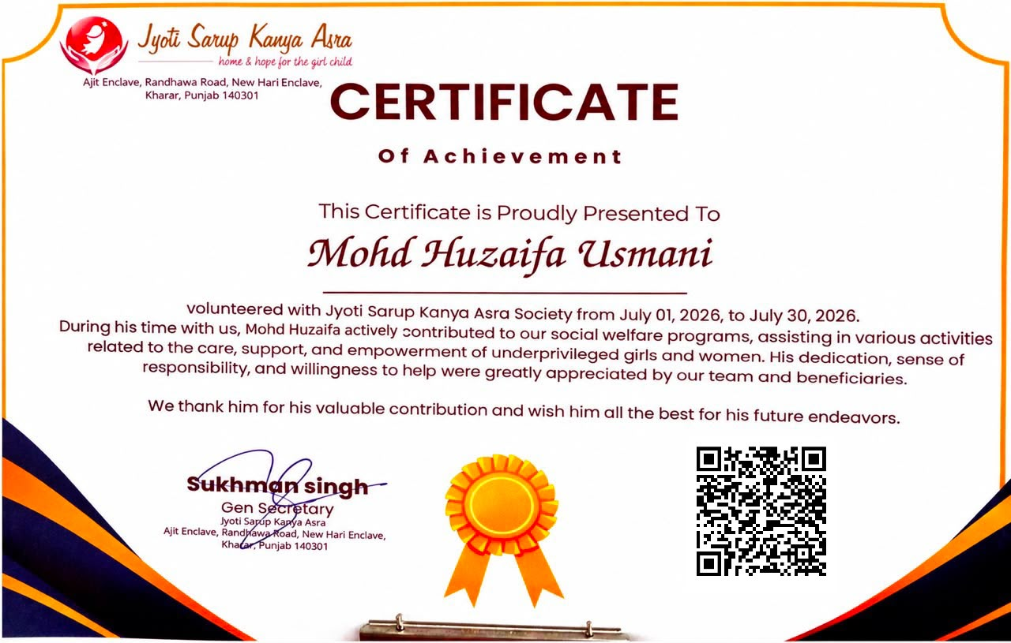
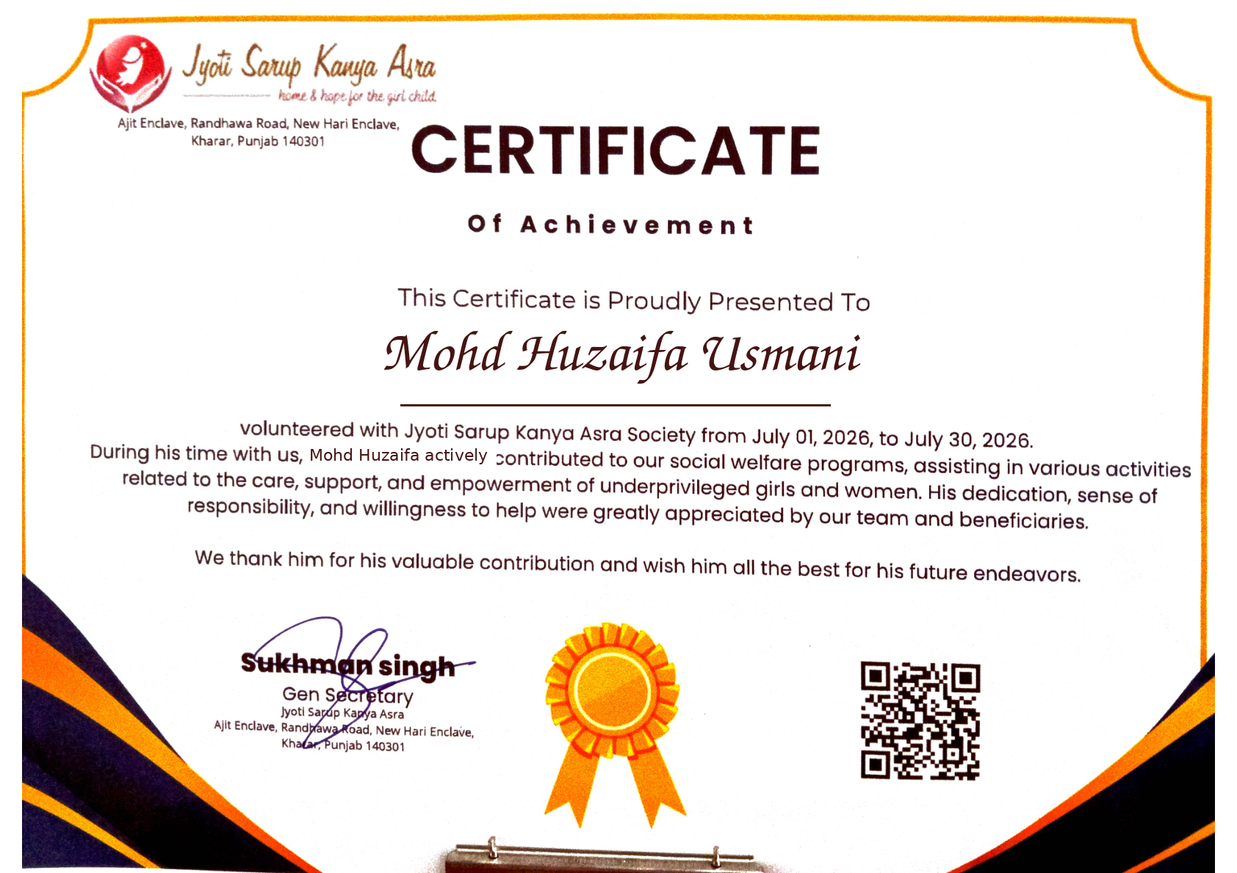
Certificate & Official Record
Certificate supplied as the primary reference for this presentation
12

Slide 13
IILM UNIVERSITY
GREATER NOIDA, UTTAR PRADESH
Thank You!
Social Welfare & Community Support Engagement
Mohd Huzaifa Usmani
Jyoti Sarp Kanya Asra Society
Roll No: 25SCS1003003703
01 July 2026 – 30 July 2026
13

