Slide 1
Behavioural evidence of suppression-induced forgetting and its interaction with psychological traits 10 Jun 2022
Usman Afzali
PhD Candidate, Psychology
Postdoctoral Research Associate, Computational Neuroscience

Slide 2
Outline
Suppression-induced forgetting
Study-1: T/NT-Extension
Study-2: T/NT-Traits

Slide 3

Deliberate attempts to suppress certain thoughts actually make them more likely to surface.

Slide 4

Introduction
Mechanisms of forgetting: passive, interference, motivated forgetting
Motivated forgetting: during encoding, during retrieval (Anderson & Hanslmayr, 2014)
The Think/No-think Paradigm (T/NT) (Green & Anderson, 2001)
Used to investigate whether people can actively suppress unwanted memories and the degree to which such suppression can affect subsequent recall.
Prof Michael Anderson

Slide 5
The T/NT phases
Phase 1 (Learning): 50 associated cue-response word pairs such as “ORPHAN – LAMB”
Cue | Response
ORPHAN | LAMB
LEVER | STEEL
VITAMIN | LEMON
BROOM | HOUSE
CLUSTER | NECKLACE
RIM | GRANITE
VICE | CIGAR
MOSS | NORTH

Slide 6
Feedback
ORPHAN –

Slide 7
Phase 2
Manipulation: 15 No-Think, the rest Think
ORPHAN – LAMB (No-Think)
LEVER – STEEL (Think)
0 (Baseline), 1, 8, and 16

Slide 8
Phase 3
Phase 3 (Recall):
Same-cue test (SCT)
Independent-cue test (ICT)
The rate is compared with the baseline
SCT
ICT
For ORPHAN – LAMB
ORPHAN -
For ORPHAN – LAMB
ANIMAL - L

Slide 9
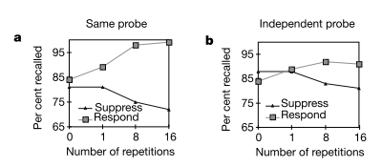
T/NT Results
T
T
NT
NT
(Green & Anderson, 2001)

Slide 10
T/NT continued
Active process of response inhibition, uses executive function systems
The executive deficit hypothesis
Works well with direct suppression:
Direct suppression: ORPHAN – LAMB
Thought-substitution: Generating new thoughts to occupy working memory (Levy & Anderson, 2002): ORPHAN – BOB
T/NT instructions make sure this does not happen. See the next slide:

Slide 11
Controlling for suppression vs. substitution
Guidelines: You should accomplish this by trying to block thinking of the Response word, but NOT by replacing it with any other thoughts, like another word, image or idea. To repeat: do not think of anything else other than the Cue word while you are blocking the Response word. Just keep paying attention to and looking at the Cue word the entire time.
During experiment: Diagnostic questionnaire and post-experimental questionnaire

Slide 12
Uses of T/NT
The relationship between suppression ability and traumatic memories
Countermeasure of Brain Fingerprinting (BFP)

Slide 13
Interaction between TNT and traumatic memories
Trained on cue-response pictures
fMRI of prefrontal regions, emotional control areas, and visual processing areas were recorded while conducting the TNT task
Results demonstrated that neural activity increased in the mentioned brain centres during the NT trials – suggesting these areas were involved with the control of emotional memories
We can exert cognitive control over emotionally distressing memories in conditions such as PTSD and OCD
Depue et al. (2007)

Slide 14
Is deficiency in retrieval suppression (NT) a potential risk factor for subsequent PTSD?
Participants went through a TNT procedure, then watched either a mild traumatic or a neutral clip, and were asked to register any ruminating thoughts of that clip
Those who had deficit in the ability to perform NT had higher registration of ruminating thoughts
Participants with better NT performance reported fewer intrusive distressing memories than participants with lower retrieval suppression abilities
Streb et al. (2016)

Slide 15
TNT study at UC
n = 24
63 word pairs: 15 fillers and 48 remaining were divided into Baseline, Think and No-Think
Frequency: 12 vs. Baseline
Collected PCL-C (PTSD) and YBOCS (OCD) scores
Both recall types: SCT and ICT

Slide 16
Our findings:
SCT:
Baseline and T recall were not significantly different, F(1,23) = 1.26, p = .273
Baseline and NT recall were not significantly different, F(1,23) = 0.98, p = .332
ICT:
Baseline and T recall were not significantly different, F(1,23) = 2.79, p = .108
Baseline and NT recall were significantly different, F(1,23) = 6.46, p = .018 (Baseline recall M = 13.17 and NT recall M = 12.25)

Slide 17
Controlling for YBOCS and PCL-C
SCT:
Baseline and T recall were significantly different, F(1,21) = 7.56, p = .012 (Baseline recall M = 12.90 and NT recall M = 13.27)
Baseline and NT recall were not significantly different, F(1,21) = 0.41, p = .527
ICT:
Baseline and T recall were not significantly different, F(1,21) = 0.99, p = .332
Baseline and NT recall were not significantly different, F(1,21) = 0.39, p = .54

Slide 18
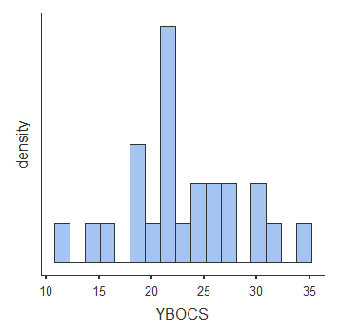
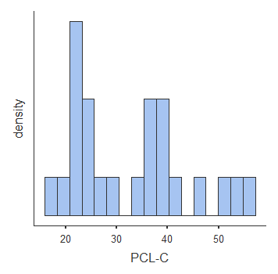
What is happening?

Slide 19
Conclusions:
Is TNT not working to begin with?
Previous studies had neuroscience components
Minimum frequency of suppression
Is it due to high PCL-C and YBOCS scores?
Or is it that BFP is a robust technique that cannot be countered with TNT
Back to the Pink Elephants:
ORPHAN – Pink Elephant (No-Think)

Slide 20
References
Green, C., & Anderson, M. C. (2001). Suppressing unwanted memories by executive control. Nature, 410(6826), 366-369. https://doi.org/10.1038/35066572
Levy, B. J., & Anderson, M. C. (2002). Inhibitory processes and the control of memory retrieval. Trends in cognitive sciences, 6(7), 299-305.
Depue, B. E., Curran, T., & Banich, M. T. (2007). Prefrontal Regions Orchestrate Suppression of Emotional Memories via a Two-Phase Process. Science, 317(5835), 215-219. https://doi.org/10.1126/science.1139560
Streb, M., Mecklinger, A., Anderson, M. C., Lass-Hennemann, J., & Michael, T. (2016). Memory control ability modulates intrusive memories after analogue trauma. Journal of affective disorders, 192, 134-142.

Slide 21
Before you leave…
Please collect your final lab
quiz slips from Cam!

