Slide 1
Research Tools
Usman Afzali, PhD
9 Aug 2023
PAST – SPSH - UC

Slide 2
Tasks
Searching for literature, keeping a record
Note taking
Stats/data processing
Writing
Collaboration

Slide 3
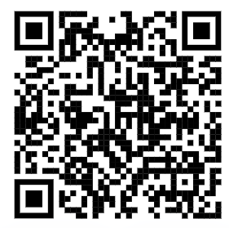
What do you use?

Slide 4
Searching for literature
Google
UC Library
PsycInfo
Scopus
Google Scholar

Slide 5
Keeping a Record
EndNote
MS Word
Mendeley
Zotero

Slide 6
Note taking
MS Word
Google Sheets
OneNote

Slide 7
Stats/data processing
SPSS
Jamovi
MS Excel
Python
R
Get code from ChatGPT

Slide 8
Writing
MS Word
CurveNote
Google Sheets
Markdown
Overleaf
Quarto
Templates available for APA, journals, etc.

Slide 9
Collaboration
OneDrive
DropBox
Email
Google Drive
CruveNote
GitHub
OSF

Slide 10
To Sum Up
Google Scholar
Zotero
OneNote
R and Python
Quarto
GitHub and OSF
ORCID
Don’t underestimate networking!!!

Slide 11
Questions?

