Slide 1
“Undefined Language”
Muhammad Usman Akram CS191078
Sameem Abbas CS191082
Sundus Saleem CS191055

Slide 2
Undefined Language
Undefined is a general purpose systems language that uses the idea of having simple, easy to remember keywords and syntax to be developer friendly. It is a statically typed language that has a single keyword for data types, functions and operators that basically perform the same action but have many syntaxes.

Slide 3
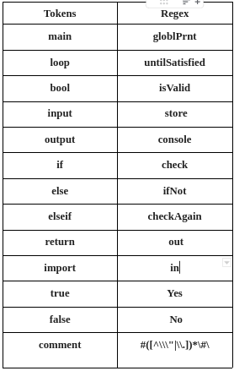
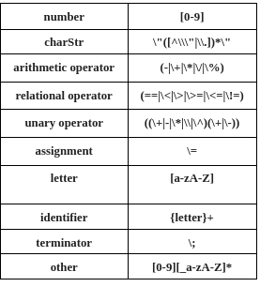
Lexical Unit

Slide 4
Grammer Rules
undefined:
MAIN undefined | LOOP undefined | BOOL undefined | INPUT undefined | OUTPUT undefined | IF undefined | ELSE undefined | ELSEIF undefined | IMPORT undefined | RETURN undefined | YES undefined | NO undefined | NUM undefined | STRING undefined | OPERATOR_A undefined | OPERATOR_R undefined | OPERATOR_U undefined | OPERATOR_E undefined | IDENTIFIER undefined | TERMINATOR undefined | COMMENT undefined | OPEN_BR undefined | OPEN_PR undefined | CLOSE_BR undefined | CLOSE_PR undefined | HEADER_FILE | OTHER | MAIN | LOOP | BOOL | INPUT | OUTPUT | IF | ELSE | ELSEIF | IMPORT | RETURN | YES | NO | NUM | STRING | OPERATOR_A | OPERATOR_R | OPERATOR_U | OPERATOR_E | IDENTIFIER | TERMINATOR | COMMENT | OPEN_BR | OPEN_PR | CLOSE_BR | CLOSE_PR | HEADER_FILE | OTHER

Slide 5
Demo

