Slide 1

Electrical Engineering
AC and DC motors Project

Slide 2
Group Members
Arsel Kaleem Abbasi
M. Hamza Khalid
M. Usman Khan
M. Tayyab
Muheed Junaid

Slide 3
BASIC INTRODUCTION
AC Motor:
AC motors run on alternating current, producing a rotating magnetic field in the stator.
They consist of a stator with windings and a rotor (squirrel cage or wound), requiring no brushes in most designs.
Widely used in industrial and household applications like pumps, fans, and appliances due to high efficiency and low maintenance.
Speed is tied to supply frequency, with variable frequency drives (VFDs) enabling precise control.
Mechanical Department

Slide 4
DC Motor:
DC motors operate on direct current, using a static magnetic field to drive the armature’s rotation.
They include a stator (magnets or windings), armature, and often brushes/commutator (brushed) or electronic controls (brushless).
Ideal for high-torque, variable-speed applications like electric vehicles, robotics, and tools.
Brushed DC motors need regular maintenance, while brushless designs offer durability and precision.
Mechanical Department

Slide 5
Efficiency:
AC motors generally have better efficiency than DC motors, especially when comparing higher power levels.
DC motors with brushes will have less efficiency than AC motors since the brush creates friction, wear and energy loss that impacts efficiency.
Speed:
AC motors are well known for their adaptability to different speeds.
DC, on the other hand, performs best when it comes to speed control and speed regulation.
Cost:
AC motors are reliable, cost-effective options for high-power jobs
DC motors are essential for applications that have limited space or need precise speed control.
Mechanical Department

Slide 6
Construction Comparison:
Stator: AC motors use laminated iron cores with copper/aluminum windings to create a rotating magnetic field, while DC motors use permanent magnets or field windings for a static magnetic field.
Rotor/Armature: AC motors have squirrel cage or wound rotors; DC motors have an armature with copper windings and, in brushed motors, a commutator.
Commutator & Brushes: Present only in brushed DC motors for current reversal; absent in AC motors and brushless DC motors.
End Bells: Both types have metal end bells to house bearings and secure the rotor assembly.
Housing & Bearings: Both use robust housing (cast iron/aluminum) and lubricated bearings for alignment and smooth rotation.
Mechanical Department

Slide 7
Working Principles
AC Motor:
AC Supply to Stator: Alternating current flows through stator windings, creating a magnetic field (unlike DC’s constant current).
Rotating Magnetic Field: Phase-shifted AC currents generate a rotating magnetic field in the stator (unlike DC’s static field).
Rotor Induction: The rotating field induces current in the rotor (e.g., squirrel cage), producing a secondary magnetic field (unlike DC’s direct current supply).
Torque Production: The rotor’s field interacts with the stator’s rotating field, generating torque to rotate the rotor (unlike DC’s Lorentz force)
Synchronous Option: In synchronous motors, the rotor locks to the rotating field’s speed (unlike DC’s voltage-controlled speed).
DC Motor:
DC Supply to Armature: Direct current flows into the armature via brushes/commutator or electronic controllers (unlike AC’s alternating supply).
Static Magnetic Field: The stator’s permanent magnets or field windings create a fixed magnetic field (unlike AC’s rotating field).
Torque Generation: The armature’s current interacts with the stator’s field, producing torque via Lorentz force (unlike AC’s induced currents).
Commutation (Brushed): The commutator reverses armature current to maintain continuous rotation (unlike AC’s natural field rotation).
Electronic Control (Brushless): Brushless DC motors use electronic switching for smooth rotation (unlike AC’s frequency-driven motion).
Mechanical Department

Slide 8
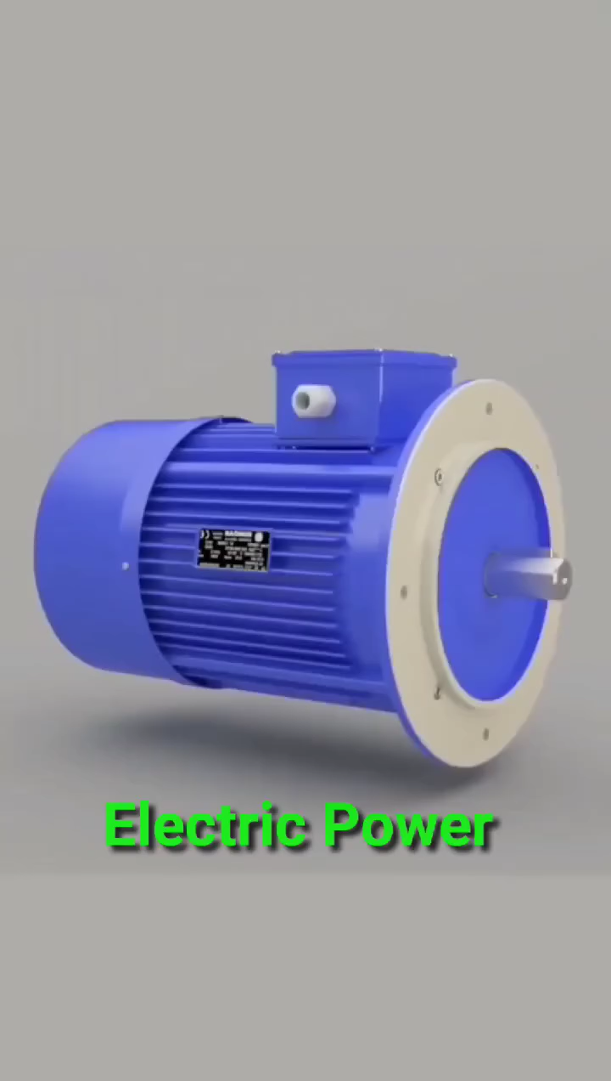
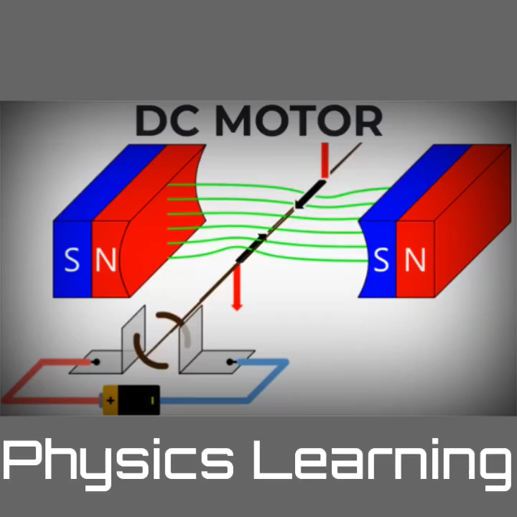
ANMATED VIDEO
Mechanical Department

Slide 9
Advantages and Disadvantages
AC Motors
Advantages:
Simpler and more robust construction.
Suitable for high power applications (like industrial use).
Lower maintenance requirements.
Easy to control speed with frequency converters (VFDs).
Disadvantages:
Less precise speed and torque control (without special controllers).
Starting torque can be lower for some types (e.g., squirrel cage induction).
Can be larger and heavier compared to DC motors.
Mechanical Department

Slide 10
DC Motor:
Advantages:
Excellent speed and torque control.
High starting torque, making them ideal for heavy loads.
Easier to reverse direction of rotation.
Disadvantages:
Higher maintenance due to brushes and commutators.
Less robust construction (more prone to wear and tear).
Generally, more expensive for equivalent power.
Not as suitable for very high-power applications as AC motors.
Mechanical Department

Slide 11
Types of Motor:
AC Induction Motors: The most common AC motors, using a rotating magnetic field to induce current in the rotor.
Synchronous AC Motors: Rotors rotate at the same speed as the rotating magnetic field, ideal for constant speed.
Brushed DC Motors: Simple design with brushes and commutators to switch current and create rotation.
Brushless DC (BLDC) Motors: Use electronic controllers instead of brushes, offering high efficiency and low maintenance.
Series DC Motors: High starting torque motors used in heavy traction systems like trains.
Shunt DC Motors: Provide stable speed control with constant magnetic fields, used in precise control applications.
Compound DC Motors: Combine series and shunt designs for balanced torque and speed control in dynamic applications.
Mechanical Department

Slide 12
Performance Characteristics:
Efficiency: AC induction motors achieve 80–95% efficiency; BLDC motors 85–90%; brushed DC motors lag at 70–85% due to brush friction and sparking.
Torque: AC motors offer moderate starting torque (150–200%), while DC motors (especially series DC) provide high starting torque (up to 400–500%).
Speed Control: AC motor speed depends on frequency and poles, requiring VFDs for flexibility; DC motors inherently allow smooth, wide-range speed control via voltage adjustments.
Maintenance: AC motors and BLDC motors need minimal maintenance; brushed DC motors require frequent brush replacement and commutator care.
Durability: AC motors and BLDC motors last longer due to fewer wear-prone parts, while brushed DC motors are less durable and need more servicing.
Mechanical Department

Slide 13
Applications
AC Motor Applications:
Industrial Machinery (Pumps, Fans, Compressors, Conveyors): Used for continuous, reliable operation with minimal maintenance.
HVAC Systems (Air Conditioners, Refrigerators, Ventilation): Powering household and commercial appliances efficiently.
Power Generation (Wind Turbines, Hydroelectric Plants): Ensures stable power generation with constant speed.
Household Appliances (Washing Machines, Dishwashers): Drives common home devices that need steady, cost-effective operation.
Mechanical Department

Slide 14
DC Motor Applications
Electric Vehicles (EVs – Cars, E-Bikes): Delivers high starting torque and precise control for electric drive systems.
Robotics and Automation (Robotic Arms, CNC Machines): Offers precise speed and torque control for automation tasks.
Small Appliances and Tools (Drills, Vacuum Cleaners, Toys): Powers portable devices and tools needing high torque.
Traction Systems (Trains, Trams): Provides strong starting torque to move heavy loads from rest.
Mechanical Department

Slide 15
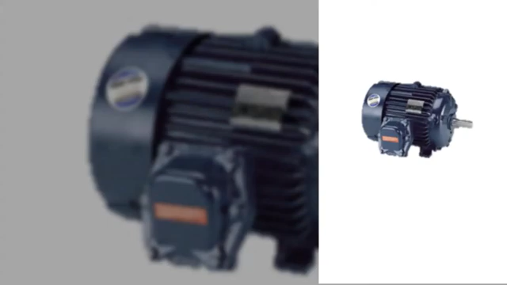
Difference and Applications
Mechanical Department

Slide 16
Current Trends:
Increased Adoption of High-Efficiency Motors.
Integration with Smart Systems (Industry 4.0)
Expansion of Variable Frequency Drives (VFDs)
Growth of Brushless DC (BLDC) and Permanent Magnet Synchronous Motors (PMSM)
Electrification of Transportation
Focus on Noise and Vibration Reduction
Customization for Niche Applications
Mechanical Department

Slide 17
Real life Scenarios:
Industrial Machinery: AC motors run pumps, fans, compressors, and conveyors reliably in factories.
HVAC Systems: AC motors power air conditioners and ventilation systems with quiet operation.
Power Generation: Synchronous AC motors maintain precise speeds in wind turbines and power plants.
Household Appliances: AC motors drive washing machines, dishwashers, and ceiling fans cost-effectively.
Electric Vehicles: Brushless DC motors deliver strong torque and efficiency in electric cars and e-bikes.
Robotics and Automation: DC motors enable precise speed and torque control in robotic arms and CNC machines.
Small Tools and Appliances: DC motors power drills, vacuum cleaners, and toys with portability and power.
Traction Systems: Series DC motors in trains and trams provide high starting torque for moving heavy loads.
Mechanical Department

Slide 18
Conclusion:
AC motors excel in efficiency and durability, ideal for heavy-duty and constant-speed industrial applications. DC motors offer superior torque and precise speed control, perfect for robotics, EVs, and portable tools. Trends highlight a shift to high-efficiency, smart, and brushless DC motors for dynamic, sustainable uses. This balance ensures electric motors will keep evolving to meet diverse performance and application needs.
Mechanical Department

Slide 19
The End
Mechanical Department

