Slide 1
Name of Group Members
Muhammad Usman Khan
Arsel Kaleem Abbasi
Ubaid Ahmed
Noor Muhammad Ali Awan
Talha Iqbal

Slide 2

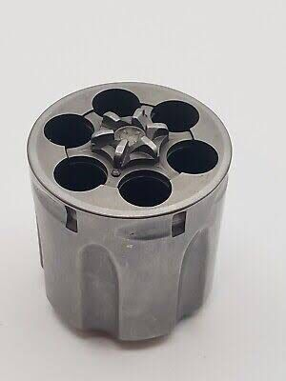
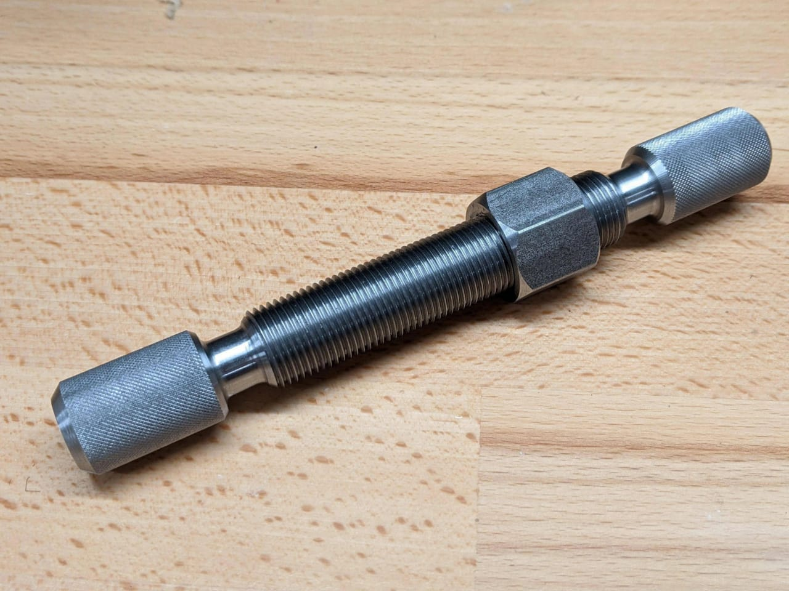
PROJECT PROPOSAL
Project Name:
Revolver with a threading Rod

Slide 3
We will create the Parts one by one
No.1
Revolver
No.2
Its Bearing
No.3
Bullets
No.4
Rod

Slide 4
Tools And Machines:
Lathe machine
Drilling Machine
Sanding Paper/File

Slide 5
Material Selection
Choose materials with appropriate strength and wear resistance (e.g., stainless steel for durability).
Manufacturing Process
For the Cylinder:
Machining: Use a lathe to achieve the cylindrical shape.
Drilling: Precisely drill the chambers for the revolver.
Finishing: Smoothen the surface using grinding or polishing.

Slide 6
For the Rod: Threading: If the rod needs threads, use a lathe or thread-cutting die. Knurling: Add a grip pattern (if required) using a knurling tool. Finishing: Polish to reduce friction.
Assembly
Fitment: Check the clearance between the cylinder and rod for smooth rotation.
Bearing/Bushing: Install a bearing or bushing if needed for reduced friction.
Securement: Add locking mechanisms (e.g., nuts, pins) if required to hold the parts in place.

Slide 7
Testing
Test the assembled parts for proper rotation and alignment. Make adjustments if necessary.
Now We will Discuss About the views of our Project,
And Lathe machine Functions.

Slide 8
3mm
D40mm
3mm
40mm
D9 mm
D10 mm

Slide 9
20mm
50mm
20mm
9mm
100mm

Slide 10
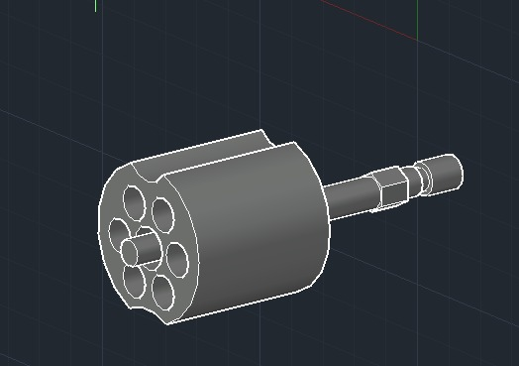
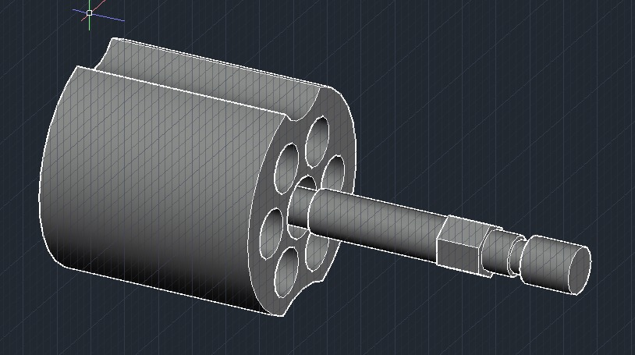
Final Assembly/ Joint Picture
From Front Isometric View
From Back Isometric View
Department of Mechanical Engineering

Slide 11
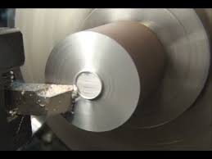
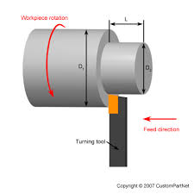
Lathe Machine Functions Include in it:
1. Facing
2. Turning
Department of Mechanical Engineering

Slide 12
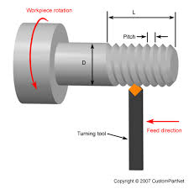
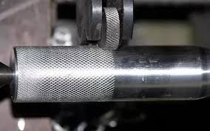
3.Threadig
4.Knurling
In this project,
We will do both internal and external threading.
Department of Mechanical Engineering

Slide 13
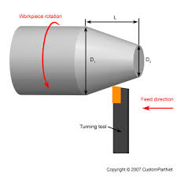
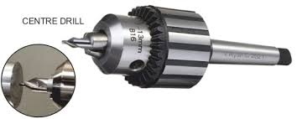
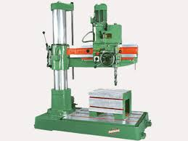
5.Drilling
6.Taper Turning
For Center Drill
Department of Mechanical Engineering

Slide 14
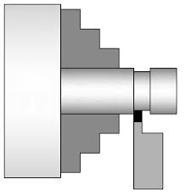

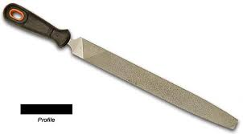
7.Grooving
8.Sandig/Filling
Department of Mechanical Engineering

Slide 15
External Threading
Knurling
Internal Threading
Taper
Turning
Department of Mechanical Engineering

Slide 16
Drilling
Department of Mechanical Engineering

Slide 17
Any Questions!!!
Department of Mechanical Engineering

Slide 18

The End
Department of Mechanical Engineering

