Slide 1

AgriAgent
Biopesticides that survive the sun
Autonomous SCADA for on-demand biopesticide formulation — Perception → Formulation → Safety → Actuator
Hackathon pitch · 3 minutes
Notes:
0:00 — Good afternoon. Biopesticides are safe for farmers, consumers, and export compliance — but sunlight destroys them within hours. AgriAgent formulates them on demand, at the moment of spraying, from live weather. One decision, made correctly, every cycle.

Slide 2

THE PROBLEM
Sunlight destroys the cure
8.8 h
37 h
72 h
Bright dry midday
Overcast morning
Night
UV 9.2 · 38 °C · 32 % RH
UV 2.1 · 24 °C · 75 % RH
UV 0 · 18 °C · 85 % RH
Bt half-life on the leaf — an 8× swing in a single day. A tank mixed at dawn is largely spent by afternoon, so farmers spray more often: higher cost, and the biological advantage is lost anyway.
Notes:
0:20 — The active ingredient is destroyed by exactly the conditions that make spraying useful. Same crop, same day: half-life swings from about nine hours at midday to three days at night. A fixed pre-mixed tank is guaranteed wrong.

Slide 3

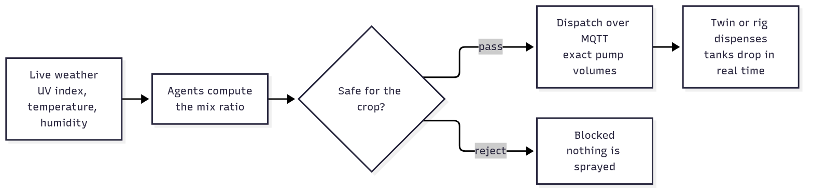
SCOPE
Not a platform. One decision.
Minimum data
Actionable output
Validated savings
UV index, temperature, humidity — pulled from live weather. Farmers never hand-enter data.
One MQTT payload: recipe → safety gate → exact pump volumes → the twin dispenses them.
Kinetics models tie the dynamic mix to the 90 % synthetic-volume-reduction target.
Notes:
0:45 — We deliberately dropped pest detection and yield prediction. The whole build answers one question: given the weather right now, what is the exact mix of biopesticide, UV stabilizer, and surfactant? Weather in, recipe out, safety-gated, dispensed.

Slide 4

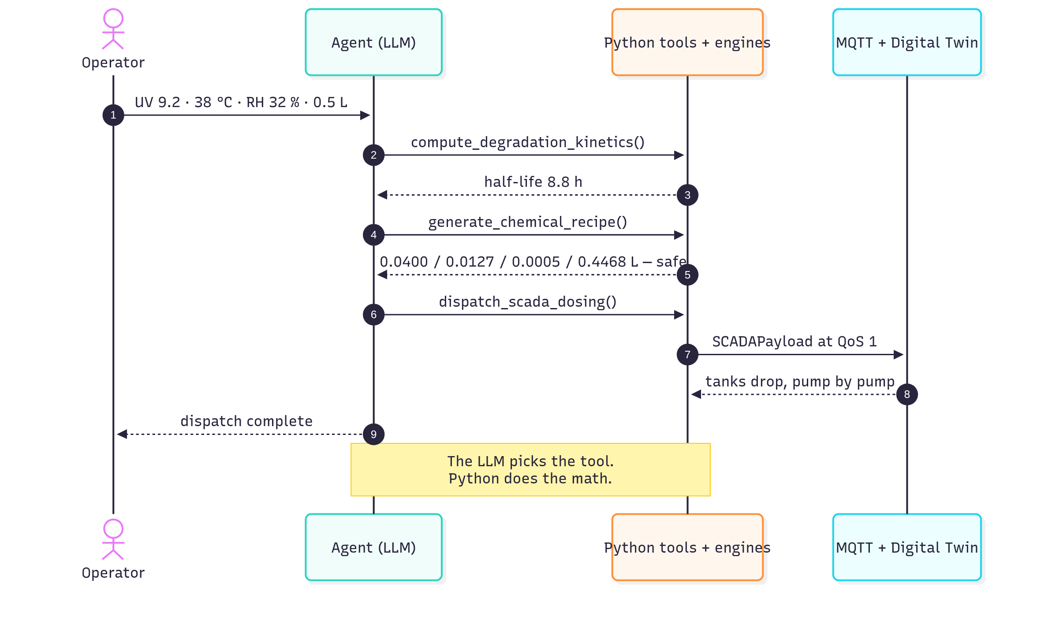
ARCHITECTURE
The LLM picks the tool. Python does the math.
Perception
reads telemetry, computes the degradation half-life
Formulation
exact litre setpoints for all four channels
Safety
machine-readable rejections — nothing unsafe is published
SCADA
pump runtimes, MQTT dispatch at QoS 1
OpenAI Agents SDK · native handoffs · every number from deterministic engines — the model never does arithmetic
Notes:
1:05 — Three named agents wired with native handoffs. The LLM decides which tool to call and when to hand off — that is all it decides. Every number you will see today comes from deterministic Python engines, validated by Pydantic at every boundary.

Slide 5

PROOF
The chemistry is not hallucinated
Confirmed kinetics
$ python src/mcp_server_scada.py --selftest
[PASS] k_baseline: got=0.078508
[PASS] half_life: got=8.829
[PASS] bio_l: got=0.04
[PASS] lignin_pct: got=2.55
[PASS] surf_pct_capped: got=0.0993
[PASS] rejects_overcap_surfactant: True
[PASS] pump1_duration: got=4.0
[PASS] all_runtimes_under_30s: True
[PASS] lignin_cap: got=3.0
… 21 checks
SELFTEST PASSED
k = k₀·(1+α·UV)
·e^(−(Ea/R)(1/T−1/T₀))
UV photolysis × Arrhenius thermal · k₀ = ln(2)/48 h⁻¹
lignin = min(3.0 %, 0.25 % + 0.25 %·UV)
UV stabilizer, capped at the solubility limit
surfactant = min(0.20 %,
0.05 %·(1+1.2(1−RH/100))·(T/293.15)^1.5)
wetting agent, capped against phytotoxicity
runtime = volume ÷ flow
0.01 / 0.01 / 0.01 / 0.05 L/s — never accepted from a caller
Notes:
1:25 — This is the credibility anchor. The engines are pure standard-library math — zero third-party dependencies — and the self-test gate proves the numbers on every run: 21 checks, from the degradation constant to the guardrail rejections.

Slide 6

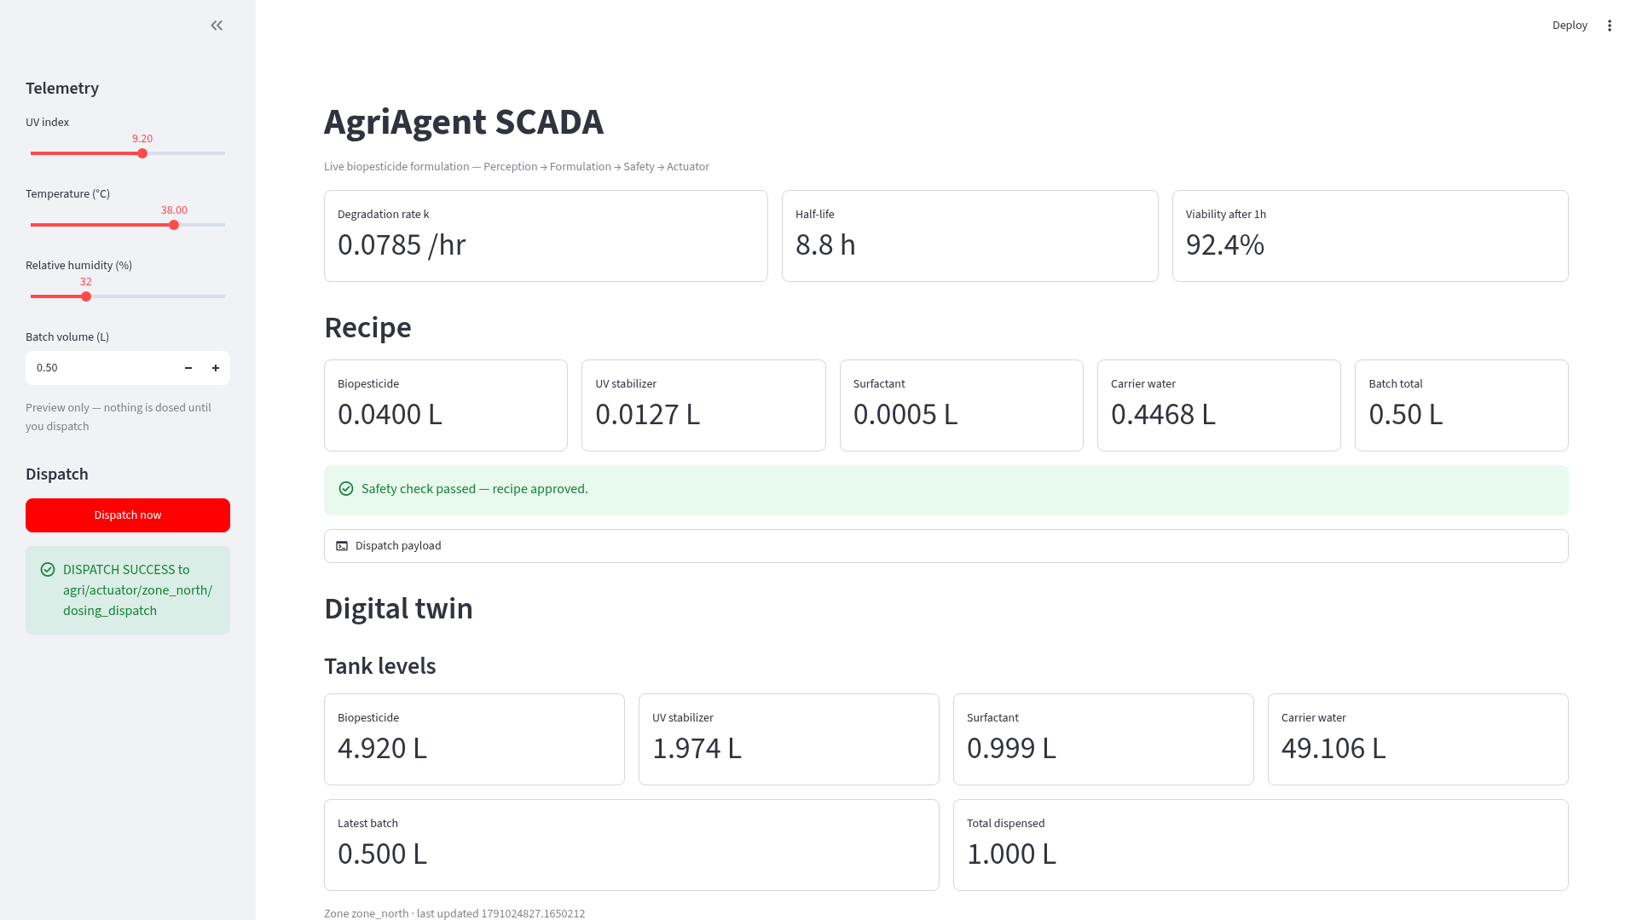
LIVE
One dispatch, end to end
The recipe
bio 0.0400 L · stabilizer 0.01275 L · surfactant 0.0005 L · water 0.44675 L
The runtimes
4.000 s · 1.275 s · 0.050 s · 8.935 s — computed from the calibrated flow table
The feedback
tank state published after every pump, then DISPATCH_COMPLETE
Notes:
1:45 — [SWITCH TO THE LIVE DASHBOARD] Watch the tanks fall as each pump actuates — state is published after every pump, not just at the end. The recipe and runtimes you see are exactly what the payload commanded. [click Dispatch now, wait ~2 s, point at the falling bars and the DISPATCH_COMPLETE event]

Slide 7

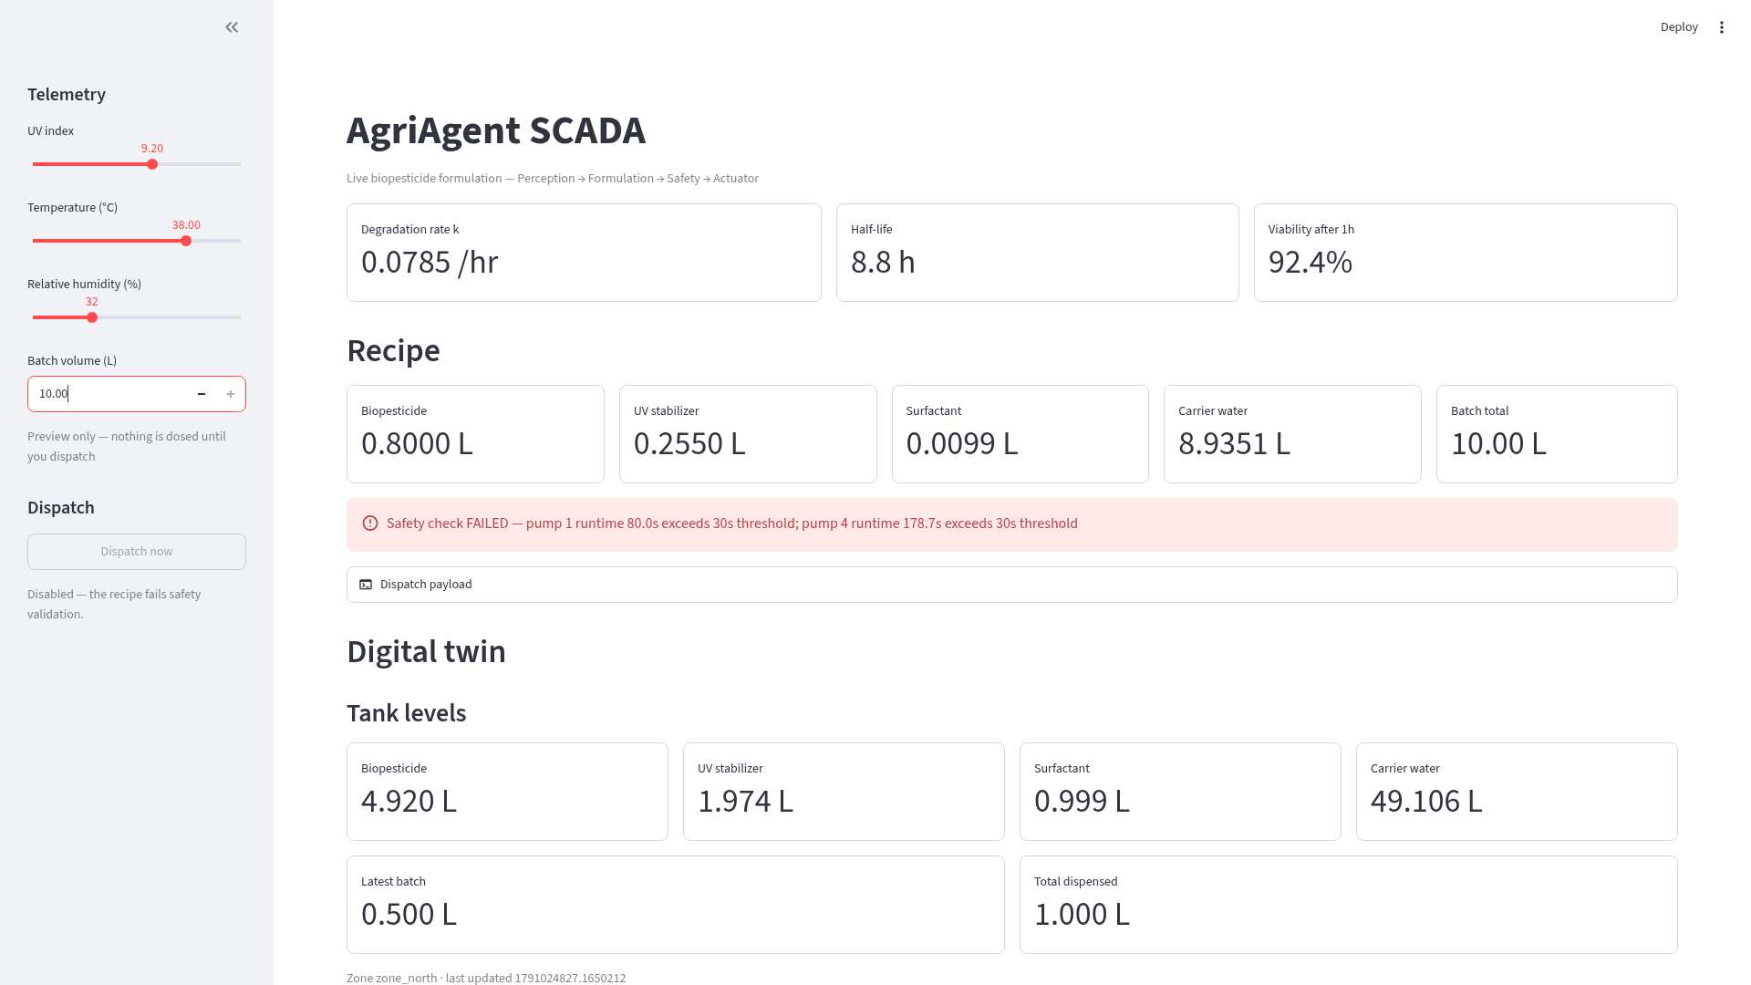
SAFETY
Refusing is the feature
10 L batch requested
pump 1 runtime 80.0 s, pump 4 runtime 178.7 s — both breach the 30 s thermal cap
Blocked before you can click
the dispatch button disables itself while the recipe fails validation
Nothing is published
no MQTT payload, tanks do not move — the rejection is machine-readable
Notes:
2:10 — [SET BATCH TO 10 L ON THE LIVE DASHBOARD] Now the dangerous request. The button disables itself before I can even try, with the exact rule that failed. A system that refuses is what makes unattended dosing acceptable — this matters more than the success case.

Slide 8

IMPACT
One decision, made correctly, every cycle
90 %
PKR 45,000
7–14×
synthetic-volume reduction target
per-acre saving (cost-model estimate)
half-life extension, lignin encapsulation (literature)
Honest limits — targets, not measurements
The 90 % and PKR figures are literature-backed targets and cost-model estimates — not results this build measured.
The physical ESP32 rig is not built: the digital twin is the demo target, and firmware inherits the same MQTT contract.
The twin simulates timed pump actuation and tank depletion — not fluid mechanics.
AgriAgent · Autonomous SCADA for on-demand biopesticide formulation
Notes:
2:35 — The commercial case: up to 90 % less synthetic volume, about PKR 45,000 per acre, and export corridors protected by residue compliance. And the honest limits, because the numbers we can prove live are the kinetics, the recipe, the guardrail, and the dispatch — the savings are literature-backed targets. Thank you.

