Slide 1
SIL10: APPLICATION Details available at zulfr.com
Issue:
Reliability models for Safety Instrumented Systems (SIS) historically rely on stationary parameters. Constant failure rates, fixed diagnostic coverage, and invariant common-cause factors establish a baseline for safety integrity. These models provide a necessary foundation for initial design. They represent a snapshot in time.
Solution:
In the physical reality of industrial operation, safety integrity is not a static attribute. It is a dynamic state. It is continuously reshaped by the cumulative effects of operational demand, environmental stressors, and specialized maintenance intervals. This framework introduces a theory of Temporal Safety Integrity. At its core is the concept of Mosaic Aging.

Slide 2
Market Comparison Matrix
Feature | Competitors | SIL10
Update Frequency | Annual | Real-time (30 sec)
SIL Vision | Static "SIL 2" | Dynamic SIL(t) trajectory
Degradation Visibility | None | 5 factors shown separately
Common-Cause Tracking | Assumed β=0.10 | Dynamic β(t) evolution
Diagnostic Coverage | Constant | Drifting DC(t) tracked
Forecasting | None | 36-month prediction
Uncertainty Quantification | None | 100-scenario Monte Carlo
Action Recommendations | None | Ranked by ROI

Slide 3
Market Comparison Matrix
Feature | Competitors | SIL10
Audit Trail | Paper-based | Immutable SHA-256 hash chain
Compliance Proof | Annual audit | 24/7 continuous monitoring
IEC 61508 Mapping | Manual verification | Automatic per calculation
Recovery Capability | Manual/untested | Tested, verified, automated
Regulatory Defense | "We assessed it" | "14.2 M proof entries available"
Cost-Benefit Analysis | Qualitative | Quantitative (ROI calculation)
Production Integration | Export/manual | Native OPC-UA, MQTT, REST APIs

Slide 4
Motivation of SIL → SIL(t)
Consider SIL10 now, or wait for an incident to force a 360‑degree realization. One path is proactive and other is painful.
It Measured in:
Loss of life,
Loss of money,
Adverse consequences no plant can afford.

Slide 5
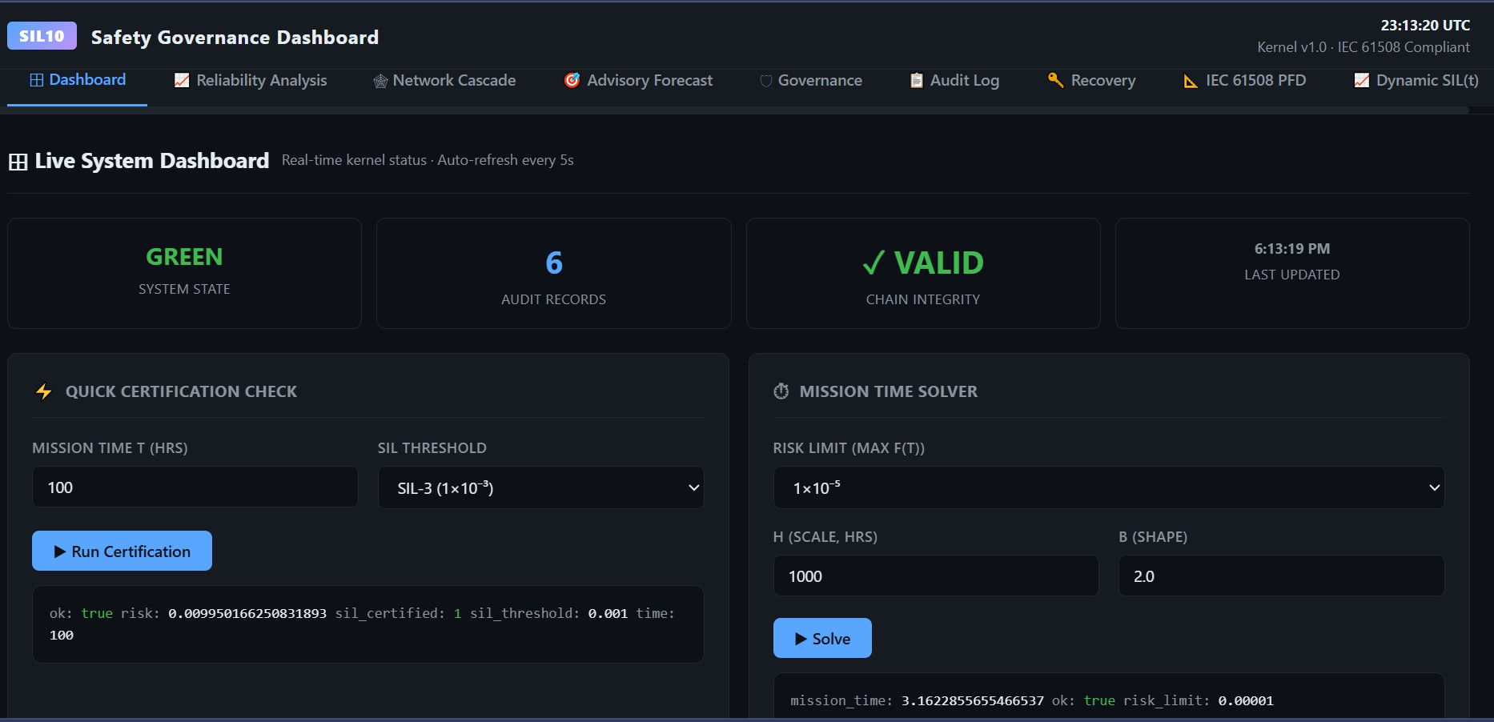
Tab 1 = Main Dash Board 1/2
Plant-wide safety health at a glance Shows: Risk score (%), loop count by SIL, alert feed, 90-day trend Graphs: Risk timeline, SIL distribution (donut), alert feed Live Connection: Real-time, <2 sec latency (Kafka Data Engineering)

Slide 6
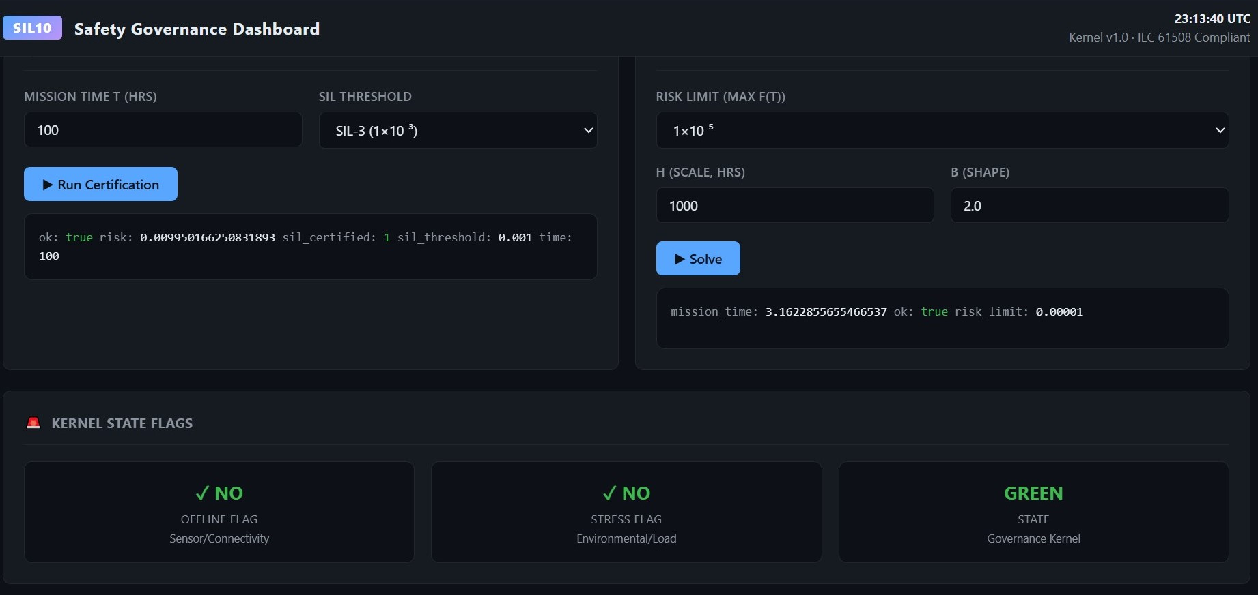
Tab 1 = Main Dash Board 2/2
Plant-wide safety health at a glance Shows: Risk score (%), loop count by SIL, alert feed, 90-day trend Graphs: Risk timeline, SIL distribution (donut), alert feed Live Connection: Real-time, <2 sec latency (Kafka Data Engineering)

Slide 7
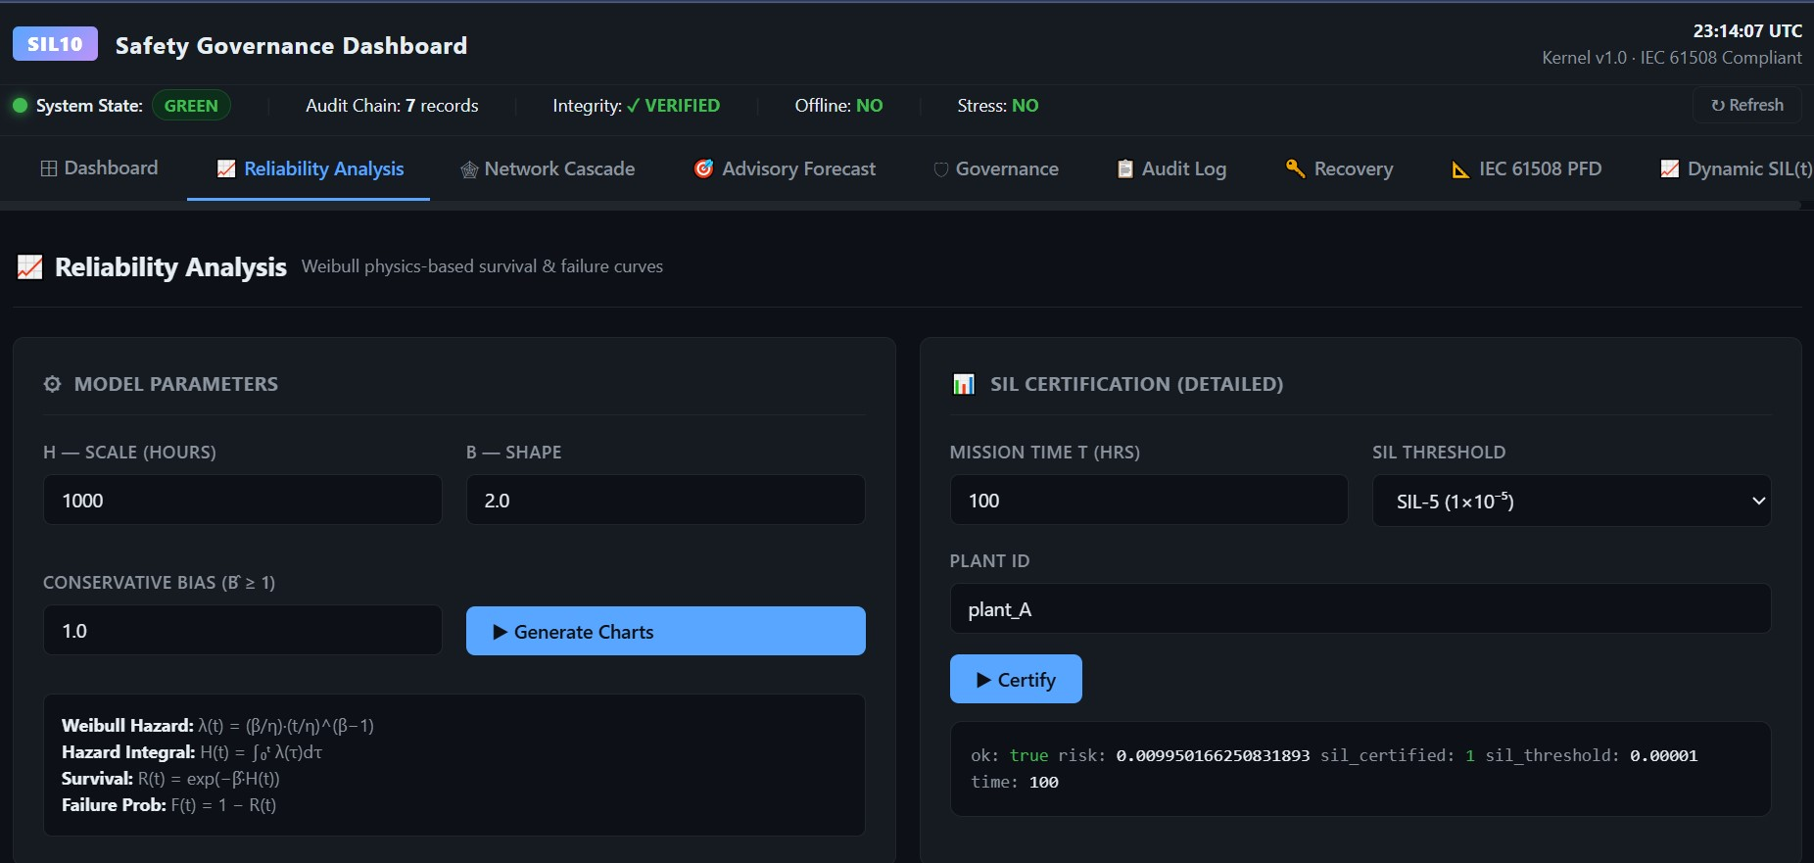
Tab 2 = Reliability Analysis 1/2
What: Why is SIL degrading? Detailed component breakdown Shows: λ_D, DC, β, 5 degradation factors per channel, 1oo2 effectiveness Graphs: Hazard rate evolution, factor stacking chart, DC drift, β(t) coupling

Slide 8
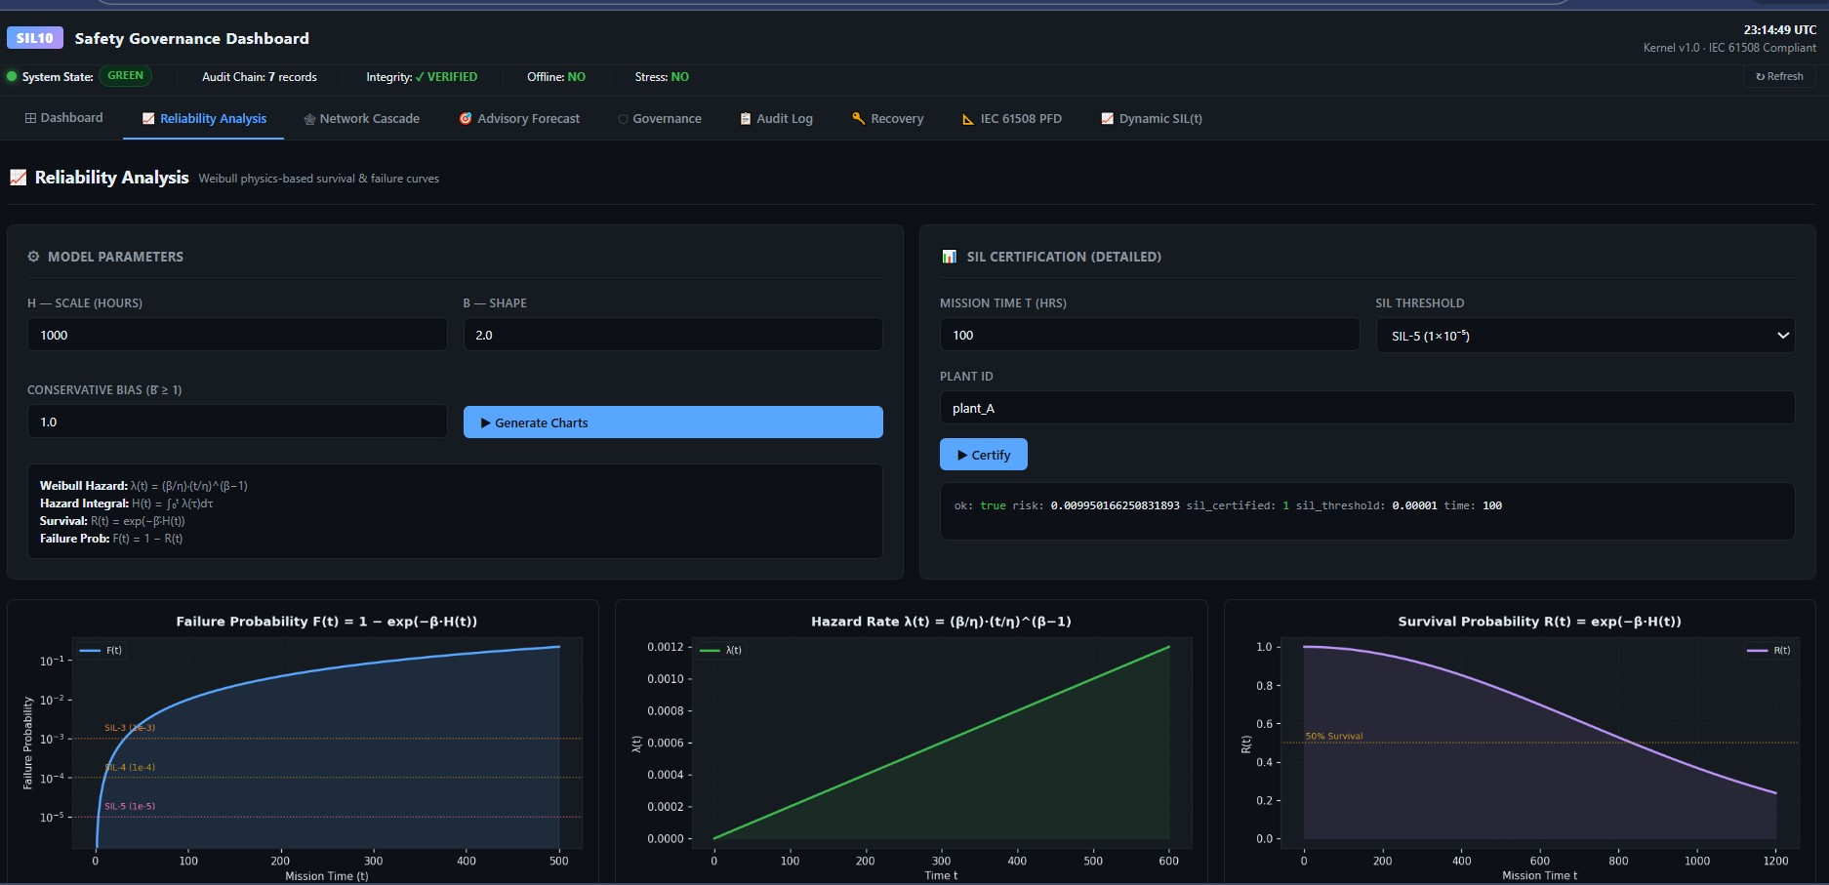
Tab 2 = Reliability Analysis 2/2
What: Why is SIL degrading? Detailed component breakdown Shows: λ_D, DC, β, 5 degradation factors per channel, 1oo2 effectiveness Graphs: Hazard rate evolution, factor stacking chart, DC drift, β(t) coupling

Slide 9
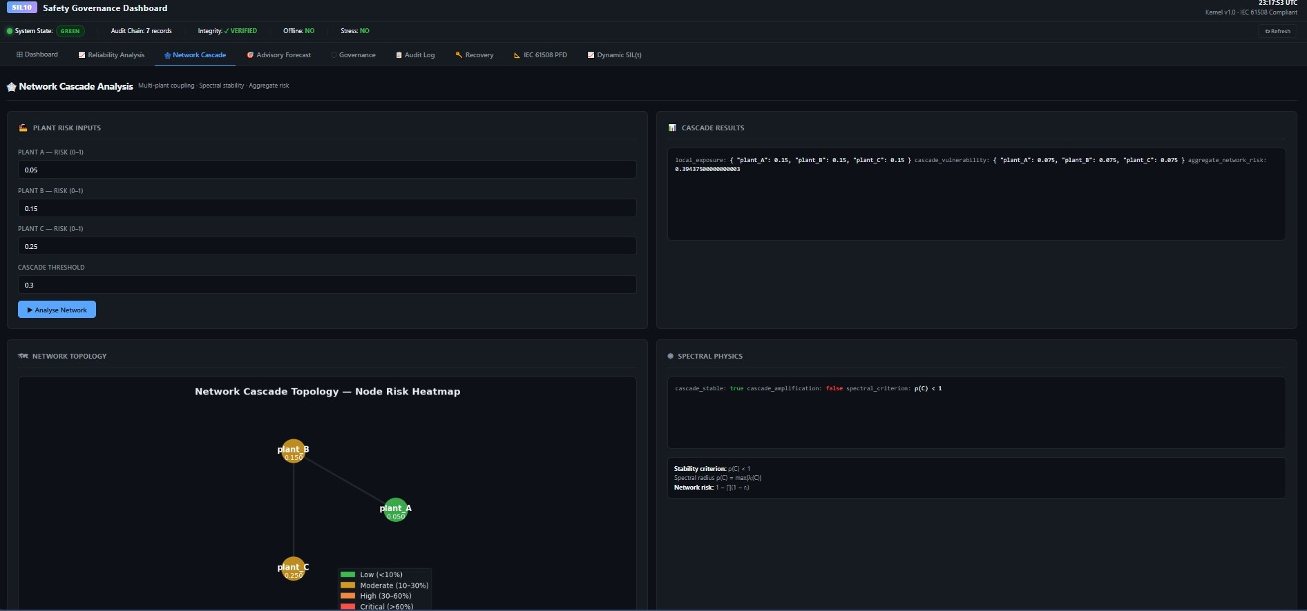
TAB 3: NETWORK CASCADE
What: If component X fails, what else dies? Shows: Dependency graph (component → loop → plant), cascade impact (SIL drops), vulnerability score Graphs: Network topology map, failure impact analysis, timeline to criticality

Slide 10
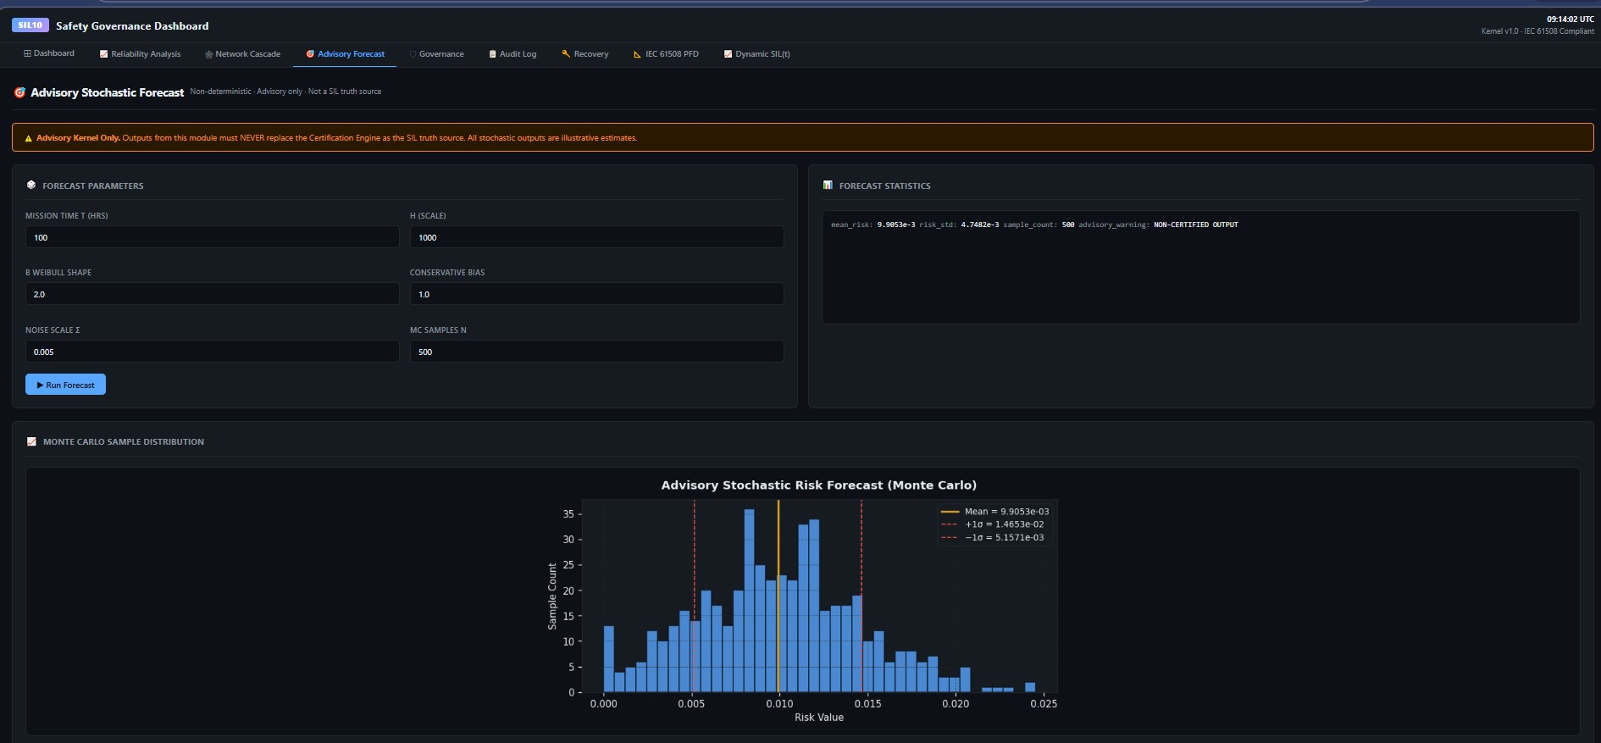
TAB 4: ADVISORY FORECAST
What: What will SIL be in 36 months? What should you do? Shows: SIL trajectory, uncertainty bands (5th-95th %ile), action plan with cost/ROI Graphs: SIL forecast curve, Monte Carlo distribution (100 scenarios), recommendation panel, intervention impact

Slide 11
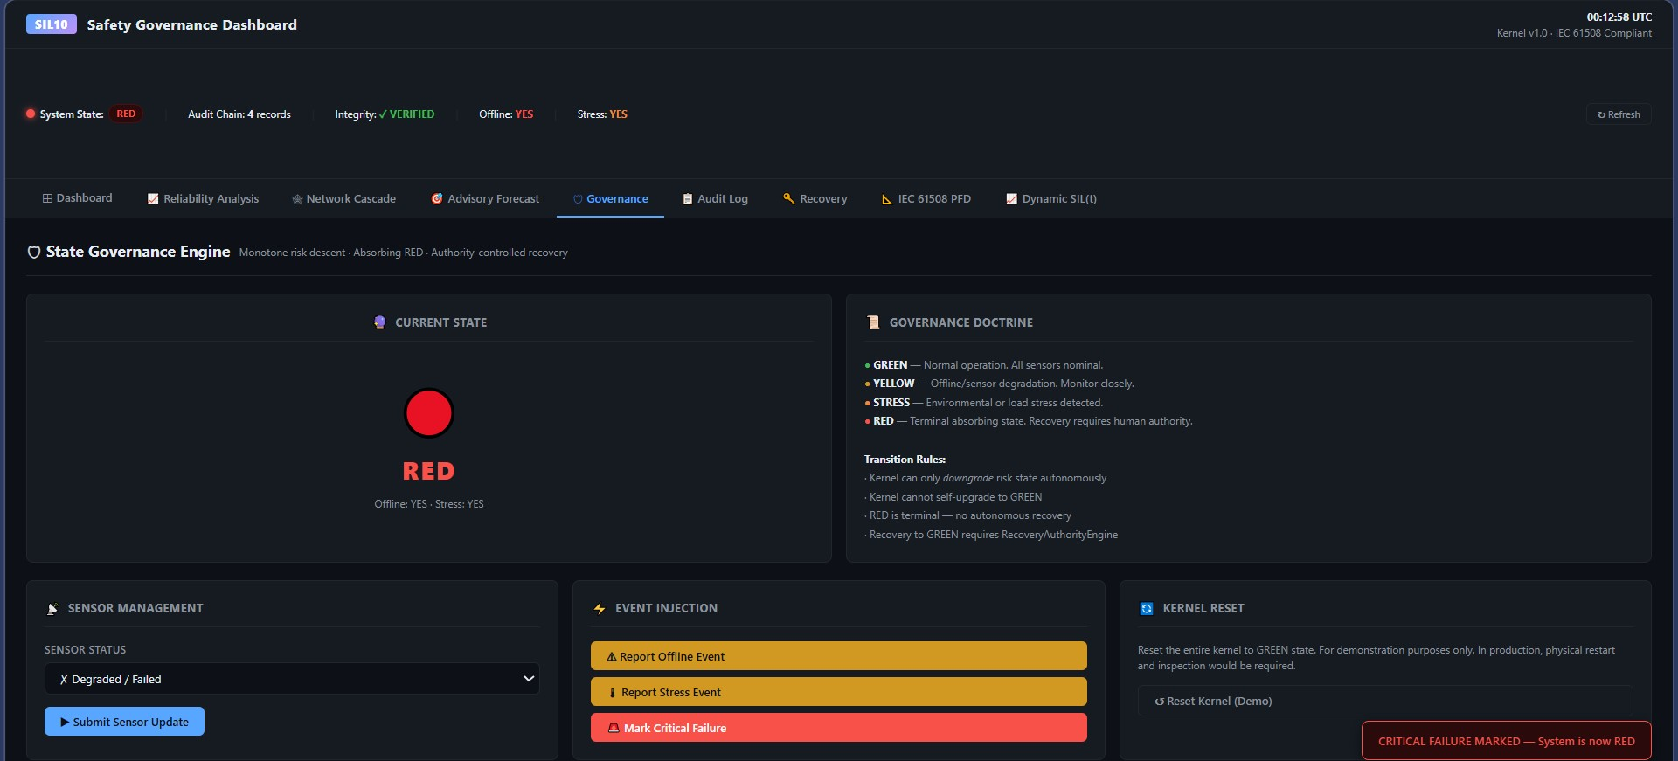
TAB 5: GOVERNANCE
What: Prove to auditors you're monitoring continuously Shows: Compliance status, monitoring duration, calculation count, alert/action logs, SIL maintenance score Graphs: Compliance timeline, governance status panel, metrics dashboard

Slide 12
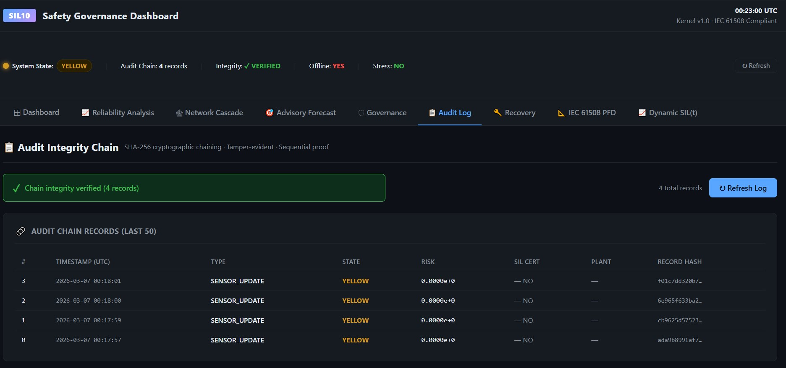
TAB 6: AUDIT LOG
What: Immutable record of every decision (SHA-256 hashed) Shows: Complete calculation history, input state, output state, change from previous, hash chain verification Graphs: Timeline browser, entry detail view, data integrity verification

Slide 13
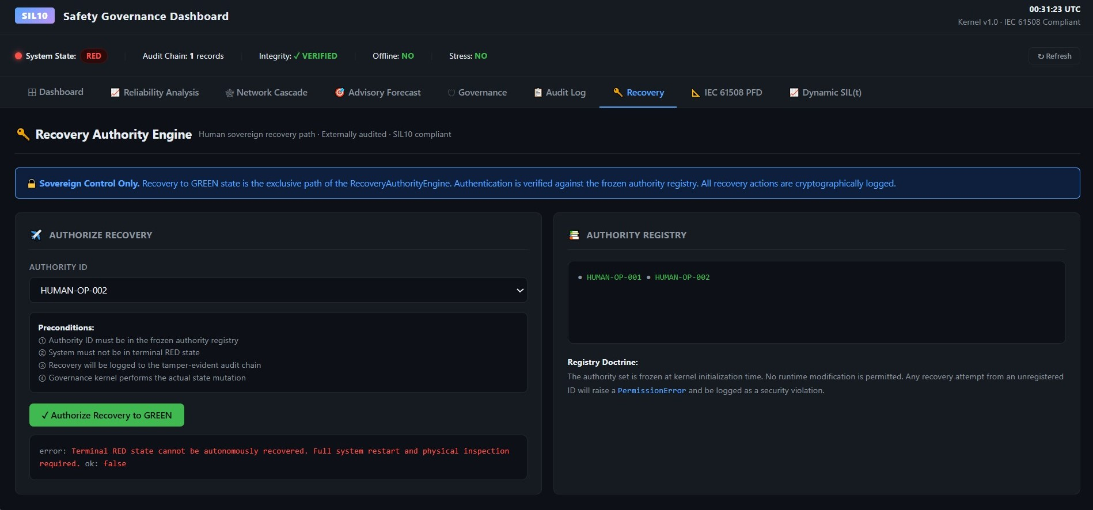
TAB 7: RECOVERY
What: System crashed? How do we restore? Shows: Backup status (PostgreSQL, InfluxDB, Kafka), RTO/RPO, recovery procedures, integrity verification Graphs: Backup timeline, restoration procedure flow, Kafka offset tracking

Slide 14
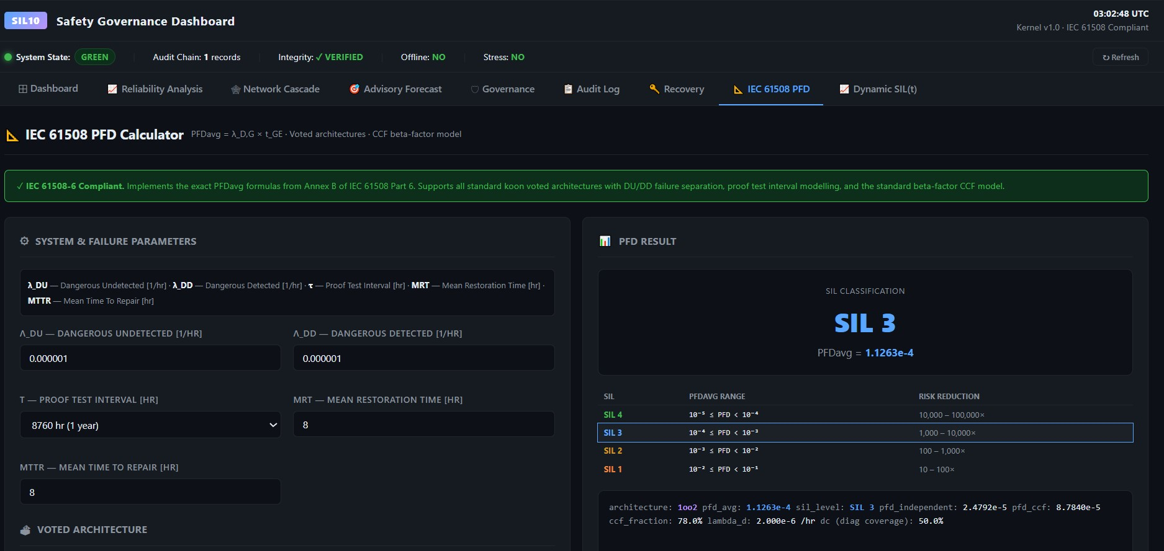
TAB 8: IEC 61508 PFD 1/3
What: Translate our calculations to official IEC 61508 terminology Shows: Formula mapping, step-by-step calculation per IEC standard, SIL classification audit certificate Graphs: Formula reference display, compliance checklist, architecture-specific calculation flow

Slide 15
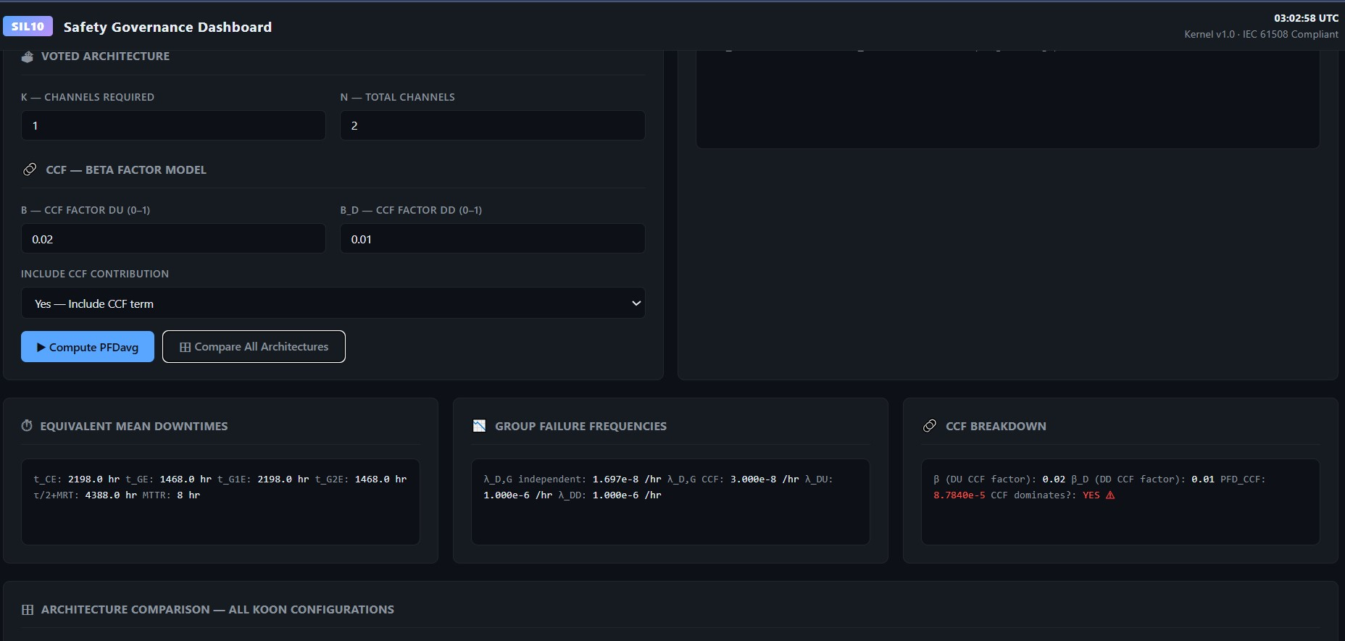
TAB 8: IEC 61508 PFD 2/3
What: Translate our calculations to official IEC 61508 terminology Shows: Formula mapping, step-by-step calculation per IEC standard, SIL classification audit certificate Graphs: Formula reference display, compliance checklist, architecture-specific calculation flow

Slide 16
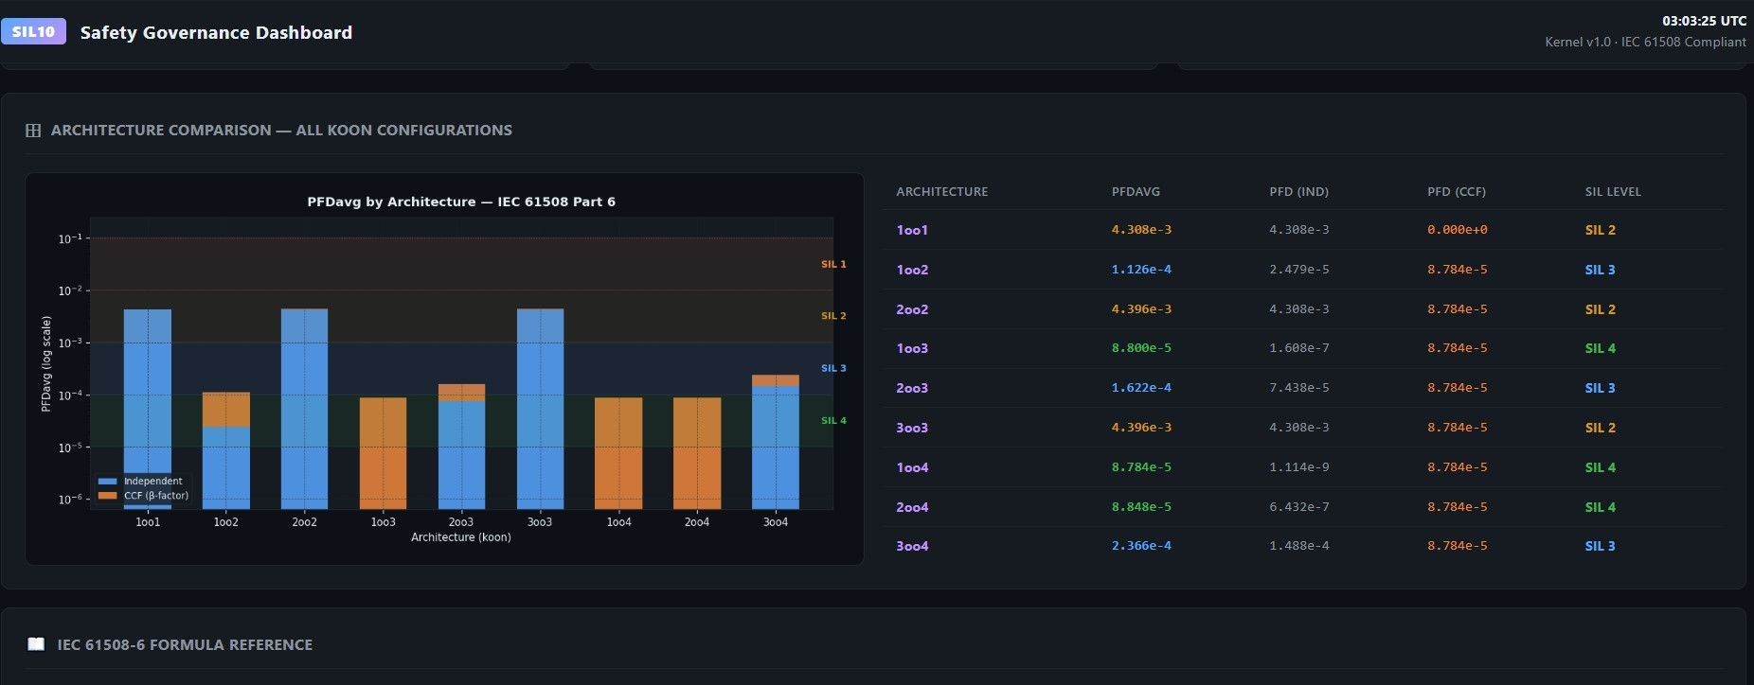
TAB 8: IEC 61508 PFD 3/3
What: Translate our calculations to official IEC 61508 terminology Shows: Formula mapping, step-by-step calculation per IEC standard, SIL classification audit certificate Graphs: Formula reference display, compliance checklist, architecture-specific calculation flow

Slide 17
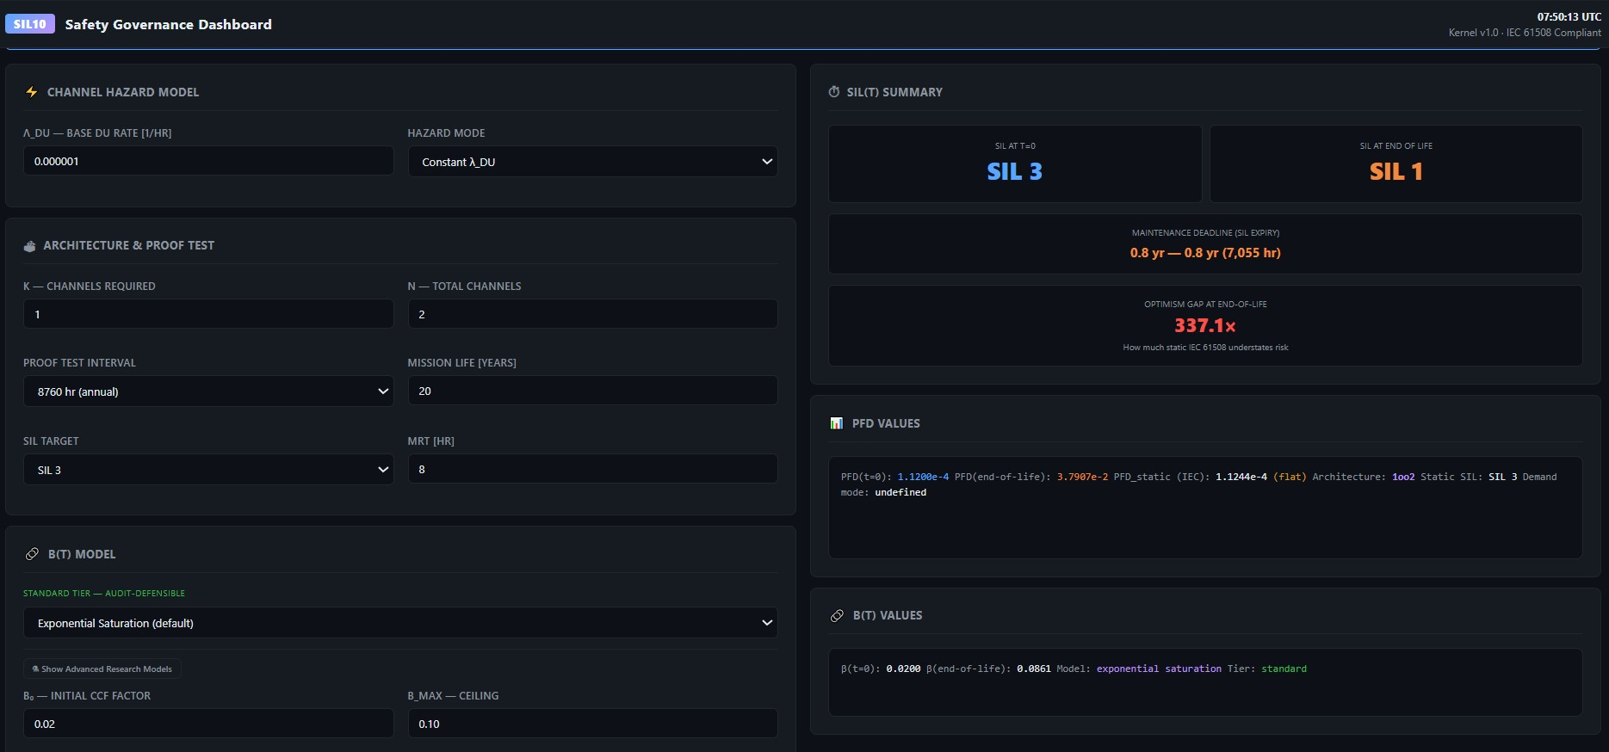
TAB 9: DYNAMIC SIL(t)
What: Not "what is SIL today" but "what will SIL be" → strategic vision for 36 months Shows: SIL trajectory with decision gates, uncertainty bands, critical thresholds marked, year-by-year snapshots Graphs: Main SIL(t) trajectory, Monte Carlo distribution, comparison (today vs year 1 vs year 5), intervention impact

