Slide 1


DAIS-10 By Usman Zafar Ph.D
Theory:
https://zenodo.org/records/18684292
DOI = 10.5281/zenodo.18684292
Application:
https://github.com/usman19zafar/DAIS10_Pyton_Library_Project

Slide 2
“Any new idea is nothing more than a new combination of old elements. The ability to make those new combinations depends on our ability to see relationships and connecting dots. Some are able to do this because they’ve had more experiences, or thought more about those experiences, than other people. They are better at connecting the dots because they have more dots to connect. Most people may know a lot, but only about a very narrow field. So they don’t have enough dots to connect, and they end up with predictable, linear solutions.”
Steve Jobs

Slide 3
DAIS-10 Introduction
DAIS‑10 (Data Attribute Importance Standard) is a meaning centric framework that classifies data attributes by their qualitative importance across a continuous, fading spectrum.
DAIS 10 is still a baby, means it is in its development Stages.
It is based of 8 engines right now inspired by mathematical derivations of data realities.
Future of DAIS-10 is Universal with unlimited potential of adoptability and customization
Humble Efforts by Usman Zafar with his AI Companions
(Theoretical Support Co-Pilot & Development Support Claude)

Slide 4
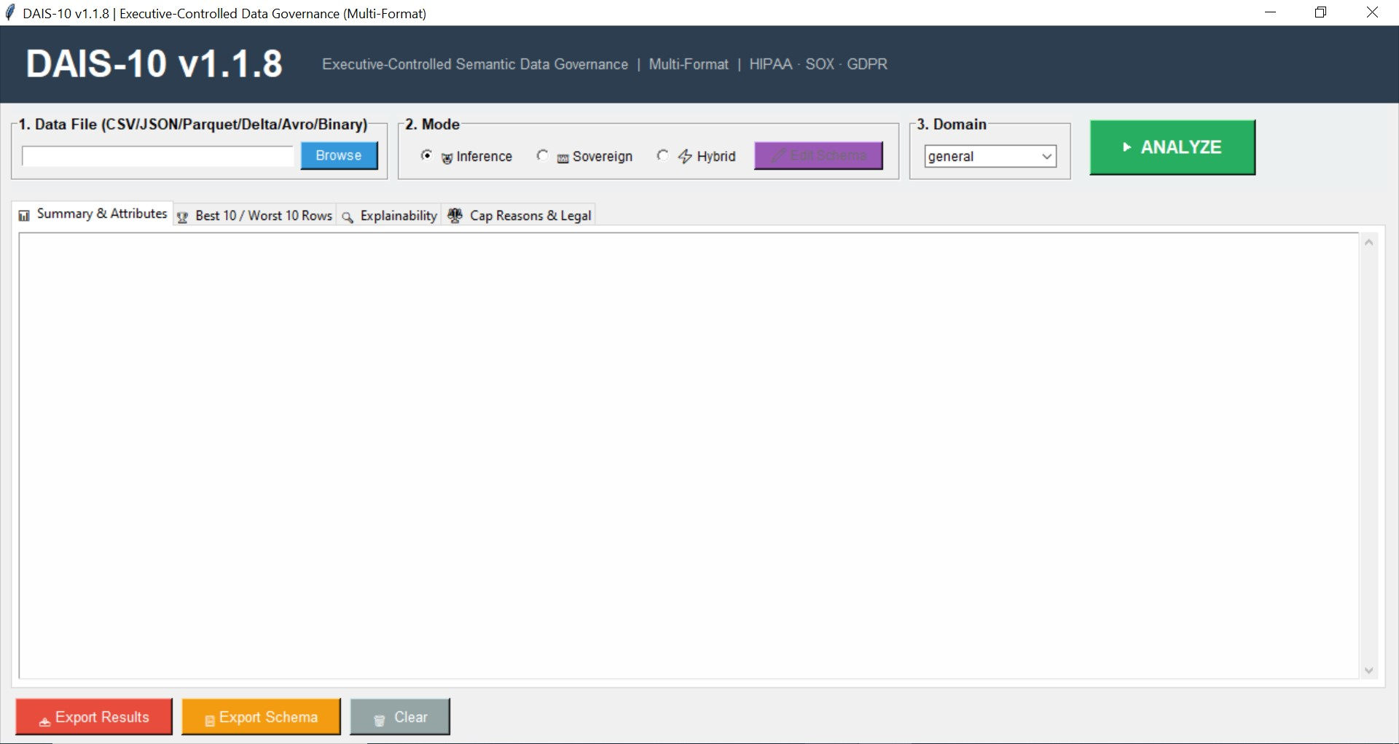
Main Display Window
Version 1.1.8
Executive Controlled Semantic Data Governance

Slide 5
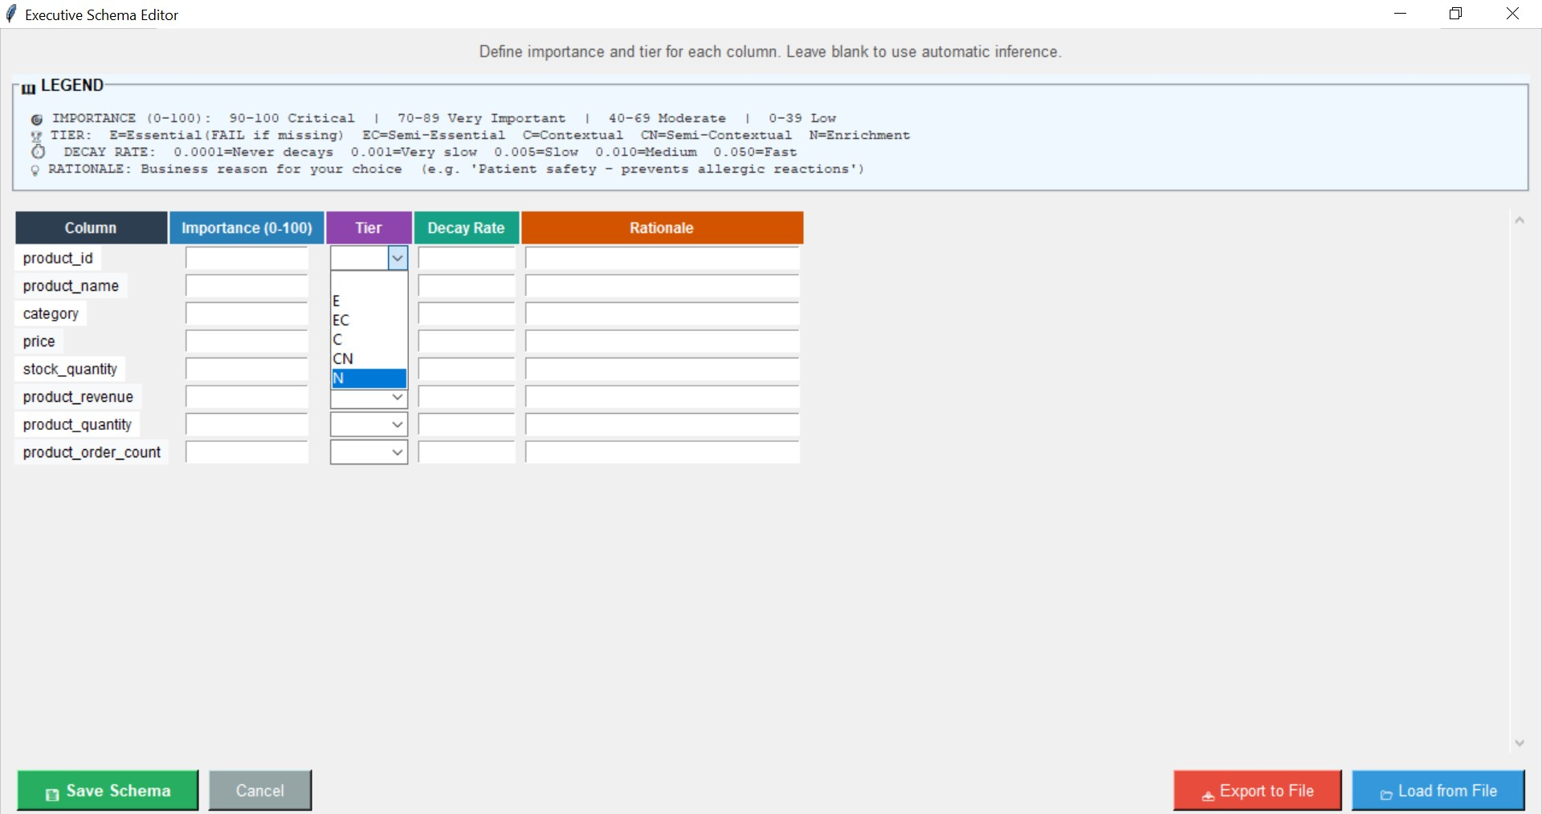
Executive Schema Editor
For Legal and Governance purpose, Data executive can customize their data by assigning values to their schema. In simplest form this is core reason of DAIS10

Slide 6
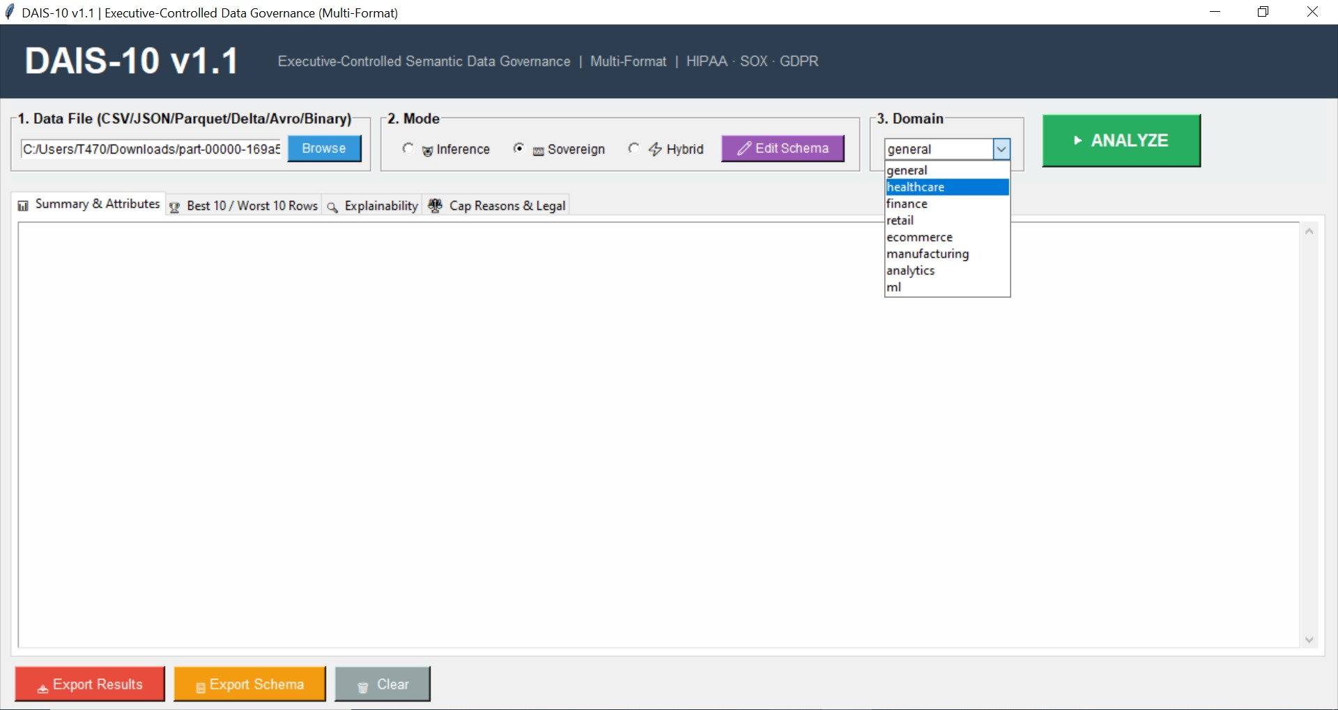
Explaining Domain
The industries those are included in DAIS 10 are Healthcare, Finance, Retail, E-commerce, Manufacturing, Analytics and Machine-Learning

Slide 7
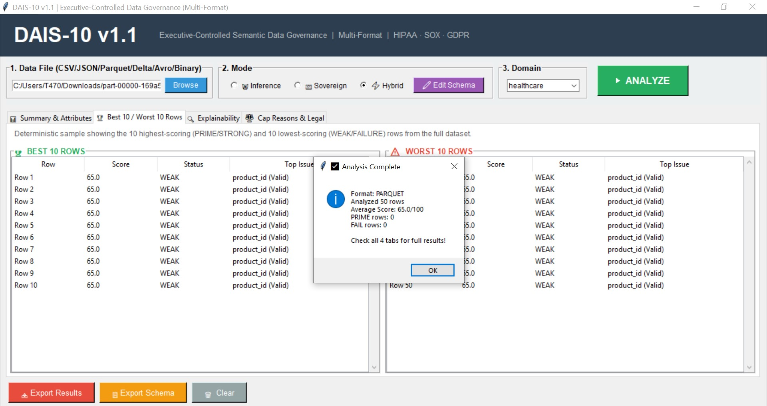
Analysis Completion Message
Analysis complete window and Summary Statistics
Results when Schema was not customized

Slide 8
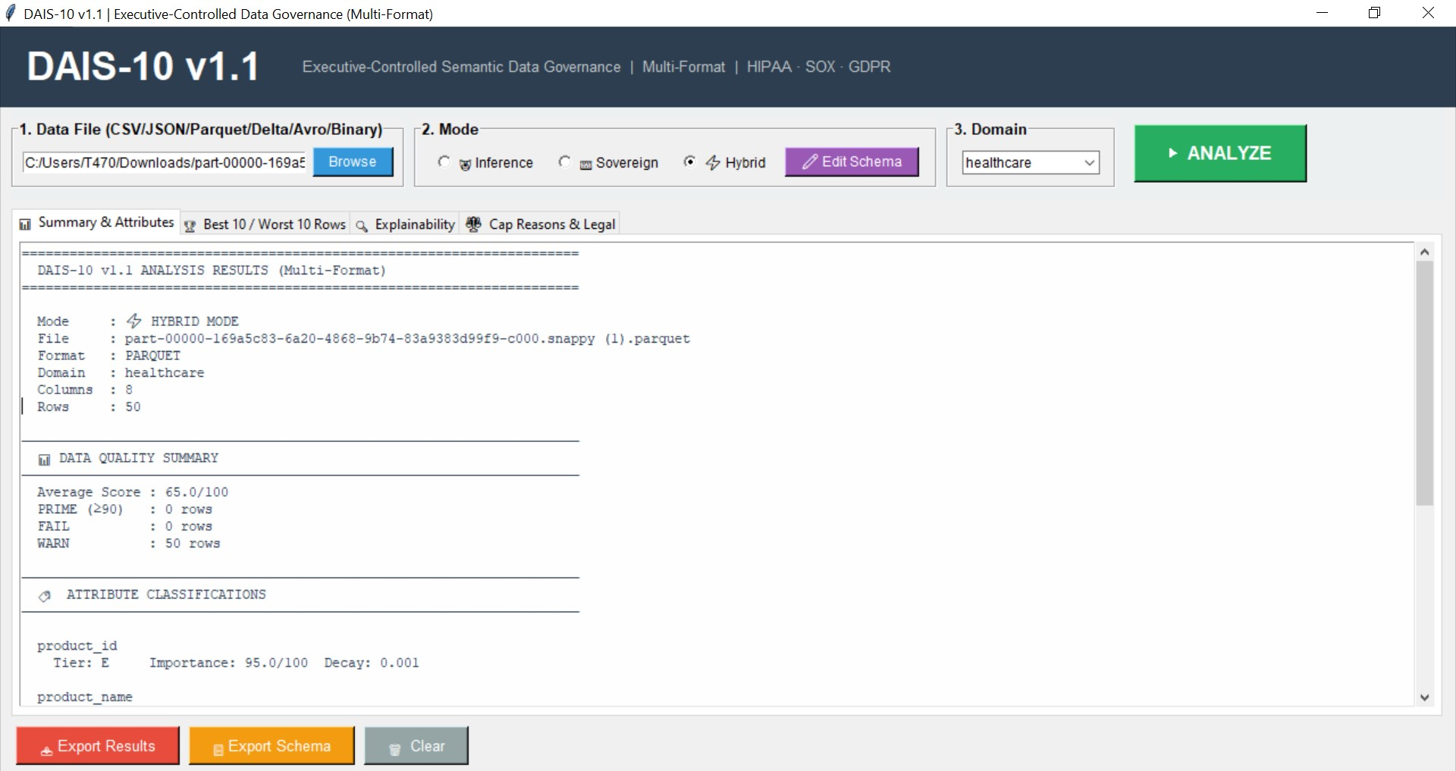
Report Example = Summary & Attributes
Report on Data derived from Parquet file format
Hybrid Mode used for Edit Schema
Industry Type = Healthcare

Slide 9
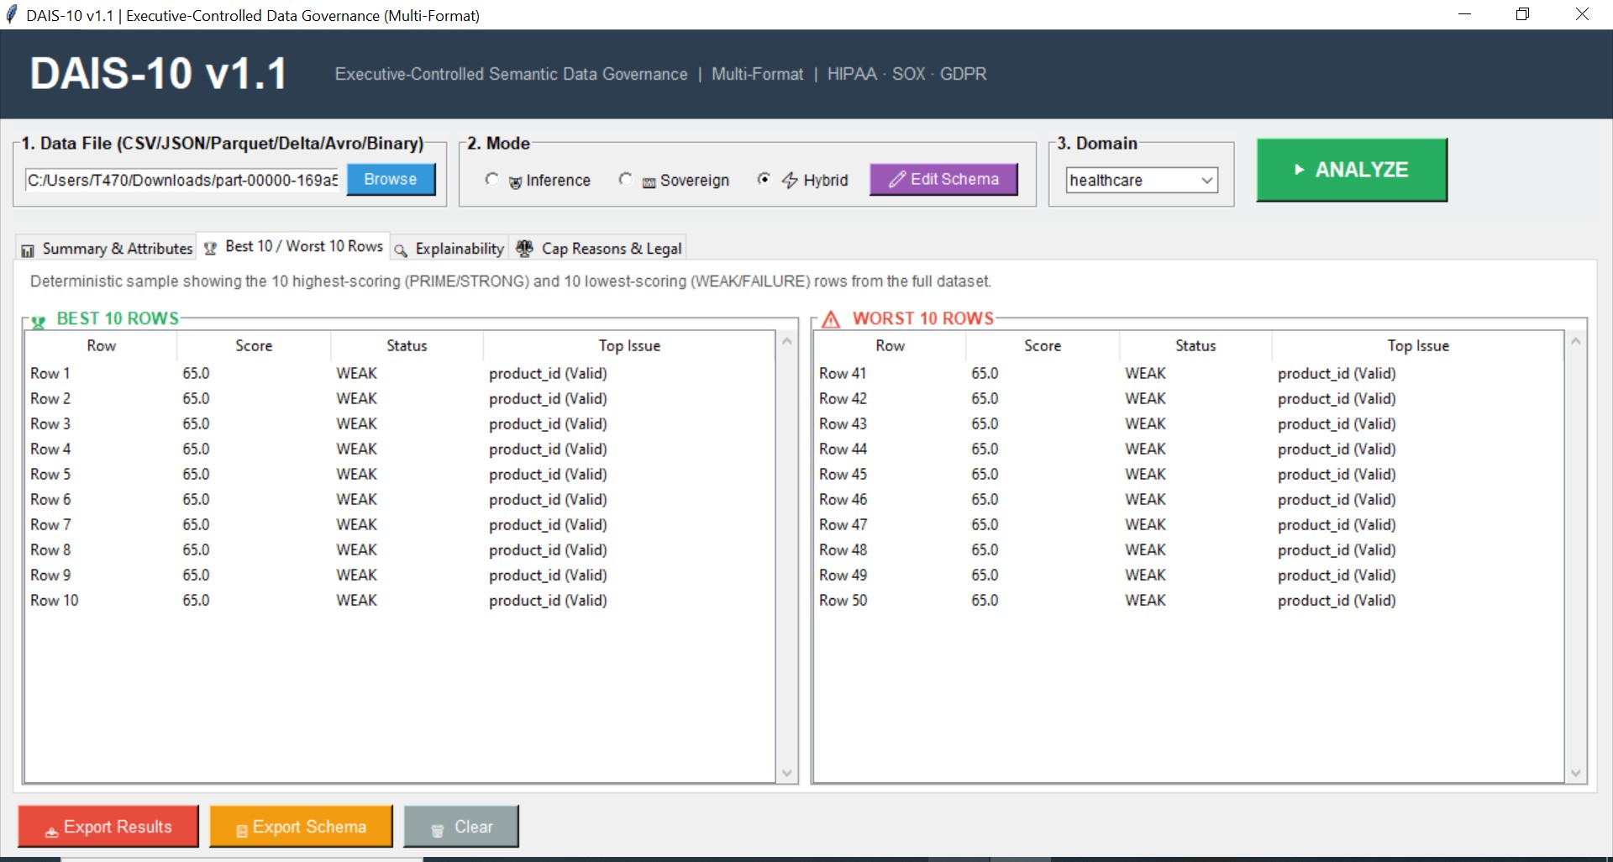
Report Format 2
Comparison of Best 10 and Worst 10 Rows

Slide 10
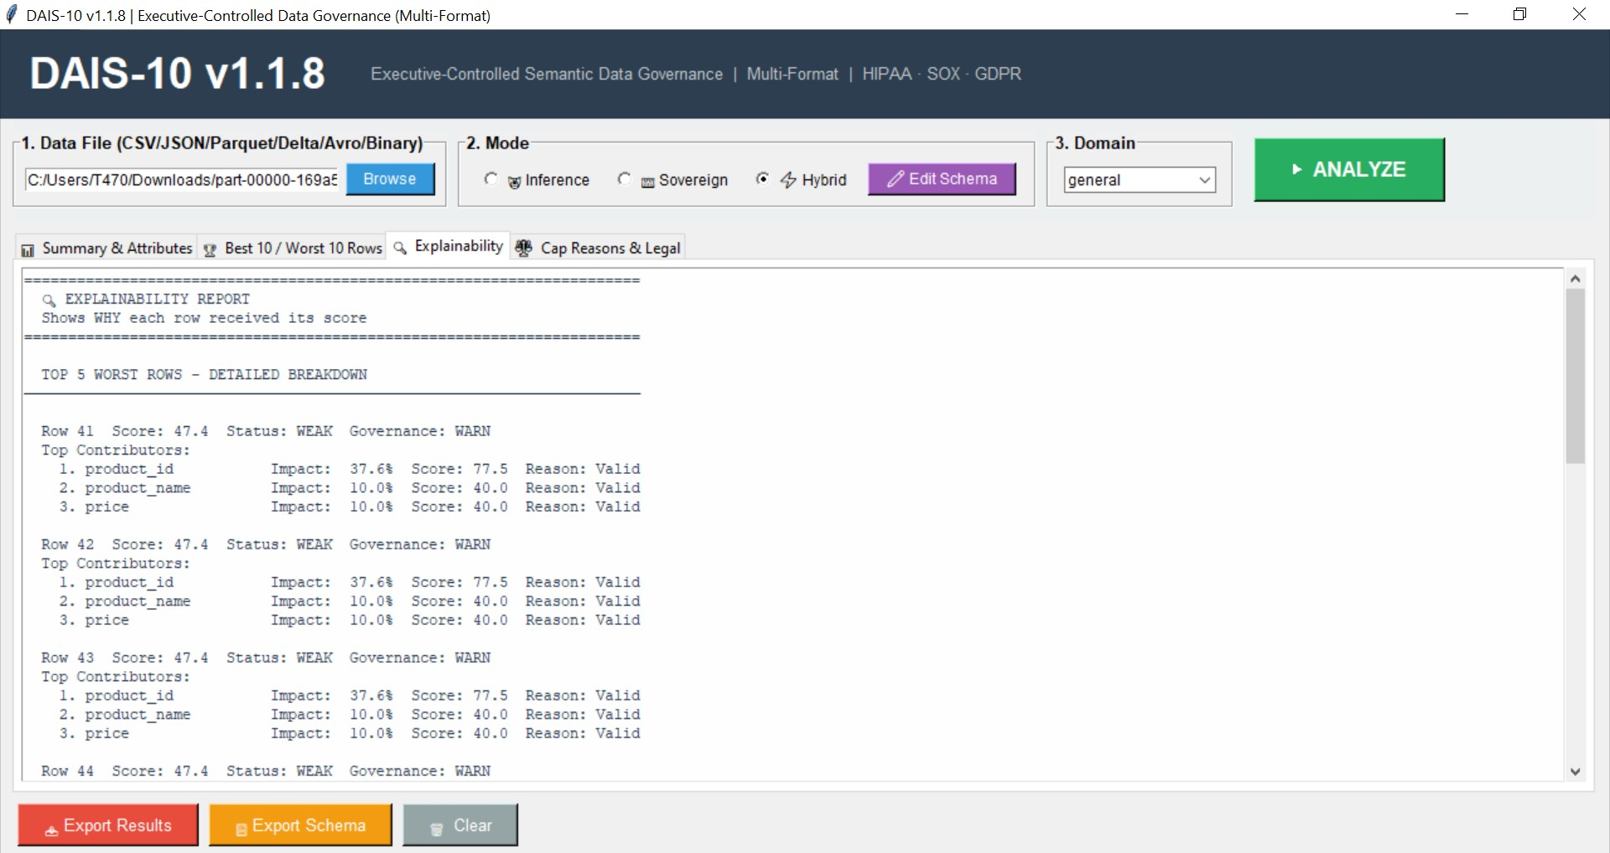
Result Explanation
Features wise results:
Impact
Score
Reason of Scoring

Slide 11
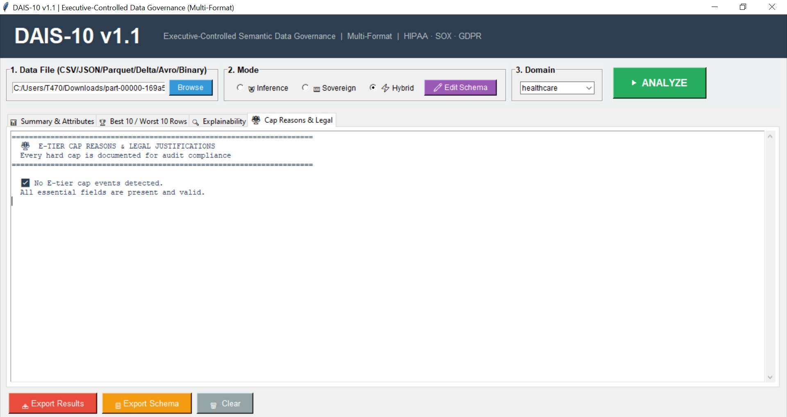
Report 4 = Data Legal Requirement
The legal frameworks added are HIPAA, SOX & GDPR
DAIS10 has unlimited options to customize it to any country or any industrial requirements.

Slide 12
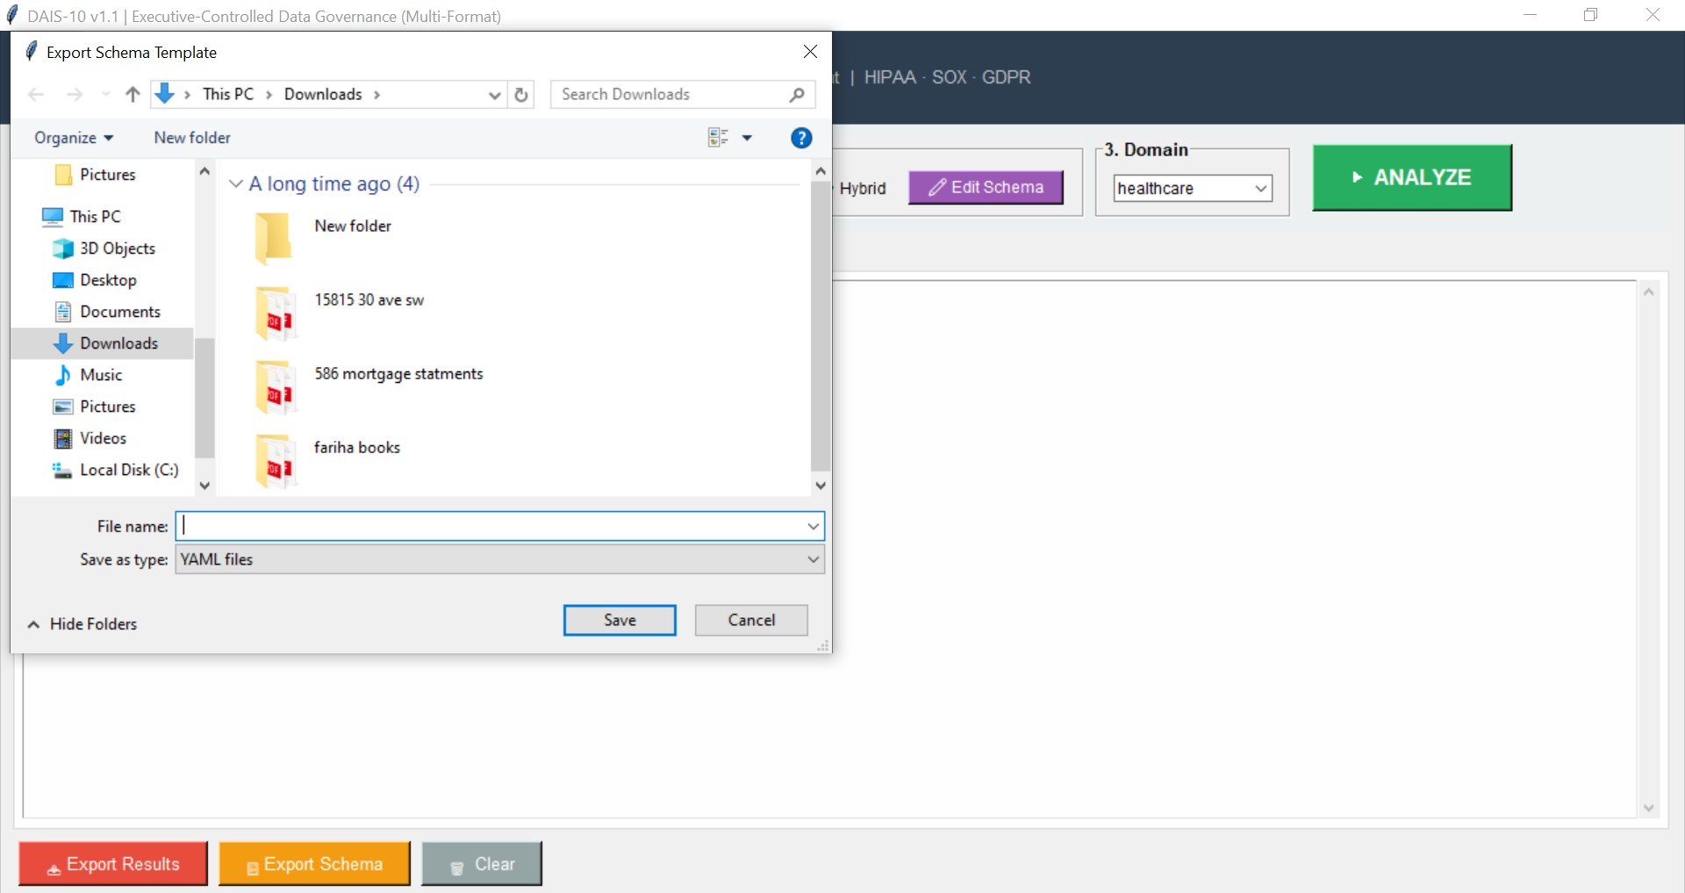
Export Schema Option
For Audit purpose
For Governance purpose
For Internal Records

Slide 13
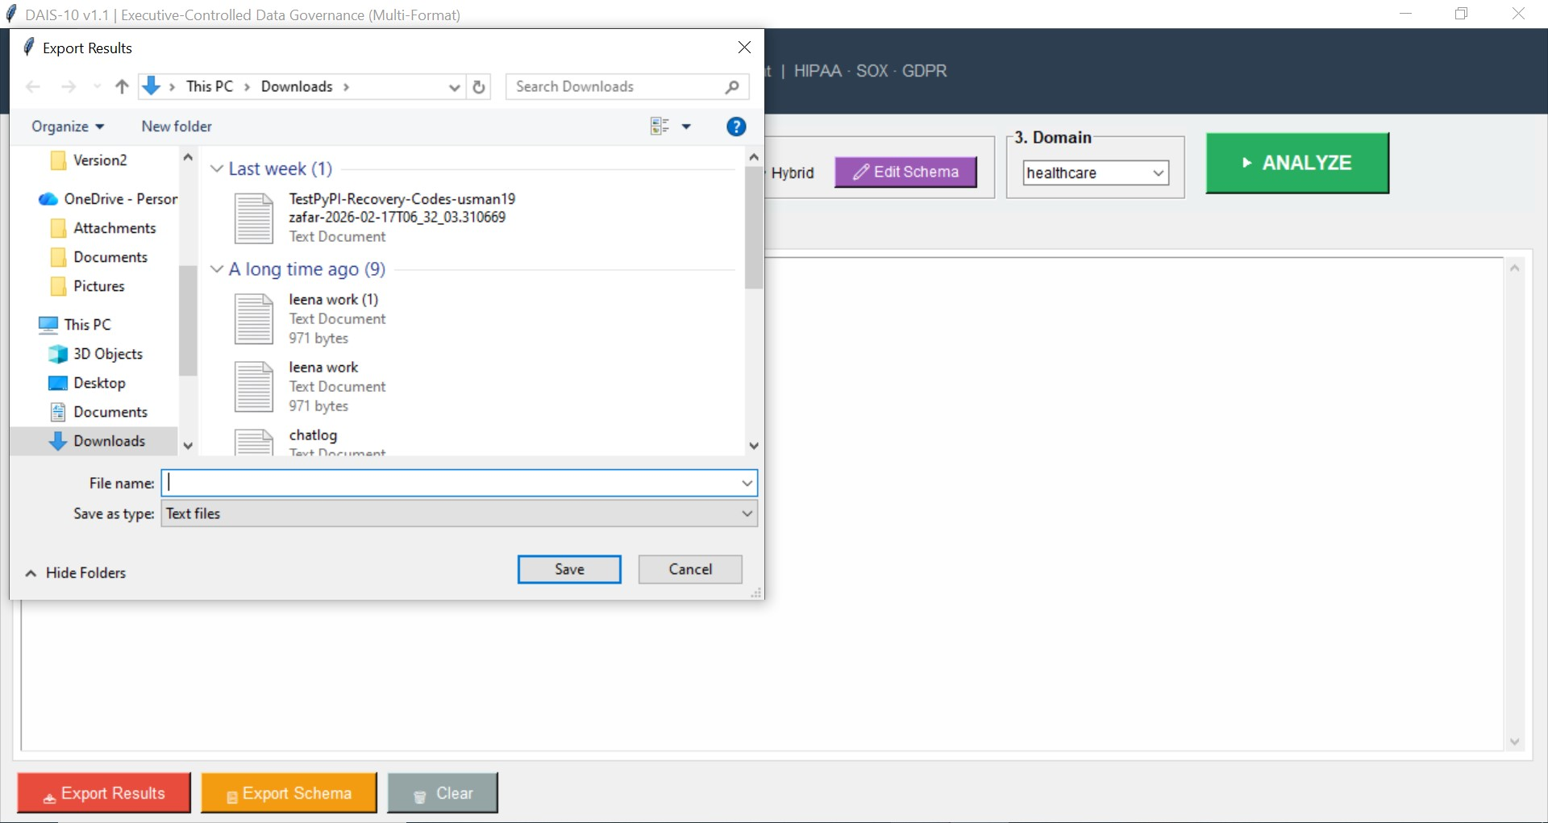
Export Result Report = DAIS10 Analysis & Report
For: Internal Record
Audit
Governance

