Slide 1
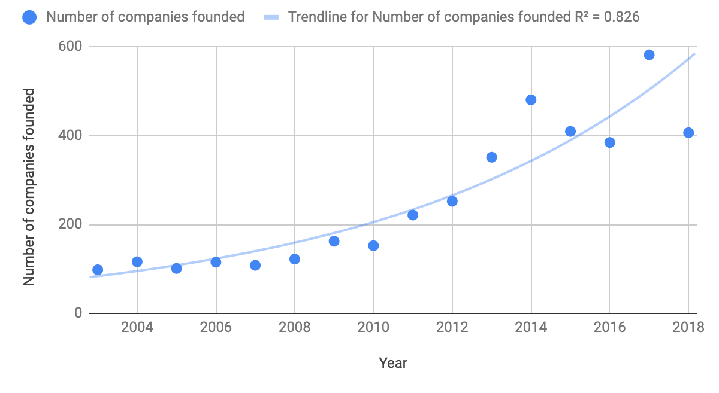
CyberSecurity Companies: Summary Statistics
Total funding since 2003: $45+ billion* in over 4,000 companies.
* Data set includes private equity and public IPO investment. Data does not include private, internal investments by large technology players (e.g. Facebook, Amazon, Netflix, Google).
Source Data from CrunchBase

Slide 2
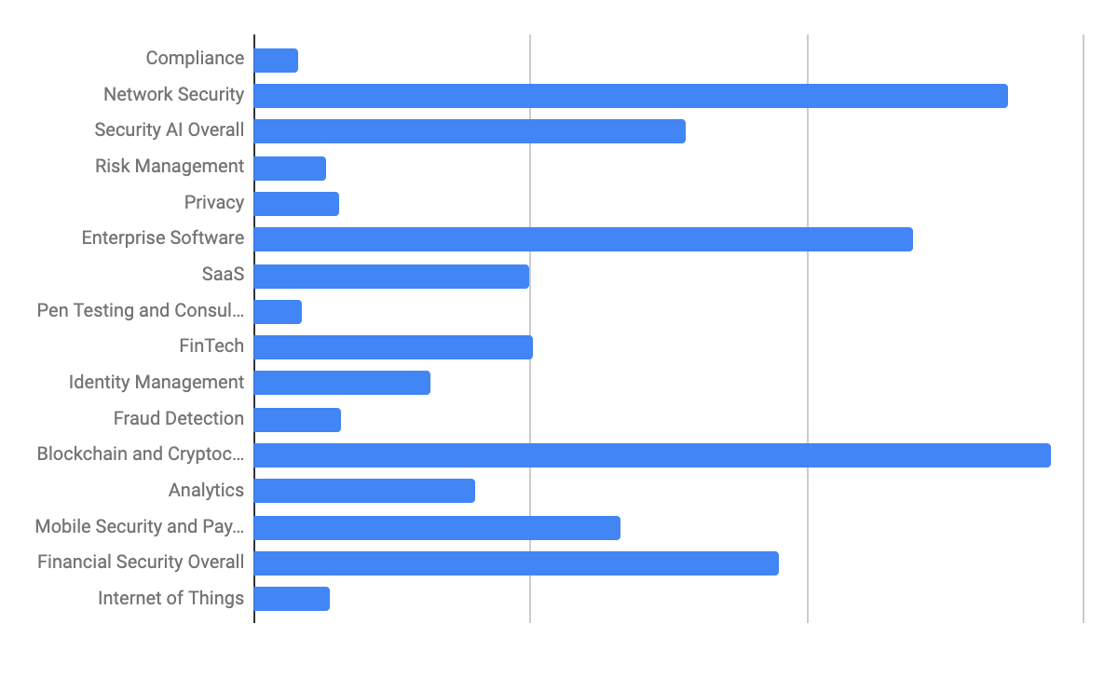
Aggregate Relative Investment by Category
Source Data from CrunchBase

Slide 3
Hypothesis: More Investment Required
Category | Approx $ Invested | Comments
Cloud Security | $10B | There has been significant investment, but not as much as network security ($13B). Key question: Is cloud security investment proportional to investment in cloud migration?
AI & Security | $7B | Probably more needed and more to come. AI helps automate and leverage understaffed cybersecurity workforce.
Analytics | $4B | More needed as analytics and automation are required to compensate for cybersecurity staffing and skills gap.
Privacy | $1.5B | more investment required; only $ thus far. May not reflect Google, Facebook, etc, but private investment is less than $5B fine FTC recently imposed on Facebook.
Fraud Detection | $1.5B | As of 2018 alone, FBI reports $2.7B in fraud annually.
Notes:
https://boingboing.net/2019/04/23/fbi-online-theft-fraud-expl.html
How much will the Google / Apple / Amazon need to invest in comparison to long-tail of other enterprises? Security is usually part of something else?

Slide 4
Hypothesis: More Investment Required
Category | Approx $ Invested | Comments
Internet of Things | $1.4B | Mirai botnet in 2016 showed impact that IoT attacks can have; more attacks likely to come.
Risk Management | $1.3B | Not enough tools to help channel security investments in the right direction?
Penetration Testing and Consulting | $857M | Not “sexy” but given talent shortage, there will probably be more need in this area, and for further automation.
Compliance | $794M | British Airways GDPR fine was $230M. Marriott GDPR fine was $123M. Project fines will exceed amount invested in short order.
Cyberinsurance | $52M | Not enough technology to help insurance companies price premiums, assess cyber-risk, and spread risk across policy holders.

Slide 5
Hypothesis: Overinvested Categories?
Blockchain and Cryptocurrencies. $14B. No “killer app” apparent even 10 years after birth of Bitcoin. By comparison, within just a few years after birth of TCP/IP, email arose as a killer app. However, web took two decades.
Mobile Security. $6.6B and it is not one of the major root causes of breaches (yet).

