Slide 1

Lending Club Case Study
Usman Khan
EDA based

Slide 2
Approach
Import Data
Data Cleaning
Remove or delete rows with null entry
Remove outliers
Remove unwanted rows, columns
Check and Convert columns for correct data types
Generate more columns that are required
Analysis
Data Understanding
Perform Segmented Univariate Analysis with Graphs
Perform Segmented Bivariate Analysiswith Graphs
Plots correlation graph
Correlations
Observations

Slide 3
Data cleaning
Before Data Clean:
Total Data Size: (39717, 111)
Data Cleaning
Sl. No | Columns | Remarks
1 | term | Convert Term count to convert to int type {36,60}
2 | int_rate | String "%" symbol to convert convert to float type
3 | grade sub_grade | convert to ordered values to int type {A-G} -> {1-5}, {A1-G5 -> {1-35} Created new columns grade_int, sub_grade_int
4 | emp_length | convert to integer values {0-10} convert dtype to int
5 | funded_amnt | Remove outliers from funded_amnt to remove any biased analysis (Considering only 25000)
6 | annual_inc | Analyze only for annual_inc < 80000 Analyze upto 80K annual income anythign > 80K are classified as high income profiles
7 | Dropped columns

Slide 4
Data Cleaning
Dropped columns with NA
'mths_since_last_major_derog', 'annual_inc_joint', 'dti_joint’, 'verification_status_joint', 'tot_coll_amt', 'tot_cur_bal’, 'open_acc_6m', 'open_il_6m', 'open_il_12m', 'open_il_24m’, 'mths_since_rcnt_il', 'total_bal_il', 'il_util', 'open_rv_12m’, 'open_rv_24m', 'max_bal_bc', 'all_util', 'total_rev_hi_lim', 'inq_fi’, 'total_cu_tl', 'inq_last_12m', 'acc_open_past_24mths', 'avg_cur_bal’, 'bc_open_to_buy', 'bc_util', 'mo_sin_old_il_acct’, 'mo_sin_old_rev_tl_op', 'mo_sin_rcnt_rev_tl_op', 'mo_sin_rcnt_tl’, 'mort_acc', 'mths_since_recent_bc', 'mths_since_recent_bc_dlq’, 'mths_since_recent_inq', ‘mths_since_recent_revol_delinq', 'num_accts_ever_120_pd', 'num_actv_bc_tl', 'num_actv_rev_tl', 'num_bc_sats', 'num_bc_tl', 'num_il_tl', 'num_op_rev_tl', 'num_rev_accts', 'num_rev_tl_bal_gt_0', 'num_sats', 'num_tl_120dpd_2m','num_tl_30dpd', 'num_tl_90g_dpd_24m', 'num_tl_op_past_12m', 'pct_tl_nvr_dlq', 'percent_bc_gt_75', 'tot_hi_cred_lim', 'total_bal_ex_mort', 'total_bc_limit', 'total_il_high_credit_limit’
Drop empty columns (columns with 0) or constant columns
['mths_since_last_delinq','mths_since_last_record','next_pymnt_d’]
['collections_12_mths_ex_med', 'acc_now_delinq', 'chargeoff_within_12_mths', 'delinq_amnt', 'tax_liens’]
New Columns
'grade_int', 'sub_grade_int', 'funded_amnt_bin', 'revol_util_bucket'
Resized data = (36135, 57)
Fully Paid ~30000
Charged Off ~5000

Slide 5
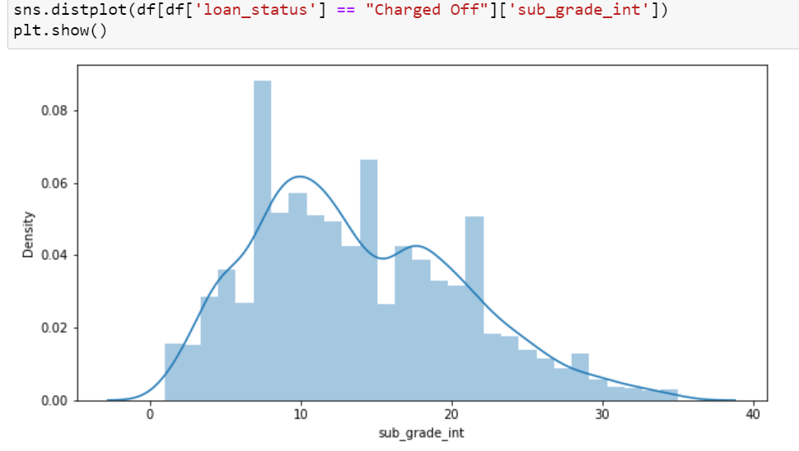
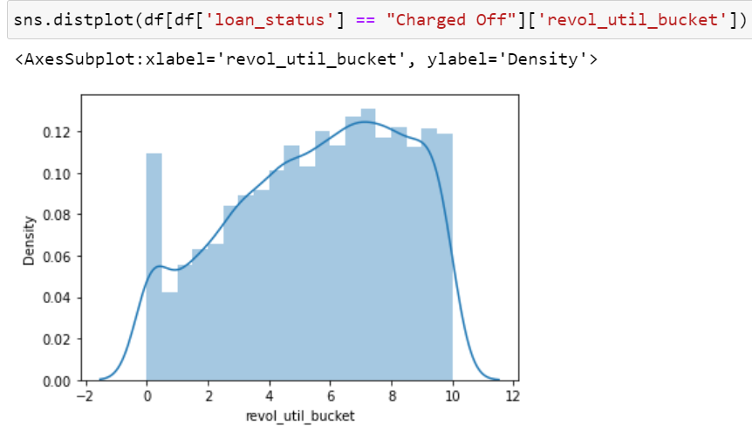
Analysis
The number of loan account charged off has correlation as below from the data set
Loans with LC sub-grade 7-22 (B2 - D2) shows high charged-off
Loan accounts with revol_util > 45% is likely to default
Loan Status with total_acc has no significance

Slide 6
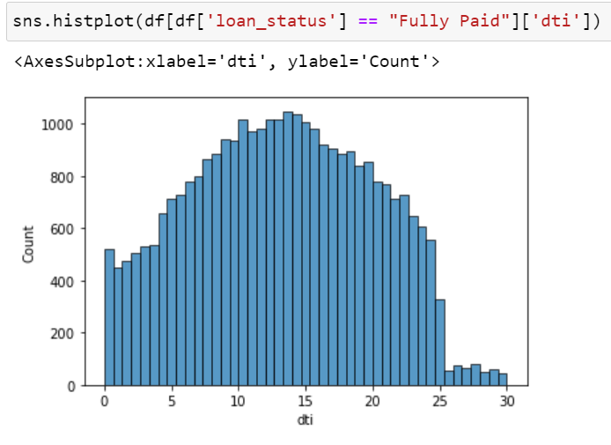
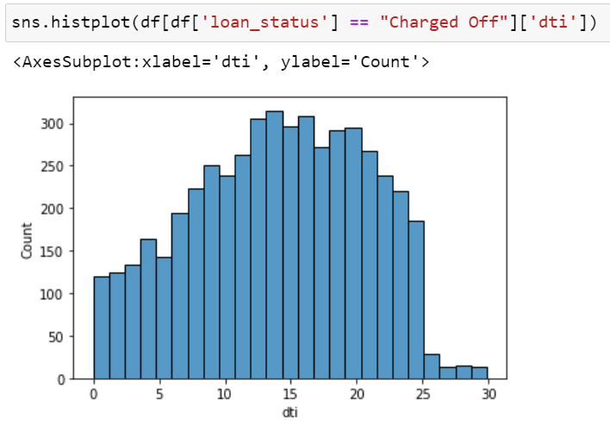
Analysis based on dti (borrower’s total monthly debt payments on the total debt obligations)
There is no significant difference with loan status and dti
However between 12 - 20 shows high defaulter, hence should be accessed

Slide 7
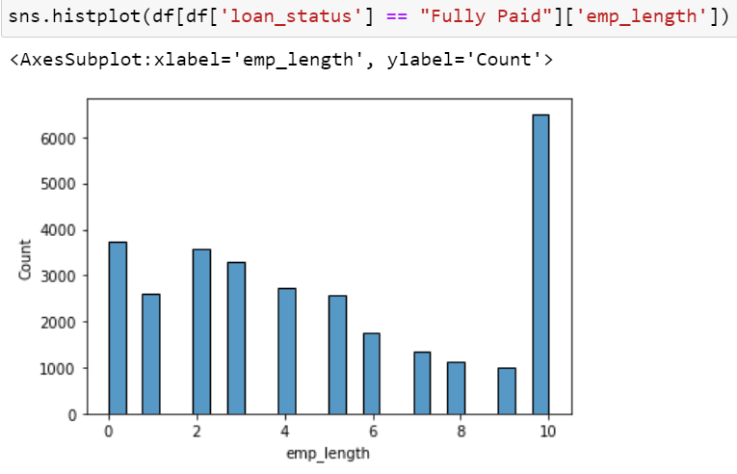
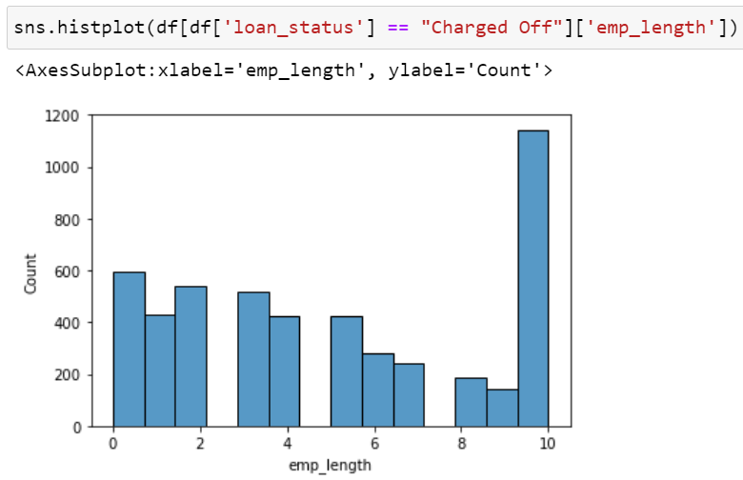
Analysis based on emp_length
Loan application with emp_length :10+ years loan should be considered as they are likely to be the defaulter as seen below
Full Paid: 21.493010805987904
Charged Off: 23.226986384881123

Slide 8
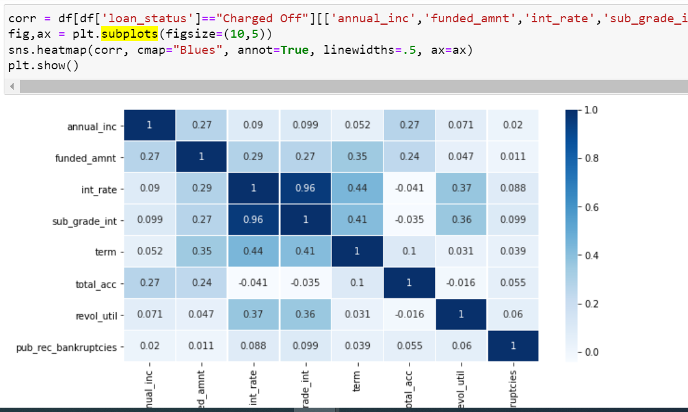
Analysis and Correlation
Home ownership won't have significance impact on the loan_status
Home Ownership and verification status shows no significance on loan status¶
Correlation
Defaulter loans has higher correlation with LC grade (41%), loan interest rate (44%),
Term, interest rate shows correlation of 44%

Slide 9
Observations and Recommendation
Observations:
Loans with LC sub-grade 7-22 (B2 - D2) shows high charged-off with
Loan accounts with revol_util > 45% is likely to default
DTI between 12 - 20 shows high defaulter rate, hence should be accessed
Interest rate, annual income, employment_length shows small correlation with the loan defaulters
Recommendation
Loan application should check the applicant LC grade before approval
Applicant with higher revolving credit utilization and DTI should be checked before approving the loans
Employment length of 10years shows highest defaulters, hence should be checked for observed factors before approval.

Slide 10
Thank You

